Slide 1
GIRO40
8 – 11 October, Edinburgh

Slide 2
D1: Update from the GIROC Reserving Research Workstream (featuring ‘The Life Cycle of the Peril’)
James Orr (Chair)
Sarah MacDonnell
Alex Marcuson
Chris Smerald
Richard Kelsey

Slide 3
Running Order
Introduction James
Reserving Survey results and plans Sarah
‘The Life Cycle of the Peril’ infomercial Alex
Story-telling Chris & Richard
Next Steps James
Notes:
Getting room filled plus James: 10 mins
Sarah: 15 to 20 mins
Alex: 10 mins
Chris (plus Richard?) 15 to 20 mins
Next Steps The Balance = 0 to 10 mins

Slide 4
Running Order
Introduction James
Reserving Survey results and plans Sarah
‘The Life Cycle of the Peril’ infomercial Alex
Story-telling Chris & Richard
Next Steps James
Notes:
Getting room filled plus James: 10 mins
Sarah: 15 to 20 mins
Alex: 10 mins
Chris (plus Richard?) 15 to 20 mins
Next Steps The Balance = 0 to 10 mins

Slide 5
GIROC Reserving Research Working Party
Established after ‘hot topics’ pitch in Brussels, GIRO 2012
Brief:
new methods: claims-level; stochastic reserving
identifying and commissioning research
Activity:
hugely enjoyable and wide-ranging discussions
‘The Grizzled Actuary’, story-telling and ‘The Ideal Actuarial Report’
Survey of Reserving Functions and their users
Peril-based framework for risk and claims manifestation
Quantifying the ‘Herd Effect’

Slide 6
Running Order
Introduction James
Reserving Survey results and plans Sarah
‘The Life Cycle of the Peril’ infomercial Alex
Story-telling Chris & Richard
Next Steps James
Notes:
Getting room filled plus James: 10 mins
Sarah: 15 to 20 mins
Alex: 10 mins
Chris (plus Richard?) 15 to 20 mins
Next Steps The Balance = 0 to 10 mins

Slide 7
GIROC Survey 2013
GRIT 2004 to 2006
Range of recommendations
producing a quantitative range of outcomes
understanding the business better
Aim of 2013 study:
what has changed since GRIT survey?
are there any barriers (if any) that may have prevented the development or uptake of new techniques

Slide 8
GRIT 2006
Stakeholders too
company board members
ratings agencies
investment analysts
regulators
GRIT stakeholder findings
communicating uncertainty
communicating key assumptions and reserve drivers and …
… communicating in general

Slide 9
So who did we talk to?
Stakeholders
Executive and non-executive directors/Senior management
Ratings agencies
Investment analysts
Regulatory bodies
Other Stakeholder Groups (CRO Forum, CFO forum etc.)
Practitioners
London Market Reserving Actuaries
Reinsurance Reserving Actuaries
Personal lines Reserving Actuaries
Consulting Reserving Actuaries

Slide 10
So who did we talk to?
Stakeholders
Executive and non-executive directors/Senior management
Ratings agencies
Investment analysts
Regulatory bodies
Other Stakeholder Groups (CRO Forum, CFO forum etc.)
Practitioners
London Market Reserving Actuaries
Reinsurance Reserving Actuaries
Personal lines Reserving Actuaries
Consulting Reserving Actuaries

Slide 11
Results Personal Lines Reserving Actuaries
Process
Data
Methods
Communication
13 respondents
Notes:
Flavour, consensus – clear messages/themes
Won’t dwell on individual responses
Will be fully written up with more details

Slide 12
Process
Quarterly reviews
Most time spent
analysis
reporting
Key constraints
Time or resources
Granularity
J
L
Notes:
2 external reviews
3 also monthly monitoring

Slide 13
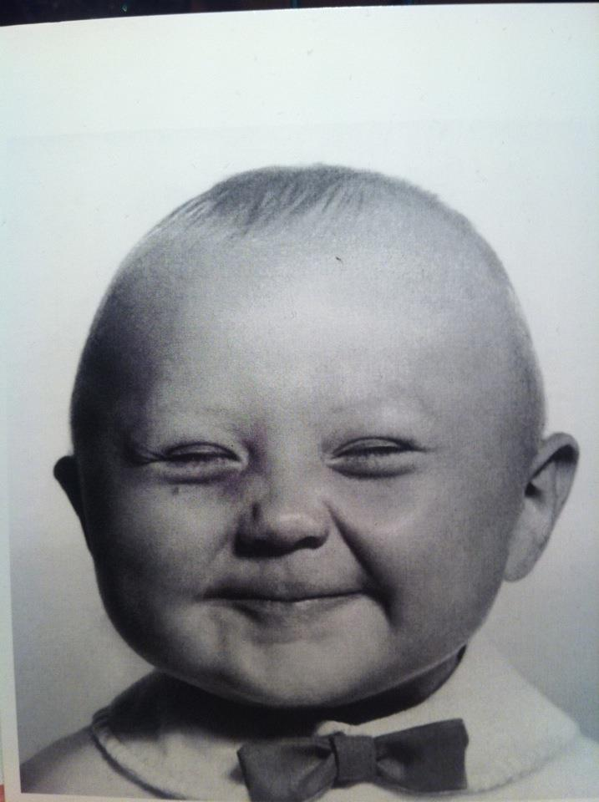
Data
The key to actuarial happiness?
5 get individual data
2 said they could get whatever they need
Room for improvement?
6 said no improvement needed
claimant level
more granularity
Notes:
One not happy “restricted” by systems

Slide 14
Data
Have things got better?
3 of the 4 who cited no change were already happy with the data they had previously
responses as to what has improved varied
more diagnostics
better splits (peril)
Notes:
Not mention all respones – most common

Slide 15
Data
Notes:
Not mention all respones – most common

Slide 16
Qualitative Data
Virtually all said good or very good
Issue driven
Demand from business
Notes:
Not mention all respones – most common

Slide 17
Methods
Chain ladder and BF/Cape Cod still king
Average cost
Large loss
Developments since 2006
Large claims modelling
PPOs
Current practice
The rise of diagnostics and drill down
Notes:
Not mention all respones – most common

Slide 18
Uncertainty
Bootstrap and scenarios rule (8 and 10 respectively)
Scenarios linked to specific or unusual cases, eg. PPOs, latent or large claims and Ogden changes
Also large loss distributions
Notes:
Not mention all respones – most common

Slide 19
Do you allow for the following in your reserve analyses?
Notes:
discussing inflation few actually allowed for this explicitly in trainagles, most in ultimate trends, e.g. when selecting BF prior
Similarly with seasonality, though majority did make adjustments in the trianglefor these. A couple only mentioned process adjustments, and only one explicitly mentioned the weather

Slide 20
Methods
What new methods have you come across that you would recommend to a fellow actuary?
9 said none
Diagnositcs
Large claims modelling
Granular reserving
Want proven and pragmatic methods - no use sitting in a theoretical box
Question of resources to try out - balance with how much value is it going to add
Notes:
Not mention all respones – most common

Slide 21
Methods
Are there any methods you have seen that would like to learn more about/see adopted/developed by the industry?
“No” - 8
Granular reserving
Notes:
Not mention all respones – most common

Slide 22
Communication
Claims and pricing
Capital
Finance
Risk mgmt/ strategy
Notes:
One not happy

Slide 23
Reports
“Before just included the numbers”
Longer, more detailed
Uncertainty
Too long?
Presentations
More questioning
/challenge
“Some of the additional information is positive”
Notes:
More detailed write up will be made available

Slide 24
Booking reserves
Notes:
More detailed write up will be made available

Slide 25
Understanding reserves

Slide 26
Personal lines reserving actuaries 2013
Relatively contented bunch (yet to hear from stakeholders!)
Positive developments in data and communication
More limited developments in methodology
GRIT recommendations appear to have been taken on board
Understanding the business
Producing a quantitative range of outcomes
GRIT actually recommended not replacing chain ladder
Will be interesting to contrast with actuaries working in Reinsurance and the London Market
…and stakeholders!
Notes:
More detailed write up will be made available

Slide 27
So who did we talk to?
Stakeholders
Executive and non-executive directors/Senior management
Ratings agencies
Investment analysts
Regulatory bodies
Other Stakeholder Groups (CRO Forum, CFO forum etc.)
Practitioners
London Market Reserving Actuaries
Reinsurance Reserving Actuaries
Personal lines Reserving Actuaries
Consulting Reserving Actuaries

Slide 28
Running Order
Introduction James
Reserving Survey results and plans Sarah
‘The Life Cycle of the Peril’ infomercial Alex
Story-telling Chris & Richard
Next Steps James
Notes:
Getting room filled plus James: 10 mins
Sarah: 15 to 20 mins
Alex: 10 mins
Chris (plus Richard?) 15 to 20 mins
Next Steps The Balance = 0 to 10 mins

Slide 29
The Life Cycle of the Peril Alex Marcuson
First thoughts
Thinking in 3 dimensions
The changing role of the actuary
Our plan for next year

Slide 30
The Life Cycle of the Peril First thoughts
The Life Cycle of the Peril
D&O: a brief discussion
Perils and exposures

Slide 31
The Life Cycle of the Peril D&O: a brief discussion
Chain-ladder
Bornhuetter-Ferguson
Good year/ bad year
Securities class actions
Policy exposures
Limits and excesses
Distributional model

Slide 32
The Life Cycle of the Peril First thoughts
The Life Cycle of the Peril
D&O: a brief discussion
Perils and exposures

Slide 33
The Life Cycle of the Peril Thinking in 3 dimensions
Perils
Catastrophe
Models
Pricing Models
Reserving Models
Exposure dynamics
Emerging experience

Slide 34
The Life Cycle of the Peril The changing role of the actuary
A digression
Pricing and reserving
Together or apart?
Feedback to planning and capital
Reporting timetables
Portfolio segmentation

Slide 35
The Life Cycle of the Peril Our plan for next year
Develop and document our framework to help an actuary to reach better expert judgements
Develop a quantitative approach that take perils and exposures into account
Testing on real and pseudo-data

Slide 36
Running Order
Introduction James
Reserving Survey results and plans Sarah
‘The Life Cycle of the Peril’ infomercial Alex
Story-telling Chris & Richard
Next Steps James
Notes:
Getting room filled plus James: 10 mins
Sarah: 15 to 20 mins
Alex: 10 mins
Chris (plus Richard?) 15 to 20 mins
Next Steps The Balance = 0 to 10 mins

Slide 37
Storytelling and Lucy Chris Smerald & Richard Kelsey
Good Actuarial Report
Just a little bit More Wicked?
How Storytelling can Help
Quality of the Story
Tragic Perils of Lucy Austral-O’Pithecus.
Able - Revealer of Deeper Insights
09 October 2013
37
Notes:
Problems that can only be defined by their complex solution
By implication this means non-unique, non-linear, not prescribable, and imperfect.
But we do it
37

Slide 38
A) Good Actuarial Report
I know actuarial reports are never going to make it to the best seller list, but let’s face it when did you last read a page turner?
Long winded because all ‘should normally’ aspects of guidance are included at a superficial level.
Statement of the results at many levels of detail
High level description of the results which could be worked out from reading the tables.
Vague description of methodology. Difficult to understand what was actually used. The values, context and reasonableness of key assumptions. Whether other plausible approaches or values were considered or ruled out.
Notes:
Problems that can only be defined by their complex solution

Slide 39
B) Is the Reserving Process now so Complex that it Truly is Wicked?
By implication this means uniquely non-unique, non-linear, non-scriptable, & arguably imperfect -more like a cooperative game theory outcome: optimal only in the sense that all can live with it.
Example: Even a simple motor class may be split into 3 levels (AD,TPD and BI). The first level AD, may be split 4 ways Wind-screen, Fire&Theft, Other AD and Non-RI Recoveries. The last level may be further split into 2 or more (attritional/large). That is 7 splits for frequency, severity for each accident year and don’t forget the trends and that bad winter and......
But with growing stakeholder requirements, methods innovations, data sophistication, and risk requirements has reserving been pushed deeper into the wicked problem space?
This may be too much ! how can we develop or explain best practice or even write a good report about what we managed to complete?
09 October 2013
39
Notes:
39

Slide 40
C) How Stories can Help
A good story can be read more than once and entertains each time.
Likewise, should the test of a good actuarial report be that it can inform 2-3 years after it was written.
To pass this test, it needs
to still inform;
for the stories and alternate endings presented to be still be plausible with the benefit of hindsight;
if the world has changed, to educate that the change could not have reasonably been foreseen ?
bold enough to complete the feedback loop showing success and failure of past predictions.

Slide 41
D) Quality of the Story Reveals More
Distance becomes a leveller. In devising the tale the author sees more clearly how perils are intertwined and has a deeper sense of the building blocks that underlay reserving problems.
So If experience and wisdom can be deepened by shared stories how do we evaluate and build on this?
“Flow” writing combined with checklists was an interesting experience, rather than creeping attempts at perfection. A sprint followed by more sprints until the end is reached, then repeated sprints redrafting and adapting as missed bits are added and logic improved. Often we only find out something obvious at the end that makes us revisit and retake our painstaking journey – something that with a sprint could have been obvious sooner.
We don’t think this can be TASed. Goodbye TAS, Hello Lucy.
09 October 2013
41

Slide 42
‘There was a lone Grizzled Actuary’
She was lone, but not lonely, rather she didn’t follow the herd, but followed her roving eye.
She had been ‘around the block a bit’ in so far as she had made mistakes, seen others make mistakes and learned from them.
She is not surprised when unexpected events happen which affect results. They happen. Some could have been reasonably predicted, some not. Experience has provided a toolkit of how to approach, investigate and run with surprises.
Actually she quite likes the surprises. This is when Grizzled Actuary comes into her own. Without these she was sidelined.
This is Lucy.

Slide 43
E) Perils of Lucy: Imparting Intermediate Experience & Wisdom needed to cut through the Wickedest Snares.
The value of experience.
The power of agency risk,
The role of conversations.
The importance of governance and controls – what is independence and objectivity.
The hypothesis structure: current, alternative, and monitoring for deviations.
Risk for less experienced actuaries using black box models.
How to choose an effective method.
What else?
09 October 2013
43
Notes:
Introduce Lucy as bit of a man eater, keenly observant driven to learn from and build others up.
Nigel: named after father in law who suggested I bring humour into my office life with disastrous consequences. I think it really means he only likes Americans who are funny.
John, just looking for a quiet life

Slide 44
What Else...
Lucy was asked what she thought of ‘peril life cycle’ or other potential new methods of reserving
“They are all well and good, but...”.
Don’t throw away the triangle. The triangle is a very good communication device which people are used to and can be used to reference development with time lines that people are familiar with (actual years!)
Actually, the more interesting triangle is the undeveloped half of the run-off rectangle which others call the future flight path.
I call the next “diagonal of the triangle” the next chapter of the story. If the story which emerges ties in with your draft then the ending will be plausible, but don’t get complacent because if the actual storyline drifts away from your script there could be a different ending.
Don’t rush to rule out or ignore other plausible stories.

Slide 45
F) Able to Glimpse Deeper Insights
Seeing and thinking through examples with Lucy of the more tricky building blocks and realizing these may be key to unravelling the wickedness of actuarial work.
Can we create a more structured framework that helps us with reserving and reporting?
Ontologies
A library of “wisdom” tales
Easily referable rules and constraints
Reference Data
Sample reports for specific stakeholder requirements?
Address and include objections/comments received en-route
09 October 2013
45

Slide 46
Running Order
Introduction James
Reserving Survey results and plans Sarah
‘The Life Cycle of the Peril’ infomercial Alex
Story-telling Chris & Richard
Next Steps James
Notes:
Getting room filled plus James: 10 mins
Sarah: 15 to 20 mins
Alex: 10 mins
Chris (plus Richard?) 15 to 20 mins
Next Steps The Balance = 0 to 10 mins

Slide 47
Next Steps James Orr
Reserving Survey
write-up the initial survey
extend the survey to the London Market and Boards
Life Cycle of the Peril
complete development of the peril-based framework
move to implementation and assessment of quantitative techniques
making use of simulated and possibly real data
Story-telling
should we commission more stories on key issues?
writing ‘The Ideal Actuarial Report’…
The ‘Herd Effect’
designing an experiment to quantify the impact of social and professional norms

Slide 48
Questions
Comments
Expressions of individual views by members of the Institute and Faculty of Actuaries and its staff are encouraged.
The views expressed in this presentation are those of the presenter.

Slide 49
Footnotes and Appendices

