Slide 1
Data Science Universe Seminar
Modelling, Analytics and Insights from Data Working Party - Update on work streams

Slide 2
Work stream 1: Research

Slide 3
Recent activity around data science universe within the actuarial community worldwide
Big Data: An Actuarial Perspective Paper; Institute of Actuaries in Belgium
The CAS Institute defines program for data science and predictive analytics credential
2015
2016
IAA ASTIN Big Data / Data Analytics Working Party – Phase 1 Paper
Big Data Working Party Presentation at IFoA Asia Conference, Singapore Actuarial Society

Slide 4
Research workstream objectives
Review what is currently out there (and what is not)
Thought leadership
Views and opinions
Tools and platforms
International perspective
Identify what could be looked into in the future
Gap analysis
Areas to research

Slide 5
Research workstream plan
May
May
Define issues to be addressed
Decide how to split the issues between Literature Review and Member Survey
June
June
July
July
Member Survey
Literature Review
– Phase 1
Aug
Aug
Sep
Sep
Other activities
e.g. Twitter/LinkedIn campaign to define similarities/differences between actuaries and data scientists?
Oct
Oct
Nov
Nov
Literature Review
– Phase 2
Dec
Dec
2016+

Slide 6
Work stream 2: New approaches to current actuarial work

Slide 7
EXISTING PROBLEM AREAS | General Insurance | Pension | Life, Health & Care | Investment
Pricing | √ |  | √
Product Design | √ |  | √
Reserving | √
Capital Modelling | √ |  | √
Exposure Management | √
Scheme Valuation |  | √
Surplus Distribution |  |  | √
Asset & Liability Modelling |  |  |  | √
Data Cleansing | √ | √ | √ | √
External Data Sources | √ | √ | √ | √
Strategic/Tactical Asset Allocation |  |  |  | √

Slide 8
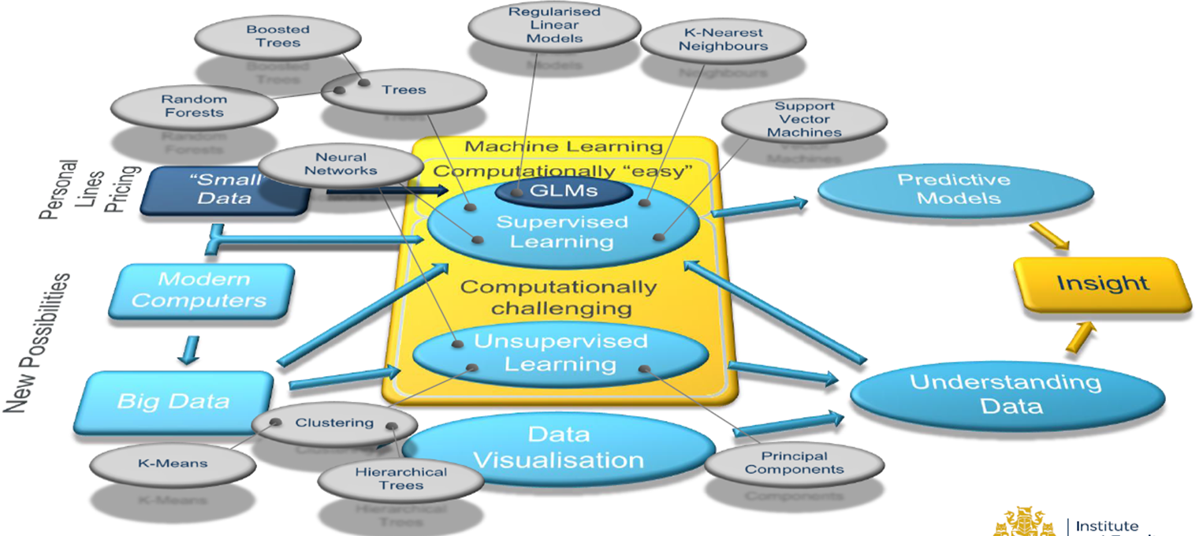
The Data Science Universe

Slide 9
Work stream 3: New areas - possible ideas and solutions in areas offering new opportunities for actuarial work

Slide 10
New Areas – Scope of workstream
The New Areas workstream will have a dual focus:
applications of modelling and analytics in existing practice areas where such techniques are not used; and
applications of modelling and analytics in new areas where actuaries have limited involvement at present, but where the actuarial skillset could add value.
To help what is potentially a very broad area of research, we have divided our efforts in to three sub-streams:
Existing areas of practice
New areas of practice
Technology
Our initial proposal is that our output will take the form of presentations at the various Institute & Faculty events to raise awareness of the new applications and opportunities for actuaries, as well as contribution to any papers produced by the MAID Working Party.

Slide 11
New Areas – Proposed areas for research
Existing areas of practice
This sub-stream will tie in with the research being undertaken as par of Workstream 2 to focus on applications of modelling and analytics in areas where actuaries currently practice, but analytical methods are used to a limited degree or not at all.
This will include consideration of practice areas within:
General Insurance
Life Insurance
Health
Reinsurance
Pensions
Investment
Risk management

Slide 12
New Areas – Proposed areas for research
New areas of practice
This sub-stream will investigate new business areas where the actuarial profession can expand and add value. This will take into considerations both existing experiences and potential opportunities in the short term.
The initial thoughts are to investigate the following opportunities and questions:
Where are actuaries already adding value in non-traditional areas?
What new areas can the profession expand to in the short-term?
Additional education requirements for actuaries and delivery channels (CPD/new exams?).
Identify unique skills that actuary possess vs. some professions seen as replacement of actuaries in certain areas, e.g. data scientists.

Slide 13
New Areas – Proposed areas for research
Technology
In addition to considering where actuaries may be able to apply modelling and analytical techniques, we will consider the technologies which may support this work.
This may include consideration of the following new and innovative technologies:
The Device Mesh
Machine learning
Advances in disease diagnosis
Cognitive computing
Telematics
Home sensors
Algorithmic trading

Slide 14
Work stream 4: Implications for professional affairs

Slide 15
Implications for the profession under four alternative scenarios
To consider future implications for the profession under four alternative scenarios. These scenarios consider the rate of evolution in data science from the current state, overlaying a range of possible positive and negative consequences for the actuarial profession:
A short paper will be produced elaborating the range of possible consequences for the profession under each scenario, this will cover five areas:
Exams, CPD, conference agenda
Public Interest issues, PR and implications for our profile, implications for the society we live in and wider regulatory environment considerations including consultation responses
IFoA Policy implications and linkages; regulation of the profession, Standards – and implications for IFoA regulation and quality (QAS)
Interaction with members on a truly cross practice basis and feedback on IFoA direction
Possible partnerships, collaboration, interacting with Influencers and lobbying; international connectivity and collaboration globally including with other leading actuarial bodies
(internal)
implication for the actuarial profession
Growth
Scenario 1 | Scenario 2
Scenario 3 | Scenario 4
Decline
Gradual
Rapid
(external) rate of evolution in data science

Slide 16
How is data science already changing your work?
The ever accelerating progress of technology has led to speculation of a singularity - a hypothetical event in which artificial intelligence would be capable of recursive self improvement.
The singularity might be science fiction - but data science is a reality!
x
x
1
Do you see developments in Data Science as a threat or an opportunity to actuaries?
Threat
Opportunity
x
x
2
Have you seen new data science techniques being applied in an actuarial context?
Yes
No
If yes – please can you provide details?
For example:
Are these techniques being led by actuaries?
Is there collaboration with other specialists?

Slide 17
How would you like the IFoA to change over the next 10 years?
%
3
% of IFoA members working in new, non-traditional, ‘Data Science’ roles?
x
x
4
Should the IFoA have a ‘data science’ exam specialism?
Yes
No
Finance and Investment
x
General Insurance
x
5
Which practice area(s) will be most impacted by new data science techniques?
Health and Care
x
Life
x
Pensions
x
ARN (optional):
Resource and Environment
x
6
Risk Management
x
Cross Practice Work
x
x
New Practice Area
x
If new, please specify:
x

Slide 18
Questions
Comments
Expressions of individual views by members of the Institute and Faculty of Actuaries and its staff are encouraged.
The views expressed in this presentation are those of the presenter.

