Slide 1

Economics MIG
Stimulating diverse economic thinking within the actuarial profession
Chair: Alex Waite
14 September 2020
Main meeting: 9.30-11.30

Slide 2
Why are we doing this…?
To stimulate the use of diverse economic thinking with the aim of:
  supplementing actuaries' professional development
  supporting actuaries in their professional work, and
  serving the public interest
…and to change the world!

Slide 3
Practical housekeeping
Please stay on mute unless invited to unmute. Video is welcome.
Please use the “Chat” (to everyone) function for comments, and questions.
Type “1 min” in the chat to ask to make a verbal contribution to the debate (or ask a question verbally). At the appropriate time I will ask you to “unmute”, and all contributions will be limited to 1 min.
The presentations and the break-out room discussions will be recorded, please turn off your camera if you do not want to be seen.
The meeting is open to actuaries, and non-actuaries (including those who have not signed up to the code of conduct of the Economics MIG).
Disagreement is anticipated, please remain professional.
The event can count towards 2 hours of CPD, if you choose to do so.
Further details regarding the Economics MIG, including joining instructions, can be found by searching the IFoA website for “Economics MIG”.
Immediately following the formal event, we anticipate hosting a more informal discussion, for those that want to stay on the call – not recorded!

Slide 4
Programme
Economics MIG Meeting
Welcome
How the Economics MIG fits into the IFoA’s Strategy
Aims of the Economics MIG
Workstream introductory presentations
  Each workstream will have one speaker to introduce their topic, their existing areas of research, and some thoughts for the aims for the year ahead
        [A short comfort break – Before Breakouts]
Workstream breakout rooms (30 minutes)
  Participants can attend the breakout room of their choice, to discuss and agree areas of future research and priorities
  [Main session recommenced at 11.00]
One-minute feedback
  Each group to list their top priorities for effecting change in 2020/21
Cross-pollination of ideas
  Bringing it all together
Wrap-up and introduction to the “after party”
[Option to stay on for an informal discussion afterwards]

Slide 5
How the Economics MIG fits into the IFoA’s Strategy
Tan Suee Chieh
President of the Institute and Faculty of Actuaries

Slide 6
Aims of the
Economics MIG
Oliver Bettis
Chairman of the Economics MIG

Slide 7
Aims of the IFoA’s Economics Member Interest Group
Motivation: The paradigm shift in economics
Why does this matter?
The aims of the Economics MIG

Slide 8
Motivation for the Economics Member Interest Group
The 2008 financial crisis was also a crisis for economics:
Adair Turner, on the need to “reconstruct” economics*
“… one oversimplified strand [of economics] dominated in the pre-crisis years”
“… do we really need … to “reconstruct economics”? My conclusion is that we do.”
* Source: “Economics After the Crisis”, by Adair Turner, MIT Press 17 April 2012

Slide 9
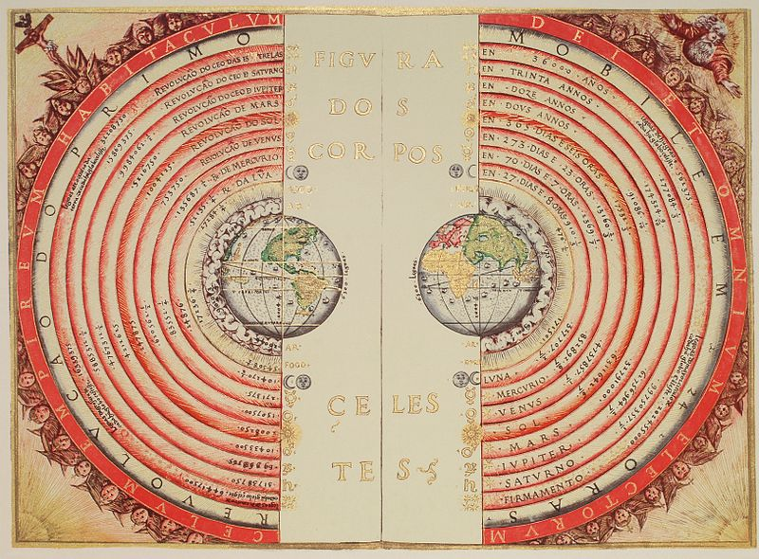
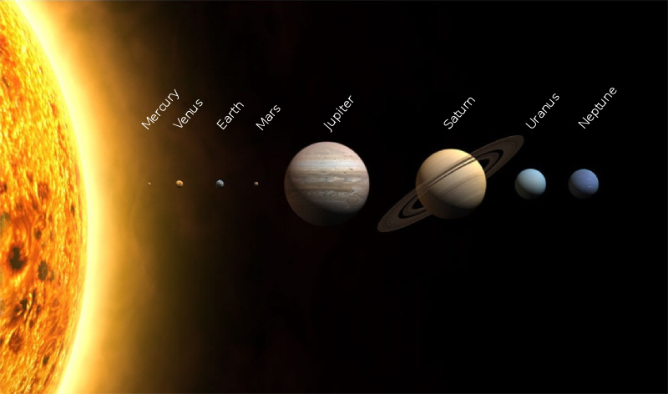
Paradigm Shift in Economics
“Today, not only is our economy in a shambles but so too is the economic paradigm that predominated in the years before the crisis… Too many have invested too much in the wrong models… But a new paradigm, I believe, is within our grasp.
What is at stake … is the stability and prosperity of our economies.”*
Joseph Stiglitz, 19 August 2010
Ptolemaic system
Galilean/Copernican system
*Economics Nobel Prize winner Joseph Stigilitz writing in the Financial Times, 19 August 2010
http://www.ft.com/cms/s/0/d5108f90-abc2-11df-9f02-00144feabdc0.html#axzz48mrgTgQ8

Slide 10
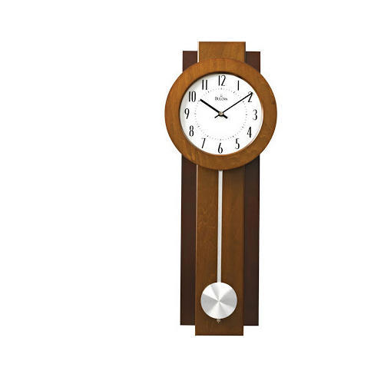
Old Paradigm of Economics
Mainstream traditional economics comes mainly from the “neoclassical school”.
Neoclassical economics assumes:
  people largely act as ‘rational’ agents
  the role of energy is largely ignored
  money is neutral, a “veil over barter”
  the economy is an equilibrium system – like a pendulum
Equilibrium systems are inherently predictable unless they are shocked from outside.

Slide 11

New Paradigm of Economics
Modern economics understands the economy is a complex system – more like a living organism.
Complex systems have emergent behaviour. Cannot deduce behaviour of the high level from aggregating the low level.
Complex systems are inherently unpredictable, sensitive to initial conditions - the butterfly effect.

Slide 12
Some of the groups investigating economics
The following organisations/initiatives on economics have been created in the last years (just a few examples):
Institute for New Economic Thinking
Rethinking Economics
UCL Institute for Innovation and Public Purpose
Promoting Economic Pluralism
OECD New Approaches for Economic Challenges
ESRC Rebuilding Macroeconomics Network Plus

Slide 13

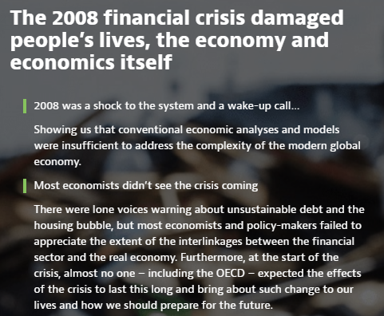
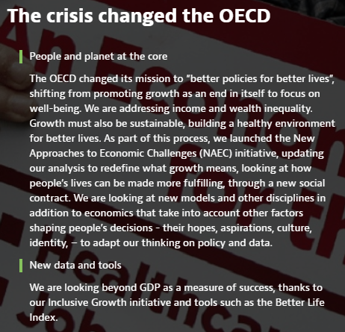

Slide 14

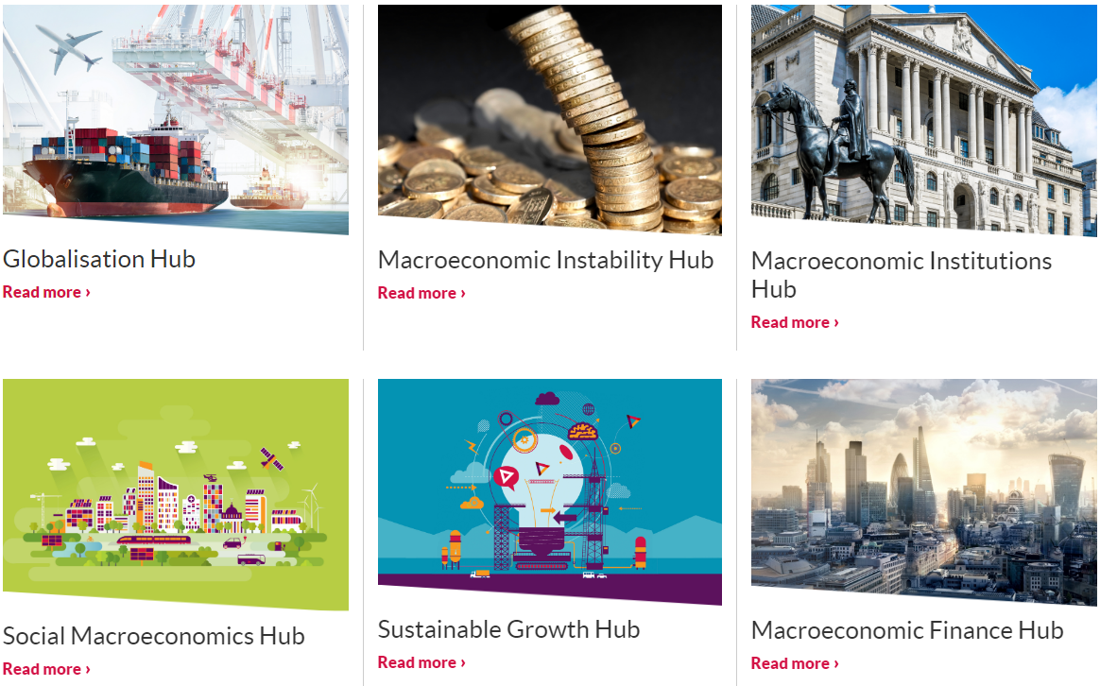
“Rebuilding Macroeconomics is a diverse and extensive network of mainstream and heterodox economists and academics from anthropology, biology, complexity, finance, history, philosophy, physics, psychology, sociology. Our Network brings together academics, policy makers, representatives of civil society and interested members of the public. Our aim is to transform macroeconomics into a policy-relevant social science.”

Slide 15
Why is the change in economics important?
“Practical men who believe themselves to be quite exempt from any intellectual influence, are usually the slaves of some defunct economist.”
JM Keynes
Investment theory
Financial regulation
Rising inequality
The economics of the coronavirus pandemic: “How do we pay for it?”
Climate change.

Slide 16
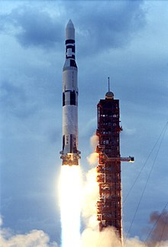
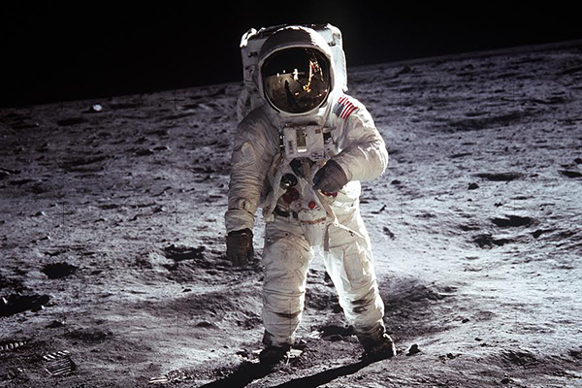
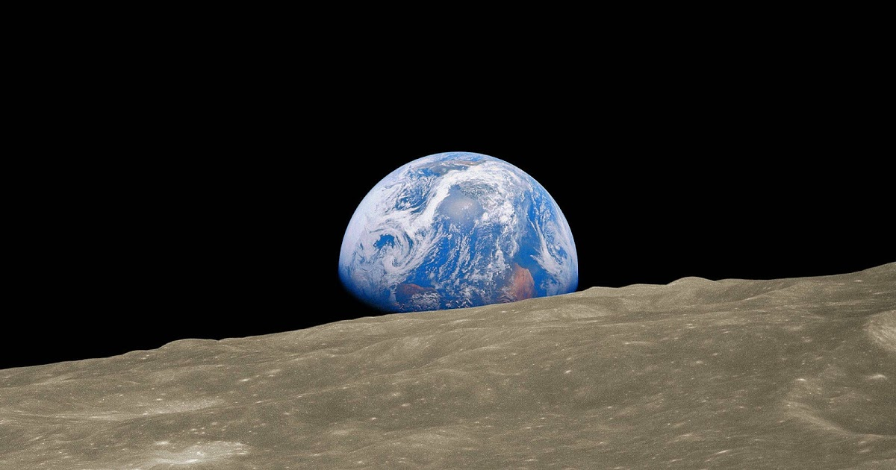
Apollo Program
Money is not a limiting factor
Physical limits of our planet and our productive resources are the real limits, not money.

Slide 17
Background to the MIG
“On Economic Thought and Actuarial Practice” by Dr Iain Clacher, published 2019
The project aimed to understand actuaries’ current and emerging uses of economic theory.
“New ways of economic thinking are already manifest, and the prominence of such approaches is growing. However, for the Profession to ask the right questions of economics, broadly defined, this requires going back to first principles about the role of the actuary and actuarial work.”

Slide 18
Aims of the MIG
The MIG reports to the IFoA’s Finance & Investment Board.
It’s a volunteer effort and receives no funding from the IFoA.
Open to all – actuaries and non-actuaries.
Managing committee of 9, we are looking for one more.
The MIG will investigate, learn, stimulate and use diverse economic thinking for the goals of:
  supplementing actuaries' education and professional development
  supporting actuaries in their professional work
  serving the public interest

Slide 19
Economics MIG
We don’t have the answers, we need to learn from research.
We need more members, more volunteers for the workstreams.
Diversity of thought and pluralistic thinking is encouraged.
We aim to produce discussion fora, papers, articles, blog posts, webinars and educational material.
Since we’re not being paid:- it should also be enjoyable!

Slide 20
Response to the Coronavirus pandemic
In May the MIG responded to a Treasury consultation on economic impact of coronavirus.
Helped to organize a newsletter which collates information on the economic impact of coronavirus, with volunteers from the IFoA’s Coronavirus pool. First edition planned for 18th September.

Slide 21
Current Workstreams
Key workstreams:
  The economic impact of Covid-19 and understanding money & debt
  Sustainability Economics
  Long-term real investment returns
  Use of capital in UK pension schemes
  Economic pluralism
  Managing uncertainty
We hope you enjoy the discussions and would like to participate in the MIG!

Slide 22
Questions

Slide 23
Workstream introductions
Workstream introductions
  The economic impact of Covid-19 and understanding money & debt
  Sustainability Economics
  Long-term real investment returns
  Use of capital in UK pension schemes
  Economic pluralism
  Managing uncertainty
Following the introductions these will be discussed in breakout groups
  You will be randomly allocated, but you are encouraged to “self-select” too
  Please listen to instructions from your chair-person
  Please “speak up”
  Please also give others the opportunity to speak up too!

Slide 24
Money & Debt
Lucy Saye

Slide 25

Money & Debt
Orthodox view of Money
  Defined by its function (store of value, medium of exchange, unit of account, final settlement)
  “Veil” over the economy through which the value of real exchange is realised
  Neutral – no effect on real economic activity - just represents the value of other commodities
  Banks are intermediaries – lend out deposits – bank multiplier
In reality money has a varied history intersecting anthropology, economics, politics, law and war!
Money has always existed as a social relationship of credit & debt
  Accounting entry systems of Babylon & Ancient Egypt
  Europe – Tally sticks
  Goldsmiths & promissory notes
Role of money in capitalism
  Marx – money (or financing) required prior to production
  Minsky – “capitalism is essentially a financial system, and the peculiar behavioural attributes of a capitalist economy centre around the impact of finance on system behaviour.”
  Hawtrey – Inherent instability of credit
  Schumpeter – role of credit in “creative destruction” which is the source of capitalism’s dynamism
  Keynes – Anything we can actually do, we can afford

Slide 26
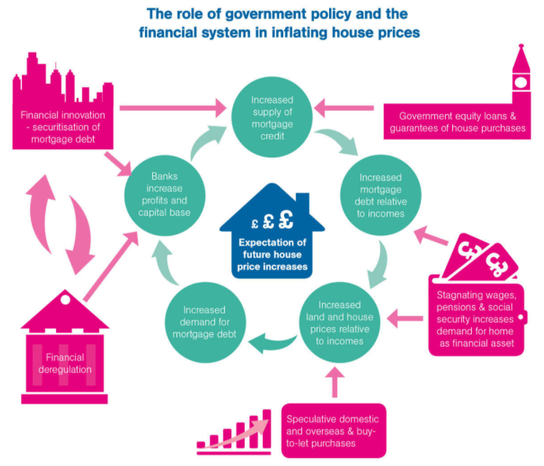
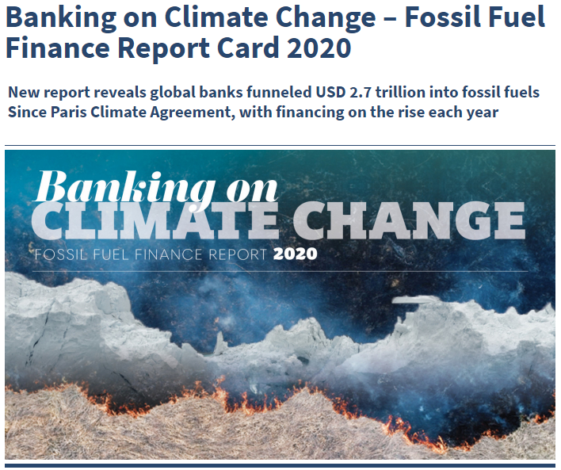
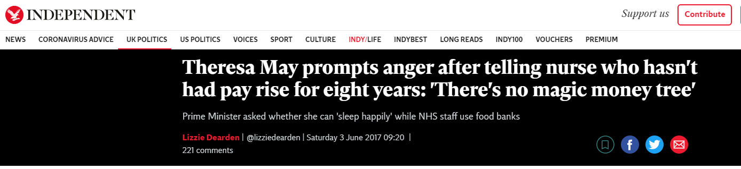
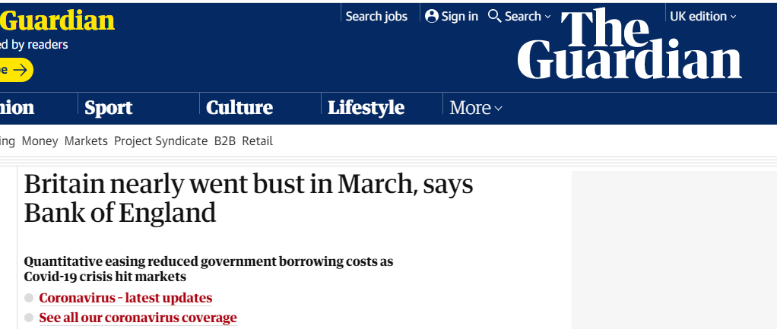
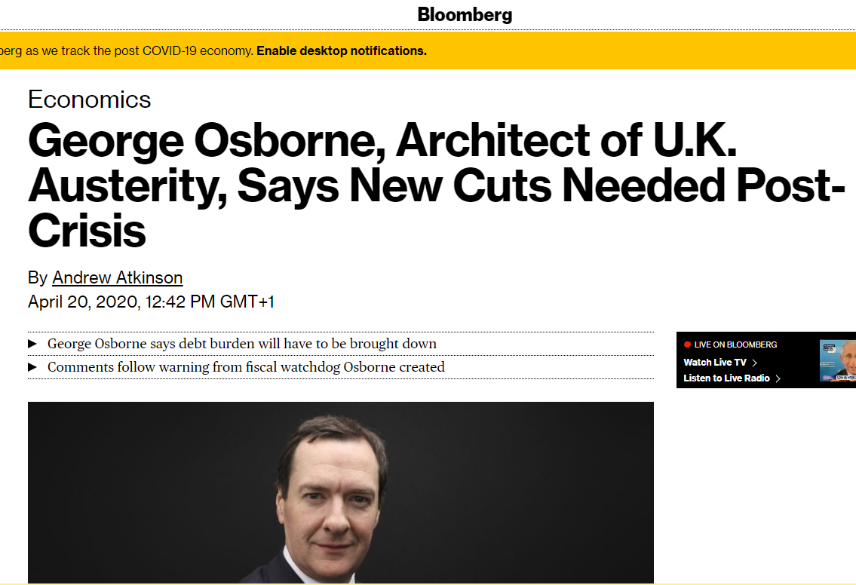
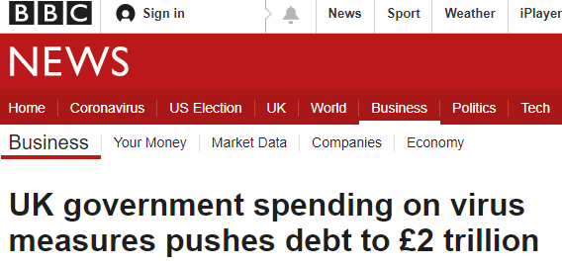
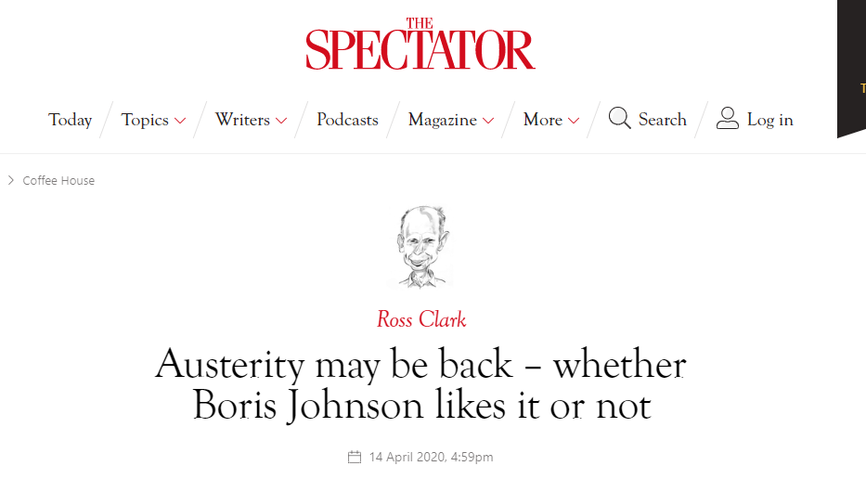
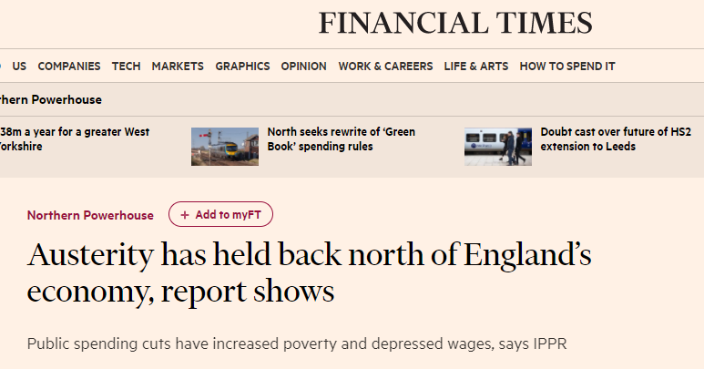
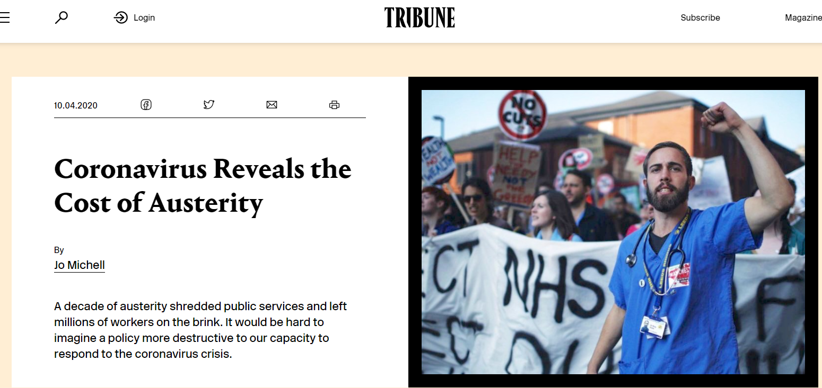
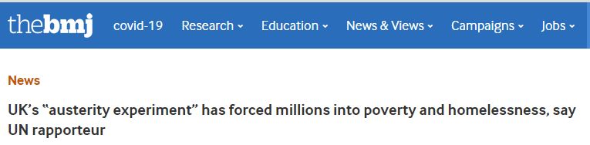

Slide 27
Sustainability Economics
Nick Foster

Slide 28
Sustainability Economics Workstream
Sustainable development is development that meets the needs of the present without compromising the ability of future generations to meet their own needs. It contains within it two key concepts:
the concept of 'needs', in particular the essential needs of the world's poor, to which overriding priority should be given; and
the idea of limitations imposed by the state of technology and social organization on the environment's ability to meet present and future needs.
Report of the World Commission on Environment and Development: Our Common Future, Chair: Norwegian Prime Minister Gro Harlem Brundtland, Oslo, March 1987
Notes:
http://www.ibtimes.co.uk/ibms-watson-cracks-medical-mystery-life-saving-diagnosis-patient-who-baffled-doctors-1574963
Image: wikmedia commons

Slide 29
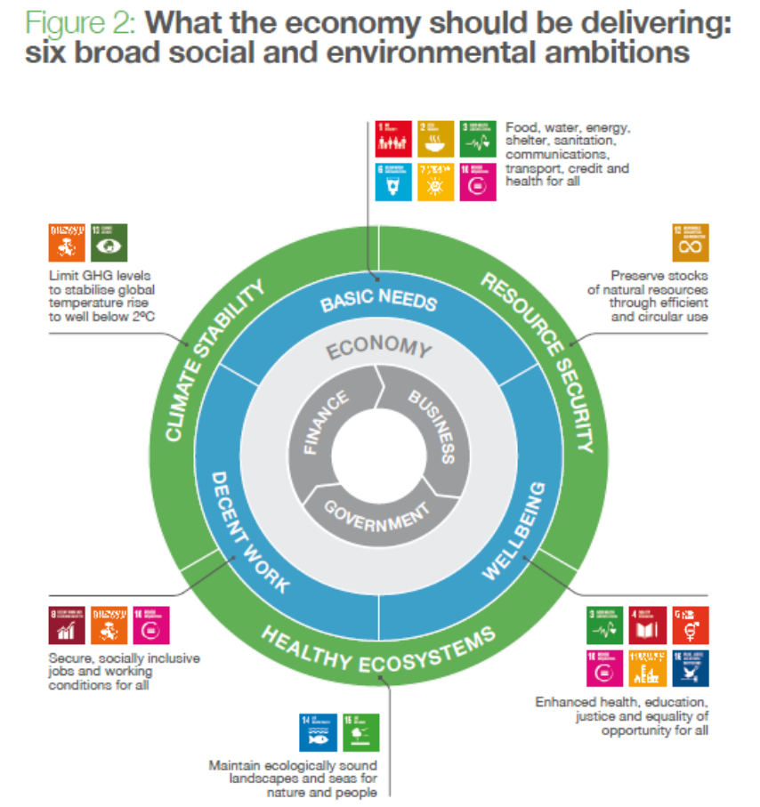
Introduction
Sustainability for me boils down to two things:
How we organise ourselves
How we measure what we do
Actuaries are well equipped to contribute to both of these
Simon Jones’ article as he stepped down as Chair of the RE (now Sustainability) Board last month highlighted the following themes:
Pluralist economics (another of our workstreams!)
Systems thinking
Interconnectedness of SDGs
Source: University of Cambridge Institute for Sustainability Leadership (CISL). (2015, July; updated 2017, November). Rewiring the Economy: Ten tasks, ten years. Cambridge, UK: Cambridge Institute for Sustainability

Slide 30
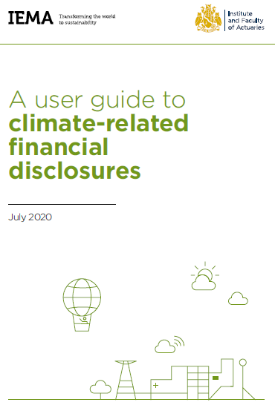
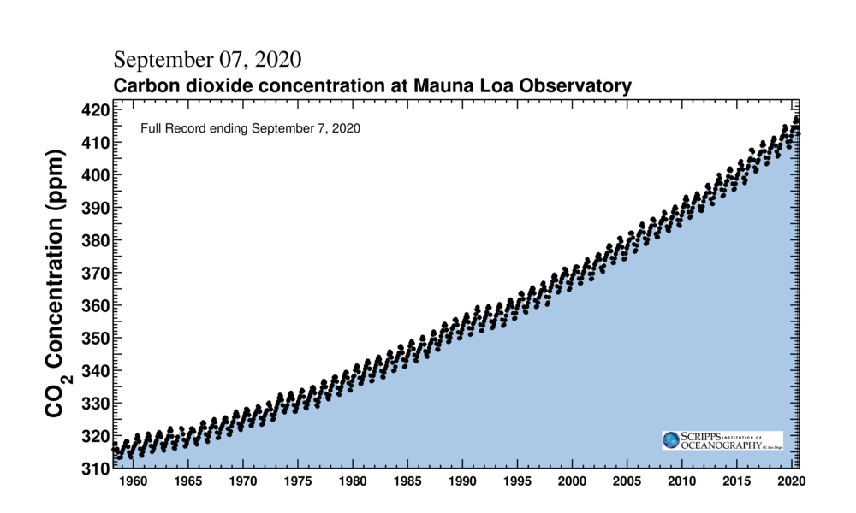
Introduction (2)
There are some moves in the right direction, eg recently on climate risk:
TCFD
DWP consultation on taking action on climate risk by occupational pension schemes
Report of the US Commodity Futures Trading Commission on managing climate risk, recognising that financial markets are not pricing climate risk and urging urgent action
European Commission to unveil a stricter 2030 emissions reduction target this week – thought to be a 55% reduction on 1990 levels
However the most important indicators (like the Keeling Curve) continue to move in the wrong direction

Slide 31
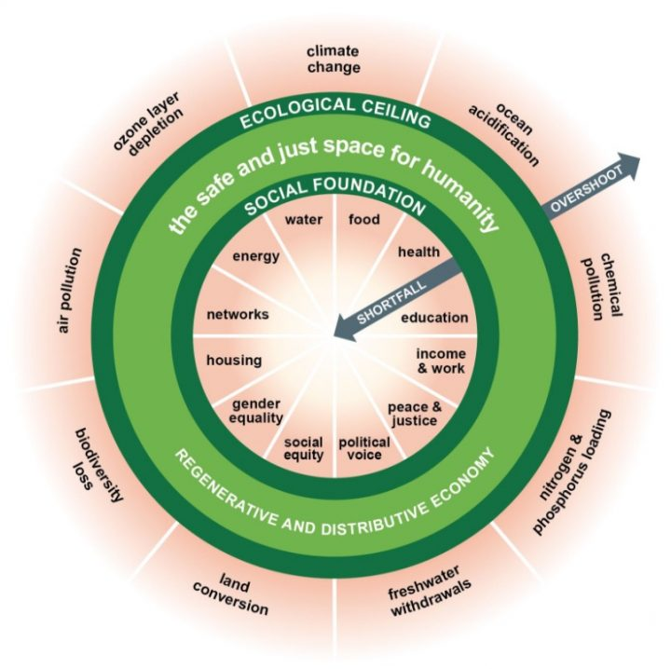
Pluralist economics
Yanis Varoufakis, August 2020
Two days ago, something extraordinary happened. Something that has never happened before in the history of capitalism. In Britain, the news came out that the economy had suffered its greatest slump ever – more than 22% down during the first 7 months of 2020. Remarkably, on the same day, the London Stock Exchange, the FTSE100 index, rose by more than 2%
This week’s events in Wall Street and the City of London mark this turning point – the historic moment that future historians will undoubtedly pick to say: It was in the summer of 2020 when financial capitalism finally broke with the world of real people, including capitalists antiquated enough to try to profit from producing goods and services.
There are few areas where how the economics coming out reflects the values which go in (explicitly or implicitly) more clearly than when we consider alternative metrics to GDP!
Amsterdam have decided the Doughnut is the post-COVID framework they need
WEF recent report on COVID-19 Risks Outlook urges incorporating green programmes into recovery plans

Slide 32
Investment Returns
Martin White

Slide 33
Long-term real investment returns
“An active engagement with, and challenging of, economics is an interesting, fascinating, and productive area of research for the actuarial profession.” (Dr Iain Clacher, Economic Thought and Actuarial Practice, June 2019)
What this is about
Why we are doing it
Who we are, and who we will engage with
How we will go about it
Desired outcomes (?) / potential outcomes (?)
When: starting now, but we can’t know how long the work will last and what will comes from it!
Breakout session; seeking participant input – learn from each other, take turns, be brief!
Objectives for the 30 min breakout session:-
Brief discussion on each of the above; presenter will try to facilitate and not talk too much
Get a tentative consensus on desired outcomes and next steps

Slide 34
Long-term investment returns: shaping the work stream: discuss and challenge
What real returns might be achieved over the next 30/50/100 years on equity portfolios?
  Where do real returns come from – do we really understand?
  Can we get any feel for the uncertainties involved?
  How have the real returns from the last 150 years arisen?
  What do we know today about the world that tells us we cannot simply extrapolate from the past
Why we are doing it
  To manage uncertainty, you have to first face up to it!
  Understanding real long term returns is vital for personal, and inter-generational, financial planning.
  All the common beliefs and expectations may turn out to be dramatically wrong.
  Strong suspicion that past real investment returns have a big component from each of population growth and growth of economic output per head
  But the world is at a climate, and ecological tipping point – to avoid disaster, past trends have to be interrupted.
  Start facing up now to the uncertainties involved.
Who we are, and who we will engage with
  All volunteers – actuarial initiative, but anyone welcome who can contribute.
  Need to be more interested to learn from each other than advocating our personal views.
  Will engage with anyone who will talk to us – including academic, government, civil society organisations
How we will go about it
  Learn as we go.
  Will depend on interests of volunteers
  Iterative process – thought amongst ourselves, develop material for discussion, engage with outsiders, review, repeat….
  We can start with a simple model – can investment returns exist in a nil-growth world?
Desired outcomes
  Insights that help society manage uncertainty
When: starting now. No obvious end point!

Slide 35
Pension Schemes
James Fermont

Slide 36
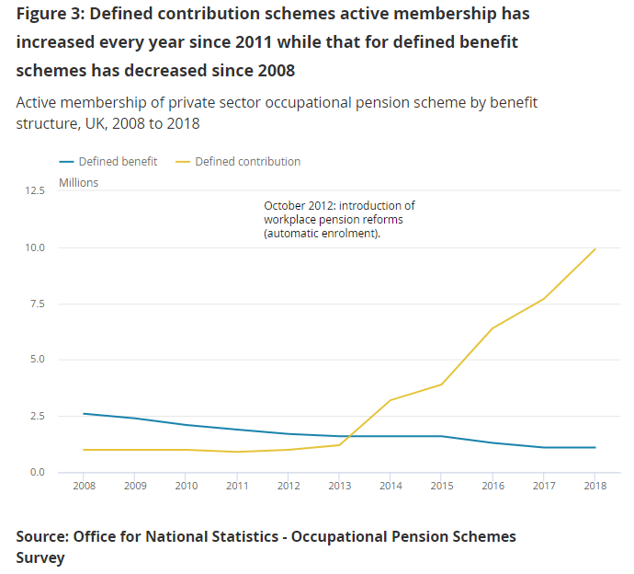
Use of capital in UK Pension Schemes

Slide 37
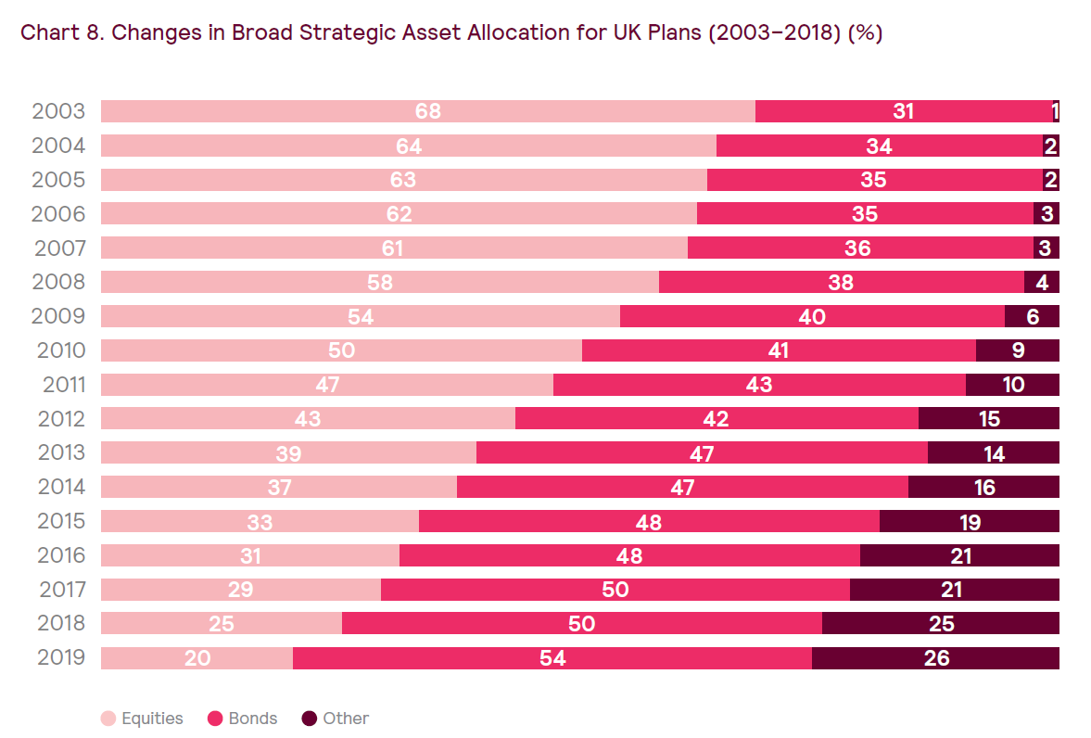
Defined Benefit (DB) Pension Schemes
Source: Mercer European Asset Allocation Survey 2019
Legislation
Maturing schemes
Less liquid assets
Impact of QE

Slide 38
Defined Contribution (DC) Pension Schemes
Typical lifestyle strategy supporting a drawdown approach at target retirement date.
Source : LCP Research
Pension Freedoms
ESG
Less short-termism?

Slide 39
Pluralism
Henry Leveson-Gower
[No additional slides]

Slide 40
Managing Uncertainty
Dr Iain Clacher

Slide 41
An intractable problem rarely discussed
J.M. Keynes – Treatise on Probability (1921)
F. Knight – Risk, Uncertainty, and Profit (1924)
L. von Mises – Human Action: A Treatise on Economics (1949)
R. von Mises – Probability, Statistics, and Truth (1957)
J. Kay and M. King – Radical Uncertainty (2019)

Slide 42
What are we talking about?
Reports that say that something hasn't happened are always interesting to me, because as we know, there are known knowns; there are things we know we know. We also know there are known unknowns; that is to say we know there are some things we do not know.
But there are also unknown unknowns - the ones we don't know we don't know. And if one looks throughout the history of our country and other free countries, it is the latter category that tend to be the difficult ones.
Donald Rumsfeld (2002)

Slide 43
The Key question and the hard answer
The key question:
What is really going on here?
The hard answer:
I/we don’t know.

Slide 44
What is needed in such circumstances?
Courage, leadership, and imagination

Slide 45
Are there useful theoretical constructs for dealing with uncertainty in everyday situations?
Are there useful practical tools for "?
Moving along the scale from not needing to address uncertainty to it being crucial:
  Where is it appropriate to use statistical techniques, ignoring uncertainty because it is immaterial or implausible? (e.g. perhaps in the pricing of motor insurance or just in the pure risk premium?)
  Where should uncertainty be incorporated? (e.g. perhaps in the calculation of risk capital for insurance risks?)
  Where is it crucially important to assess uncertainty more fully? (e.g. perhaps in the ORSA, or climate stress testing)
  What about Rumsfeld's unknown unknowns? How should they be dealt with? Can insurers and pension schemes be made resilient unknown unknowns? Is this desirable or appropriate?
  Which types of uncertainty are captured in each of the previous bullets/situations?
When is it appropriate to treat risks/uncertainties statistically or with probabilities?
Where does this get us in trouble? Can we identify the types of events, exposures, risks, uncertainties, scenarios, situations where we could get into trouble by treating uncertainties as statistical risk?
What do we do with irreducible uncertainty? When we encounter it in our actuarial work? For clients, for policyholders, for other stakeholders?

Slide 46
Workstream: Breakout discussion
You will be randomly allocated, but please “self-select” from:
  The economic impact of Covid-19 and understanding money & debt
  Sustainability Economics
  Long-term real investment returns
  Use of capital in UK pension schemes
  Economic pluralism
  Managing uncertainty
A reminder of the “ground rules”:
  Please listen to instructions from your chair-person
  Please “speak up”
  Please also give others the opportunity to speak up too!
You should be automatically returned at 11am
  …but if not, we are on the same link as the original meeting

Slide 47
Breakouts
If you are still here, please speak up…!

Slide 48
Welcome back
We will start again shortly

Slide 49
Workstream “1 minute feedback”
Key objectives for each workstream:
  The economic impact of Covid-19 and understanding money & debt - Lucy
  Sustainability Economics - Nick
  Long-term real investment returns - Martin
  Use of capital in UK pension schemes - James
  Economic pluralism - Henry
  Managing uncertainty - Iain

Slide 50
Cross-pollination of Ideas
Martin White
[No additional slides]

Slide 51
Better understanding the real economy: a collaboration of diverse volunteers (PT1/2)
Origin: concern that actuaries need to engage more with economic thought
… and that economic thought is too important just to be left to the economists: it is up to all of us to ask ourselves challenging questions
Diverse group of people with different passions – but aim is to learn from each other rather than persuade each other. Human angle is important, not just technical.
Always to be asking “what is going on here”
Complex world – models, especially very simple models, can be helpful to give us insights about the world, even if taken literally they could lead to mistakes and unintended consequences
Fun as well as usefulness: the power of small groups to spark ideas
Current work streams – may seem scattergun / random, and there will be more
However, any line of enquiry is potentially useful to the whole, and to understanding today as well as thinking about the future

Slide 52
On understanding today and thinking about the future (PT2/2)
Do we understand well enough how wealth is created in companies?
And what this means for how we provide for our individual and collective futures?
But we face huge challenges, meaning that the future has to look quite different from the past – and every work stream has potential to shed light on this
Climate change; a sustainable world in ecological terms; resource constraints; “growth” no longer accepted as solution – indeed, it may be part of the problem
Financial stuff – mechanics of money, of financial (as opposed to real) investment (pardon the simple terminology!)
Principles for tackling uncertainty: Kay/King recent book but masses of other good resources too – we will develop reading lists for the public MIG site
Our preparation for today didn’t talk much about corporate behaviour, corporate cultures, or impact of financial intermediation: for this see separate new project at https://www.uksa.org.uk/Savers_Take_Control

Slide 53
Thank you
Wrap up
Alex Waite

Slide 54
“After Party”
Recording is now turned off!

Slide 55
Appendix
Background to the Economics MIG

Slide 56
Background to the Economics MIG
Membership and approach
The MIG is open to anyone to join, and is not limited to actuaries. Indeed, seeking out external expertise is important for this MIG.
We intend that the style of the discussions will be suited to the purpose of the MIG, which is a search for discovery and enquiry into economic questions that are relevant to the areas in which actuaries operate. An important theme is the need to face up to uncertainty as a pre-requisite to being able to tackle difficult questions.
Of particular interest are lines of thought and enquiry which are additional to the economic paradigms which have dominated both academia and the financial sector over the last few decades. The style will be to encourage and engage with fresh questions, especially questions which seem to have had limited attention to date, and to encourage diversity of thought.

Slide 57
Background to the Economics MIG
Scope
The Economics MIG is sponsored by the F&I Board of the IFoA to:
  Raise awareness and understanding of our use of economic thought, theories and models and the implications for policyholders, pension scheme members, insurers, regulators and society.
  Engage in meaningful discussions in various areas of economics, especially those relevant to our stakeholders. For example, in assessing implications for managing long term assets and liabilities and addressing the related risks and uncertainties.
  Engage with interested parties, including academics, outside the actuarial profession, to deepen the level of understanding of MIG members, with a view to posing and investigating questions of importance to actuaries in today’s rapidly changing world and of expected relevance to the future.
  Promote discussion and debate about the strengths and limitations of current economic thinking, of actuaries’ current uses thereof, and whether actuaries' current uses should be revised, refined, supplemented or replaced altogether in the future.
  Support members of the MIG and the IFoA in assessing implications of economics and actuaries' use thereof.

