Slide 1
Sessional Research Event: Equity Release Mortgages (ERM)
Tom Kenny, Just
Charles Golding, Golding Smith & Partners
Alex Mockridge, Legal & General
Raj Saundh, EY
Scott Robertson, Phoenix Group Holdings

Slide 2
Disclaimer
The views expressed in this presentation are those of invited contributors and not necessarily those of the IFoA or our employers. The IFoA and our employers do not endorse any of the views stated, nor any claims or representations made in this presentation and accept no responsibility or liability to any person for loss or damage suffered as a consequence of their placing reliance upon any view, claim or representation made in this presentation.
The information and expressions of opinion contained in this publication are not intended to be a comprehensive study, nor to provide actuarial advice or advice of any nature and should not be treated as a substitute for specific advice concerning individual situations. On no account may any part of this presentation be reproduced without the written permission of the IFoA.

Slide 3
Agenda
Background
Ways to model the no negative equity guarantee
Valuation of ERMs
Structuring of ERMs
Credit rating
Online survey
Next steps

Slide 4
Background

Slide 5

The ERM Working Party and the IFoA Support
Working party members
Tom Kenny (Chair) - Just
Charles Golding (Deputy) – Golding Smith
Gina Craske - KPMG
Andrew Dobinson - LBG
Stuart Farrell – LV=
Owen Griffiths – L&G
Sam Gunter - Hodge
Nigel Hayes - Aviva
Jyotsna Kaushik - PWC
Working party members (ctd)
Alex Mockridge – L&G
Scott Robertson - Phoenix
Raj Saundh - EY
James Thorpe – Deloitte
IFoA support team
Mairi Russell

Slide 6
Why is equity release important?
Customers https://www.youtube.com/watch?v=gZoI_C3BGAc
Investors
£1.8tn of £2.6tn
+£4bn
5.2%
15-20yrs
+75bps
Source: Equity release council/Bank of England

Slide 7









Who are the investors in equity release?
Who are the investors?
6 retail annuity providers
-£4bn in 2018 (source: ABI)
8 bulk annuity providers
- £35bn in 2018 (source: Hymans)

Slide 8
Who are the investors (ctd)?
Who are the investors?
-Reinsurers
-Pension funds
-Fund managers

Slide 9

CP13/18 | The build up
David Rule speech April 2018, Bank of England priority is:
  “insurers capture the compensation for the risks they are exposed in the Fundamental Spread…so…Matching Adjustment is not overstated”
“insurers hold appropriate capital against these risks.”
Notes:
The David Rule speech in April 2018 summarised the regulatory drivers behind CP13/18, published in July 2018

Slide 10

CP13/18 | SS3/17
July 2017
Four principles applied in Effective Value Test
  No reduction in risk if all securitised notes held
  Economic value of ERM < PV Deferred Possession
  PV Deferred Possession < Value of Immediate Possession
  Compensation for risks retained > BE cost of NNEG
PRA will use EVT to determine if MA benefit is too high
Notes:
PRA view is that compensation for risks should be higher than best estimate cost of NNEG because FS captures expected cost of defaults and cost of downgrades

Slide 11
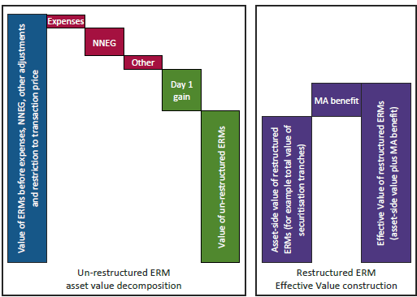
CP13/18 | EVT?
Economic value (green) < PV of Deferred Possession
Notes:
Four principles in isolation

Slide 12
Ways to model no-negative equity guarantee

Slide 13
What do firms currently use to model NNEG?
Most firms use Black Scholes and variants
Closed form solution
Geometric Brownian Motion – a random walk with drift
Constant volatility
Black 76 is mainly used and requires a forward house price inflation rate
Decrements modelled deterministically
Some use stochastic models for valuation/validation
Offering the potential for greater sophistication
Notes:
In our survey of nine firms, seven (78%) used Black Scholes
Constant volatility could lead to a material over or understatement by duration – some form of volatility curve might give better results.
Black 76 was normally used with the forward house price inflation rate usually based on CPI or RPI plus a margin for house price growth in excess of inflation (Nationwide Index shows UK average over 2% per annum above RPI over the last 40 years)
Black Scholes is clearly used to value the put option at each future point in time with the number of mortgages terminating at that time modelled deterministically
Stochastic models allow much greater sophistication including the possibility of stochastic decrements, correlation between future market interest rates and pre-payments etc.

Slide 14
What does academic research show?
House prices exhibit
Autocorrelation
Momentum effects
Mean reversion
Conditional heteroscedasticity
Volatility that varies by property groups
Jumps
Assuming Geometric Brownian Motion could lead to inaccurate results
Notes:
Autocorrelation or serial correlation. Strong correlation between house price movements over time periods separated by interval or lag. This type of correlation is often noted in markets where there is seasonality.
Momentum effects. The observed tendency for rising house prices to rise further and for falling prices to keep falling. This is a particular type of autocorrelation.
Mean reversion. The tendency for house price returns to move back to a historical average rate of growth.
Conditional heteroskedasticity. This relates to non-constant volatility of house prices where you would see periods of high volatility as well as periods of “calm” or low volatility. The process assumes that there is a correlation between volatility rates from one period to the next. It may well exhibit mean reversion where the volatility rate tends to move back to a historic average volatility rate.
Volatility that varies by property groups. This is another form of heteroskedasticity. The housing market is not homogeneous and the volatility can vary by region and type of property.
Jumps. Some significant market movements have been observed in relatively short time periods e.g. following the 2007-8 financial crisis.

Slide 15
UK Annual HPI (Source: Nationwide HPI)

Slide 16
UK Annual Real HPI (Source: Nationwide HPI and ONS RPI)

Slide 17
Moving Average Real HPI (Source: Nationwide HPI and ONS RPI)

Slide 18
Volatility and autocorrelation by region (Source: Nationwide HPI)
The tables below update figures given by the original ERWP in 2005

Slide 19
HPI by property type (Source: ONS)

Slide 20
What are the issues?
Monte Carlo vs closed form
Sophistication of models
Calibration and estimation of parameters
Real world vs risk-neutral or “halfway house”
The deferment rate or rental yield assumption in risk-neutral model
Choice of discount rate
Consistency with overall valuation of the NNEG
Notes:
At the life conference, there was a strong vote in favour of Monte Carlo or simulation based approaches. However, closed form is useful from a comparative viewpoint if you are a regulator and is useful in pricing.
Sophistication. Clearly, with a more sophisticated the model, you could model more features including, for example, correlations between prepayments and interest rates (and early redemption charges). However, greater sophistication makes closed form solutions less likely.
Calibration and estimation of parameters. Models need to be calibrated and, the poorer the fit of the model, the greater the issues and the more need for workarounds. Maximum likelihood (MLE), method of moments (MM) and generalised method of moments (GMM). Model risk is real even with a well-defined model.
Real-world vs risk-neutral of halfway house. Real world is clearly appropriate if you are looking at cash flows. However, a risk-neutral approach requires there to be a market to hedge the risk which in the case of individual properties does not exist. Risk-neutral models tend to give higher NNEG costs in the current market environment (explain). A halfway house solution might be the answer, for example, a model that allows for mean reversion or, maybe, not using a risk-free rate.
In a real-world approach, you are looking at the return from house prices to determine whether the NNEG applies and so the division of the total return into two components is academic. In a risk-free approach, you have issues as you cannot short-sell a house so using a rental yield in place of a dividend yield in a Black-Scholes formula does not give you a no-arbitrage solution. In addition, it presupposes that the rental yield will remain constant with changing house prices which historically has not been the case. In addition, someone letting a property will incur costs which reduce the gross yield substantially – letting agency fees, maintenance costs, voids etc. so what is the yield. There are other questions about whether the rental yield reduces the propensity for house price growth, particularly on a regional basis.
Risk-free (swap or repo) yelled curve or greater. Use of stochastic interest rate model.
Consistency of valuation assumptions.

Slide 21
Possible solutions
There are multiple possible models including:
  AR(I)MA, (E)GARCH, GJR, MCMC and VAR
  Jump diffusion processes could be incorporated
Combined models such as AR(I)MA-(E)GARCH
Risk neutralisation e.g. using Esscher transforms or Maximum Entropy
Closed form solutions might require a compromise and suitable calibration
Notes:
AR(I) MA Autoregressive moving average – “I” refers to integrated with data values replaced by differences – ARMA models are typically used where mean reversion applies
(E)(G)ARCH – autoregressive conditional heteroskedasticity where the volatility– “G” refers to generalisation where there is autoregression and (mean reversion) for the volatility parameter – “E” refers to exponential and is a variant which models log volatilities.
GJR – Glosten-Jagannathan-Runkle models for volatility clustering. Might be better fit than GARCH or EGARCH based on research in the investment market.
MCMC Markov Chain Monte Carlo methods . You ight recall that a Markov Chain is one where the probability of each event depends only on the state attained in the previous event
VAR – Vector autoregression model is a stochastic process model used to capture the linear interdependencies among multiple time series.
Jump Diffusion Process – Robert Merton
Combined might give better fit.
Risk-neutralisation. This is a mathematical way of going from a predictive “real world” probability distribution to a “no arbitrage” risk-neutral one. Academics have proposed various ways: Esscher Transforms which is a way of converting one probability density function to another. Maximum entropy is an information theory idea where entropy refers to a measure of the amount of information gained. There are others e.g Wang Transforms.
As for Black-Scholes where de-smoothing is used to allow for autocorrelation where a compromise is made then some adjustments to parameters may be needed to give a better fit..

Slide 22
The way forward
Co-funded independent research commissioned by IFoA and ABI on NNEG
Under oversight of Actuarial Research Centre
Kent Business School under Prof Radu Tunaru appointed
Review Group comprising 50: 50 ABI and IFoA/ARC representatives with Professor Johnny Li as the Chair
Interim results – shared with stakeholders at IFoA and ABI
Final published results – Q1 2019 is objective

Slide 23
Valuation of ERMs

Slide 24
Valuation methodology – IFRS 17
Do ERMs meet the definition of ‘insurance contract’?
  “A contract is an insurance contract only if it transfers significant insurance risk...” (IFRS17, B17)
  “Insurance risk is significant if, and only if, an insured event could cause the issuer to pay additional amounts that are significant in any single scenario, excluding scenarios that have no commercial substance (ie no discernible effect on the economics of the transaction)…” (IFRS17, B18)
If in scope, calculation of CSM, risk adjustment etc. likely to be required
Issue 1 of 25 in IASB staff paper IFRS 17, Concerns and implementation challenges
https://www.ifrs.org/-/media/feature/meetings/2018/october/iasb/ap02d-ifrs17.pdf
Notes:
Ongoing debate around insurance vs. investment contract classification
We understand from our research and interviews with practitioners that the current market practice is to value as an investment contract
Remains to be seen if ERMs can be explicitly de-scoped from IFRS 17, the IASB will be keen to avoid any further implementation delays

Slide 25
Valuation methodology – Solvency II (1)
ERMs have been a regulatory focus for several years, including publication of a number of consultation papers and letters to CEOs
Recent guidance has focused on NNEG valuation and internal ratings
2016
DP1/16
2017
SS3/17
2018
CP13/18
2019
???
CP48/16
CP21/17
SS7/18
David Rule letter
02/07/2018
David Rule letter
10/12/2018
Paul Fisher letter 15/10/2014
Paul Fisher letter 20/02/2015
PS31/18
Notes:
Paul Fisher letters – outline how MA benefit can be claimed on ERMs through securitisation
Various consultations – clarifying rules around MA eligibility, ratings and MA benefit
David Rule letter – strengthened stance, “(firms) should not assess (NNEG risk) as lower by assuming future house price growth in excess of the risk-free rate”
CP13/18 introduces EVT

Slide 26
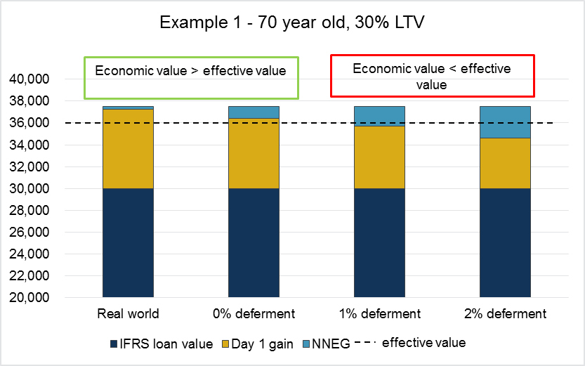
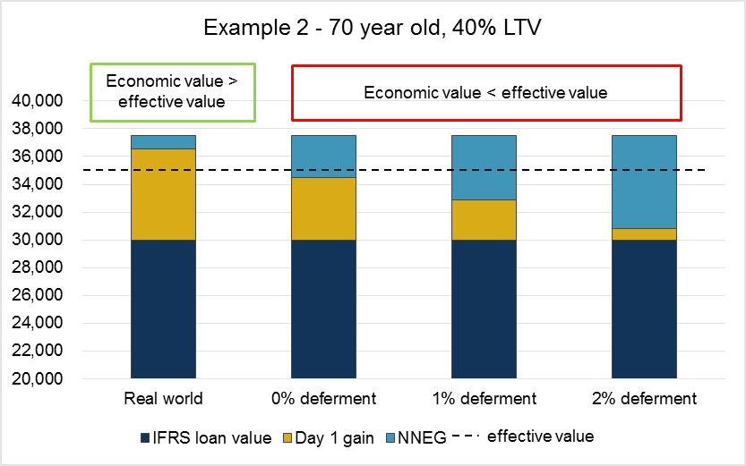
Valuation methodology – Solvency II (2)
Effective value test ‘looks through’ structuring and internal rating
Notes:
EVT highly sensitive to deferment rate
Also sensitive to risk free rates
NNEG increases exponentially with LTV
The majority of firms surveyed by us were applying a ‘real world’ Black-Scholes approach, suggesting that they may be financially impacted by the EVT

Slide 27
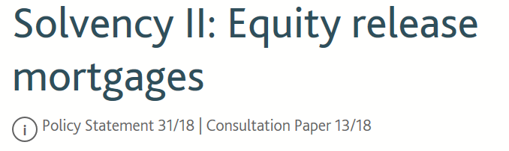

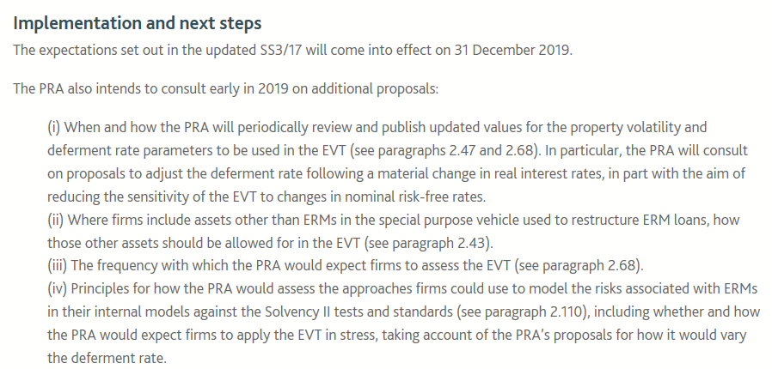
Valuation methodology – Latest developments
https://www.bankofengland.co.uk/prudential-regulation/publication/2018/solvency-ii-equity-release-mortgages
www.theactuary.com
Notes:
25 Oct announcement – came as a surprise, although the IFoA and industry were lobbying for a delay. The planned implementation date has been pushed back by at least a year. (Annuity writers may hope that the planned risk refinements may end up being implemented at the same time.)
The delay gives ERM writers more time to engage with the regulator and make any necessary adjustments to their strategy.
The IFRS 17 1 year delay is half the 2 year delay asked for by industry
This allows bodies such as the ABI more time to lobby for ERMs to be explicitly de-scoped.
The continuing difficulties experienced with valuing ERMs show the need for thought leadership, and we hope that the IFoA and ABI commissioned research will help address this

Slide 28
Structuring of ERMs

Slide 29
Securitisation – what does it mean for ERM?
The structure
The incremental risk implications
Notes:
Structure
Firms have been pushed into a restructure in the UK under the MA to achieve cashflow fixity
Securitisation has been the chosen path- the door is open for alternatives but we are on a tried and tested path
Talk through basic features (originate outside, set up SPV, transfer assets into SPV, issue note(s), annuity writer buys the rated part into the MAP and the unrated part goes elsewhere (either in the business or sold)
“Regulatory” structure – looks different to the SPVs for CMBS/ RMBS – also very different to known public vehicles
Risks
Not as simple as you might expect it to be – adding fixity changes the nature of the risk too
Short dated – can easily end up with a liquidity concern
Timing – Fixity means I might need to plug gaps in “lumpiness”
Longer dated – an increasing level of uncertainty over time
Summary – Some questioning around the appropriateness to match annuities (which is probably correct given the cashflow uncertainty), you can get the benefit but it has forced companies into new territory in terms of their thinking
Suggest that we have a a post-Brexit view here - mine would be that “this is an area where there has been a lot spent and there is some gain from the PRA. The bar hs been set for the players today so it’d be hard to pull back on this / unwind the structures for those that have them. It also allows more explicit matching / risk management protocol for the annuity business so there are some positives for the regulator in doing it this way. Maybe soften the position on “fixity” meaning other solutions may be viable for smaller players though”

Slide 30
Securitisation – balancing your own firm’s needs
Varies significantly, with all upwards of 60% cash flows in the MA portfolio, but some significantly higher where there are multiple rated notes
Variety of approaches used, with multiple rated notes with larger portfolios and a single rated note for smaller portfolios
Optimise financials, complexity and cost
Number of notes
Liquity & cash traps
New business
Size of the notes
Some use cash buffers, others may buy in liquidity if there is sufficient internally or it is cost effective to buy externally
May have a whole new SPV, segment collateral within an existing SPV or use the same pool of collateral to write more mortgages
There is no “one size fits all” solution in the market

Slide 31
Securitisation – valuation and capital modelling
Valuation in base
  The equation of value
  Total value of whole loans plus cash holdings less frictional costs of the SPV = Total value of notes issued by the SPV
Valuation in stress
MA under stress
  “The PRA considers that a ‘mechanistic approach’ based on the re-application of the approach used to calculate TPs is unlikely to result in an SCR that takes into account all quantifiable risks to which a firm is exposed, including the risk of losses that are not allowed for within the TP calculation. (SS8/18)”
Notes:
Two distinct ways of looking at this
RMBS / CMBS markets, where the value of each traded note is driven by market’s view of that note versus alternative investments
Equity (or mezz / sub –debt) trading where the market prices at much higher yield
Helpful to join the two elements - typically considers the retention of value between the assets and the SPV
Stress uses a similar formulation to this
MA under stress is more complex – muddied further by the considerations set out in CP13/18 and this part of emerging.
It’s already difficult without CP13.18 in mind though
“no mechanistic” – this acts as a baseline. Relies on the re-rating of the note(s) themselves and re-application. The reassessment of the rating itself is not trivial – to do this in capital models requires a large amount of information / stresses on stresses. Ratings also drop at discrete points rather than being a smooth function.
Helpful to simplify the problem down – methods perhaps the subject of future research though.
Then want to reassess the FS itself
Default characteristics have changed
Liquidity characteristics have also changed
LGDs for the ERM asstes are typically quite low though
Expect that you will need to reassess the characterisitics in stress and the minimum is to take the max of the 2. Difficult to justify anything else.

Slide 32
Credit rating of Re-structured ERMs

Slide 33
The need for an internal credit rating
Special Purpose Vehicle
Senior Note(s)
Solvency II requirement
Complex and large exposure
Map to CQS and FS
Internal rating
Matching Adjustment
Identify and measure the risks
Prudent Person Principle
Junior Note
Solvency II Regulation underpins internal rating requirement

Slide 34
How to be consistent with ECAI rating?
Model cash flows under individual and combined stress scenarios
ERM Portfolio
Senior Note(s)
Assess the resilience of the structure to meet debt obligations
Apply expert judgement in assessing the quantitative and qualitative analysis to determine final rating
Identify and assess non-market risks
Junior Note
Internal ratings aim to be broadly consistent with ECAI
Notes:
What we new things have we learned:
AAA to AA rating require structure that meets its debt obligations in terms of both amount AND timely payment. Lower rating allow for a deferral in payment provided the structure is able to support payment of all debt obligations by the legal final maturity of the debt obligation.
The strict definition of default is based on the legal wording of the debt obligation. It is common in debt obligations that the borrower is permitted to pay within x business days after the specified payment dates. Therefore, in assessing the default risk, ECAI’s will model default is occurring after the x days has elapsed.
In assessing the ability to meet debtor obligations, the ECAI will take into account any structural features such as liquidity facilities, contingent reserves to meet note payments as they fall due.

Slide 35
Deriving rating scenario assumptions
Risk factor
ECAI approach
AAA
Extreme, “never seen before” scenario
House Prices
Generic stress consistent with RMBS methodology
AA
A
Interest rates
BBB
Close to best estimate scenario
Mortality
Idiosynchratic stresses informed by product features, historical data and expert judgement
BB
Morbidity
B
Prepayment
Rating scenarios are derived by a combination of published ECAI assumptions and expert judgement
Notes:
There may be a desire for Insurers to attempt to translate rating stresses into a probability distribution in order to more closely align a credit rating with capital and/or ORSA stresses. From our discussions with rating agencies, this is not an approach that they are familiar with, and from observation of individual stresses, it is also clear that not all variables are stressed to the same extent. We therefore consider that it is easier to demonstrate ECAI consistency in internal ratings by comparing and justifying assumptions and judgements used against ECAI published criteria, rather than setting a probability level
What we have concluded are:
Firms should use house price stress scenarios in line with ECAI published scenarios. The ECAI scenarios borrow from their extensive experience in rating and analysing the house price risk associated with RMBS structures.
For mortality, morbidity and prepayment scenarios, ECAI’s would seek to understand and place reliance on the firm’s relevant experience data in determining appropriate rating stresses.
In order for portfolio data to be taken into consideration, we expect that data covering one full economic cycle must be made available to rating agencies. Short term spikes in historical data could be used to set stresses at the A and BBB level. Simple and prudent extrapolation could then be used to set stresses at the AA and AAA level
Annual review of rating scenarios

Slide 36
How to apply expert judgement
Modelled Scenarios
Expert Judgements
Rating
ECAI’s will consider a range of scenarios
Consider plausibility of the modelled scenario
Document rating decision and expert judgement applied
Materiality of modelled results
Significance of the risk factor
Expert judgement is a fundamental part of rating approach
Notes:
Document expert judgement
No 2 ECAI’s will apply expert judgement in the same way

Slide 37
Online survey

Slide 38


CP13/18 | What do you think?
Use online poll to survey audience on points raised from CP13/18 and PS31/18
    Join at
    slido.com
    #4355

Slide 39
Next steps

Slide 40
Next steps
Finalise paper
Analyse the impact of the academic research on the matching adjustment
Analysis of mortality, long term care and voluntary early repayment experience

Slide 41
Questions
Comments
The views expressed in this [publication/presentation] are those of invited contributors and not necessarily those of the IFoA. The IFoA do not endorse any of the views stated, nor any claims or representations made in this [publication/presentation] and accept no responsibility or liability to any person for loss or damage suffered as a consequence of their placing reliance upon any view, claim or representation made in this [publication/presentation].
The information and expressions of opinion contained in this publication are not intended to be a comprehensive study, nor to provide actuarial advice or advice of any nature and should not be treated as a substitute for specific advice concerning individual situations. On no account may any part of this [publication/presentation] be reproduced without the written permission of the IFoA [or authors, in the case of non-IFoA research].

