Slide 1
First Anniversary: CANUK
David Hare
President-elect
Institute and Faculty of Actuaries

Slide 2
CANUK
A networking platform for Chinese actuaries in the UK.
A communication channel to other Chinese actuarial associations.
Dedicated to advise and support Chinese students in the UK.

Slide 3
Institute and Faculty of Actuaries – Strategy Update
Over the past 18 months we have been working
on implementing changes to our focus, how we
operate and how we measure our successes.

Slide 4
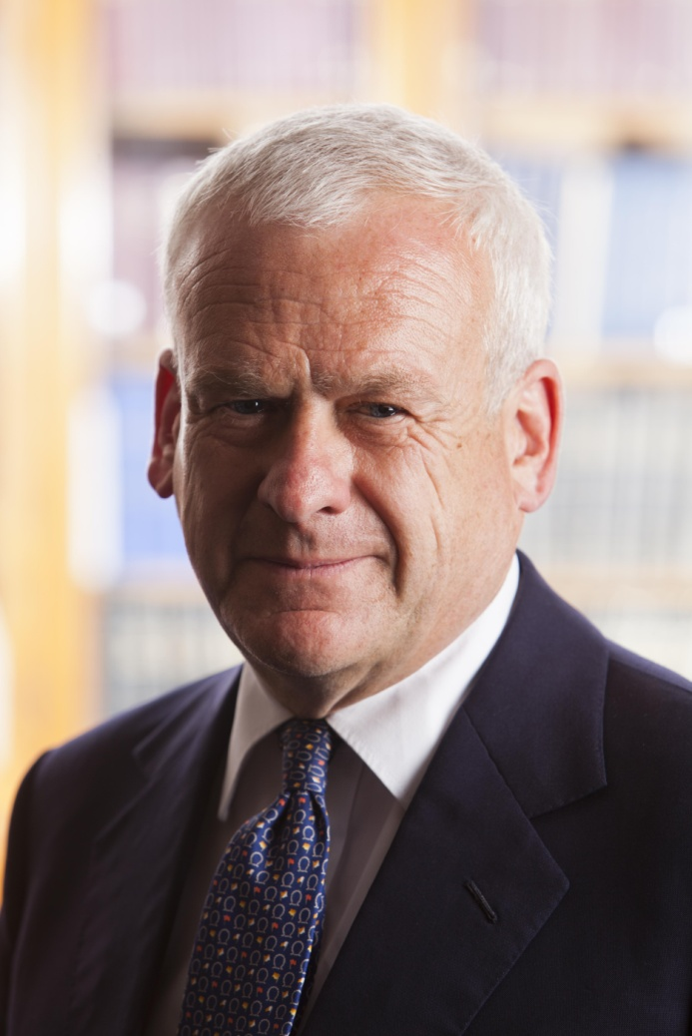
Philip Scott
President, Institute and Faculty of Actuaries
Priorities for his term as President:
Brand
Customer Focus
Leadership

Slide 5
Brand: some key principles
The element that keeps such organisations at the top of their game is a solid brand identity.
A good brand adds value.
A good brand means you are easily recognised, trusted and used frequently.
Good business and growth flows from a good brand.

Slide 6
Our values How we measure behaviour
Integrity: honest, accountable and professional
We are: Doing the right thing for the organisation, our members
the profession and the public interest.
Community: inclusive, accessible and collaborative
We are: building relationships and communities by listening and
giving people a clear voice
Progress: relevant, supportive and purposeful
We are: leading the future of the profession together
Notes:
These are the yardsticks by which we measure our behaviour. They will drive our decisions, form our beliefs and unite us as an organisation. Our values will resonate with our audiences and appeal to like minded people. Our values are critical to our brand’s success.
There has been a huge amount of effort dedicated to this tranche of brand work. These have evolved, in partnership with the executive and council. They are aligned with the strategy launched in 2011 and support the Actuaries Code.
They will drive the performance structure of the staff as well as be the corner stone for volunteer induction.

Slide 7
Institute and Faculty of Actuaries
Our Vision
We will serve the public interest by ensuring that where there is uncertainty of future financial outcomes, actuaries are trusted and sought after for their valued analysis and authority.
Our Mission
The objects of the Institute and Faculty of Actuaries shall be, in the public interest, to advance all matters relevant to actuarial science and its applications and to regulate and promote the Actuarial Profession.
(Charter of the Institute and Faculty of Actuaries, August 2010)

Slide 8
The Institute and Faculty’s Strategic Objectives
Education
To provide high quality qualifications for our students and lifelong education for our members.
Learned Society and Thought Leadership
To advance all matters relevant to actuarial science.
Public Affairs and Promotion
To speak up on relevant matters of public interest and to raise awareness of the work of actuaries and the value we add to society.
Licensing and regulation
To license and regulate the members of the Institute and Faculty in such a way as to assure public confidence.
Member support
To offer excellent support that meets members’ varied and evolving needs.

Slide 9
On Education
Maintain our gold standard qualifications
Online application of the CA3 (Communication) exam
Accredited the Chinese University of Hong Kong
Looking into accrediting other universities in China
Launched the Sir Edward Johnstone prize in China
Recognition of the potential talent in China

Slide 10
On Thought Leadership and Learned Society
Launched the Actuarial Research Centre
Two major lectures per year
Continuing sessional events to present ongoing research: -Discount rate project
-Third Party Working Party

Slide 11
On Public Affairs China Insurance Weekly, 26 September 2012

Slide 12
On Regulation
Publication of the Regulatory Strategy
Professional skills training

Slide 13
On Member Support
400 Club
Using technology to deliver CPD wherever you are
Launched the International Actuarial Careers Network
(IACN)
Improvements to the volunteering experience
Volunteer Engagement Manager - Debbie Atkins
Volunteer handbook/ directory of opportunities
Volunteer recognition Pins

Slide 14
CANUK: Some achievements…
Better communication between our members here and in China
Created an environment of sharing knowledge
Delivery of CPD in China
Set up Solvency II Asia Subgroup
Planning to set up a General Insurance Pricing Forum (GIPF)
Organised networking events

Slide 15
Our visit to China and the Far East, September 2012
Beijing
14 September
Standard Life Reunion
15-16 September
Chinese Actuarial Association Conference
17 September
Meeting with the Financial Services
and Economic team at the British
Embassy.
China Banking Regulatory Commission
Securities Regulatory Commission
Peking University
Tsinghua University
18 September
China Insurance Regulatory
Commission
Central University of Finance and
Economics
Shanghai
19 September
Stakeholder lunch
Shanghai University of Finance and
Economics
Member Event
Hong Kong
20 September
Mandatory Provident Fund Authority
Hong Kong University
Member Event
21 September
Commissioner of Insurance
Chinese University of Hong Kong
Singapore
21 September
Monetary Authority of Singapore

Slide 16
Recent email from a Volunteer in China.
“Even though Beijing is remote from the UK, I still feel the change happening. The Visits to China get more and more frequent, events such as new qualifier ceremonies have been held locally and our community gets more vibrant.”
“All of this benefits members a lot. To volunteer for the Profession is a great choice for me –it’s a fantastic way to help shape the future of the Profession.”
2 December 2012

Slide 17
The Institute and Faculty of Actuaries
One Profession, many communities -delivering first
rate qualifications, member support and high
standards
Providing a quality service to our members.
Ensuring they have the right skills, training and tools in an ever changing profession.

