Slide 1
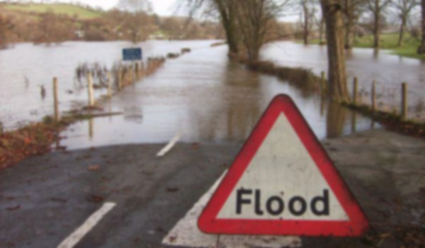
Flood Working Party
Are we asking the right questions?
Laura Evans and Emma Bergin
“Road Closed. Wales.” by Morien Jones is licensed under CC BY 2.0/www.MorienJones.com/ /Tint and blur applied to original

Slide 2
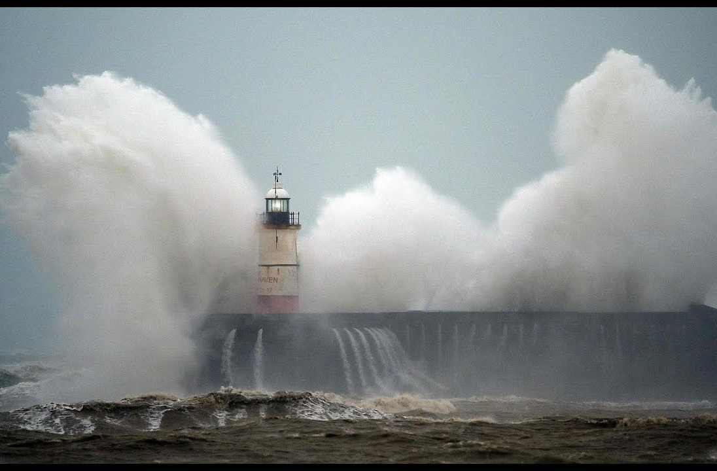
Slido www.slido.com #10915

Slide 3
Agenda
Recent UK flood events
Major UK flood events since 2007
Themes to explore with this data
Major Global flood events this year

Slide 4
Recent UK Flood events
*Costs communicated as ‘in excess of’ these figures. Data based on final ABI press releases.

Slide 5
Comparing the costs of these recent floods to other recent historical floods
*Costs communicated as ‘in excess of’ these figures. Data for Ciara/Dennis and November based on final ABI
press releases. Older events based on paper published by EA ‘Estimating the Economic costs of the winter
floods 2015 to 2016’, also largely based on ABI data.

Slide 6
Slido What could be the drivers of this difference (short phrases or one word answers)? www.slido.com #10915

Slide 7
When we look at this exhibit there are a number of themes that come to mind
Defenses?
Climate?
Underinsurance?
Resilience?

Slide 8
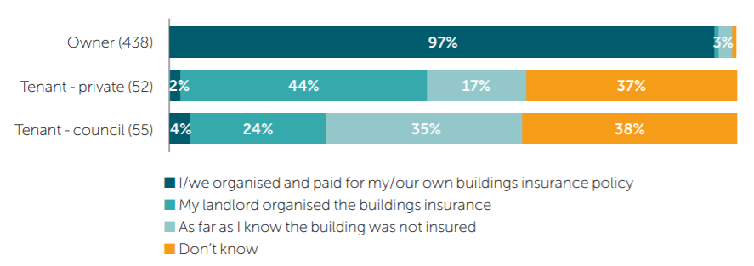
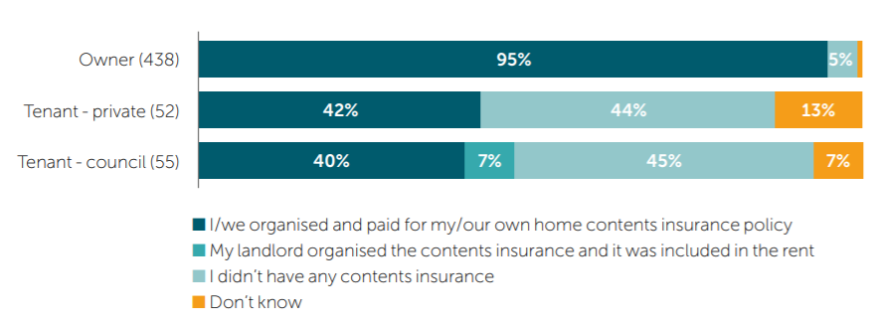
Is Flood Risk Underinsured?
*Extract from the independent review ‘Flood insurance review 2020: Doncaster’,
https://www.gov.uk/government/publications/flood-insurance-review-2020-blanc-review

Slide 9
Slido What questions should we be asking about underinsurance? www.slido.com #10915

Slide 10
Is Climate Change driving an increase in flooding?
*Source: UK National Climate Projections (UKCP18).

Slide 11
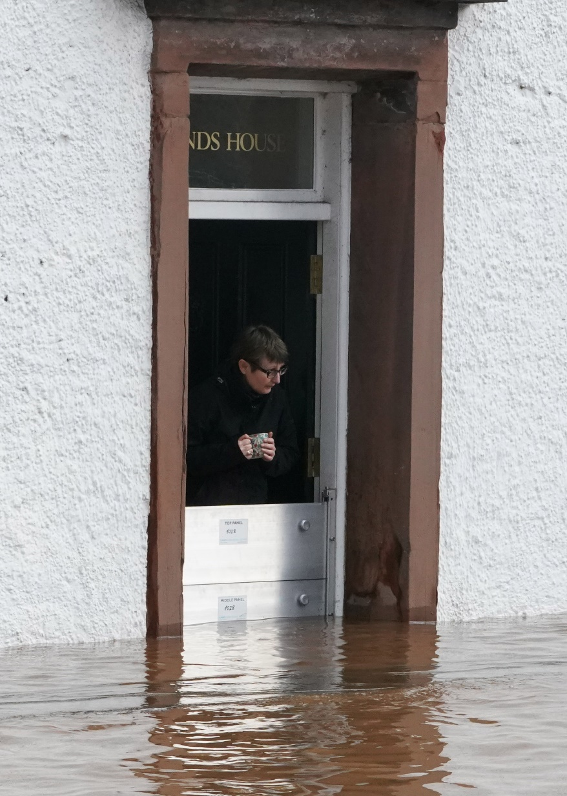
Does this show improved resilience?

Slide 12
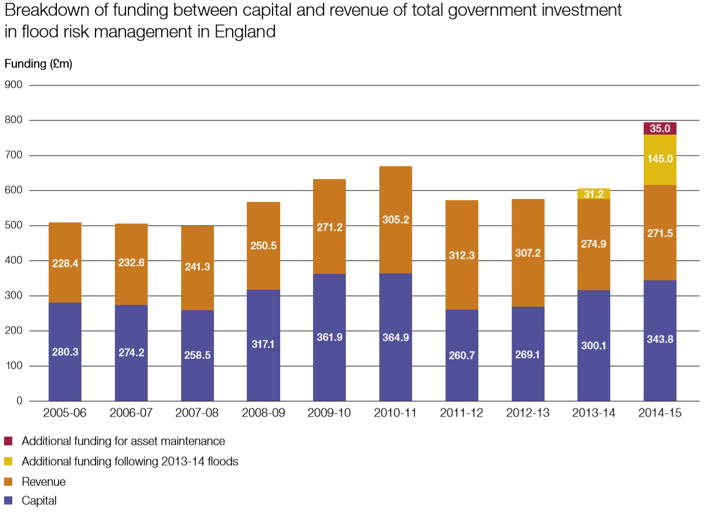
Are we seeing improved flood defences or response?
Placeholder - timeline
*Source: National Audit Office (2014),
Strategic flood risk management.

Slide 13
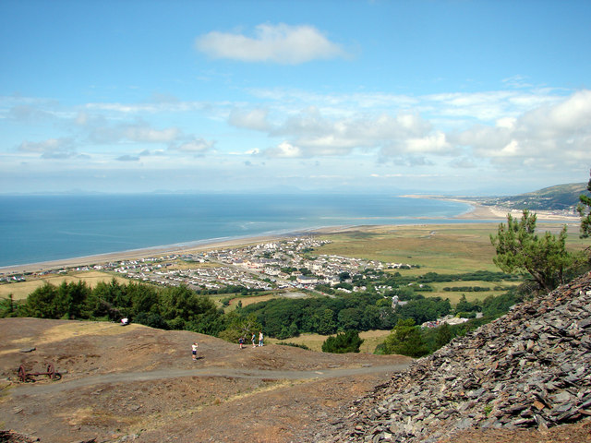
Are defences always the solution? Eg. Fairbourne.
A view of Fairbourne from Golwen state quarry
© Copyright John Lucas https://www.geograph.org.uk/profile/14997 and licensed under CC by 2.0

Slide 14
Slido What questions should we be asking about climate change, resilience and defences? www.slido.com #10915

Slide 15
Some of the larger Global Flood events in 2020 Costs in GBP (£)/ USD ($)
January
February
April
May
June
UK Ciara/Dennis
£214m/ $290m
Jakarta, Indonesia
£60m/ $80m
Canada, Alberta
£130m / $180m
India, Bangladesh, Cyclone Amphan
Southern China Floods
£570m/ $760m
£35m/ $50m
(includes storm damage)
Australia, East Coast
£500m/ $660m
July
August
September
October
Japan
£490m / $660m
Hurricane Laura – Arkansas, Mississippi, Louisiana, Texas
Hurricane Sally - Alabama, Florida, Georgia
Hurricane Delta, Louisiana
£375m / $500m
£450m/ $600m
£225m/ $300m
*Costs approximate sourced from local general insurance
bodies, for US based on middle of national
flood insurance programme ranges. Figures to nearest £5m
converted to £ and $ using exchange rates based on those from
Dec 2020.

Slide 16
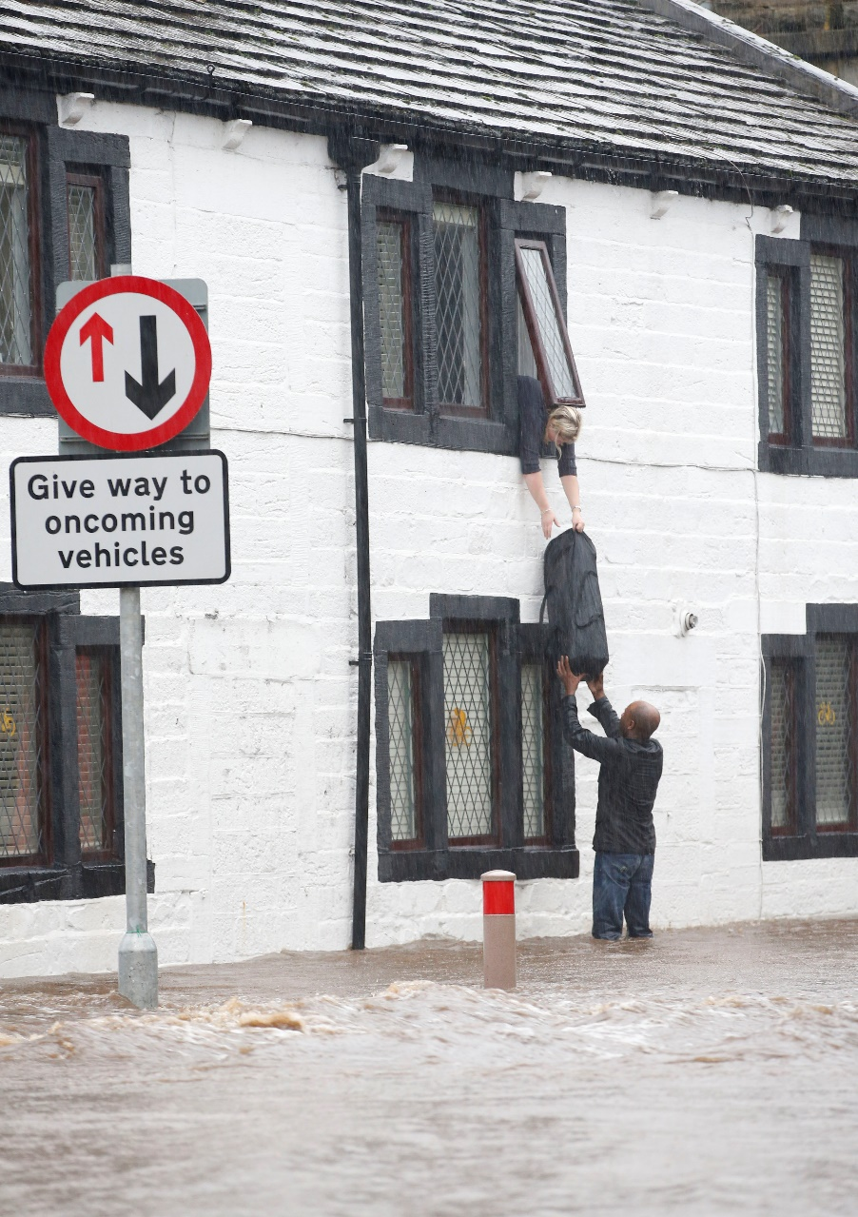
What is the role of insurance in flooding?

Slide 17
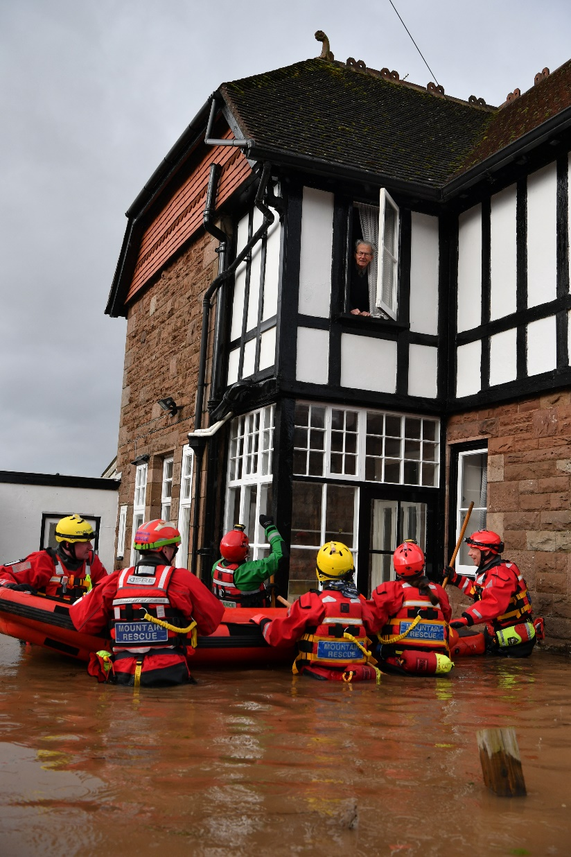
Are we asking the right questions?

