Slide 1
Flood, Flood Re and Actuaries
From the IFoA Flood Working Party:
Stephen Cox – Legal & General
Phil Moss – Lane, Clark and Peacock

Slide 2
GIRO Flood Working Party
Aim: To be a source of knowledge and expertise within the Actuarial Profession on matters relating to flood with a particular focus on the UK.
To develop the Profession’s position on UK flooding.
To produce reference material for UK actuaries.
To improve the understanding of flood risk amongst the industry, government and public.
To gather data and opinions from the industry to inform the above.
To work with industry bodies to report on market developments following the expected launch of Flood Re in 2015.

Slide 3
The Flood Problem
Created by insurers:
Insurance is about pooling the unknown
Risk models have differentiated most perils more and more over the last 25-30 years but flood, by its nature has a more extreme variation than others
Exacerbated by external factors:
Climate change
Population growth
Diminishing resources

Slide 4
Problem - Trends in weather patterns
2014 was the UK’s warmest ever year and eight of the top ten warmest years have occurred since 2002.
Five of the UK’s top six wettest years have occurred since 2000.
Many models are based on the average of past years. However, there is some evidence that expectations for 2015 should be greater than the average of past years.

Slide 5
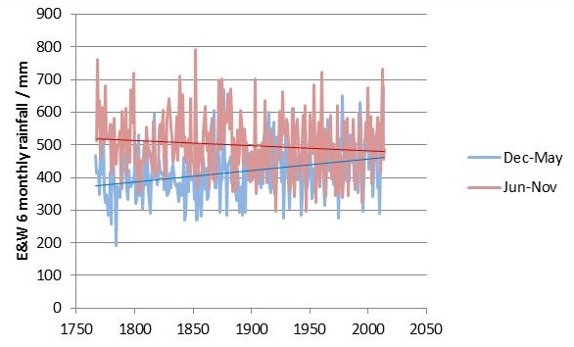
Problem - Trends in weather patterns
Trend for a warmer time than recorded in the past – this increase in energy is expected to lead to more storms and greater rainfall as warmer air can carry more moisture.
The impact on rainfall is less clear – winters have been wetter and summers drier over the last 250 years but more recently summers also appear to be wetter again.

Slide 6
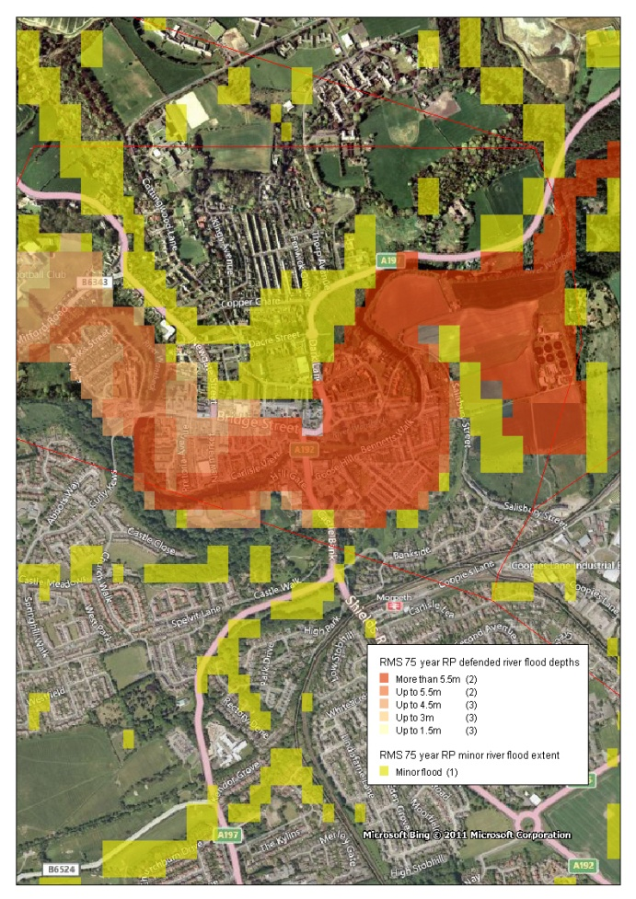
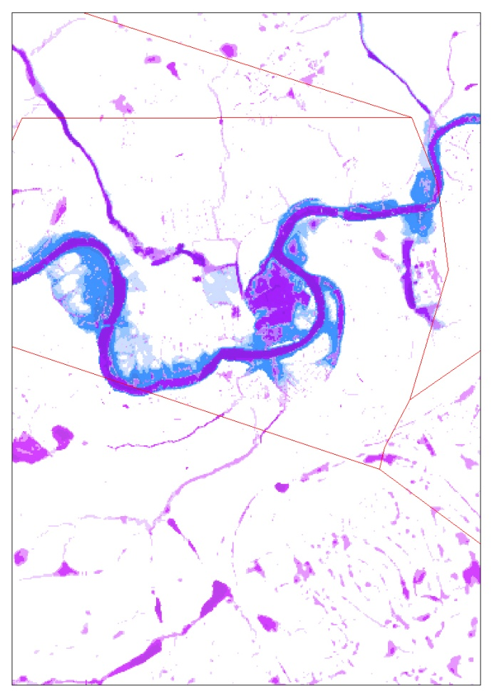
Problem - Insurers
Insurers have got much better at predicting flood risk at a more granular level. This has seen the expected flood cost for the worst properties become more extreme leading to a problem of affordability and availability.
Better granularity

Slide 7
Problem – Insurers
21st May, The Actuary:
“New model helps Canadian insurers better understand flood risks A “fully probabilistic” flood model has been developed to help insurers and reinsurers better underwrite and manage these risks in Canada.”
22nd May, Flood Re weekly briefing:
“Canadian delegation visit to Flood Re - This week we were delighted to be able to host a visit from colleagues from the Insurance Bureau of Canada who are exploring whether a Flood Re type solution could be applicable in their country. They spent time with our Executive team asking about the strategy and objectives for Flood Re as well as gaining significant insight into the operational programme that is in place.”
But not quite as it seems – flood insurance availability

Slide 8
Flood Re
a / the solution?

Slide 9
What is Flood Re?
Designed to enable high flood risk households to obtain affordably priced flood insurance, Flood Re is an agreement between UK insurers and the Government to allow insurers to pass the flood risk element of a home insurance policy into a not-for-profit fund that will pay any subsequent flood claim.
Aim is to allow a sustainable transition to risk reflective pricing over 25 years.
Flood Re is designed to provide support to those homeowners who, without it, are most likely to face problems in obtaining affordable flood insurance.
Exclusions include:
Homes built after 1 January 2009
Commercial properties, including commercial leasehold properties (although there are some exceptions)

Slide 10
How will Flood Re work?
Low flood risk homes
Premiums
Flood Re premiums
Claims
Home insurers
Levy
Flood Re
Premiums
Flood Re claims
High flood risk homes
1-2% highest risk ~350,000
Claims

Slide 11
How will Flood Re work?
Insurers can reinsure domestic property insurance flood risks for homes built prior to 2009 with a not for profit pool for a fixed cost depending on council tax band and cover type:
Cover Type |  | Property Council Tax Band
 |  | A | B | C | D | E | F | G | H
 | Wales: | A/B/C |  | D | E | F | G | H | I
Buildings only |  | £132 | £132 | £148 | £168 | £199 | £260 | £334 | £800
Contents only |  | £78 | £78 | £98 | £108 | £131 | £148 | £206 | £400
Buildings and Contents combined |  | £210 | £210 | £246 | £276 | £330 | £408 | £540 | £1,200

Slide 12
Who pays?
The insurance industry (ABI) is paying the £10m set up costs to get Flood Re up and running. The Flood Re pool itself has two sources of income:
Premiums of flood risks passed by insurers, which will be capped based on Council Tax bands.
An additional levy on the industry, equivalent to the existing cross-subsidy that exists in the market. This will be around 2.4% of a policy which equates to a notional average of £10.50 per customer.
Possibility of a further levy (Levy II) if Flood Re cannot meet its funding requirements.

Slide 13
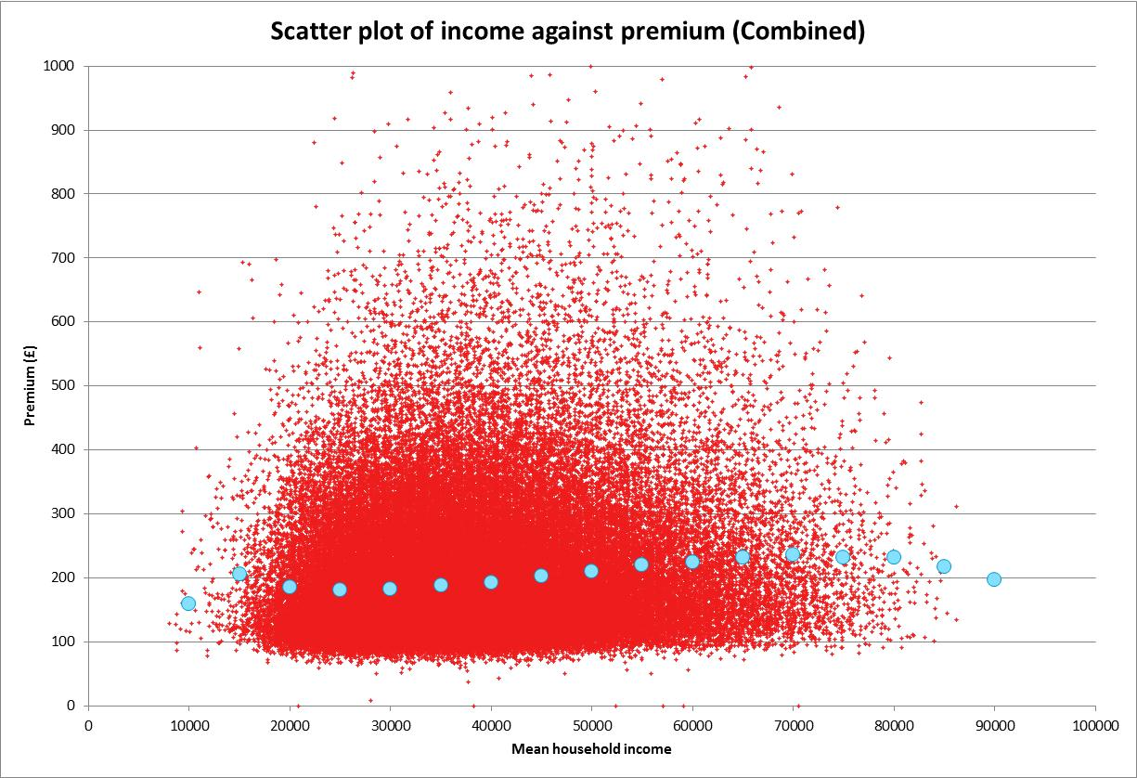
Flood Re
Affordability:
Flood Re is effectively funded by a percentage load on most home insurance premiums
Household premiums are greater for those with higher incomes but not that much

Slide 14
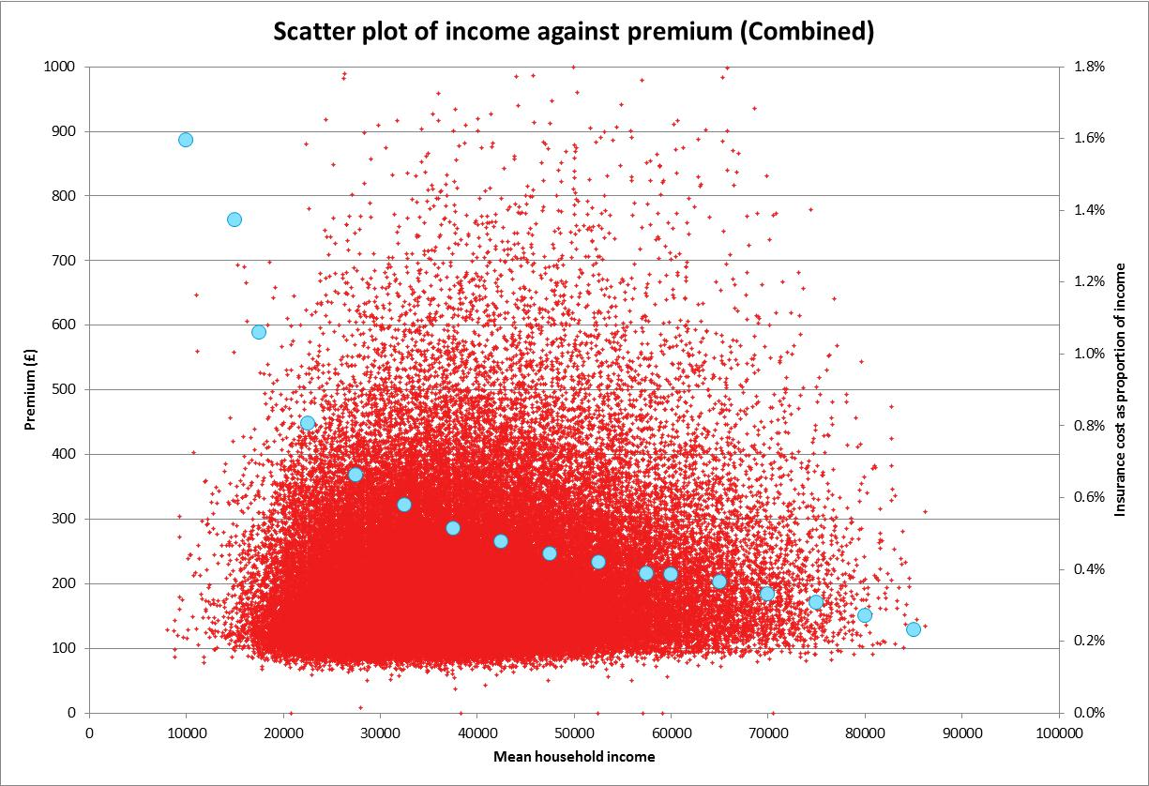
Flood Re
Affordability:
Looking at the ratio of premiums to income shows how the burden of Flood Re falls hardest on those with lower incomes

Slide 15
Flood Re - Strengths
Provides coverage for consumers – a market for new business
Very likely to improve price/terms for majority of customers who are subject to high flood risk
Properties built since 2009 cannot be ceded to Flood Re – this introduces a pressure on planning to fully consider flood risk
Intention to return to risk reflective premiums within 25 years encourages investment in defences and improvement of housing stock (by owners)
Some scope for resilient repairs

Slide 16
Flood Re – Controversies
Who pays and who benefits
Coverage – Band H/I added
Windfall benefit for insurers with historically weaker underwriting
25 years – and associated uncertainty
Levy I timing <> coverage
Cost, difficulty and delay in inception
1 in 200 - a disincentive to underwrite

Slide 17
The IFoA as a public interest body
A possible view on flood
We are open and honest, acting impartially and with a sense of justice to all. Our role is to contribute to setting standards and policy in the financial sector, and other areas where we have expertise, in all countries. We should also speak out when appropriate, particularly where the public may not understand the associated risks. This also applies to publishing material which will help the understanding of consumers of financial services and the members of pensions schemes.

Slide 18
Profession’s View?
Flood Re:
Be clear on 25 year outcome – stated return to risk reflective pricing but talk from Flood Re of intention to use time to make underlying issue much better
So what are benefits – originally planned to give time for people to adjust to risk reflective pricing but can resilience be improved?
And who pays for it – Flood Re can fund some resilience and householders can do more over 25 years, government can build and maintain defences but may be a challenge just to maintain flood costs

Slide 19
Profession’s View?
Insurers:
Covering uncertainty – not what is predictable – should we explain this? Address other views of ‘pooling’ of risk?
Huge social role of insurance may be forgotten!

Slide 20
Profession’s View?
Government:
Sustainable development – growth-oriented economic model vs finite ecosystem
Role of defences

Slide 21
Profession’s View?
Ultimately - what helps the public
Build awareness of opportunity to improve housing in ‘breather’ provided by Flood Re - constructive
Risk of some customers becoming uninsured as result of the fairly regressive charging of the subsidy (24% of households already uninsured) – but how can this be addressed? A wider issue?
Be clear about what Flood Re is and isn’t and what else government can do to address the underlying issues

Slide 22
Questions
Comments
Expressions of individual views by members of the Institute and Faculty of Actuaries and its staff are encouraged.
The views expressed in this presentation are those of the presenter.

