Slide 1
IFoA Genetics Working Party
What next for the Concordat and Moratorium?
Nick Chadwick, Richard Cohen and Dr. Aisling O’Loughlin

Slide 2
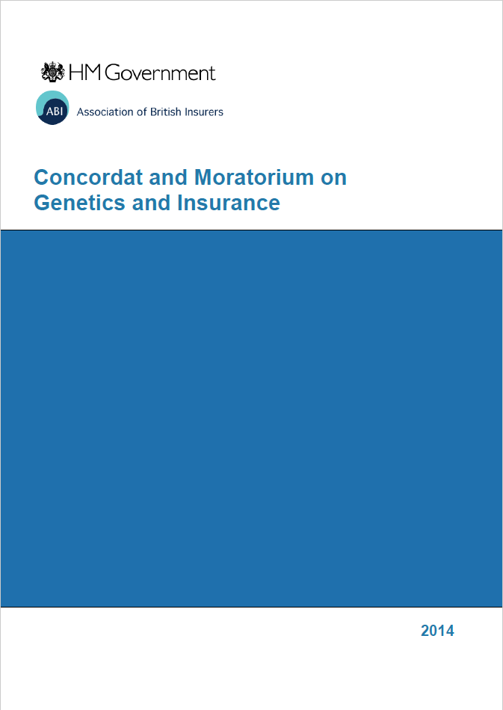
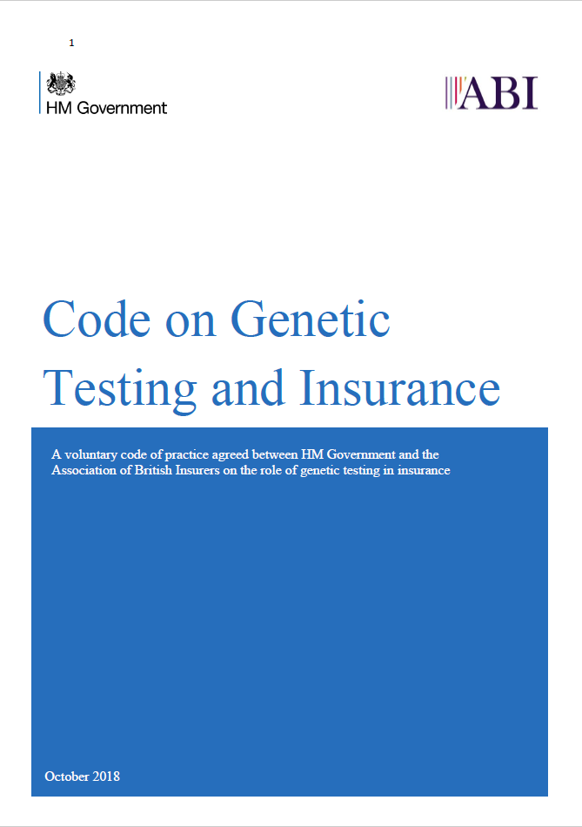
The Concordat is dead! Long live the code.
Notes:
Concordat first introduced in 2001. Agreement between government and ABI on how insurers can use genetic information.
First thing to say…
What’s changed (apart from the name)
Removal of cliff edge (Brexit gag?) – why? Confidence that code will not just fall away.
Simplified language (comment that it is an clear and easy read)

Slide 3
Core principles
An insurer will not require or pressure an applicant to undertake a predictive or diagnostic genetic test in order to obtain insurance.
The results of a predictive genetic test may be considered in an application for insurance only when both of the following conditions are met:
This Code states that the specific predictive genetic test may be considered and;
The sum assured exceeds the financial limits set out in this Code.
Notes:
Read out and elucidate with an example.
Clarify predictive / diagnostic?
Mention that insurers are allowed to take predictive tests into account if it is to the applicant’s benefit. Give example – e.g. family history, but negative test? What are the implications of this if testing becomes more mainstream? (Genetic testing by absence of negative test result?)

Slide 4
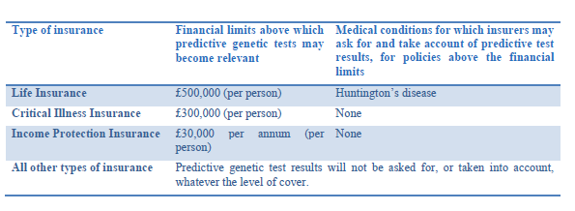
Current predictive tests that may be considered
Notes:
Currently only one “carve out” – and currently no clear candidates for inclusion
One key question is whether this list will expand over time.

Slide 5
What does the future hold?

Slide 6
Where are we at the moment?
Penetration
Danger Zone
Current settlement
Where we are now
Predictiveness
Notes:
The current settlement is predicated on insurers being comfortable that the level of information asymmetry between consumers and insurers is at an acceptable level to enable insurance markets to operate efficiently
However as time goes by, we are likely to see progress in two areas
Penetration will increase, and more and more consumers will have access to genetic test results, whether via the direct to consumer market or public health initiatives
The usefulness of the results to consumers in their decision making may also increase over time
There is also likely to be an interaction between these two areas – more testing makes new insights more likely, and more predictive tests become a more attractive proposition
The risk to society here is not to be understated – the implications of too high a level of informational asymmetry between consumers and insurers would be a collapse in the market. This would be a particular issue for critical illness cover, where those with low risk might choose to self-insure removing the benefits of pooling.
We’re going to look at the current position, and what the future might hold in each of these two areas. Firstly Richard will look at market penetration, and then Aisling will look at the predictiveness of genetic testing.

Slide 7
Genetic Testing – the landscape

Slide 8
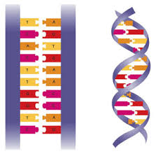
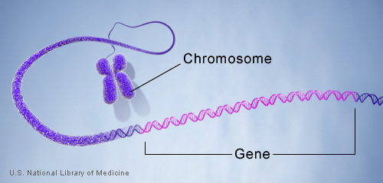
Genes and Mutations
A gene is a collection of bases (or letters) which can either act as instructions to make proteins or influence the production of other proteins (by forcing genes that make proteins to be repressed or activated).
A ‘spelling mistake’ in the code of a gene (known as a mutation) mean that the gene may perform at a sub-optimal level, potentially not performing at all.
Notes:
All non reproductive and healthy cells contain 23 pairs of chromosomes which are inherited equally from both parents passing down information from one generation to another.
A chromosome is a package of DNA molecules storing information as a code made up of four bases: adenine (A), guanine (G), cytosine (C), and thymine (T).
Human DNA consists of about 3 billion bases, and more than 99 percent of those bases are the same in all people. The bases form defined pairs which create the familiar double helix structure.
In humans, genes vary in size from a few hundred DNA bases to more than 2 million bases.
The Human Genome Project estimated that humans have between 20,000 and 25,000 genes.
The order, or sequence, of these bases determines the information available for building and maintaining an organism, similar to the way in which letters of the alphabet appear in a certain order to form words and sentences.
Mutations generally occur when DNA is replicating itself or splitting to form Egg or Sperm cells. They can also be induced extrinsically by external factors, such as UV radiation and free radicals.
Mutations can be accumulated naturally in two ways. It can either be passed down from parent to offspring, which is called hereditary mutation, or acquired throughout an organism’s lifetime. The latter, Acquired mutations, occur intrinsically from errors during DNA replication in actively dividing cells.
By performing large scale (either across the whole genome or at specific predetermined locations) ‘proofreading’ studies, Geneticists are able to identify association of specific spelling mistakes with a disease, thereby identifying a gene, and potentially a specific mutation within that gene as a potential cause leading to a higher probability of developing a particular disease.
https://www.singerinstruments.com/resource/what-are-genetic-mutation/
Images:
Credit: U.S. National Library of Medicine
https://ghr.nlm.nih.gov/primer/basics/chromosome
https://ghr.nlm.nih.gov/primer/basics/gene
http://nitro.biosci.arizona.edu/courses/EEB195/Lecture04/Lecture04.html

Slide 9
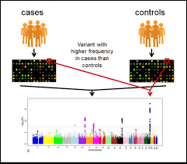
Identifying and testing for mutations
Specific mutations are linked with a disease by using either genome wide association studies (GWAS) or gene-specific candidate-driven studies
Identifying a definitive causative relationship between a gene and a disease can be difficult
Polygenetic expression – more than one gene involved (polygenic risk score – regression analysis)
Genotype vs Phenotype
Epigenetics - Non-sequence alterations to DNA
Environmental factors influencing disease expression
Notes:
A GWAS compares the entire genome of control and non-control individuals to ascertain which genes and mutations might be associated with a specific disease – this normally identifies a single base mutation that is associated and hence likely causative of a disease.
Single nucleotide polymorphisms (SNPs) are the most common type of genetic variation among people. Each SNP represents a difference in a single DNA building block, called a nucleotide.
D2C testing usually involves testing for Single Nucleotide Polymophorisms (SNPs) identified by Genome Wide Association Studies (GWAS).

Slide 10
Uses of Genetic tests
Purpose | Description | Relevant Insurance/Actuarial and why
Predictive Medicine | Predictive genetic testing determines the chances that a healthy individual with or without a family history of a certain disease might develop that disease. | Life/CI: Probability to present with a specific disease is determined by the genetic make-up of an individual – this could lead to an invalidation of actuarial models via anti-selection.
Diagnosis (and prognosis) | Diagnostic testing is used to identify or confirm the diagnosis of a disease or condition in a person or a family. Diagnostic testing gives a "yes" or "no" answer in most cases. It is sometimes helpful in determining the prognosis in addition to any treatment. | CI: Diagnosis of specific conditions leading to a pay-out.
Pharmacogenetics | The ability of an Individual to metabolise specific drugs might impact dosage or side effects. Targeted treatments that are specific to the DNA of a Cancer might improve treatment outcomes. | Health/PMI: payment for ineffective drugs; New targeted therapies costing much more money
Lifestyle/Traits | Testing of non-clinical genes that might impact lifestyle, including nutrition and exercise. | All – indirectly. Improvements in lifestyle leading to lower incidence of disease and lower severity/quicker recovery if occurs.
Ancestry | Ancestry/Genealogy testing lets you know where your family came from and which genetic markers you have. | Not currently applicable – although certain diseases are more or less prevalent in certain Ancestral profiles.
Notes:
Including Prognosis

Slide 11
Factors influencing Penetration

Slide 12
Take-up rates of testing and how this has ramped over time
Source: MIT Technology Review
https://www.technologyreview.com/s/610233/2017-was-the-year-consumer-dna-testing-blew-up/

Slide 13
Pharmacogenetics
Diagnosis
Predictive medicine
Lifestyle/Traits
Ancestry
D2C
B2B
Notes:
According to the latest report published by Credence Research, Inc. “Direct-to-Consumer (DTC) Genetic Testing Market - Growth, Future Prospects and Competitive Analysis, 2018-2026,” the global direct-to-consumer genetic testing market was valued at US$ 117.1 Mn in 2017 and expected to reach US$ 611.2 Mn by 2026, expanding at a CAGR of 19.4% from 2018 to 2026.
Grand View Research, Inc - The global genomics market is expected to reach USD 27.6 billion by 2025

Slide 14
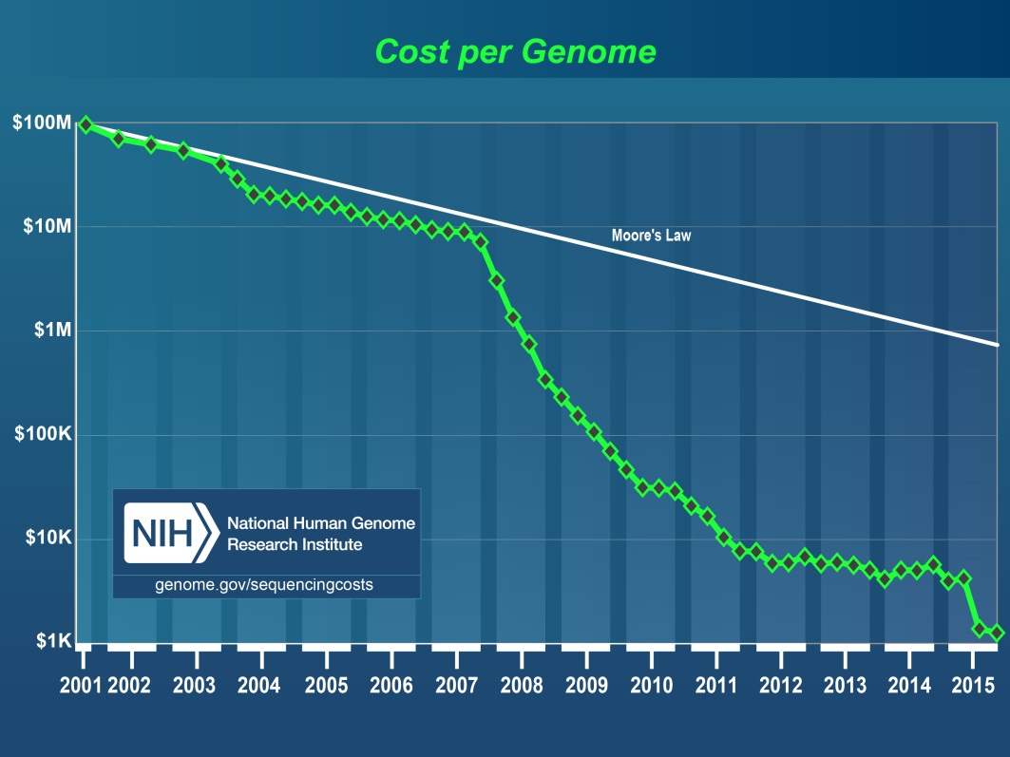
Cost of Genetic Testing
The National Human Genome Research Institute (NHRI) estimates that it cost between c.$500m-$1bn to complete the first whole genome sequence in 2003 as part of The Human Genome Project. This process took more about 13 years in total.
In 2006 the average cost had reduced to c.$20-25m.
In 2016 this would have cost below $1,000.
Introduction of Second generation techniques
Notes:
https://www.wired.co.uk/article/precision-medicine
https://www.genome.gov/27565109/the-cost-of-sequencing-a-human-genome/
The above estimated cost for generating the first human genome sequence by the HGP should not be confused with the total cost of the HGP. The originally projected cost for the U.S.'s contribution to the HGP was $3 billion; in actuality, the Project ended up taking less time (~13 years rather than ~15 years) and requiring less funding - ~$2.7 billion. But the latter number represents the total U.S. funding for a wide range of scientific activities under the HGP's umbrella beyond human genome sequencing, including technology development, physical and genetic mapping, model organism genome mapping and sequencing, bioethics research, and program management. Further, this amount does not reflect the additional funds for an overlapping set of activities pursued by other countries that participated in the HGP.
Latest companies are talking about $100 genome in 1hour. Not realistic yet but they are doing <$500 apparently.

Slide 15
How useful are genetic tests in predicting future illness?
Notes:
For me this question can be broken down into two parts:
How predictive are the tests?
and
How useful is the prediction?
First we’ll look at some specific examples, and then consider these questions more broadly.

Slide 16
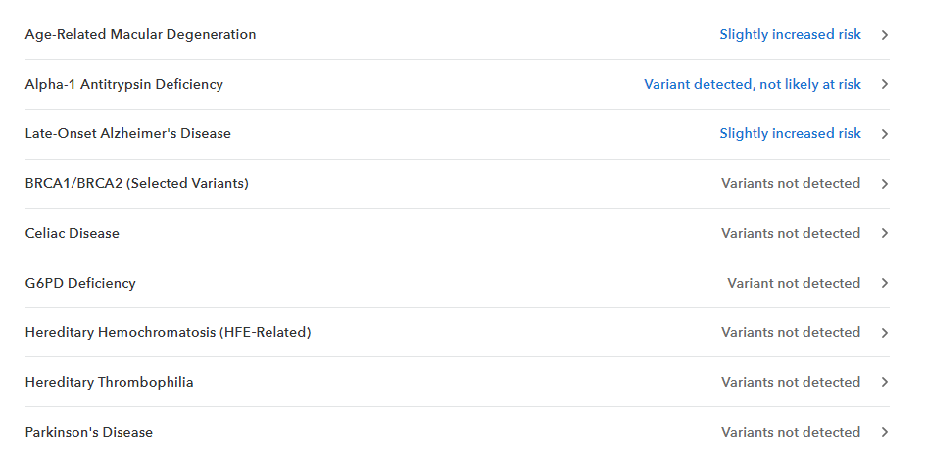
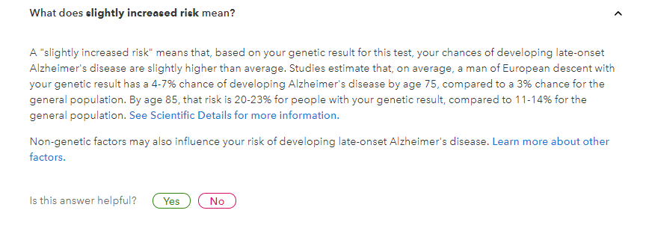
Case study – 23andme
Notes:
As has been previously mentioned, We have entered an age where genetic information is readily available at low cost, which has driven the availability of direct to consumer genetic testing. And there are now dozens of companies offering DTC genetic tests. The largest and best-known is 23andMe.
They offer saliva-based personalised genetic health risk reports, among other types of reports (such as ancestry).
They state that their mission is: “To help people access, understand and benefit from the human genome.”
This is a list of some of the conditions 23andMe test for, and what a genetic health risk report looks like.

Slide 17
How Predictive are Current Genetic Tests?
23andMe’s DTC tests include:
Parkinson’s Disease
Variants in just two of the genes known to be associated with PD are included; LRRK2 and GBA
Late-onset Alzheimer’s Disease
The test focuses on APOE, a gene involved in cholesterol metabolism
Carrying two APOE4 variants is thought to increase risk 11-fold but many individuals with one of two copies of APOE4 never develop the disease, and many with no copies get AD
Celiac disease
23andMe test for 2 variants
15-30% of the population have one of these, however only 3% of these will develop the disease
But not:
Coronary Artery Disease
A heritable component accounts for approximately 40-50% of risk, with over 60 known genetic variants accounting for only half of this
These genetic tests can tell an individual they have an increased risk of developing a disease, but not whether the individual will or will not get the disorder. In fact, most individuals with one of these risk variants will in fact never develop the
disease.
Notes:
Here we take a closer look at the most well known of the disorders for which genetic testing is commercially available and dive deeper into how useful these genetic predictive tests actually are using these specific examples.
Parkinson’s Disease
A genetic test can tell an individual they have an increased risk of developing PD, but not whether the individual will or will not get the disorder.
23andMe’s test screens for a few specific variants in just two genes; LRRK2 and GBA. However, there are many other genes, and many other variants in the two named genes, which are also known to increase risk, and are not tested for.
Most individuals with an identified genetic risk variant will in fact never develop the disease as the variants tested for require the co-expression of other genes to be harmful.
Late-onset Alzheimer’s Disease (this is most common type of AD, defined by an onset over the age of 65)
23andMe’s test focuses on APOE, a gene involved in cholesterol metabolism.
There are four types of APOE (APOE1,2,3 and 4), and each individual can carry two variants, one on each chromosome.
The variant associated with AD is APOE4. If both of an individuals APOE are of type APOE4, it is thought to increase risk of developing AD 11-fold compared with the population average.
However, many individuals with one of two copies of APOE4 never develop the disease, and many with no copies get AD.
There are many variants in many other genes which are known to contribute to disease risk, but each variant alone is associated with just a small increase.
Celiac disease
23andMe’s test for 2 variants. A positive result indicates the presence of a group of genes associated with Celiac disease, but again having one of these does not mean an individual will develop celiac disease.
15-30% of the population have one of these variants, however only 3% of these will develop the disease.
Coronary Artery Disease - an example of what DTC tests like 23andMe can’t test for
A leading global cause of mortality with a long recognised heritable component of approximately 40-50%.
There are over 60 genetic variants implicated, from mutations in genes involved in cholesterol transport to inflammation, and remodelling and maintenance of the tone of vasculature. Known genetic variants account for only half of the known heritability.
It is possible to divide a population into high and low risk where the top 20% of individuals are twice as likely to develop the disease, but testing of many different genes is required.
So you can see that the common message is that these genetic tests can tell an individual they have an increased risk of developing a disease, but not whether the individual will or will not get the disorder. In fact, most individuals with one of these risk variants will in fact never develop the disease. At the same time many people who are told that no variants have been detected will get the disease.

Slide 18
How Predictive are Current Genetic Tests? - Cancer
Cancer is caused by uncontrolled cell division. Mutations in genes associated with increased cell division are linked with an elevated risk for cancer.
Breast Cancer
Most incidences of breast cancer are not hereditary.
For those with a genetic component, mutations in BRCA1 or 2 (the “Angelina Jolie gene”) account for 20% of the increased risk.
23andMe only test for 3 out of thousands of possible mutations in the BRCA genes and these 3 are only present in individuals of Ashkenazi Jewish ancestry.
Prostate Cancer
The primary risk factor (apart from sex!) is age, but those with a family history are twice as likely to develop the disease.
BRCA genes are implicated.
It is only possible to identify high risk individuals by combining tests for many variants of a large number of genes. Alone, each of these would confer only a slightly greater risk.
Notes:
So let’s look at some more examples.
Cancer is caused by uncontrolled cell division, as we all know it is very common – 1 in 3 affected. It would be great if we could take a genetic test to tell us if we’re going to get it or not.
There are generally two types of genes/pathways where mutations can cause cancer – we can think of one set of genes as the driver, this pushes on cell division, and the other as the break, these stop cell division. So if the driver is upregulated, it acts like an accelerator and cell division is increased. Another way uncontrolled cell division can happen is where the break fails – so cell division proceeds unchecked and unstopped.
Breast Cancer
Most cases of breast cancer are not hereditary, but for those that are, that have a genetic component, BRCA is often responsible.
BRCA genes are tumour suppressor genes – the breaks. . If they are mutated they can’t function properly, can’t stop cell division.
These genes were made famous by Angelina Jolie. She was tested for mutations because of a high incidence of breast/ovarian cancer in her family, decided that because the test was positive, she would have a double mastectomy to reduce her chances of being affected.
So let’s look at some more examples.
Cancer – common – 1 in 3 affected. It would be great if we could take a genetic test to tell us if we’re going to get it or not.
Cancer is caused by uncontrolled cell division.
There are generally two types of genes/pathways where mutations can cause cancer – we can think of one set of genes as the driver, this pushes on cell division, and the other as the break, these stop cell division. So if the driver which pushes on cell division is upregulated, it acts like an accelerator and cell division is increased. Another way uncontrolled cell division can happen is where the break fails – so cell division proceeds unchecked and unstopped.
Breast Cancer
Most cases of breast cancer are not hereditary, but for those that are, that have a genetic component, BRCA is often responsible.
BRCA genes are tumour suppressor genes – the breaks. . If they are mutated they can’t function properly, can’t stop cell division.
These genes were made famous by Angelina Jolie. She was tested for mutations because of a high indicence of breast/ovarian cancer in her family, decided that because the test was positive, she would have a double mastectomy to reduce her chances of being affected.
23andMe only test for a small number out of a huge pool of potential mutations in these genes. Furthermore, these are only present in individuals of a particular genetic ancestry.
Even a clinical test for BRCA mutations will only test for the mutations present in an individuals family, so other potential mutations will be missed.
Prostate Cancer
There are a few risk factors for prostate cancer, the primary one being that males are more affected!! We do know there is a genetic component as those with a family history are twice as likely as the general population to develop the disease.
We also know that BRCA is also implicated in prostate cancer.
Overall, there are many variants of a large number of genes that each confer a slightly greater risk. By combining many variants it is possible to identify high risk individuals (four times more likely than the average individual to develop the disease). This is not available DTC.

Slide 19
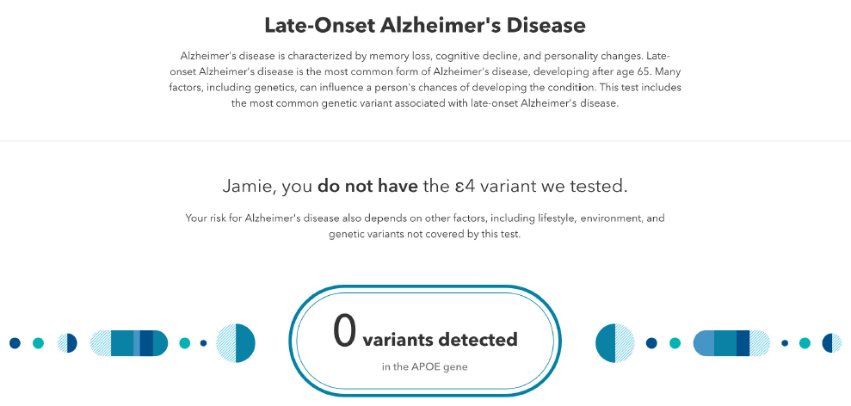
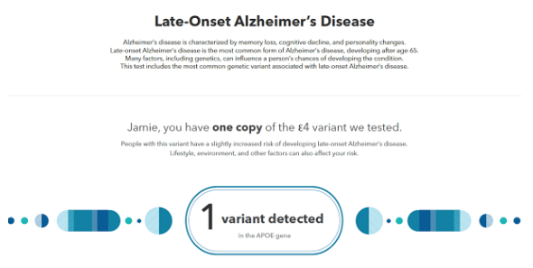
How Predictive are Current Genetic Tests?
Genetic risk factors depend on ancestry.
Some genetic variants may correlate with the disease rather than being a causal factor.
For most disorders, only a certain variant is tested for while there may be many more risk factors.
Most genetic variants confer only a small increase in risk, and the best predictive power for a meaningful result comes from combining many variants.
Or
Source: Example Reports from 23andMe
Notes:
Here we revisit the two parts of the question of how useful these tests are in predicting disease – how predictive is the test? How useful is the result? – how much more information will it give insurers/individuals than a family history?
How predictive are these tests?
Genetic risk factors depend on descent. This is because certain mutations are inherited through generations, so they have historically become most common in certain ancestries. Need a wider basis for more predictive power in different ancestries.
Some genetic variants that are more common in those with a disease simply correlate with the disease, but are not causal. They appear with the disorder, are also inherited but they do not actually cause the disease. They could simply correlate or they could be disease modifiers, eg. act by altering the expression of the disease causing gene. They can reduce the accuracy of predictions.
For most disorders, only a certain variant is tested for while many contribute to the disorder. For example, for Alzheimer's disease an individual may get the report below stating they do not have the APOE4 risk variant. This is misleading as it does not mean the individual has a lower risk of getting AD than the general population, rather it means that the individual actually has the same risk as the general population. It just means they don’t have this one genetic variant which would increase their risk. They could of course have any number of other genetic variants which might increase their risk, but these are not tested for.
Most genetic variants (with the exception of BRCA and APOE) are associated with just a small increase in risk of disease development, and the best predictive power for a meaningful result comes from combining many of these in a regression equation to give a polygenic risk score. The more genes/mutations tested for the better because each variant by itself has only a small increase.

Slide 20
How Useful is the Prediction?
Most disorders are multi-causal in nature, either multi-genic or caused by the interaction between genes and the environment/lifestyle.
E.g. Parkinson’s, Alzheimer’s, cancers and cardiovascular disease.
Often lifestyle risk or protection factors play as much – or more – of a role in disease prediction than genetics, e.g. stroke.
The risk result for an individual can change over the course of their lifetime and lifestyle can often counteract genetic risk.
One individual may get contrasting risk reports from different companies through their alternate selection of genetic variants and assumptions in their risk models.
Risk reports by companies such as 23andMe can be updated with new knowledge, but new tests will not be run. One might question the validity of a risk report that is subject to change.
Notes:
Now we come to the second part of the question – How useful is the prediction?
Most disorders are complex and multicausal. This means a positive genetic risk factor may not tell the whole story. This can be because the disorder is multigenic (caused by the interaction between many genes) or multifactorial – they come about due to the interaction between genes and the environment. We know this partly thanks to twin studies, where 2 individuals with exactly the same genetic code are susceptible to different diseases.
Some well documented examples where there is an interaction between genes and the environment are:
Parkinson’s Disease – where head trauma and exposure to pesticides can increase risk.
Alzhiemer’s Disease – High blood pressure and cholesterol are known risk factors.
Cancers – smoking, alcohol consumption, obesity.
Cardiovascular disease – Diet, obesity.
Often lifestyle risk factors play as much – or more – of a role in disease prediction than genetics, eg. lifestyle for stroke, smoking for cancer. But there are also lifestyle protective factors like caffeine for Parkinson’s, increasing exercise, changing diet for CVD. We need to know how the genetic variants interact - not only with each other, but also the environment - to bring about the trait to increase the usefulness of these tests.
Predictions for one individual can change over time. Lifestyle is also important here.
There is still the issue of incorrect predictions/interpretation. An individual may be told they are at low risk of developing a disease because they have no common mutation but they might still get it from another cause – this could be another mutation in the same gene, or other gene, or because of a lifestyle factor.
Different companies even report different risks for the same individual. This can happen if they use different sets of genetic variants and assumptions in their risk models. This obviously reduces the predictiveness/usefulness of these tests. The regression analysis actually works best when combined with environment/lifestyle variables. So again, we need to know how the genetic variants interact with each other and the environment to bring about the trait.
Risk reports can be updated with new knowledge, even though a new test isn’t run. This inherenty undermines the validity of the risk reports, as they are subject to change with advancements in technology.
Another aspect to the usefulness of a prediction is the effect it might have on an individual’s behaviour.

Slide 21
Impact on Insurance
Notes:
Interestingly, in spite of the believe of genetic test takers that the results will motivate them to alter their lifestyle/behaviours, if an individual receives a genetic risk score indicating a susceptibility/predisposition for a certain disease they do not actually alter the behaviours which could alter the likelihood of disease development!!!...
However… they sometimes take out/increase insurance.

Slide 22
Impact of Genetic testing on Insurance
Various academic papers have reviewed the odds ratio change in likelihood to increase insurance coverage with a positive genetic test result.
A 2016 meta-analysis published in The BMJ suggests that communicating DNA based disease risk estimates has little or no effect on risk-reducing health behaviour.
A ‘Genetic lens’ paper analysed the impact of genetic testing on trauma cover if widely adopted for breast and prostate cancer and coronary heart disease.
There is little or no impact on lapse rates
A four fold increase in genetic test take-up rates could lead to a claim cost increase of 7%
Genetic disease (Gene) | Year study | Insurance product | Odds ratio of change behaviour after positive test
Breast cancer (BRCA1/2) | 2003 | Life insurance | 5.1x more likely to increase coverage
Huntington's disease (HD) | 2010 | Long-term care insurance | 5x more likely to buy insurance
Colorectal cancer (HNPCC) | 2001 | Life insurance | 1.3x more likely to buy insurance
Notes:
On screen, some particular example papers/studies which highlight what I’m saying.
People suggest that they would change behaviours to healthier options in the event of a higher risk prediction from a genetic test, however it has been seen that people don’t actually shift behaviours. There is however a bigger increase in these individuals insuring themselves.

Slide 23
Conclusion
Notes:
RC:
The key factors driving the penetration of genetic testing include:
Cost
Availability and ease of access
Predictiveness
Actionable outcomes
Costs and ease of access have significantly reduced over the last ten years (currently a few hundred dollars), but until predictiveness and actionable outcomes improve genetic testing will remain a nice to have and penetration will remain low (particularly for non-genealogy testing). This might be a longer term issue for the Insurance world, but in the short and mid term (next 5 years) we are probably OK. We should work with the new ‘Concordat’ as a professional body to provide insights into the effects in the longer term.
Predictiveness
Currently predictiveness is arguably no better than taking a family history or understanding an individual’s lifestyle, and certainly no better than combining this information. The tests are limited to a small number of diseases, at the intersection of the diseases for which some variants are associated with an increased risk, and the diseases we are most interested in (whether this is due to their common nature, or devastating effects).
Currently, results from DTC genetic testing services remain unreliable for risk assessment as the effects of most SNPs/mutations are difficult to interpret and are not necessarily clinically relevant. With the exception of a limited number of SNPs, most of the genetic variants used by DTC genetic testing companies offer modest predictive information and provide only small changes in a person’s risk profile.
Current tests are limited by sample groups (ancestry differences), the lack of understanding of disease pathways – how genes interact, modifiers Vs drivers, correlating Vs causal results, the vast numbers of SNPs and how they vary between groups and individuals, and also by the interaction between genes and the environment. This last point means that even when we fully understand the genetic code and how genes interact to bring about a disease, predictiveness will still not be fully accurate.
Although much progress has been made we are far from unravelling the complexity of, and level of interplay involved in, human genetics.
This will change.
BUT it can’t be denied that the growing availability of relevant,
reliable and predictive health information from genetic testing will increase the
threats of anti-selection to insurers.

Slide 24
Conclusion
Penetration
Danger Zone
Current settlement
Where we are now
Predictiveness

Slide 25
Questions?

