Slide 1
Hormone Replacement Therapy and its long-term impact on the survival of women in the United Kingdom
Nurunnahar Akter
Ilyas Bakbergenuly, Nicholas Steel, Elena Kulinskaya
University of East Anglia
The ‘Use of Big Health and Actuarial Data for understanding Longevity and Morbidity Risks’ research programme is being funded by the Actuarial Research Centre.
www.actuaries.org.uk/arc

Slide 2
Outline
A Brief Description of Hormone Replacement Therapy
Study Design and Patient Selection Criteria
Survival Models of All-Cause Mortality
Results

Slide 3
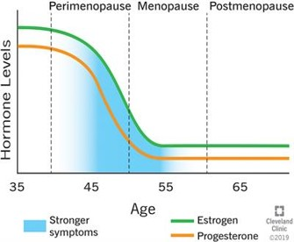
Hormone Replacement Therapy (HRT)
Around 80% women in the western countries suffer from menopausal symptoms
HRT is mainly used to ameliorate menopausal symptoms
First available in the United Kingdom in 1965
The routes of administration are oral tablets, transdermal patches, injections, topical gels and ointments.
(British Menopause Society, 2019)

Slide 4
Study design and model selection
Patients born between 1921 to 1960 and prescribed any kind of oral and/or transdermal HRT at age between 46 and 65 in 1984-2017 are the cases
Controls are non-users of HRT and matched with cases up to one-to-three ratio by year of birth and general practice
Outcome is death from any cause
Any kind of cancer, acute myocardial infraction (AMI), serious heart failure, stroke (except TIA), chronic kidney disease (CKD) stage 3-5, dementia, oophorectomy before 45 years, premature ovarian insufficiency, premature menopause, and surgically induced menopause are excluded
Analysis included 105,199 cases and 224,643 matched controls.
Covariates included in the final model are type of HRT, birth cohort, age at HRT, deprivation status, hypertension and its treatments, coronary heart disease, oophorectomy/hysterectomy status, interaction of smoking with body mass index (BMI), and smoking with type II diabetes
Incomplete records in BMI, smoking, and deprivation status were dealt with by multilevel multiple imputation using the ‘jomo’ package in R programming software.

Slide 5
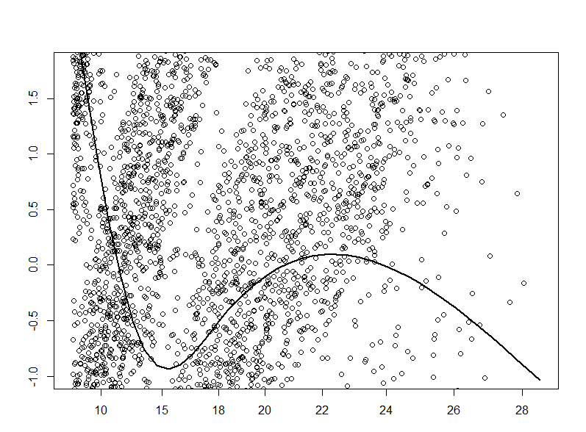
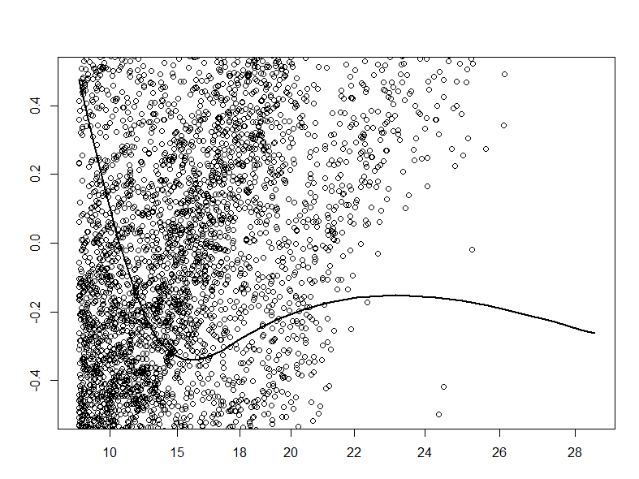
Proportional Hazard (PH) Assumption in the Cox Regression Model
Birth Cohort 1941-1950
Birth Cohort 1951-1960
β(t)
Time
Time
Proportional hazards (PH) assumptions were checked by Grambsch and Therneau test and also by plotting the scaled Schoenfeld residuals against time
Birth cohorts and age category at HRT violated the PH assumptions.

Slide 6
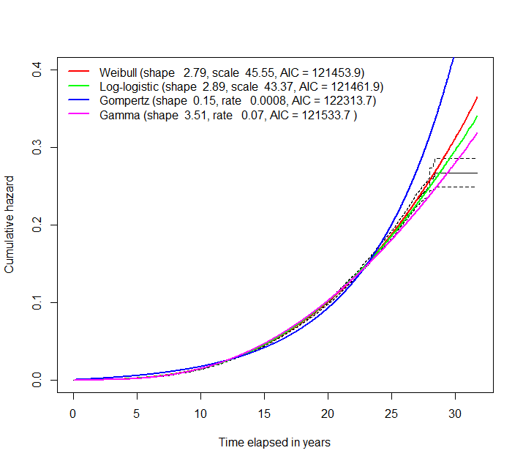
Techniques of Handling Non-proportionality
Conventional Methods
Split-time model: Follow-up time split into multiple intervals
Stratified model: Time varying covariates are not estimated
Double-Cox survival model
Underlying baseline hazards of the study population are fitted with different parametric distributions
Weibull distribution provided the best fit to the baseline hazards of this study population
Weibull-Double-Cox model was fitted to handle the non-proportional hazards.
This model incorporates the Weibull hazard function with Cox-regression model
The value of Akaike’s Information Criterion (AIC) is an indication of the goodness-of-fit. The lower the AIC the better the fit.

Slide 7
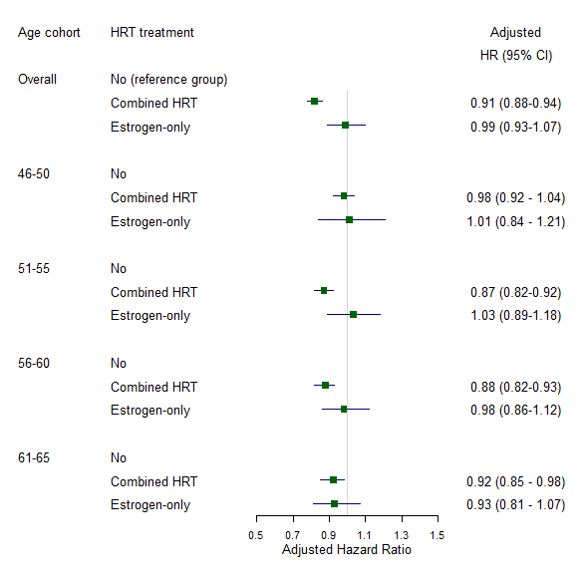
Age-specific HRT effects
Adjusted effects of HRT on all-cause mortality were estimated on full data and age subgroups at first treatment separately
No effect of estrogen-only HRT
Overall, combined HRT reduces mortality by
Highest reduction was in women who started treatment at age 51 to 55 years
No significant reduction in combined HRT users of age group 46 to 50 at first treatment.

Slide 8
Forest Plot of other Risk Factors

Slide 9
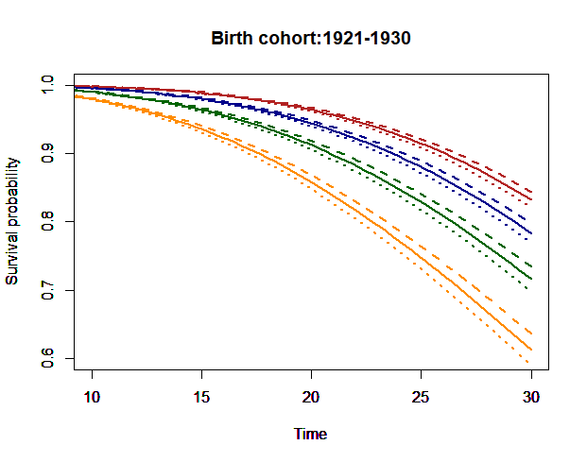
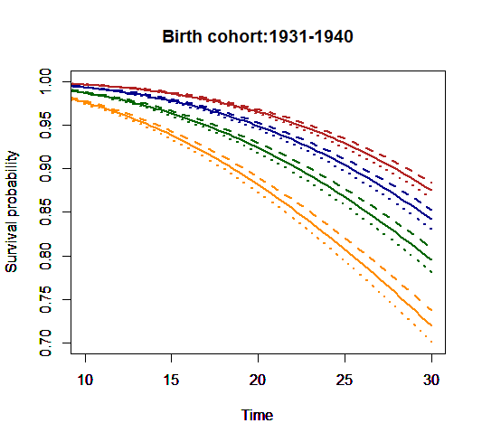
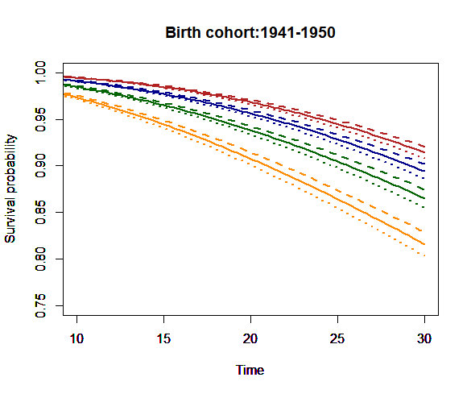
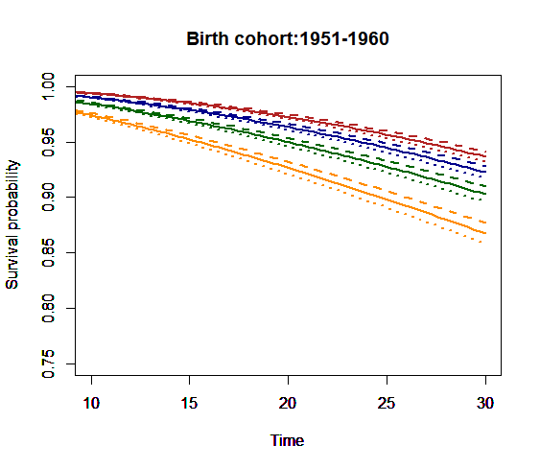
Survival from study entry by birth cohort
Red: Age 46-50
Blue: Age 51-55
Green: Age 56-60
Yellow: Age 61-65
Dashed lines: Combined HRT
Dotted lines: Oestrogen-only HRT
Solid lines: Non-users
Time: time from study entry
Age groups are based on age at first HRT treatment
Survival prospects improved in later birth cohorts

Slide 10
Ongoing work
Development of a survival model with age as a time-scale
Calculation of life expectancy using the age model.

Slide 11
The Actuarial Research Centre (ARC)
A gateway to global actuarial research
The Actuarial Research Centre (ARC) is the Institute and Faculty of Actuaries’ (IFoA)
network of actuarial researchers around the world.
The ARC seeks to deliver cutting-edge research programmes that address some of the
significant, global challenges in actuarial science, through a partnership of the actuarial
profession, the academic community and practitioners.
www.actuaries.org.uk/arc

