Slide 1
Meeting the Challenge of Periodical Payment Orders
Anthony Wright, The MDU
Sarah MacDonnell, LCP
Scott Jamieson, Kames Capital

Slide 2
Agenda
The challenge posed by PPOs
Candidate investments
Discussion

Slide 3
What is a PPO?
A PPO is a contingent, deferred, whole-life, wage inflation linked, guaranteed, impaired annuity, where the identity of the annuitant and the size of the annual payments are unknown at inception.

Slide 4
GIRO PPO Working Party
Annual quantitative & qualitative survey
Impaired life mortality
Reinsurance
Market solutions
“How to” guide
Structured settlements in other jurisdictions
See IFoA website!

Slide 5
Agenda
The challenge posed by PPOs
Candidate investments
Discussion

Slide 6
PPOs – what do you need to know?
Fundamentally changing UK motor insurance as we know it
  implications for liability and medical malpractice too

Slide 7
PPOs – what do you need to know?
Periodical Payment Orders
(structured settlements)
Replace lump sum with annuity
From 6 year liability to future term of 40 years on average
Annuity element typically covers care costs
Lump sum still paid alongside
Annual payments are inflation protected – linked to earnings inflation
Only started appearing in 2008

Slide 8
PPOs – what do you need to know?
30%
25%
20%
15%
10%
5%
0%
2005
2010
2015
2020
2025
2030
2035
2040
2045
PPO reserves (settled PPOs only) as a proportion of UK motor market reserves

Slide 9
Greater risk than a life annuity
Mean term of 40 years
Earnings inflation link
Pension-like cashflows (Defined benefit)

Slide 10
New areas of risk for GI practitioners
Interest rate
Inflation
Mortality
Credit
Asset matching

Slide 11
Impacts on all areas of the business
Reserving
Capital
Pricing
Investment Strategy
Administration

Slide 12
How is the market adapting?
The Bereavement Curve
Acceptance
Denial
Understanding
Anger/fear
Depression

Slide 13
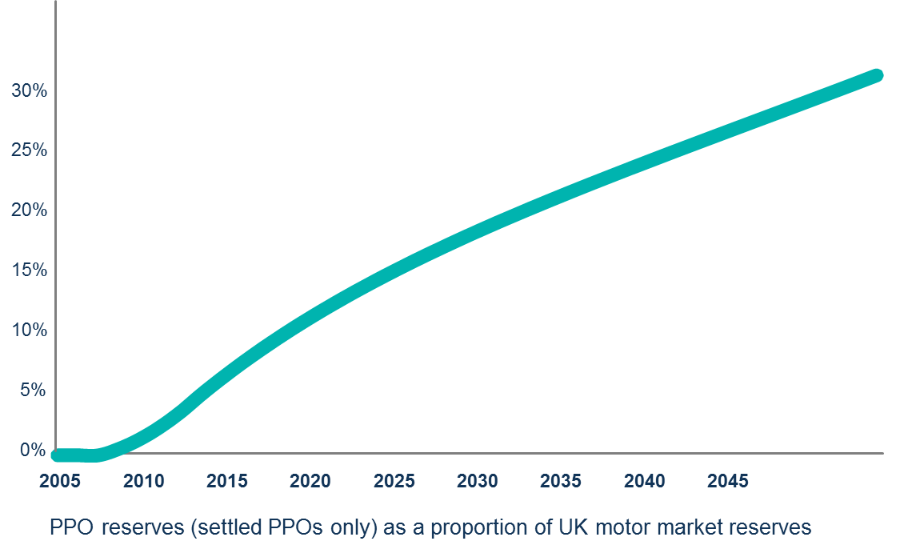
Investment
Our survey said:
  just 3 out of 14 insurers
  and one reinsurer
  had changed their investment strategy
Critical mass?
Call for Government to issue longer term gilts

Slide 14
How many?
 | Number of PPOs
Motor Insurance Industry: | ~500
MIB: | ~100
NHS: | Many More
Current value of motor industry PPO reserves: ~£2bn
  Based on mean:
    annual amount (£85k)
    life expectancy (44 years)
    0% net discount rate
Larger if take into account large claims known about but not yet settled as PPOs
Smaller for direct insurers if take reinsurance into account
Health warning: Figures subject to a large degree of uncertainty
Highly dependant upon assumptions selected

Slide 15
How many?
Only set to increase
Term of GI liabilities will continue to lengthen over decades
PPO reserves (settled PPOs only) as a proportion of UK motor market reserves

Slide 16
History
Number of PPOs by settlement year

Slide 17
History
Ogden discount rate
Ogden tables used to calculate lump sum awards
Real rate set at 2.5% in 2001 by Lord Chancellor
  Series of consultations between November 2010 and May 2013

Slide 18
History
Number of PPOs by settlement year
2008
Economic crisis
Link to ASHE established

Slide 19
ASHE
Year on year percentage change (April to April)

Slide 20
ASHE
Annual Survey of Hourly Earnings
Survey not an index
  Sample 1% of jobs drawn from HM Revenue and Customs PAYE records
  “SOC” Occupation codes
  Percentiles
Short history - started in 2004 replacing the National Earnings Survey NES
  Back history to 1998 also published at the time
Numerous “features”
  Occupation code allocations change every 10 years (2002 and 2012)
  Methodology changes 2007
  External impacts:
    2003 Implementation of Care Standards Act and changes to the Manual Handling Operations Act
    EU Working Time Directive
    1999 introduction of the minimum wage

Slide 21
Longevity
Impaired lives
  Brain injury 70%
  Spinal injury 20%
Small cohorts

Slide 22
One size does not fit all
Size/Business mix
Motor proportion
International Group
Composite
Demographics
Risk attitude/appetite
Outlook
Long/short term

Slide 23
PPOs – what do you need to know?
Fundamentally changing UK motor insurance as we know it
Better outcome for claimants

Slide 24
Agenda
The challenge posed by PPOs
Candidate investments
Discussion

Slide 25
Stochastic Liability Cashflows

Slide 26
The ideal PPO investment
Source: Clarke, Lee & Jamieson (2013) How to deal with PPOs in practice, (available online at www.actuaries.org.uk)

Slide 27
Option #1: UK Government IL bonds
Source: Clarke, Lee & Jamieson (2013) How to deal with PPOs in practice, (available online at www.actuaries.org.uk)

Slide 28
Option #2: UK Corporate IL bonds
Source: Clarke, Lee & Jamieson (2013) How to deal with PPOs in practice, (available online at www.actuaries.org.uk)

Slide 29
Option #3: Infrastructure
Source: Clarke, Lee & Jamieson (2013) How to deal with PPOs in practice, (available online at www.actuaries.org.uk)

Slide 30
Infrastructure market
Source: Clarke, Lee & Jamieson (2013) How to deal with PPOs in practice, (available online at www.actuaries.org.uk)

Slide 31
Opportunity set
Source: Clarke, Lee & Jamieson (2013) How to deal with PPOs in practice, (available online at www.actuaries.org.uk)

Slide 32
Accessing infrastructure
Source: Clarke, Lee & Jamieson (2013) How to deal with PPOs in practice, (available online at www.actuaries.org.uk)

Slide 33
Listed Infrastructure Performance
Source: Clarke, Lee & Jamieson (2013) How to deal with PPOs in practice, (available online at www.actuaries.org.uk)

Slide 34
UK listed investment companies
Source: Clarke, Lee & Jamieson (2013) How to deal with PPOs in practice, (available online at www.actuaries.org.uk)

Slide 35
Option #4: Unconstrained solution
Source: Clarke, Lee & Jamieson (2013) How to deal with PPOs in practice, (available online at www.actuaries.org.uk)

Slide 36
Capital treatment under Solvency II
Source: Clarke, Lee & Jamieson (2013) How to deal with PPOs in practice, (available online at www.actuaries.org.uk)

Slide 37
Capital treatment of investments under Solvency II
Source: Clarke, Lee & Jamieson (2013) How to deal with PPOs in practice, (available online at www.actuaries.org.uk)

Slide 38
Agenda
The challenge posed by PPOs
Candidate investments
Discussion

