Slide 1
Simulation based capital models – testing, justifying and communicating choices
Life Aggregation and Simulation Techniques Working Party
David Stevenson, Steven Oram

Slide 2
Agenda
Introduction
Copulas
  Selecting correlations
  Allowing for tail dependence
  Worked example
Proxy models

Slide 3
Introduction
Background
Increasing sophistication in modelling of effects of diversification in economic capital models
Move away from techniques based on correlation matrices to simulation based techniques using copulas and proxy models
Motivated in part by Internal Model requirements of Solvency II
  ‘probability distribution forecast’ means a mathematical function that assigns to an exhaustive set of mutually exclusive future events a probability of realisation - Article 13(38) of Solvency II Directive
Must be able to justify underlying assumptions on an empirical basis – Article 234 of Delegated Regs
Increased scrutiny of choices made by stakeholders (e.g. Boards, senior management, model validators, supervisory authorities)
Notes:
Solvency has brought increased emphasis on justifying choices and assumptions
Data Standards
Statistical Quality Standards
Expert Judgement
Independent Validation
Also requirement that Boards collectively have an adequate understanding of the main assumptions and limitations in the model
All this leads to increased scrutiny of whether model is fit for purpose
And increased demands on actuaries to be able to communicate their recommendations effectively so that senior management and Boards can make well-informed choices

Slide 4
Introduction
Objectives of Working Party
Look into the different techniques used
Investigate how actuaries can assess and choose between the approaches available
How choices made can be tested, justified and communicated to stakeholders
Technical details and merits of specific techniques not main focus
Report provides a survey of the approaches currently being used by UK life insurers
And examples of how choices can be tested and the outcomes communicated
Focus on copula + proxy model approach
The WP hopes the report will be a useful reference for actuaries working on economic capital models and applications for Internal Model approval
Not necessarily a complete toolkit – actuaries should choose approaches which are most suited to the specific circumstances
Notes:
nn

Slide 5
Introduction
Copula + proxy model approach to capital aggregation
Most common approach adopted by UK life insurers with approval to use an internal model to calculate their SCR
Notes:
In this presentation we’ll focus on the most common technique that has been adopted by insurers that intend to use an internal model
to calculate their SCR under Solvency II: the copula + proxy model approach
This has two main components
(i) a model for risk factor changes built up from models for individual risk factors + a copula that describes the dependency structure between the,
AND
(ii) a proxy model which estimates the effects of changes in risk factors on economic capital

Slide 6
Introduction
Justifying choices - different audiences, different needs
Boards/senior management
Responsible collectively for appropriateness of Internal Model
Need to understand
  Why specific model was chosen
  Conceptual basis and key features
  Significant assumptions and judgements
  Impact of reasonable alternatives
  Strengths and limitations
Do not need detailed mathematical theory
Model validators
Evidence model meets all relevant tests and standards – e.g. Statistical Quality and Calibration standards
Fit for purpose in managing risk
Want to make sure that technical basis is sound
Visualisation techniques can support effective communication

Slide 7
Copulas

Slide 8
Copulas
Setting the scene
  Reminder of what a copula is
  Gaussian and Student’s t copulas
Choosing correlation assumptions – bottom-up approach
Tail dependence - reminder
Gaussian copula - example of one approach using coefficient of finite tail dependence
Top-down validation

Slide 9
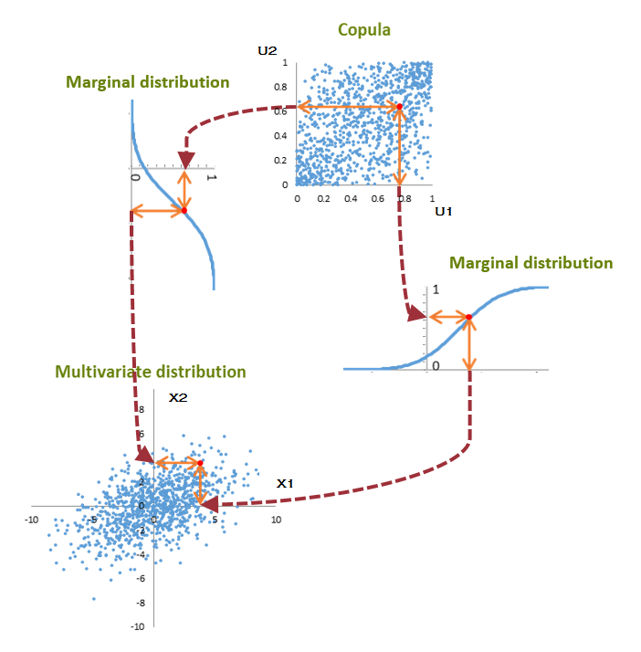
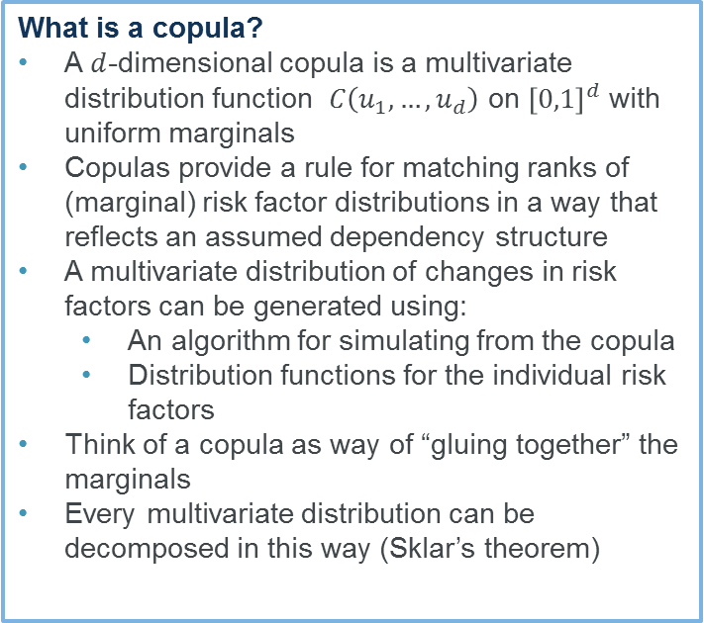
Copulas – reminder
What is a copula?
A $d$-dimensional copula is a multivariate distribution function $C\left(u_{1}, …,u_{d}\right)$ on ${\left[0,1\right]}^{d}$ with uniform marginals
Copulas provide a rule for matching ranks of (marginal) risk factor distributions in a way that reflects an assumed dependency structure
A multivariate distribution of changes in risk factors can be generated using:
  An algorithm for simulating from the copula
  Distribution functions for the individual risk factors
Think of a copula as way of “gluing together” the marginals
Every multivariate distribution can be decomposed in this way (Sklar’s theorem)
Notes:
Brief reminder of a copula
Essentially it’s an algorithm for matching up the ranks of changes in individual risk factors to form combinations of changes in risk factors in a way that respects an assumed dependency structure.
Most companies that have applied to use an internal model to calculate their S2 SCR from 2016 have opted for a parametric copula – the majority have gone for Gaussian but some have gone for a Student’s T.
Towers Watson 2015 Risk Calibration Survey – 7 companies using a Gaussian and 3 using a T for at least part of the aggregation.

Slide 10
Choice of copula
Most UK life companies with approved Solvency II Internal Model using Gaussian copula
Significant minority using Student’s t copula (at least for market risk as part of “grouped t copula”)
Choice influenced by various factors:
  Transparency/complexity
  Use test and continuity with correlation matrix approach
  Preference to approach for allowing for tail dependence
  Straightforward simulation algorithms
  Scarcity of data to support more complex models

Slide 11
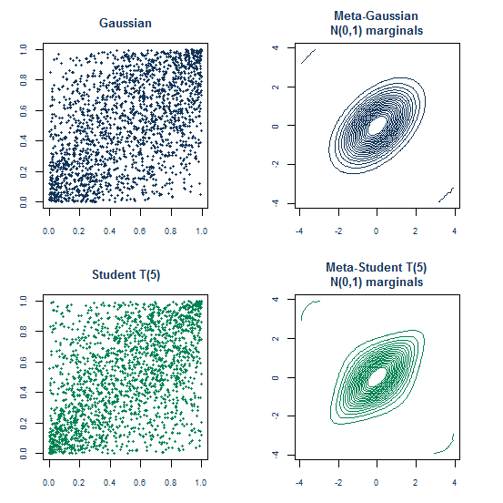
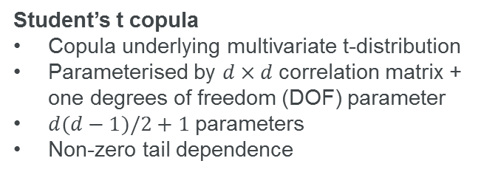
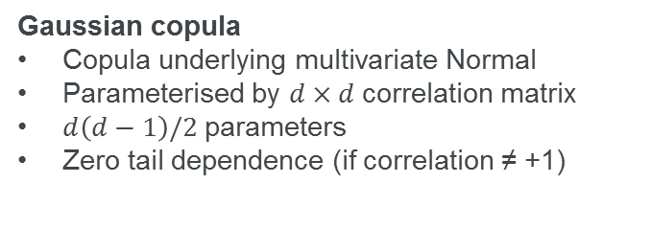
Choice of copula
Gaussian copula
Copula underlying multivariate Normal
Parameterised by $d×d$correlation matrix
$d\left(d−1\right)/2$parameters
Zero tail dependence (if correlation ≠ +1)
Student’s t copula
Copula underlying multivariate t-distribution
Parameterised by $d×d$correlation matrix + one degrees of freedom (DOF) parameter
$d(d−1)/2+1$parameters
Non-zero tail dependence
Notes:
Reminder
Gaussian copoula is the copula underlying a multivariate Normal and T copula is copula underlying a multivariate Student’s T distribution.
Both have a correlation matrix at their heart.
The T copula has one additional parameters called Degrees of Freedom which, together with the correlations, controls the coefficient of tail dependence between pairs of risks.
Pictures show scatter plots of copulas and contour plots of meta distribution with standard Normal marginal.
Can see tail dependence of T through clustering in corners and contours poking into corners.

Slide 12
Choosing correlation assumptions
Expert judgement
Causal effects – what happens to risk factor X if risk factor Y changes?
Common underlying risk drivers
Views on tail dependence
Risk profile
Sensitivities
Internal consistency of assumptions
Benchmarking
Validation
Expert judgement panels
  Experts from different business areas
  Review and challenge proposals and rationale
  Synthesise and document conclusions
Independent validation
External assurance
Data
Typically scarce or non-existent
May not contain sufficient information about extreme events
Different time periods can suggest different values
Where exists, not sufficiently reliable as sole basis for assumption
See also PRA executive updates dated 9 March 2015 and 15 January 2016

Slide 13
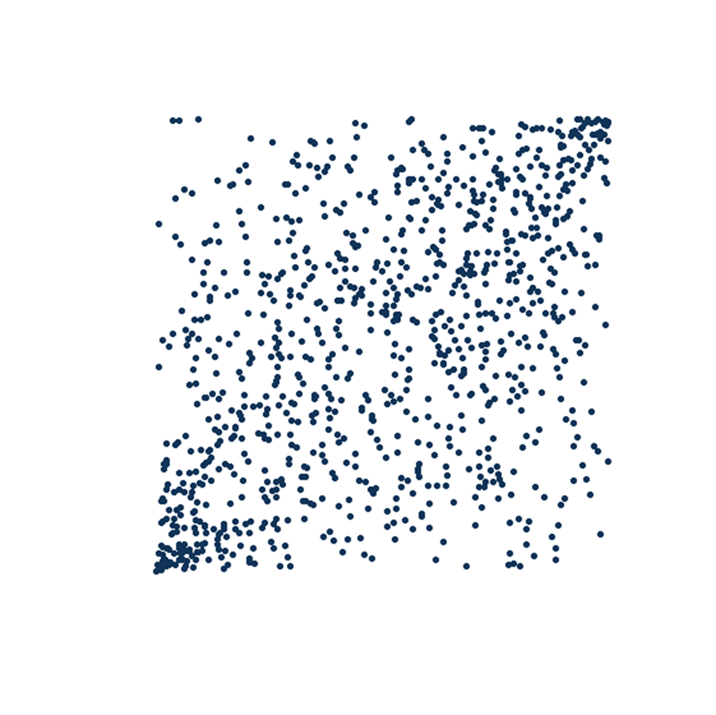
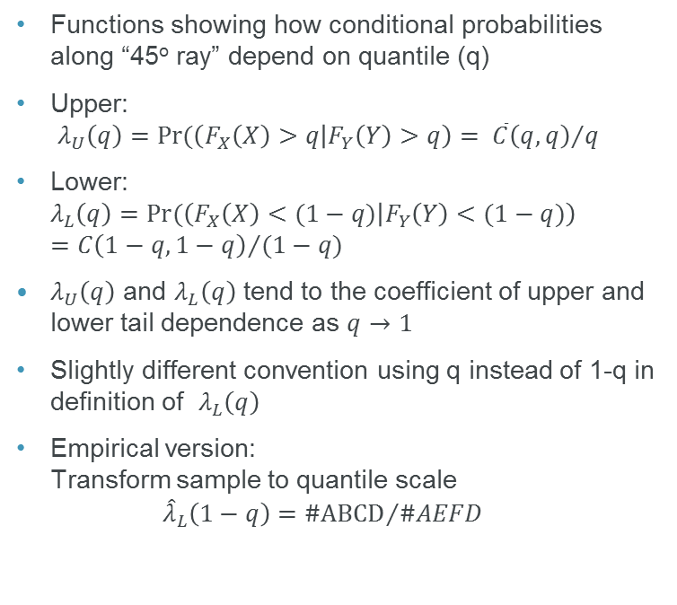
Tail dependence
Coefficients of finite tail dependence
Functions showing how conditional probabilities along “45º ray” depend on quantile (q)
Upper:
$λ_{U}\left(q\right)=Pr(\left(F_{X}\left(X\right)>q | F_{Y}\left(Y\right)>q\right){= {\overline{C}\left(q,q\right)}/q}$
Lower:
$λ_{L}\left(q\right)=Pr(\left(F_{X}\left(X\right)<(1−q) | F_{Y}\left(Y\right)<(1−q)\right){} ={C\left(1−q,1−q\right)}/{(1−q)}$
$λ_{U}\left(q\right)$ and $λ_{L}\left(q\right)$ tend to the coefficient of upper and lower tail dependence as $q→1$
Slightly different convention using q instead of 1-q in definition of $λ_{L}\left(q\right)$
Empirical version:
Transform sample to quantile scale
${\hat{λ}}_{L}\left(1−q\right)={\#ABCD}/{\#AEFD}$
D=(0,q)
C
F=(1,q)
A = (0,0)
B=(q,0)
E=(1,0)

Slide 14
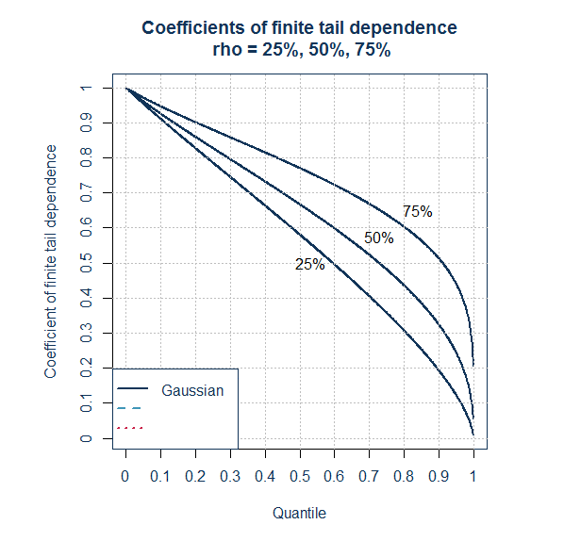
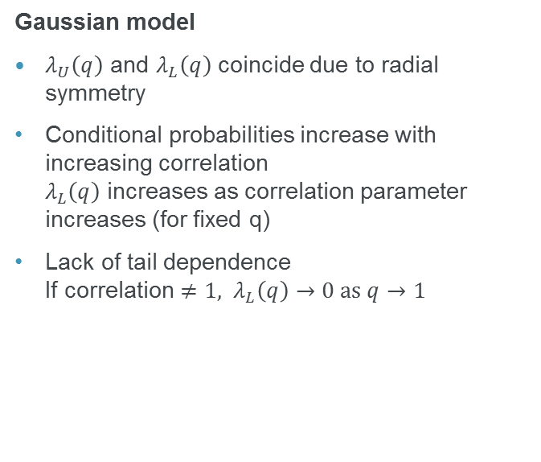

Coefficients of finite tail dependence
r increases (for fixed q)
Lack of tail dependence
If correlation $≠1, {\hat{λ}}_{L}\left(q\right)→0 \text{as} q→1$
Gaussian model
$λ_{U}\left(q\right)$ and $λ_{L}\left(q\right)$ coincide due to radial symmetry
Conditional probabilities increase with increasing correlation
$λ_{L}\left(q\right)$ increases as correlation parameter increases (for fixed q)
Lack of tail dependence
If correlation $≠1, λ_{L}\left(q\right)→0 \text{as} q→1$

Slide 15
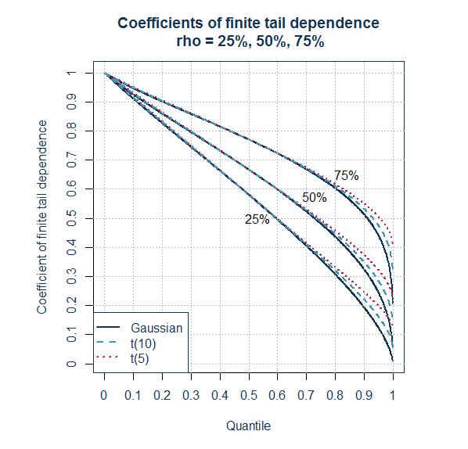
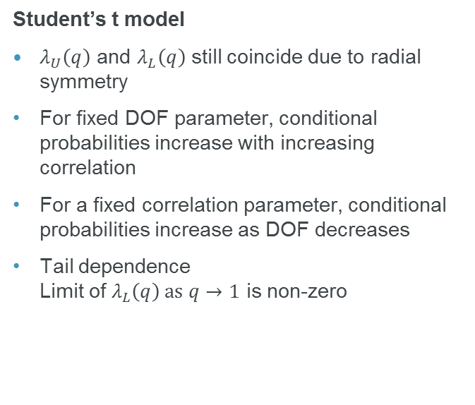
Coefficients of finite tail dependence
Student’s t model
$λ_{U}\left(q\right)$ and $λ_{L}\left(q\right)$ still coincide due to radial symmetry
For fixed DOF parameter, conditional probabilities increase with increasing correlation
For a fixed correlation parameter, conditional probabilities increase as DOF decreases
Tail dependence
Limit of $λ_{L}\left(q\right) \text{as} q→1$ is non-zero

Slide 16
Tail dependence – why take into account?
Ratio of joint exceedance probabilities of T-copula to Gaussian
(99th percentile)
joint exceedance probs (i.e. prob X and Y both exceed their 99th percentiles) for Gaussian
Scaling factor to obtain equivalent probability for a T-copula
With correlation parameter of 50%, a T-copula with 5 degrees of freedom has a joint exceedance probability twice that of a Gaussian
Moving from a Gaussian to a T-copula keeping the correlation parameter fixed turns a “1 in 770 year event” into a “1 in 385 year event”
If Gaussian copula is used, typical approach is to strengthen some correlations to allow for tail dep
Correlation/DOF | 2 | 5 | 10 | 30 | Gaussian
0% | 18.49 | 7.47 | 3.73 | 1.74 | 0.00010
25% | 6.31 | 3.34 | 2.13 | 1.35 | 0.00044
50% | 3.05 | 2.01 | 1.52 | 1.17 | 0.00129
75% | 1.78 | 1.41 | 1.22 | 1.08 | 0.00317
Based on example in “Quantitative Risk Management”, McNeil, Frey and Embrechts
Notes:
Assumptions about tail dependence are important because they define hpw likely extreme changes in risk factors will occur together in your model.
For example, a bivariate T copula with 5 degrees of freedom would be expected to produce twice as many events where changes in both risk factors exceed their 99th percentile values compared to a Gaussian copula.
Can see that, all other things equal, the ratio increases as the assumed correlation reduces or the degrees of freedom parameter reduces.

Slide 17
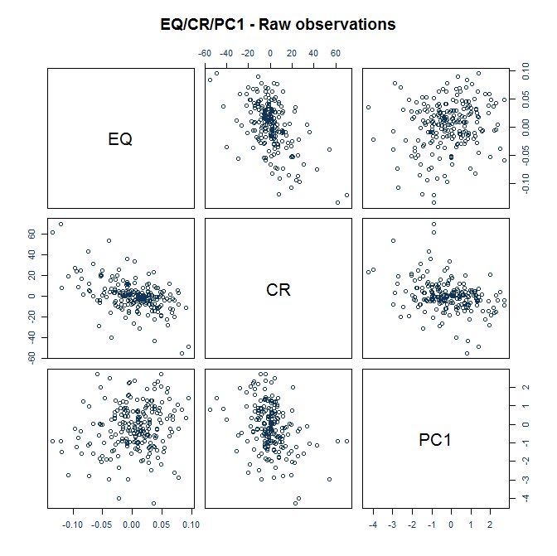
Using data to inform judgements
Example
Monthly increases in:
  FTSE-All Share index
  Corporate Bond Spreads (widely used index)
  PC1 (Bank of England gilts spot curve)
31.12.1996 to 31.12.2014
216 data points
Notes:
We’ll look at how some statistical techniques can help inform assumptions based on a concrete data set.
Important to note that assumptions are generally not based on data alone.
We’ve looked at Equity, Credit and Fixed Interest because these tend to be richest data series
Can see the strong negative correlation between increases in credit spreads and falls in equity values in chart.

Slide 18
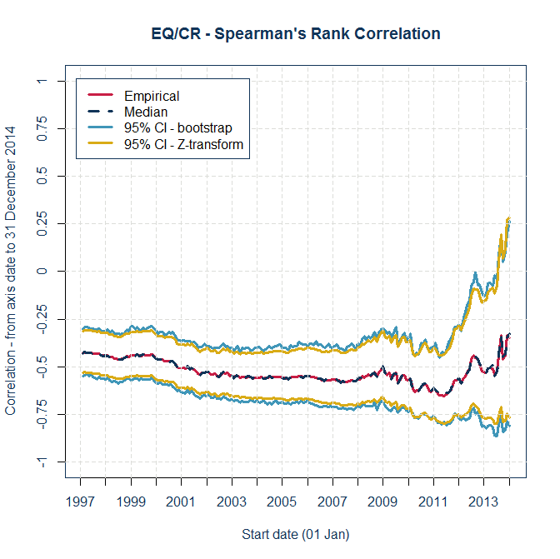
Different time periods
Observed values of correlation depend on time period
Shorter periods may not contain extreme events and be subject to sample error
Longer periods may be dominated by benign behaviour
Spearman’s rank correlation for periods starting 01 January YYYY to 31 December 2014
Confidence intervals generated using
  Fisher Z-transformation
  Bootstrapping with re-sampling
Values over longer periods more useful in informing “best estimate” view and related uncertainty rather than allowance for tail dependence
Notes:
The usual techniques for setting correlations can be applied – charting behaviour over different periods. Can also draw confidence intervals around correlations.
These can help inform the best estimate assumption, but are of less value in informing decisions about tail dependence.
Chart suggests that a value in the range -40% to -50% might be appropriate.

Slide 19
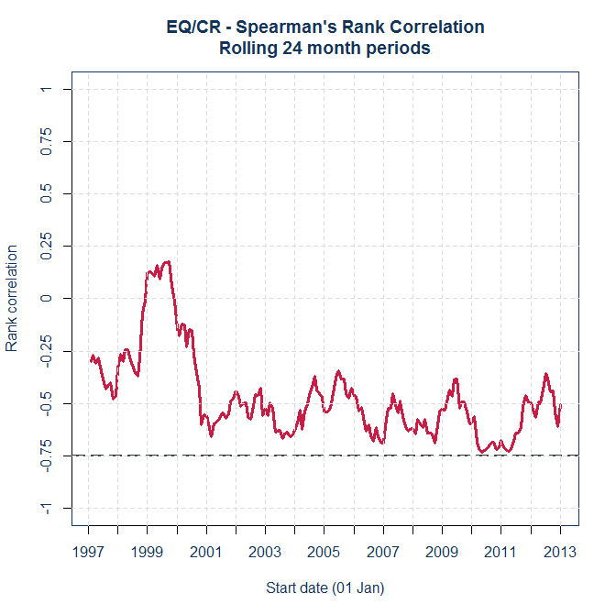
Different time periods
Looking at correlations over shorter periods may give more information about behaviour in adverse conditions and help inform any allowance for tail dependence
But less data means greater sampling error and greater uncertainty around conclusions
Chart shows 24 month rolling correlation for EQ/CR reached around -75% in financial crisis
Test conclusions by looking at different sampling windows
Notes:
Looking at shorter time periods illustrates how correlations have responded to extreme events and may help inform views of a “stressed correlation”.
In this case, correlation reached -75% after financial crisis.
But short data period increases uncertainty.

Slide 20
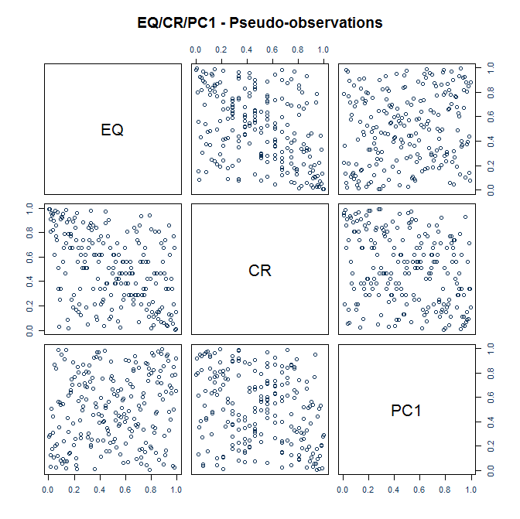
Statistical fitting techniques
Method of Moments
Formulae based on rank correlations
  Inverse Spearman
  Inverse Tau
Use to parameterise correlation matrix.
Need to use other techniques to estimate other parameters (e.g. MLE for DOF of a T-copula)
Maximum Pseudo-Likelihood (MPL)
Transform data to pseudo-observations in range (0,1) by converting to ranks and dividing by (N+1)
Form log likelihood by evaluating copula density function at pseudo-observations and maximise using optimisation routine (e.g. R package)
Require coincident data so less useful in practice – bivariate analysis can help inform judgements
Notes:
There are a number of statistical methods than can be used to fit copulas to data:
Analogues of Method of Moments for 1-dim distributions
Estimate the correlation matrix using sample rank correlations and formula involving the sine function
For a t-copula, the degrees of freedom parameter needs to be estimated by using MLE once the correlation matrix has been chosen.
Maximum Pseudo-Likelhood
Convert the observations onto the quantile scale by ranking and dividiing by N+1
Choose a parametric copula model and fit it using standard MLE technqiues

Slide 21
Bivariate fits
inverse Tau | EQ/CR |  | CR/PC1 |  | PC1/EQ
Copula | Rho | DOF | Rho | DOF | Rho | DOF
Gaussian | -46.6% |  | -29.6% |  | 16.0%
T | -46.6% | 2.60 | -29.6% | 11.30 | 16.0% | 4.43
MPL | EQ/CR |  | CR/PC1 |  | PC1/EQ
Copula | Rho | DOF1 | Rho | DOF1 | Rho | DOF1
Gaussian | -48.8% |  | -31.8% |  | 16.8%
T | -46.5% | 2.60 | -31.2% | 9.40 | 16.6% | 6.08
Relatively small differences in correlation assumptions between MPL fit for Gaussian and T
Note small DOF parameter for EQ/CR – indicator of tail dependence?
Notes:
We’ve done this for the three different possible pairs separately and for the whole data set.
For EQ/CR, the fitted T-copula shows a low degree of freedom parameter.
May indicate some allowance for tail dependence would be appropriate.

Slide 22
Allowing for tail dependence
If using a Gaussian copula to calculate SCR may want systematic process for selecting correlations which results in:
  Best estimate view
  Additional allowance to adjust for lack of tail dependence
Technique using charts of coefficient of finite tail dependence
Joint work with Stephen Makin based on ideas of Gary Venter (see e.g. “Fit to a t”, 2003)
More useful for justifying assumptions to stakeholders with some knowledge of statistics e.g. independent validators
Other techniques are available – e.g. for Student’s t copula (and more generally), selecting parameters to match sample values of higher order rank invariants such as “arachnitude” – see Shaw, Smith, Spivak (2010) and Smith (pre-print)

Slide 23
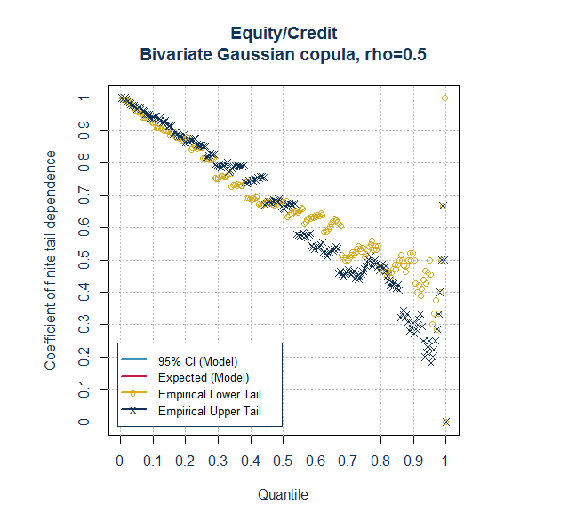
Allowing for tail dependence
Step 1 – Plot data
Chart empirical coefficients of finite tail dependence
May need to change signs of one data set if correlation is negative – we have multiplied equity returns by -1
Gold circles correspond to events where equity values fall and credit spreads widen
Blue crosses represent opposite tail
Some evidence of asymmetry
Notes:
So how can you use this in practice?
Technique based on an approach described by Gary Venter in “Quantifying Correlated Reinsurance Exposures with Copulas”
Example based on EQ/CR
First you can chart the corresponding functions based on the actual data
The gold circles are events where spreads widen and equity values fall.

Slide 24
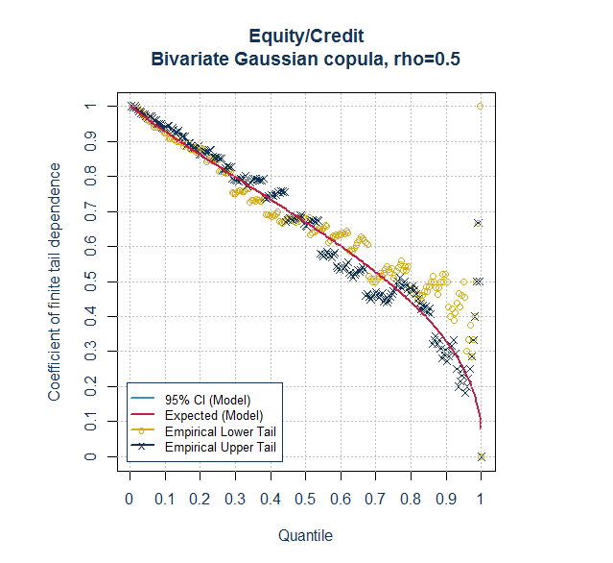
Allowing for tail dependence
Step 2 – choose a copula model
Choose a copula model and parameterisation
In this case a Gaussian model with correlation parameter of 50%
Plot the coefficient of finite tail dependence for the model (red line)
Red line drops towards zero as expected for model with zero coefficient of tail dependence
50% is consistent with the MPL parameter
Notes:
Next, chose a copula model and chart the function forecast by that model – the red line
For the models we look at, the lower and upper coefficients are equal so there is only one red line.
We also add in confidence intervals around the red line.
For a sample of data, even if the assumed model is correct, random variation will result in the empirical conditional probabilities deviating away from the red line
If the data falls outside the confidence interval at a given percentile, then that would indicate that the model is a poor fit.

Slide 25
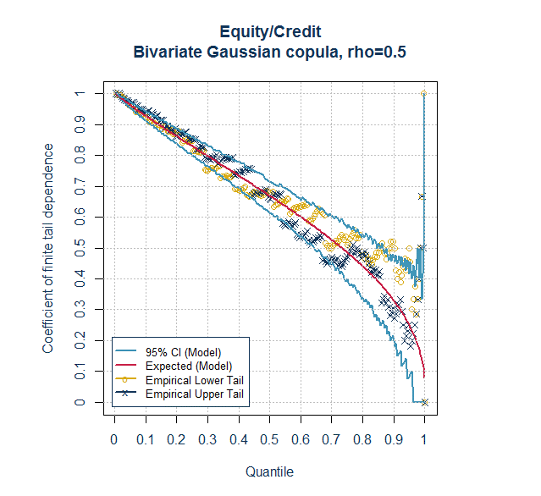
Allowing for tail dependence
Step 3 – plot envelope of confidence intervals
Draw envelope of confidence intervals (blue lines) around model values using bootstrapping techniques – in this case 5000 simulations of 216 observations from the chosen copula model
For a given q, these illustrate the range you might expect observed values to fall into if the process followed the assumed model
If company is exposed to fall in equity values and rise in credit spreads, it may want the model to produce conditional probabilities which are more consistent with data in lower tail

Slide 26
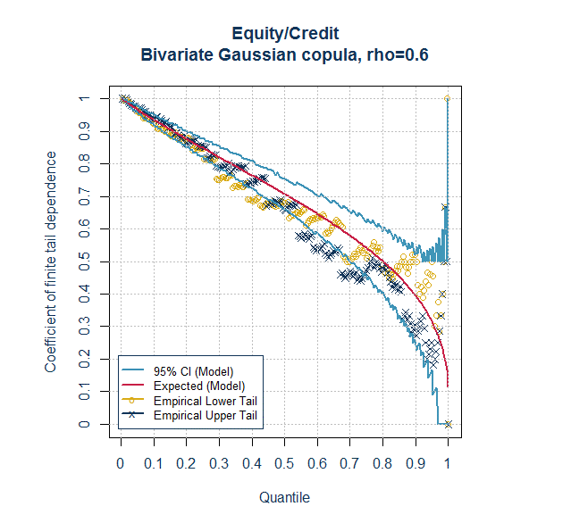
Allowing for tail dependence
Step 4 - Test alternative models/parameterisations
Correlation = 60%
Different models/parameterisations shift red curve and envelope of confidence intervals
Use:
  judgement
  knowledge of own risk profile (i.e. which tail is relevant)
  percentile of biting scenario (e.g. derived from averaging simulations in window around SCR)
  to inform choice of correlation
Notes:
If you have chosen a Gaussian model, then you can use this tool to form a view on the additional allowance over your central assumption to allow for tail dependence.
If you have an idea where your biting scenario is, you can select a suitable percentile and choose the assumptions so that the model result is broadly in line with the empirical conditional probabilities at that percentile.
For example, 70% might be appropriate if EQ or CR appears at around 95th percentile in your biting scenario.
But at expense of moving away in body of distribution.
Whether that is something you are worried about depends on financial impact at the percentiles you use for risk management purposes.

Slide 27
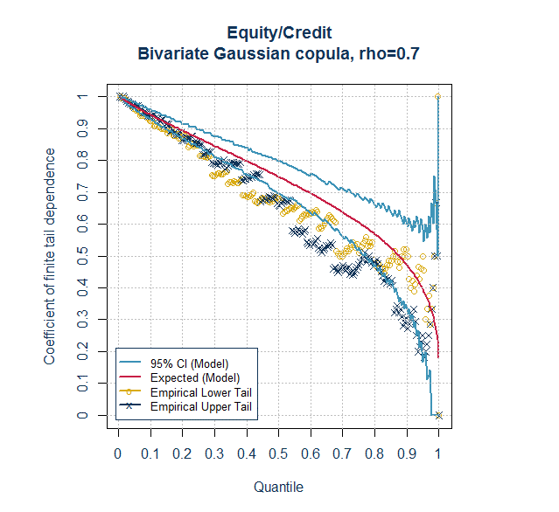
Allowing for tail dependence
Step 4 - Test alternative models/parameterisations
Correlation = 70%
Appears to be better fit to lower tail but poor fit in body of distribution
Significantly higher than MPL estimate of 48.8%
Difference of c20% well in excess of 95% confidence interval of ±c10% around Spearman’s rank correlation
Still need expert judgement overlay – do not rely on data alone!

Slide 28
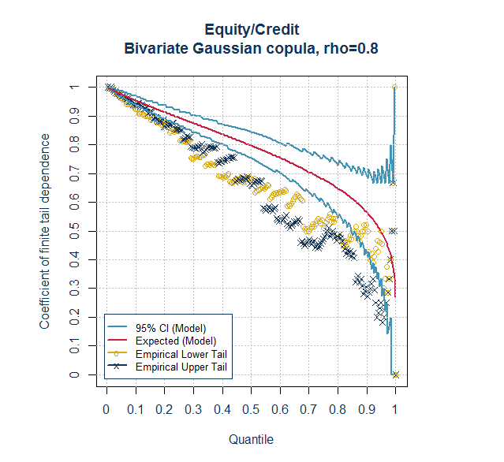
Allowing for tail dependence
Step 4 - Test alternative models/parameterisations
Correlation = 80%

Slide 29
Strengths and Limitations
Strengths
Straightforward for Gaussian
Easy to visualise – charts can help facilitate discussion on judgement
Not focussed on single percentile
Can be applied separately to data for pairs of risk factors – use not restricted to time periods where data exists simultaneously for all risk factors
Can help make additional allowance for tail dependence explicit
Limitations
Does not generalise easily to more complex copulas
Judgement remains essential when fitting - data scarce in tails
Only looks along 45º ray – i.e. same percentile for both risk factors (could modify but increases complexity)
Does not automatically produce PSD matrix

Slide 30
Top-down validation
Is the model fit for purpose?
Peer review/expert judgement panels
Independent validation
External assurance
Focus on rationale for most material assumptions – does the reasoning stack up?
Benchmarking – are any assumptions outliers? If so, how strong is the justification?
Internal consistency – were there any large movements when making the matrix PSD? Maximum change, histograms of adjustments, estimated impact using correlation matrix approach.
Was the review/governance process appropriate?
Does the output look reasonable?
  Do the scenarios in a window around the SCR or the “smoothed biting scenario” seem reasonable given risk profile?
  Express in “real world” terms – e.g. fall in equity values of x%, increase in life expectancy of male aged 70 of y years, increase in A rated credit spreads of z bps, increase in lapse rates by w%.
  Is the allocation of diversified capital to individual risk factor/line of business consistent with the risk profile?
Notes:
The usual approach to parameterising a copula is a bottom-up one – for example, correlations are usually set pairwise or in blocks.
It’s important to ask yourself whether the resulting copula is fit for purpose by applying some general “top down” sense checks.
Process – has appropriate use been made of expert judgement? (Who was involved? Did they have the relevant experience and knowledge?) Was the review and challenge appropriate?
Am I happy with any adjustments made to the raw parameterisation that I approved that are required for technical reasons – e.g. to make a correlation matrix PSD?
How large are the adjustments?
What is their distribution (e.g. draw a histrogram)
Which are the financial ly most significant adjustments?
Is there a fundamental reason for any particularly large adjustments (e.g. a inconsistency in one or more correlations)
Do the adjustments have a material impact on my results? (estimate using correlation matrix)
Consider applying tolerances to any adjustments.
There are methods available which allow you weight adjustments made on blocks of assumptions or event to keep a square PSD submatrix fixed
What are the most significant assumptions? Focus review on these.
Do the scenarios in the window around the SCR look reasonable given my knowledge of risk in the business?
If you derive a smoothed biting scenario, does this scenario seem reasonable?

Slide 31
Proxy Models

Slide 32
Proxy Models
Model of full actuarial model results, which can be evaluated quickly
  Calculate balance sheet impact under each scenario generated by copula
  For example using curve fitting or replicating portfolios
Also used for balance sheet estimation and solvency monitoring.
Proxy model stages:
Design
Calibration
Validation
One-off + reviews
On-cycle - techniques to move steps off-cycle

Slide 33
Validation
Validation needs to be:
  Use focused:
    What are we using the proxy model for?
    And what area(s) of the distribution should we be testing?
  Informative:
    What are the potential sizes of model error?
    In what parts of the distribution, or for which particular risks?
    How can we improve the model?
  Clearly presented:
    Easy to understand
    Clear conclusions
  Practical to perform within reporting timescales
Notes:
Proxy modelling moves us from a ‘reality-driven’ approach (what is the product What are the cashflows?) to a data-driven approach (what do my models tell me about my sensitivity to risks).
Model risk already existed in the approximations implicit in heavy models (cashflow timing, data grouping etc)
Proxy model usage in economic/regulatory capital is well established – in a sense, when we are deep in the tails there is much potential for ‘error’ e.g. in the calibrations and copula methodology and parameterisation. So the use of proxy models is just another layer of judgement on top of that.
However, use is expanding as shown earlier e.g. risk appetite and estimation of balance sheets. The level of accuracy required of the proxy model may be higher here:
- because they are used to report results externally
- because they are used in firm’s risk management processes
Validation should be Use focussed, Informative and clearly presented. In particular we should extract ourselves from a purely data approach, and determine what is causing fitting problems – what judgements have we made and how can we change these to improve the fit.
Clear presentation is vital so that it is clear what limitations may exist – refer to graphs coming up in this pack

Slide 34
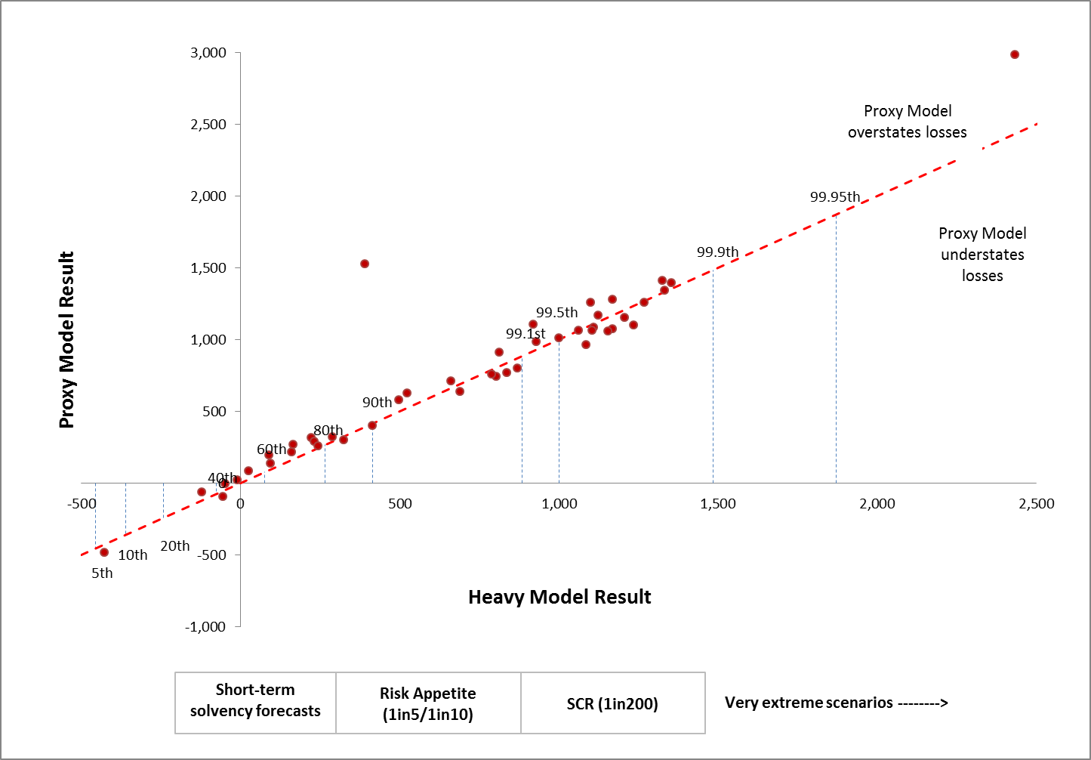
Out of Sample Testing
Diagnostic tools:
Finding issues:
Visual inspection
Points outside tolerance e.g. 5%
Clustering above or below the line
Diagnostic statistics:
Mean (unbiased?)
MSE/SD (quantum of error)
Skewness of errors
Can look at full sample or subset around a given percentile.
Notes:
Example graph – good practice
Clearly shows the results and clearly shows how relevant each point is for different purposes
Investigate outliers – there may be a good reason e.g. testing incorrect or the scenario is particularly extreme. Do these points suggest a systemic problem?
What other patterns can be inferred from eyeballing the results? Clustering above/below the line suggests bias.

Slide 35
Out of Sample Testing
Proxy model overstating losses
Diagnostic tools:
Finding issues:
Visual inspection
Points outside tolerance e.g. 5%
Clustering above or below the line
Diagnostic statistics:
Mean (unbiased?)
MSE/SD (quantum of error)
Skewness of errors
Can look at full sample or subset around a given percentile.
Proxy model understating losses
Notes:
Example graph – good practice
Clearly shows the results and clearly shows how relevant each point is for different purposes
Investigate outliers – there may be a good reason e.g. testing incorrect or the scenario is particularly extreme. Do these points suggest a systemic problem?
What other patterns can be inferred from eyeballing the results? Clustering above/below the line suggests bias.

Slide 36
Out of Sample Testing
Diagnostic tools:
Finding issues:
Visual inspection
Points outside tolerance e.g. 5%
Clustering above or below the line
Diagnostic statistics:
Mean (unbiased?)
MSE/SD (quantum of error)
Skewness of errors
Can look at full sample or subset around a given percentile.
Investigate clear outliers: testing error or genuine fitting problem?
Notes:
Example graph – good practice
Clearly shows the results and clearly shows how relevant each point is for different purposes
Investigate outliers – there may be a good reason e.g. testing incorrect or the scenario is particularly extreme. Do these points suggest a systemic problem?
What other patterns can be inferred from eyeballing the results? Clustering above/below the line suggests bias.

Slide 37
Out of Sample Testing
Diagnostic tools:
Finding issues:
Visual inspection
Points outside tolerance e.g. 5%
Clustering above or below the line
Diagnostic statistics:
Mean (unbiased?)
MSE/SD (quantum of error)
Skewness of errors
Can look at full sample or subset around a given percentile.
Errors look skewed in this region
Notes:
Example graph – good practice
Clearly shows the results and clearly shows how relevant each point is for different purposes
Investigate outliers – there may be a good reason e.g. testing incorrect or the scenario is particularly extreme. Do these points suggest a systemic problem?
What other patterns can be inferred from eyeballing the results? Clustering above/below the line suggests bias.

Slide 38
Making sense of out-of-sample results
Two questions:
  Is the model suitable for use?
  Can the model be improved?
Statistics can be informative, but we shouldn’t rely solely on these:
  Can show up issues but not diagnose them
Tolerances can be used to identify areas for investigation
Out-of-sample results can be used to improve proxy model fit
Can be used to understand the potential error around the true result
Errors are expected, but bias and trends in the errors are not.
Notes:
Validation should answer two questions:
Is the model unsuitable for use? (what tests would we use to decide on that)
Can the model be improved – ultimately to lower the model risk further
Make point that while statistics are helpful in summarising data and identifying issues, they do not diagnose them. Especially with small sample sizes
Setting of tolerances is normal, but why do we set them? If we set tight tolerances and deem failure in the breach of them, we will never have a valid model.
Also, note that errors are normal and to be expected – as noted in Hursey et al, we should not reject models based on any particular sample if re-ordering wouldn’t change the result. Focus on identifying trends and bias – use the data and statistics as a guide and investigate further

Slide 39
Questions
Comments
The views expressed in this [publication/presentation] are those of invited contributors and not necessarily those of the IFoA. The IFoA do not endorse any of the views stated, nor any claims or representations made in this [publication/presentation] and accept no responsibility or liability to any person for loss or damage suffered as a consequence of their placing reliance upon any view, claim or representation made in this [publication/presentation].
The information and expressions of opinion contained in this publication are not intended to be a comprehensive study, nor to provide actuarial advice or advice of any nature and should not be treated as a substitute for specific advice concerning individual situations. On no account may any part of this [publication/presentation] be reproduced without the written permission of the IFoA [or authors, in the case of non-IFoA research].

Slide 40
References
A.J. McNeil, R. Frey, P. Embrechts: “Quantitative Risk Management – Concepts, Techniques and Tools” (2nd Edition, Princeton, 2015)
Gary G. Venter: “Fit to a t – Estimation, Application and Limitations of the t-copula” (ASTIN Colloquium, Berlin, 2003)
R.A. Shaw, A.D. Smith, G.S. Spivak: “Measurement and Modelling of Dependencies in Economic Capital” (B.A.J., Vol 16, Issue 03, Sept 2011)
P. Sweeting and F. Fotiou, “Calculating and communicating tail association and the risk of extreme loss”, (2013), British Actuarial Journal, Vol 18, Issue 01, pp13-72.

Slide 41
Appendix

Slide 42
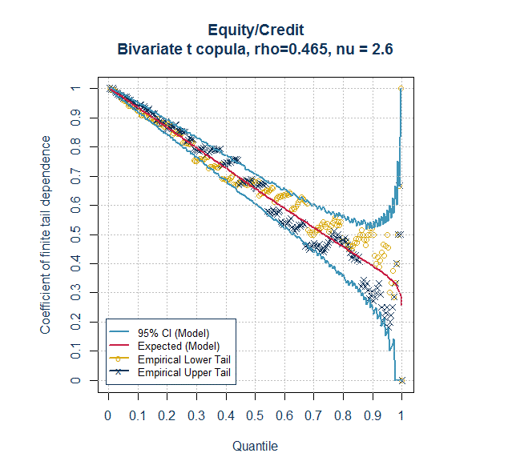
Allowing for tail dependence
Step 4 - Test alternative models/parameterisations
Student’s t copula with MPL parameterisation
Correlation = 46.5%
DOF = 2.6

Slide 43
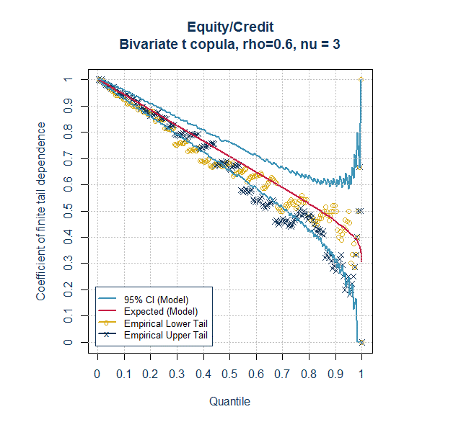
Allowing for tail dependence
Step 4 - Test alternative models/parameterisations
Student’s t copula
Correlation = 60%
DOF = 3
Better fit globally than available from Gaussian, but DOF will differ for each pair of risk factors

Slide 44
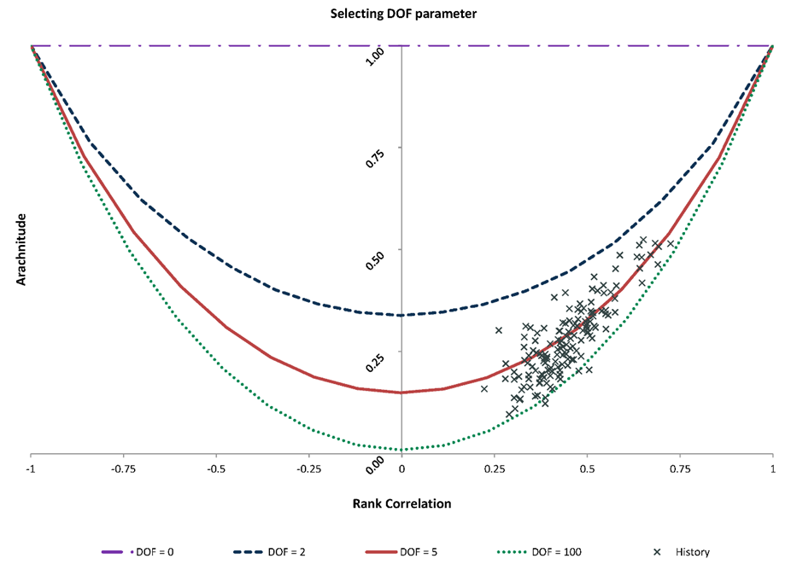
Higher order rank statistic matching
Arachnitude
Set copula statistics to match higher order rank statistics – e.g. “arachnitude”
Generalises inverse Spearman technique
Most commonly used when fitting t copula to market data
Capable of generalisation to other copula families (Fourier series expansion of copula density)
Approach involves judgement in selecting DOF parameter to fit curve of (rank correlation, arachnitude) for model to sample values
See Shaw, Smith, Spivak (2010) and Smith (pre-print)
*Reproduced with kind permission from the 2010 paper by Shaw/Smith/Spivak
Notes:
Explain that the lines are not dependent on the actual data;
Data shows monthly total returns for equity indices of 18 different geographies (i.e. 153 distinct pairs of risk factors) over the period 31 December 1969 to 31 December 2009
In step 4, we need to decide which DoF best fits the data; in theory we could do some sort of regression, although probably best to pick a more rounded answer; we may also want to give more prominence to points that have more impact to our results (for example the markets where most of our investments are made); this dataset suggests that 5 might be a reasonable answer.
In step 5, having decided on what DoF is appropriate, we draw that curve and then we can either keep the same rank correlation and find the arachnitude value of the relevant DoF curve we have chosen, or take the closest distance between each cross and the curve to determine what is the optimal point on the curve and thus identify a new rank correlation too; we can then back solve for the particular copula and DoF to get the correlation matrix parameter.

