Slide 1
Survival analysis after a first ischaemic stroke event: a case-control study in the adult population of England.
Padma Chutoo, Elena Kulinskaya, Ilyas Bakbergenuly, Nicholas Steel & Dmitri Pchejetski
University of East Anglia
The ‘Use of Big Health and Actuarial Data for understanding Longevity and Morbidity Risks’ research programme is being funded by the Actuarial Research Centre.
www.actuaries.org.uk/arc

Slide 2
Outline of presentation
Introduction
Hazards, hazards ratios and the Cox Regression.
Study description.
Survival Models’ findings.
Summary and Conclusions.

Slide 3
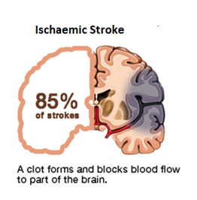
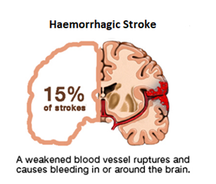

What is Stroke?
Ischaemic stroke is caused by a blood clot that blocks or plugs a blood vessel in the brain.
Haemorrhagic stroke is caused by a blood vessel that breaks and bleeds into the brain.
Transient Ischaemic Attacks or TIAs, are “mini-strokes” whereby the symptoms from the clot appear temporarily. TIAs are warning signs that should be taken seriously.

Slide 4
Rationale of study
Stroke is the biggest single cause of major disability in the UK. Almost two–thirds of stroke survivors leave hospital with disability.
The average age for someone having a stroke is decreasing, with over a third of strokes in adults between 40 and 69 [NICE, 2018].
Stroke prevalence is projected to increase by 120% between 2015 and 2035 and the associated societal costs will almost treble [King et al.,2020].

Slide 5
Aim of study
Previous research on IS have been based on relatively modest patient samples and suffered from methodological limitations.
This study analyzes the long-term hazards of all-cause mortality among IS patients relative to the matched controls taking into consideration different socio-demographical factors, medical therapies and comorbidities.

Slide 6
Data
Our research uses The Health Improvement Network (THIN) primary care data to develop statistical models of longevity
Our subset of THIN includes all patients born before 1960 and followed to 01.01.2017, this is 3.5 million patients
The advantage of using individual-level medical data is that it is possible to model both the uptake of medical treatment and the effect of that treatment on longevity conditional on the individual lifestyle and health factors instead of the aggregated profile.

Slide 7
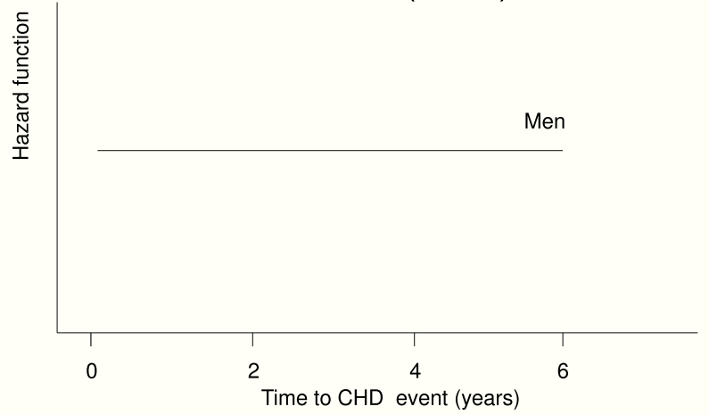
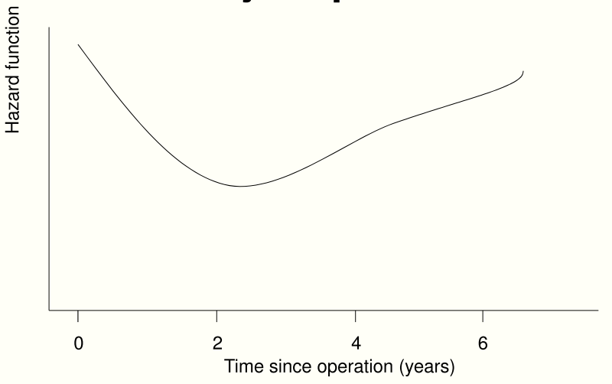
Hazard aka “force of mortality” and “mortality intensity”
Survival analysis often aims to model the hazards of death.
Hazard is an instantaneous failure rate at time (age) t
  Probability that an individual will experience the event at time t given that the event has not yet occurred.

Slide 8
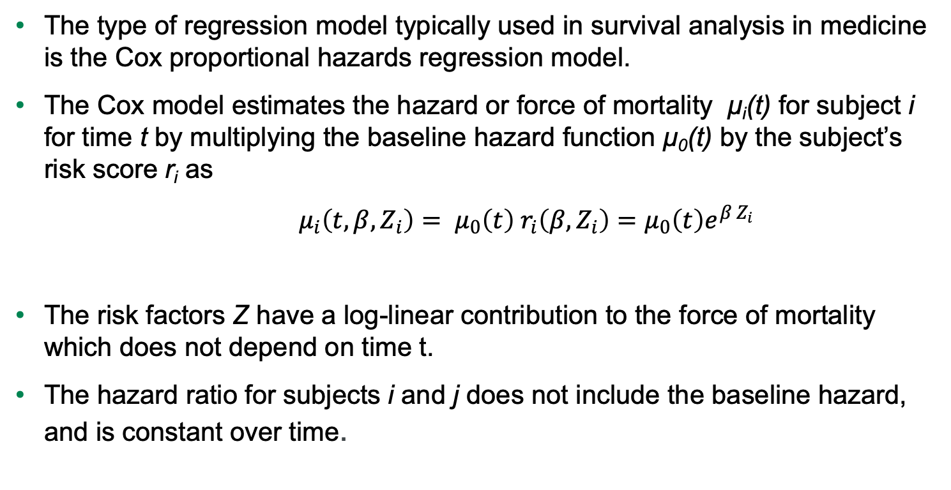
Cox proportional hazards regression
The type of regression model typically used in survival analysis in medicine is the Cox proportional hazards regression model.
The Cox model estimates the hazard or force of mortality μ_{i}(t) for subject i for time t by multiplying the baseline hazard function μ₀(t) by the subject’s risk score r_{i} as
${ μ}_{i}\left(t, β, Z_{i}\right)= μ_{0}\left(t\right){ r}_{i}\left(β, Z_{i}\right)=μ_{0}\left(t\right)e^{β Z_{i}}$
The risk factors Z have a log-linear contribution to the force of mortality which does not depend on time t.
The hazard ratio for subjects i and j does not include the baseline hazard, and is constant over time.

Slide 9
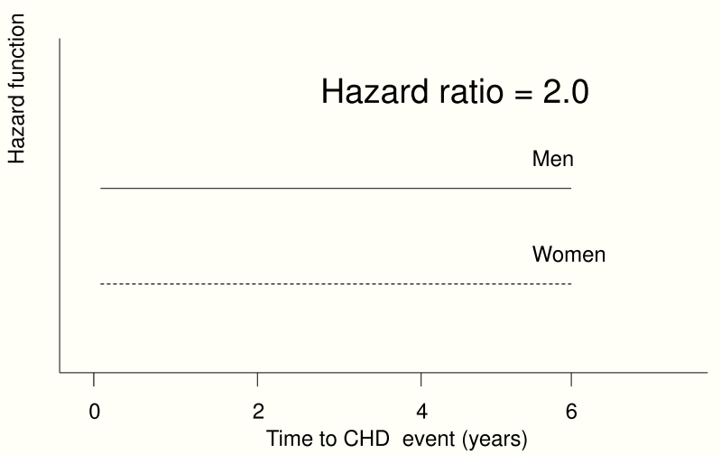
Hazard ratio (HR)
Cox model assumes constant hazard ratio over time

Slide 10
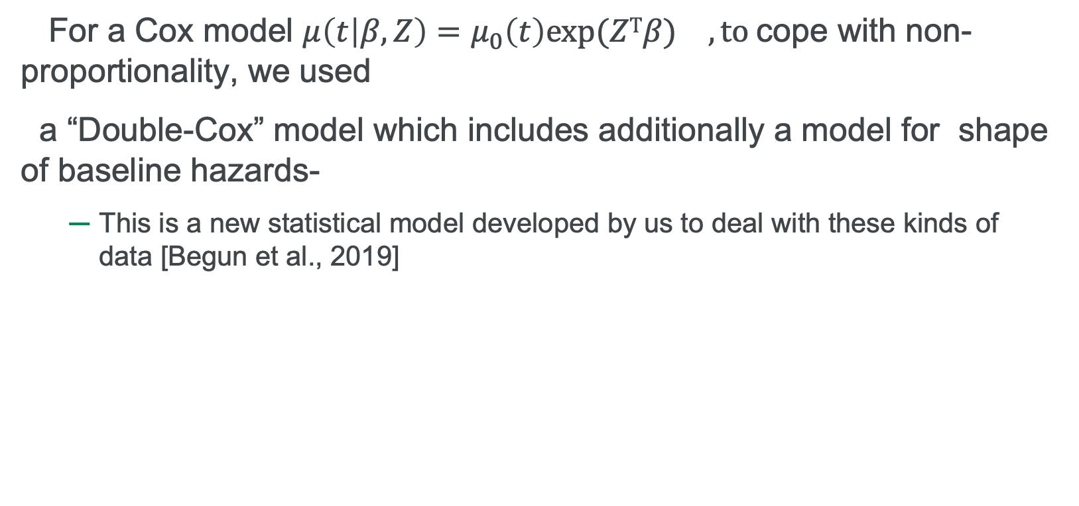
What if the proportional hazards assumption is not met?
For a Cox model $μ\left(t | β, Z\right)=μ_{0}\left(t\right){exp⁡(ZΤβ) }^{}, to$cope with non- proportionality, we used
a “Double-Cox” model which includes additionally a model for shape of baseline hazards-
  This is a new statistical model developed by us to deal with these kinds of data [Begun et al., 2019]

Slide 11
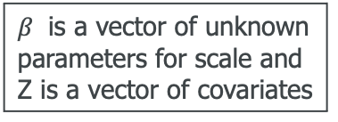


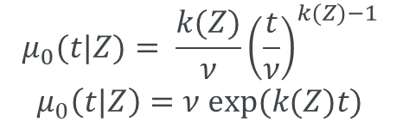
Parametric “Double-Cox” regression
Components:
A baseline hazard function (which changes over time).
The risk factors Z have a log-linear contribution to the force of mortality which does not depend on time t.
The Cox parametric regression model
$μ(t|Z)=μ_{0}(t|Z)$ $U exp{(ZΤβ)}$
$β$ is a vector of unknown parameters for scale and Z is a vector of covariates
Baseline hazard function
U ~ Gamma with mean 1 and variance σ² is a shared (across a cluster, e.g. GP practice) frailty. σ² is population heterogeneity
Weibull or Gompertz baseline hazard function with scale 𝜈 and shape k. Shape k is modelled as k=k(Z).
Additional regression model to allow varying shape depending on covariates
$$μ_{0}(t|Z)= \frac{k(Z)}{ν}{\left(\frac{t}{ν}\right)}^{k(Z)−1}$$
$$μ_{0}\left(t|Z\right)=ν exp⁡(k(Z)t)$$
$$\text{k}\text{(}\text{Z}\text{)} \text{=}k0e^{ZΤβk}$$

Slide 12
Stroke study: brief description
Objective: impact of 1st ischaemic stroke on survival.
The study period is from 1986 up to 2017.
Design: case/control 1:3
Exclusion criteria: prior major cancers, dementia, chronic kidney disease stages 3+ and haemorrhagic stroke.
The primary outcome is all-cause mortality.
A total of 20,250 eligible patients with first-ever IS event and their 55,519 controls.

Slide 13
Stroke study: Variables of interest
Drugs: Antihypertensive drugs, Antiplatelet drugs, Anticoagulant drugs, Lipid regulating drugs and antidiabetic drugs.
Medical conditions: Asthma, Atrial Fibrillation, CKD, CHD, PAD, Hypothyroidism, COPD, Diabetes, Hypercholesterolemia, Hypertension, Depression.
Demographics and lifestyle: Blood Pressure, Cholesterol, BMI, gender, date of birth, age at entry, smoking status, alcohol status and IMD Decile.
.

Slide 14
Methodology
Missing data were imputed using the Multiple Imputation method using the ‘jomo’ package in R and results were pooled using the Rubin’s rule.
A “double”– Cox ( Weibull-Cox) model was used for the survival modelling.

Slide 15
IS case fatality and medications 1995-2016
Stroke survival outcomes in England improved over time.
Pre-morbid use of preventive anticoagulants, anti-hypertensive drugs and statins increased over time, but antiplatelet treatment use declined after year 2010 in England

Slide 16
Results
Table 1: Adjusted estimated hazard ratios of all-cause mortality by age at diagnosis
and case-control status (from the Weibull- Cox model on the imputed data)
Comparison group | Relative to: | HR (95% CI)
Cases aged 39-60 years | Controls aged 39-60 years | 5.67(4.93-6.51)
Cases aged 61-70 years | Controls aged 61-70 years | 3.77(3.22-4.37)
Cases aged 71-76 years | Controls aged 71-76 years | 3.02(2.60-3.57)
Cases aged 77+ years | Controls aged 77+ years | 2.95(2.55-3.40)

Slide 17
Results
Figure 1: Hazard ratio curves with 95% confidence intervals for patients aged 39-60 years at entry on aspirin. (Cases on aspirin were compared to cases who are non-users of aspirin. Controls on aspirin were compared to controls who are non-users of aspirin.)

Slide 18
Longevity after IS : Some examples
Medical condition | Gender | Age at diagnosis | Years after diagnosis | Number of years lost
IS | Female | 50 | 2 | 14.1
IS | Male | 50 | 2 | 16.0
IS | Female | 60 | 2 | 9.9
IS | Male | 60 | 2 | 11.2
IS | Female | 70 | 2 | 6.9
IS | Male | 70 | 2 | 7.8

Slide 19
Conclusions
Cardio-vascular comorbidities are more prevalent among IS patients than their matched controls.
The IS patients face a higher long-term risk of death compared to controls.
Aspirin provides long-term survival benefits to IS patients. Long-term aspirin monotherapy could be a better choice than other antiplatelet options for IS patients.
Management of risk factors should be a long-term endeavour. Continuing BP control is most important to prevent further strokes

Slide 20
References
King, D., Wittenberg, R., Patel, A., Quayyum, Z., Berdunov, V. and Knapp, M., 2020. The future incidence, prevalence and costs of stroke in the UK. Age and ageing, 49(2), pp.277-282.
Begun, A., Kulinskaya, E. and MacGregor, A.J., 2019. Risk-adjusted CUSUM control charts for shared frailty survival models with application to hip replacement outcomes: a study using the NJR dataset. BMC medical research methodology, 19(1), p.217.
Khare, S., 2016. Risk factors of transient ischaemic attack: An overview. Journal of Mid-life Health, 7(1), p.2
Edwards, J.D., Kapral, M.K., Fang, J. and Swartz, R.H., 2017. Long-term morbidity and mortality in patients without early complications after stroke or transient ischaemic attack. Cmaj, 189(29), pp.E954-E961.
NICE, 2018 : https://www.nice.org.uk/Media/Default/About/what-we-do/Into-practice/measuring-uptake/NICE-Impact-stroke.pdf

Slide 21
Questions
Comments
The views expressed in this presentation are those of the presenter.

Slide 22
Extra slides

