Slide 1
Understanding blockchain for insurance use cases A practical guide for the insurance industry
Zhixin Lim
Chadwick Cheung
Darko Popovic

Slide 2
Contents
Introduction
Blockchain 101
Insurance use cases
Risks and challenges
Guide to adopting blockchain solutions
Disclaimer: The views expressed in this publication are those of invited contributors and not necessarily those of the Institute and Faculty of Actuaries or the employers of the contributors. The Institute and Faculty of Actuaries and employers of the contributors do not endorse any of the views stated, nor any claims or representations made in this publication and accept no responsibility or liability to any person for loss or damage suffered as a consequence of their placing reliance upon any view, claim or representation made in this publication. The information and expressions of opinion contained in this publication are not intended to be a comprehensive study, nor to provide actuarial advice or advice of any nature and should not be treated as a substitute for specific advice concerning individual situations. On no account may any part of this publication be reproduced without the written permission of the Institute and Faculty of Actuaries.

Slide 3
Introduction

Slide 4
Introduction to the working party
“Risk Management in a Digital World” Working Party
Formed in 2018
Focuses on researching and developing the risk management practices and capabilities for assessing and managing risks associated with InsurTech activities
Working Party members
Darko Popovic (Chair): Director, FTI Consulting
Carole Avis: CRO, L&G Insurance & General Insurance
Matthew Byrne: Chief Actuary, NFU Mutual
Chadwick Cheung: Manager, EY
Martin Donovan: Head of Actuarial and Finance, ExO Hub Irish Life (IRL)
Yiyi Flynn: ERM Manager, Prudential
Craig Fothergill: Deputy Chief Actuary, Assurant
Zahra Hossein-Zadeh: Actuarial Advisor, Accident Compensation Corporation New Zealand (NZ)
Jinal Shah: Incubation Manager, JITO JIIF (IND)
Zhixin Lim: Senior Manager, HSBC
Notes:
UK, Ireland, NZ, India
Not all actuaries

Slide 5
Previous output (Phase 1)
“Improving the Success of InsurTech Opportunities”
Including “Guidelines for risk considerations during the innovation journey”
Sessional event October 2018, Edinburgh
BAJ paper
SAI event early 2019
Relied on output from our survey on risk management in a digital world…
…and interviews with senior stakeholders in industry
Notes:
UK, Ireland, NZ, India
Not all actuaries

Slide 6
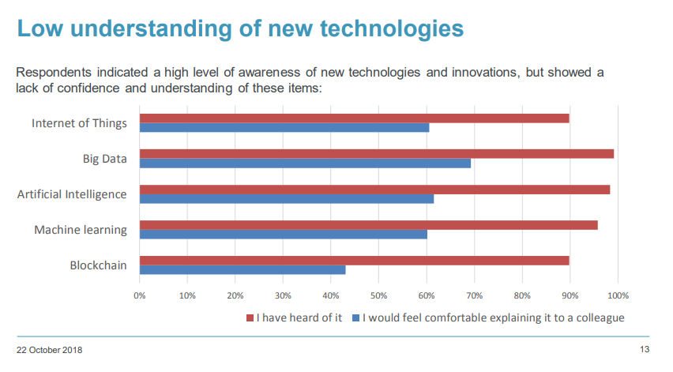
Phase 2: Why focus on Blockchain?
Notes:
Update from survey re-run 2019/2020:
Compared to last year’s survey I think that means just under 100% have heard of blockchain (was 90% previously), but only around 25% can explain it to colleagues – was 40% previously!
And only 5% are comfortable talking to a group of peers about it as we are doing now

Slide 7
Phase 2: Objectives
Objectives:
Explain to colleagues what blockchain is and how it works
Have an initial discussion on potential use cases
Consider the risks and opportunities at a high level
Have a framework in place if deciding to pursue blockchain development opportunity
Key sections for today’s session:
Education piece
Consideration of insurance industry use cases
Consideration of risk and challenges
ERM Framework checklist in the context of a blockchain solution to further pursue an opportunity
Notes:
We want actuaries to be able to:
List the items
So we’re not looking to answer everything, or identify one area where we think it’s really important to move onto blockchain
I think we’ve stayed reasonably neutral…but would be good to discuss in the Q&A as I am sure many of view have views on the topic…

Slide 8
Blockchain 101

Slide 9
What is blockchain and how does it work?
For the purposes of this paper, the working party uses the following definition to set a baseline and common understanding:
Blockchain, a variant of Distributed Ledger Technology (DLT), is a shared database/ledger on which the state (i.e. the current snapshot of data) is confirmed and verified without the need for a trusted centralised authority.
At its most basic level, blockchain is a ledger which is shared by multiple participants. Data is verified by multiple entities instead of a single organisation. The data is then propagated and stored by each participant.
Let’s demonstrate how this works in a simple exercise, and it will introduce some of the key concepts of blockchain technology, including:
Distributed ledger
Decentralisation
Consensus
Permissionless vs. permissioned; public vs private
Miner

Slide 10
How is blockchain different?
The key difference between a blockchain and a traditional database is (de)centralisation.
Database | Feature | Blockchain
Client-server architecture | Topology | Peer-to-peer network
Centralised | Authority | Decentralised (if permissionless)
Transparent to the extent approved by the administrator | Transparency | Fully transparent (if public)
Create, Read, Update, Delete | Data operation | Read and Write only
Relatively easier to compromise | Security | Much harder to compromise
Much faster and more scalable | Performance | Scalability is constrained by decentralisation or security
1
2
3
4
5
6
Distributed – verified data is propagated to participants on the blockchain network so that multiple parties have the same record.
Decentralised – the maintenance of the network, including data verification, does not depend on a centralised authority.

Slide 11
How is blockchain different?
Database | Feature | Blockchain
Client-server architecture | Topology | Peer-to-peer network
Centralised | Authority | Decentralised (if permissionless)
Transparent to the extent approved by the administrator | Transparency | Fully transparent (if public)
Create, Read, Update, Delete | Data operation | Read and Write only
Relatively easier to compromise | Security | Much harder to compromise
Much faster and more scalable | Performance | Scalability is constrained by decentralisation or security
1
2
3
4
5
6
Transparent – data on the blockchain is fully auditable for those with access.
Read / Write only – (almost) impossible to delete once written on the blockchain.
Tamper-resistant – verified data is cryptographically secured, making it resistant to malicious alterations.
The “Impossible Triangle” – a (conventional) blockchain is (for now) only able to have two of these attributes, namely scalability (defined as throughput), decentralisation and security.

Slide 12
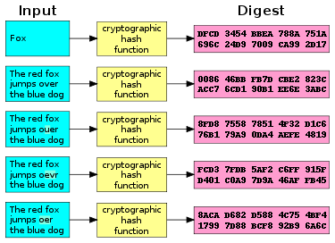
What are the key components of blockchain?
There are four key components in a blockchain:
Cryptographic hash function
Digital signature
Blocks and chains
Consensus algorithm
Cryptographic hash function - a mathematical algorithm that maps data of arbitrary size (often called the “message”) to a bit string of a fixed size (i.e. the “hash” or “digest”) and is a one-way function, that is, a function which is practically infeasible to invert.

Slide 13
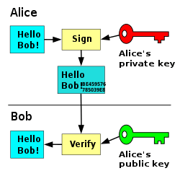
What are the key components of blockchain?
Digital signature – it serves as a unique fingerprint and provides the assurance that the proposal to change the state (i.e. the current snapshot of the data) of the blockchain originates from a network node that is authorised to do so. This is achieved using asymmetric cryptography, where a pair of “keys” – one public, and the other private – could be used to encrypt and decrypt data.

Slide 14
What are the key components of blockchain?
Blocks and chains - the root hash/Merkle root forms part of the block header. Another component of the same block header is the hash of the previous block. This unique data structure where blocks are chained together is a distinctive feature of blockchain that makes it tamper-resistant.

Slide 15
What are the key components of blockchain?
Consensus algorithm - The consensus mechanism is a set of rules that determine how data is verified, how conflicting information is resolved, and how agreement is reached on committing changes to the blockchain without a trusted centralised authority. Here are some examples:
Consensus algorithm | High-level description
Proof-of-Work (PoW) | Requires solving cryptographic puzzles by brute computational force for a state change to be committed to the blockchain.
Proof-of-Stake (PoS) | Unlike PoW where miners compete to commit state changes to the blockchain, PoS selects from a pool of validators who hold a certain amount of the digital currency/token native to the blockchain (i.e. the stake).
Proof-of-Authority (PoA) | Trusted entities vote on whether to commit the state changes to the blockchain.

Slide 16
Insurance use cases

Slide 17
Brief context on blockchain
The Times, 19/Dec/2019
Hedge funds eavesdrop on vital Bank of England briefings
The Times, 03/Jan/2009
Chancellor on brink of second bailout for banks

Slide 18
Drivers for use cases in insurance
Compelling use cases arise from a need to:
Produce a shared tamper-resistant record
Reduce operational frictions and costs
Remove intermediaries

Slide 19
Examples of use cases
Pricing and underwriting
Sales and distribution
Decentralised digital ID enables frictionless quote generation as personal data could be safely shared with multiple insurers
Product management
Blockchain and smart contracts could streamline the inception and admin of reinsurance, swaps, and securitisation
Claims handling
Smart contracts could automate claim payouts
Decentralised data lake could provide a large varied dataset for product pricing

Slide 20
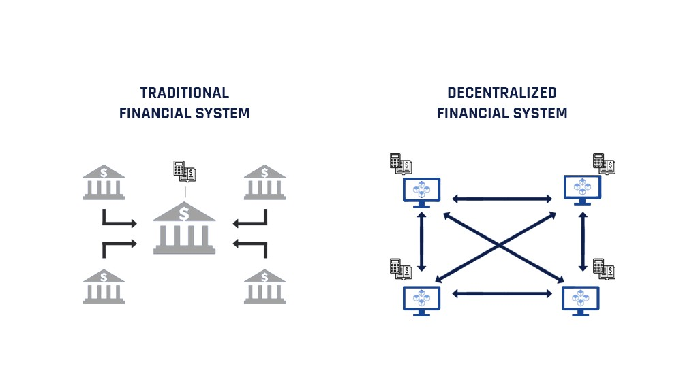
Decentralised finance (DeFi) and insurance
Key characteristics:
Peer-to-peer
Permissionless
Current limitations:
Relatively new technology
User experience

Slide 21
Risks and challenges

Slide 22
Top risks and challenges to consider
Costs of adoption
Blockchain is a nascent technology as standards/platforms are still emerging
While many concepts have been proven, most PoCs failed to progress further
One exception is a catastrophe excess of loss (Cat XoL) reinsurance application launched by an industry blockchain consortium
Blockchain solutions development requires an understanding of multiple disciplines such as mathematics, cryptography, computer science
Talents are hard to find and usually a diverse team is needed
Blockchain is allegedly the most in-demand skill in 2020 according to a professional social media site
There are specific challenges depending on the type of blockchain
In the case of permissionless blockchains, mass collaboration and adoption (i.e. network effect) is required to reap the full benefit
In the case of permissioned blockchains, intellectual property (IP) might be owned by a select few which might deter new entrants from joining the network

Slide 23
Top risks and challenges to consider
Security
Immutability of blockchain can be a double-edged sword
Hacks/fraud/mistakes on the blockchain cannot be reversed easily and may require drastic measures, e.g. hard-forking
Vulnerability in software can be exploited e.g. bugs in smart contract code can lead to financial losses
The infamous hard-fork of the Ethereum blockchain, i.e. the “Decentralised Autonomous Organisation (DAO) fork” in July 2016, serves as a cautionary tale
Data recorded on the blockchain is not inherently trustworthy unless data is native to the blockchain, i.e. “on-chain” data created within the blockchain
Smart contracts often rely on external data feed (i.e. off-chain data) from sources known as “oracles”
Oracles ore often data silos operating in a centralised fashion, creating a single point of attack. This is known as the “Oracle Problem”

Slide 24
Top risks and challenges to consider
Regulation
Data protection laws, e.g. GDPR pose challenges but there are solutions:
Not store any personal data on the blockchain. Instead, pointers are used on the blockchain to refer to where personal data is stored off the blockchain
Only store the hash value of the personal data on the blockchain. It may be argued that the hashed data is anonymised hence does not constitute personal data
There is a lack of clear guidance on the accounting and solvency capital treatment of cryptoassets, e.g. cryptocurrencies, asset-backed tokens, utility tokens, digital collectibles
What is the fair value of the asset if it is not traded in deep and liquid markets?
What are the key risks associated with the asset? What is the “1-in-200” scenario?
It is unclear whether smart contracts would be recognised as a formal legal contract, and which regulation cryptoassets fall under
The UK Jurisdiction Taskforce published its legal statement on their status under English and Welsh law in Nov 2019 and concluded that smart contracts are legally enforceable, and that cryptoassets should be treated as property (but not legally binding)

Slide 25
Top risks and challenges to consider
Business strategy and culture
No companies are prepared to share commercially sensitive data
One solution that is generating a lot of attention is zero-knowledge proof (ZKP) which allows data to be shared between two parties without revealing the data
ZKP is an encryption technique which allows one party (the prover) to prove to another party (the verifier) that they know a value x, without conveying any information apart from the fact that they know the value x
The lack of support from within the organisation due to a natural reluctance to change
Creating a culture which encourages innovation and continuous improvements is no small task and will take time
One approach is to allow transformation to take place in a gradual and ring-fenced manner by establishing a new brand under the parent company

Slide 26
Guide to blockchain adoption

Slide 27
A solution looking for a problem?

Slide 28
Guide to blockchain adoption

Slide 29
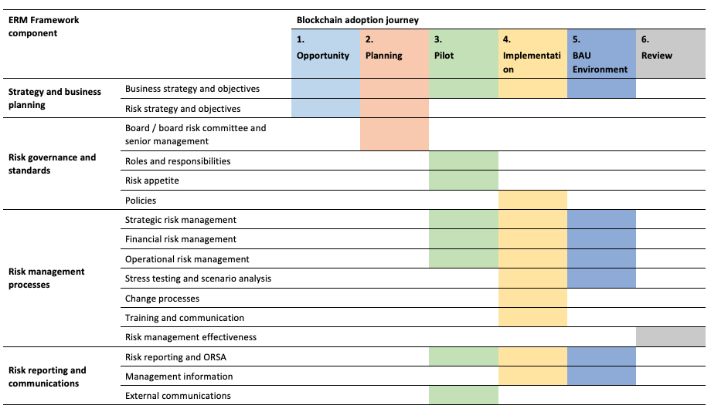
Guide to blockchain adoption

Slide 30
Examples of considerations
Do you need blockchain?
Is there a need for a shared version of truth among multiple parties?
Could a shared version of truth be achieved using existing technology?
Is there a need for decentralisation?

Slide 31
Examples of considerations
Which blockchain platform to use for implementation?
Permissioned or permissionless?
Is the platform widely adopted within and outside of the industry?
If not widely adopted, would there be interoperability issues with other platforms?
Is the performance of the platform limited by certain design choices?
Is there a readily available pool of developers for the platform?
Does adopting a platform which uses Proof-of-Work (PoW) constitute a breach of ESG policy (due to its excessive use of electricity)?

Slide 32
Questions
Comments
The views expressed in this [publication/presentation] are those of invited contributors and not necessarily those of the IFoA. The IFoA do not endorse any of the views stated, nor any claims or representations made in this [publication/presentation] and accept no responsibility or liability to any person for loss or damage suffered as a consequence of their placing reliance upon any view, claim or representation made in this [publication/presentation].
The information and expressions of opinion contained in this publication are not intended to be a comprehensive study, nor to provide actuarial advice or advice of any nature and should not be treated as a substitute for specific advice concerning individual situations. On no account may any part of this [publication/presentation] be reproduced without the written permission of the IFoA [or authors, in the case of non-IFoA research].

