Slide 1
What are the most important questions arising from the use of economic theories which should be addressed by current or future research?
Professor Steve Keen
www.patreon.com/profstevekeen

Slide 2
What alerted me to the 2008 crisis?
Minsky’s “Financial Instability Hypothesis”
  Is capitalism stable or unstable?
    “the fundamental instability of a capitalist economy is upward. The tendency to transform doing well into a speculative investment boom is the basic instability in a capitalist economy.”
  Is there a relationship between debt and income?
    “The natural starting place for analyzing the relation between debt and income is to take an economy with a cyclical past that is now doing well… As the period over which the economy does well lengthens, two things become evident in board rooms. Existing debts are easily validated and units that were heavily in debt prospered; it paid to lever.”

Slide 3
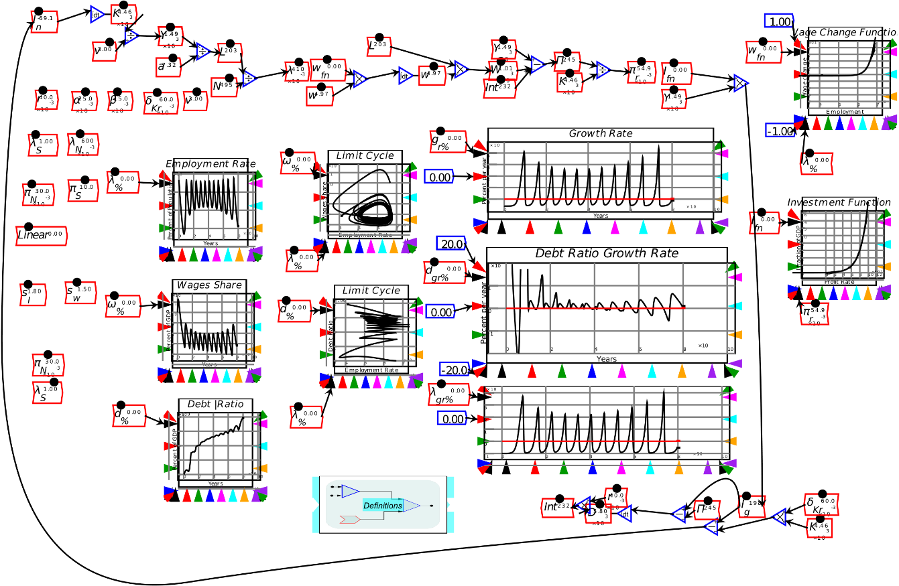
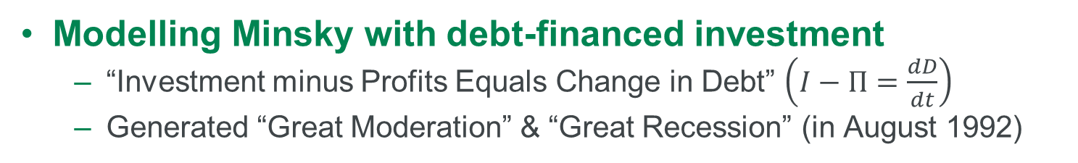
What alerted me to the 2008 crisis?
Modelling Minsky with debt-financed investment
  “Investment minus Profits Equals Change in Debt” $\left(I−Π=\frac{dD}{dt}\right)$
  Generated “Great Moderation” & “Great Recession” (in August 1992)

Slide 4
What alerted me to the 2008 crisis?
Post-1992 data began to behave like my model
  Diminishing cycles before crisis (“Great Moderation”)
  Rising private debt to GDP levels

Slide 5
Why did so few others look at these factors?
Mainstream priors advise ignoring banks & private debt
  Loanable Funds: “no role for credit in aggregate demand”
  Modigliani-Miller: “no role for leverage in asset valuations”

Slide 6
High-level challenges to economics?
Incorporate money & finance into macroeconomics
  Money & Finance are lubricants, not “frictions”
Escape the DSGE monopoly
  Develop ecosystem of economic models, not just DSGE
Consider a-theoretic approaches to macroeconomics
  Sufficient data exists for Deep Neural Networks
    Two “Great Depression” events
    Schularick/Shiller/Bank of England etc. long term data series
  Become more data than theory driven

Slide 7
Questions
Comments
Expressions of individual views by members of the Institute and Faculty of Actuaries and its staff are encouraged.
The views expressed in this presentation are those of the presenter.

