Slide 1
Consumer Understanding
Cars are complex. Consumers don’t need to know the inner workings, just some basic information to ensure it meets their needs, along with the comfort that it has a regular MOT / Service from a professional.

Slide 2
Value of with-profits for consumers Working party update
Tim Bateman (Chair), and
Ben Stroud
Notes:
This presentation was delivered at the Yorkshire Actuarial Society (YAS) on 16th May 2018

Slide 3
Working party members:
Chair: Tim Bateman (Mazars)
Deputy Chair: Jonathan Welsh (Wesleyan)
Secretary: Ben Stroud (ReAssure)
Kris Overlunde (PwC)
Rosalind Rossouw (Sun Life Financial of Canada)
Ross Thompson (Standard Life)
Catherine Thorn (Prudential)
Catherine Zhang (Abbey Life)
Andrew Fraser (Standard Life) – till May 2018
Rebecca MacDonald (PwC) – till July 2017

Slide 4
Agenda
The value of with-profits for consumers working party.
Scope: Do consumers understand the value of their with-profits policies?
Background & Survey Methodology
Customer Engagement & Sentiment
Ben Stroud – ReAssure
Tim Bateman – Mazars
Conclusion & Next Steps
Tim Bateman – Mazars
Notes:
The working party was set up to review the question of whether with-profits consumers understand their policies.
We don’t expect customers to be experts, but do they understand the basics? Do they understand enough to avoid making bad decisions?
Work was split into 2 phases:
Phase 1 = review the current with-profits environment and existing research
Phase 2 = carry out consumer research of our own

Slide 5
Background

Slide 6
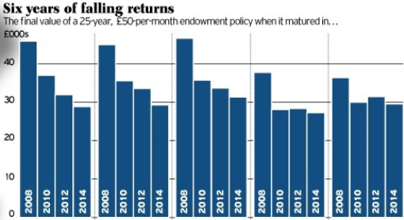
With-profits funds continue to make negative headlines...
Savers should plot their escape from zombie funds
The Times – 9 July 2016
Endowment Scandal! The endowment scandal gets even worse: 70,000 face selling homes as plans expected to pay £110,000 are now worth just £24,000 Daily Mail – 16 November 2017
Help! Why has my 'with profits' pension fund shrunk 11% in two years as stocks hit record highs?
www.thisismoney.co.uk – 20 May 2015
Savers see with-profits pensions slashed by 87%: Thousands promised annual payments of £30,000 now set to receive just £3,700
www.thisismoney.co.uk – 12 July 2016
The Telegraph – March 2014
Notes:
With-profits continues to suffer from negative headlines.
Is there more we can do as an industry to get better information into the public domain?

Slide 7
With-profits funds have performed comparably to similar unit-linked funds...
Single Premium Pensions – 20 Year Return Comparison
Source: Money Management surveys – values typically as at 1st Jan 2016. 1 March 2015 where PRA returns have been used.
Notes:
If you look beyond the headlines, with-profits funds have performed comparably well.
Note – source is Money Management, this gives an example of a 20 year single premium pension. We looked across a range of terms and products and – although with-profits doesn’t outperform in all cases – the overall message is positive (see phase 1 report or CILA slides).

Slide 8
With-profits funds have performed comparably to similar unit-linked funds...
Single Premium Pensions – 20 Year Return Comparison
... But performance varies by fund
And “performance” depends on customer expectation
Source: Money Management surveys – values typically as at 1st Jan 2016. 1 March 2015 where PRA returns have been used.
Notes:
But with-profits fund performance does vary widely, and customers were given high expectations when the policies were taken out (typically in the 80’s).
Yellow bars show range of returns.

Slide 9
... “with-profits” can have very different exposures
Estate Distributions
+ Smoothing
+ Guarantees
+ MVR’s
“Business” profits and losses
With-profits
Portfolio of underlying assets
Unit Linked
... These features do present communication challenges that are not present in other investment products
Notes:
This does add complexity relative to unit linked.
Furthermore the key features / exposures can change over time for the same fund.

Slide 10
Phase 1 Summary
With-profits performance has been comparable to similar UL funds …
On average
But it is highly variable, dependent upon the fund
Information provided on benefit statements varies:
Content
Terminology
There is little existing consumer-specific with-profits research

Slide 11
Survey Methodology
All figures, unless otherwise stated, are from YouGov Plc. Total sample size was 4,585 adults, of which 473 held a with-profits financial product. Fieldwork was undertaken between 2nd - 6th November 2017. The survey was carried out online. The figures have been weighted and are representative of all GB adults (aged 18+).

Slide 12
Survey methodology
Online survey carried out by YouGov
Fieldwork was undertaken between 2nd – 6th November 2017
Single/Multiple choice questions & open-ended questions
19 questions if has at least one financial product + another 16 questions if has a with-profits policy
Final data is statistically weighted to the national profile, and split by categories, e.g. age, gender, social groups
Notes:
The key points to note from the survey methodology were that:
We used YouGov, a well respected survey company
One of the main reasons they were selected was because of their ability find a representative sample of with-profits customers
It was an online survey, which helped with the turnaround so we had the results in time to present at this conference. Although I’ll discuss this more later.
Although it could be argued this leads to some selection bias in terms of only showing computer literate policyholders
Of the interviewees with at least one financial product, (473) 17% of them had a with-profits policy, which was pleasing because YouGov had initially expected this to be lower.
And as you can see this survey is hot off the press having been completed earlier in the month and has thrown up some interesting statistics
The full findings of the results will form part of the written report which will be produced in due course

Slide 13
Survey – Representative sample
Numbers of respondents:
Total: 4,585
At least one financial product: 2,851
With-profits product: 473 (17%)

Slide 14
Survey population With-profits financial product (sample size 473)
Notes:
I will flick through the next two slides quickly, but the key takeaways are:
We feel this that the with-profits sample is a good representation
As would be expected the majority of with-profits policyholders are over 55
As a lot of with-profits products are now closed to new business
Slightly older than the control sample

Slide 15
Survey population With-profits financial product (sample size 473)
Notes:
I will flick through the next two slides quickly, but the key takeaways are:
We feel this that the with-profits sample is a good representation
As would be expected the majority of with-profits policyholders are over 55
As a lot of with-profits products are now closed to new business
Slightly older than the control sample

Slide 16
Results Overview
All figures, unless otherwise stated, are from YouGov Plc. Total sample size was 4,585 adults, of which 473 held a with-profits financial product. Fieldwork was undertaken between 2nd - 6th November 2017. The survey was carried out online. The figures have been weighted and are representative of all GB adults (aged 18+).

Slide 17
How much information do consumers want?
Higher or Lower
How about with-profits policyholders?
Is the proportion who think the amount of information is about right Higher or Lower than for all financial customers?

Slide 18
How much information do consumers want?
Higher !

Slide 19
What information do consumers want?
With-profits policyholders want the ‘difficult to provide’ information

Slide 20
How often do/would consumers review their financial product? (with-profits policyholders)
Do consumers really intend to review more frequently?

Slide 21
Customer Engagement
All figures, unless otherwise stated, are from YouGov Plc. Total sample size was 4,585 adults, of which 473 held a with-profits financial product. Fieldwork was undertaken between 2nd - 6th November 2017. The survey was carried out online. The figures have been weighted and are representative of all GB adults (aged 18+).

Slide 22
Why with-profits?
Customers were asked the reasons for choosing a with-profits product
Notes:
Suggests a lot of people knew what they wanted at outset
Values come from grouping responses to Q based on high level groups

Slide 23
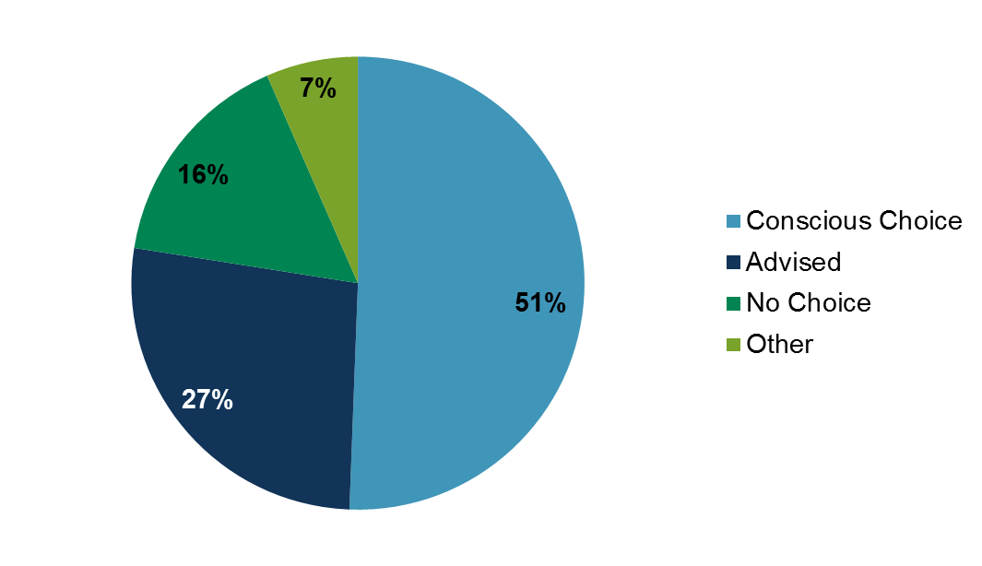
Why with-profits?
Customers were asked the reasons for choosing a with-profits product
Conscious Choice responses in more detail:
Customers appear to have been engaged with the product originally!
Notes:
Looking at the “Conscious Choice” category more granularly suggests people did research and chose WP for one reason or another

Slide 24
Customer loyalty / apathy?
Customers were asked how long they were likely to hold on to their with-profits product … Any guesses how many would stay until/after maturity?

Slide 25
Customer loyalty / apathy?
Customers were asked how long they were likely to hold on to their with-profits product … Any guesses how many would stay until/after maturity?
Is this customer loyalty or apathy?
Notes:
What does this tell us, in it for the long term?

Slide 26
Are customers engaged?
Customers were asked what info they would like to receive in annual statements
Notes:
What info wanted in annual statements
Point out the more obvious things scored highly
Worryingly low scores lower down – risks, improving projected position, gtees
Some specific comparisons overleaf

Slide 27
Are customers engaged?
Customers were asked what info they would like to receive in annual statements
Customers don’t seem to want to know what they can do about it, or what risks and protections they should be aware of!
Notes:
People want to know what the projected position is, but not what they can do to improve it
People want their current value but not the downside protection

Slide 28
Are customers engaged?
Customers were then asked what info they would like to receive when approaching maturity:
53% want this information (cf 32% in annual statements)
Suddenly customers become interested in what they can do about it
But it could be too late.
Notes:
Now move on to info received/wanted approaching maturity – people turn back on again!

Slide 29
Customer understanding - Benefits
Customers were asked what the benefits of having a with-profits product were:
Less than 20% of WP customers see guarantees or smoothing as a benefit!
Guarantees and smoothing are two of the main benefits of with-profits over other investment types. Are we so out of line with customers’ thinking?
Notes:
Customer view of the benefits of WP – respondents could choose as many as they wanted
Some sensible results but so few choosing some of the key benefits!

Slide 30
Customer understanding – Value and Options
Customers were asked if they understood how the cash-in value of their with-profits product could change and if they understood all of their options and guarantees
53% did not understand how their cash-in value could change
59% did not understand all of their options and guarantees
What does this mean for customer communications? What more can we do to try and land the message and the important features of products?
Understanding of the options available doesn’t increase with age
Notes:
Understanding of volatility in current value and options and guarantees
Little understanding of how/why value could change from one statement to the next
Ditto for what options and guarantees are available – possible use of jargon causing misunderstanding?
Segue into customer communications IF THAT FOLLOWS, otherwise just a tease

Slide 31
What do customers value about with-profits?
Conscious purchase to hold till maturity
Limited understanding of smoothing and guarantees
Short term focus
What more can we do to help increase customer engagement and understanding or help us improve communications?
Notes:
Surprising or disappointing
Holding to maturity – apathy or do they value it?
Do customers understand terminology (even MVRs) – and how can we test this?
Behavioural economics shows us customers not always economically rational
More info = better understanding of our customers = meet their needs

Slide 32
Customer Sentiment
An alternative analysis
Notes:
Now we’ll look at policyholder communication, linking back to our review of annual statements we reviewed during phase 1.

Slide 33
Tool to look at customer sentiment
Survey included freeform text responses ‘What do you like or dislike about your annual statement?’
Neural network used to measure sentiment
Able to group responses into themes
Notes:
Data from ‘free text’ responses to questions
System trained already on amazon reviews – can detect sentiment in text, character by character
A general property of certain large neural networks that are trained to predict the next step or dimension in their inputs
Also gives a numerical fingerprint of response – which allows responses with similar meanings to be identified and grouped or clustered automatically (even if they don’t use the same words)
Many possible applications – detect customer sentiment in customer by team, monitor trends etc
This tech will be available real time in the near future
Actuaries working with people from other disciplines can be a very powerful combination

Slide 34
Customer sentiment in survey responses ‘What do you like about your annual statement?’
(+1.11) [My provider] has done an excellent job for me with my SIP and I get full annual info from [my adviser] who provides my monthly income.
(+1.10) Clear and concise; everything I need on one page.
(-0.77) Nothing. Don't know enough
(-0.76) No, waste of paper
(-0.67) They are obliged to send them. Like is not a useful word in this context
Overall sentiment +0.095
Notes:
Examples showing sentiment measures of different responses
Overall sentiment value (average all responses):

Slide 35
Customer sentiment in survey responses ‘What do you dislike or would change about your annual statement?’
(+0.45) Being jargon free; easier to understand
(-1.62) Too long and complicated and does not explain anything relevant in plain English
(-1.52) Waste of paper, for which I am paying.
??? Too lengthy; too wordy; too much legal waffle ; lay out very boring ; small font; incomprehensible explanations; poor definitions; too repetitive
Notes:
Examples showing sentiment measures of different responses
Overall sentiment value (average all responses):

Slide 36
Customer sentiment in survey responses ‘What do you dislike or would change about your annual statement?’
(+0.45) Being jargon free; easier to understand
(-1.62) Too long and complicated and does not explain anything relevant in plain English
(-1.52) Waste of paper, for which I am paying.
(-1.91) Too lengthy; too wordy; too much legal waffle ; lay out very boring ; small font; incomprehensible explanations; poor definitions; too repetitive
Overall sentiment -0.096
Notes:
Examples showing sentiment measures of different responses
Overall sentiment value (average all responses):

Slide 37
Digital fingerprint allows grouping of responses
Grouping (clustering) does not rely on customers using identical language, or even spelling correctly!
Example responses grouped together:
Easy to understand
'Easy to understand; informative'
'Clear;concise;up to date'
Value
'Clear about its overall value.‘
'Comparisons of value now against 1 year previously'
Notes:
Examples showing sentiment measures of different responses
Overall sentiment value (average all responses):

Slide 38
Key themes important to customer
Clarity
Easy to understand
Keeps me informed
Value
Available online
No particular view
Notes:
Digital fingerprint also allows the grouping of similar responses
To look at themes in the free text responses for what customers really like and don’t like
Easy to understand
responses: 115
avg sentiment: 0.44
relevant words: 'easy', 'clear', 'understand'
sample responses:
'Easy to understand; informative;'
'Clear;concise;up to date'
'They are informative and generally clear to understand‘
Value
responses: 39
avg sentiment: 0.19
relevant words: 'value', 'current', 'final'
sample responses:
'Clear about its overall value.'
'Comparisons of value now against 1 year previously'
'Just the surrender and transfer value of my units.'
'Don't Know'
responses: 253
avg sentiment: 0.00
relevant words: 'n/a', 'dk', 'none'
sample responses:
'Don't know'
'N/a'
'None.‘
'Value'
'Mixed bag'
responses: 538
avg sentiment: 0.15
relevant words: 'information', 'like', 'how'
sample responses:
'I am very happy about the way the performance of my products is presented'
'Regular updates and online access to review the performance of my chosen investments'
'No, waste of paper'
Notes: responses cover the full range of sentiment from good to bad. Needs further analysis to identify clear themes.
'No'
responses: 251
avg sentiment: -0.10
relevant words: 'no', 'nothing', 'really'
sample responses:

Slide 39
Conclusion and next steps

Slide 40
Summary and Conclusions – 1 of 2
Returns are competitive, but we could do more to “advertise”
With-profits can change over the lifecycle - ongoing engagement is important
Consumers want regular and detailed information –increasingly as they near maturity
Consumers believe they have a reasonable understanding of the information being provided...
... and better relative to holders of financial products generally.

Slide 41
Summary and Conclusions – 2 of 2
However, certain key issues are not well understood...
...and many will not actively manage their policy
Clearer communication is key, but only one part of the solution.

Slide 42
Next steps
Second survey to gain deeper understanding of with-profits customers
Using sentiment analysis
Inviting companies to participate
To help inform best practice
Please contact us if you have any further feedback or comments.

Slide 43
Questions
Comments
Expressions of individual views by members of the Institute and Faculty of Actuaries and its staff are encouraged.
The views expressed in this presentation are those of the presenter.

Slide 44
Discussion Points
What level of understanding do consumers need?
Is providing more information helpful to consumers or does it simply add to the confusion?
Is it the provider’s role to educate?
Is greater tailoring of individual communications the way forward ? (is it achievable?)
Is it important that a customer understands how a closed fund operates?

Slide 45
Should you require any further information, please do not hesitate to contact:
Chair: Tim Bateman (Mazars LLP) tim.bateman@mazars.co.uk
Deputy Chair: Jonathan Welsh (Wesleyan) Jonathan.Welsh@wesleyan.co.uk
Secretary: Ben Stroud (ReAssure) Ben.Stroud@reassure.co.uk
Further working party details, including our Life Conference 2017 and CILA 2017 presentations can be found here:
https://www.actuaries.org.uk/practice-areas/life/research-working-parties/value-profits-consumers

Slide 46
Contributors
Our special thanks go out to the following contributors to Phase 1:
Mazars
Wesleyan
ReAssure
Standard Life
NFU Mutual
Sun Life Financial of Canada
Aviva
LV=
Equitable Life
PwC
KPMG
Healthy Investment
Kingston Unity
Royal London
AEGON
Phoenix Life
Legal & General
Scottish Widows
ABI
MAS

