Slide 1
Wearables and the Internet of Things: Working Party Update
Anna Spender – Director of Actuarial & Data Analytics, Psyon
Colin Bullen – Partner, Habits at Work

Slide 2
Agenda
Introduction
Overview of wearable devices and the Internet of Things
Types of measurements
Current examples of use
Data considerations
Risks and challenges
Technical developments – what the future may bring…
Considerations for the future of insurance

Slide 3
Introduction to Working Party and Brief

Slide 4
Working Party Brief
This Working Party aims to look at the emergence of wearable technology and the internet of things and their current and potential use within the health and care area
Wearable technology related to healthier wellbeing is developing quickly and the working party looks to develop an understanding of the currently available technology, and the capabilities of the next generation. This includes considering the impact of wearables on individually underwritten protection products and/or employee benefit schemes

Slide 5
Working Party members
Workstream 1 – Stakeholder analysis | Workstream 2 – Devices and uses
Chair: Anna Spender | Deputy Chair: Colin Bullen
James Cripps | Lisa Altmann-Richer
Robin Duffy | Mark Farrell
Chris Falkous | James Wigzell
Tony Horn | Wendy Yeap
Expert: Oliver Werneyer | Expert: Cother Hajat

Slide 6
Introduction
Rapidly developing area
Wide and ever expanding range of wearables, devices, apps, data aggregators & platforms
Increasing numbers of insurers have started incorporating technology into their product offerings
More than 30% of insurers worldwide* are already using wearable technology for customer engagement
* Accenture Technology Vision for Insurance 2015

Slide 7
Devices Investigated
Wrist – activity/HR | Clothing | Body | IoT | Medical
Apple Watch | Tune shoes | Ouraring | Sentiance | Quell
Fitbit | Under Armour SpeedForm | Prevent - mouthguards | AliveCor - Kardia Mobile | SEEQ Mobile Cardiac Telemetry
Mio Global | ATO-Gear Arion | Kokoon | mybitat | Stedi
Sence | Iofit shoes | Neuroon | OnKol | DIA-VIT
HELO | OMBra | Sleep Shepherd | 3rings | Shade
Garmin | Samsung WELT | Muse | Canary care | GlucoTrack
Striiv | Lumo Run shorts | Modius Health | Howz | SwellFit
Misfit | VSP Global | Moodmetric | Preventice Solutions | BeVITAL
Jawbone | InSenth IN1 | Bloomlife | Mimo | ADAMM
Moov | Osterhoutgroup | Qardio Arm | Philips lifeline | Valedo
Xiaomi |  | Freestyle Libre | Future path | iTBra
TomTom |  | Omron RS4/6/8 | my-signals
 |  | iHeart | Smartplate
 |  | Qardio | Smart cities
 |  | Lifepatch | NHS "test beds"
 |  |  | TZOA
 |  |  | Alcove

Slide 8
Devices Investigated
Wrist – activity/HR | Clothing | Body | IoT | Medical
Apple Watch | Tune shoes | Ouraring | Sentiance | Quell
Fitbit | Under Armour SpeedForm | Prevent - mouthguards | AliveCor - Kardia Mobile | SEEQ Mobile Cardiac Telemetry
Mio Global | ATO-Gear Arion | Kokoon | mybitat | Stedi
Sence | Iofit shoes | Neuroon | OnKol | DIA-VIT
HELO | OMBra | Sleep Shepherd | 3rings | Shade
Garmin | Samsung WELT | Muse | Canary care | GlucoTrack
Striiv | Lumo Run shorts | Modius Health | Howz | SwellFit
Misfit | VSP Global | Moodmetric | Preventice Solutions | BeVITAL
Jawbone | InSenth IN1 | Bloomlife | Mimo | ADAMM
Moov | Osterhoutgroup | Qardio Arm | Philips lifeline | Valedo
Xiaomi |  | Freestyle Libre | Future path | iTBra
TomTom |  | Omron RS4/6/8 | my-signals
 |  | iHeart | Smartplate
 |  | Qardio | Smart cities
 |  | Lifepatch | NHS "test beds"
 |  |  | TZOA
 |  |  | Alcove

Slide 9
Sensors
Accelerometer
Compass/magnetometer
EEG biosensor
ECG biosensor
Galvanic skin response (stress monitor)
GPS
Gyroscope
Heart rate monitor
Oximetry monitor
Skin conductance
Skin temperature

Slide 10
Measures Available
Measurements current available
Activity time | Coughing | Goal progress | Respiration rate and patterns
Ankle curvature | Distance | Heart rate/pulse | Sleep duration
Ascent/Decent (Floors) | ECG/EKG | Heart rate variability (HRV) | Sleep quality (N3/light/REM)
Blood pressure | EEG | Impacts to head (forces) | Steps
Blood sugar | Falls (in the elderly) | Light exposure (pre-sleep) | Swimming lengths
Body composition | Fitness (Cardiovascular) | Location | Swimming strokes
Body temperature | Focus/attention | Pace/speed/cadence | UV exposure
Calories | Galvanic skin responses (emotional health) | Pollution | V02 Max (derived from HRV)
Contractions | Girth | Posture and balance, pressure distribution and weight shift information | Weight

Slide 11
Measures Available
Measurements current available
Activity time | Coughing | Goal progress | Respiration rate and patterns
Ankle curvature | Distance | Heart rate/pulse | Sleep duration
Ascent/Decent (Floors) | ECG/EKG | Heart rate variability (HRV) | Sleep quality (N3/light/REM)
Blood pressure | EEG | Impacts to head (forces) | Steps
Blood sugar | Falls (in the elderly) | Light exposure (pre-sleep) | Swimming lengths
Body composition | Fitness (Cardiovascular) | Location | Swimming strokes
Body temperature | Focus/attention | Pace/speed/cadence | UV exposure
Calories | Galvanic skin responses (emotional health) | Pollution | V02 Max (derived from HRV)
Contractions | Girth | Posture and balance, pressure distribution and weight shift information | Weight

Slide 12
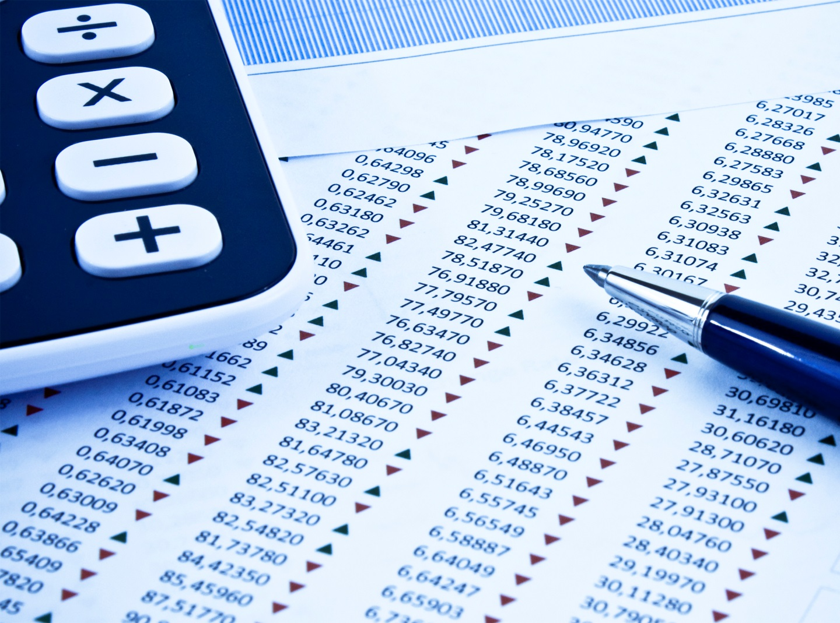
Wearables accuracy and consistency
Laboratory conditions
+/-10% accuracy on steps
Heart rate measures +/-5% accurate
Derived energy measures unreliable
Considerations
How device is worn
Self reported information
Direct measures versus derived measures
Real world
Over 100% variance in real life steps tracked
Consistency is better – individual issues
seem to be systematic

Slide 13
Current uses

Slide 14
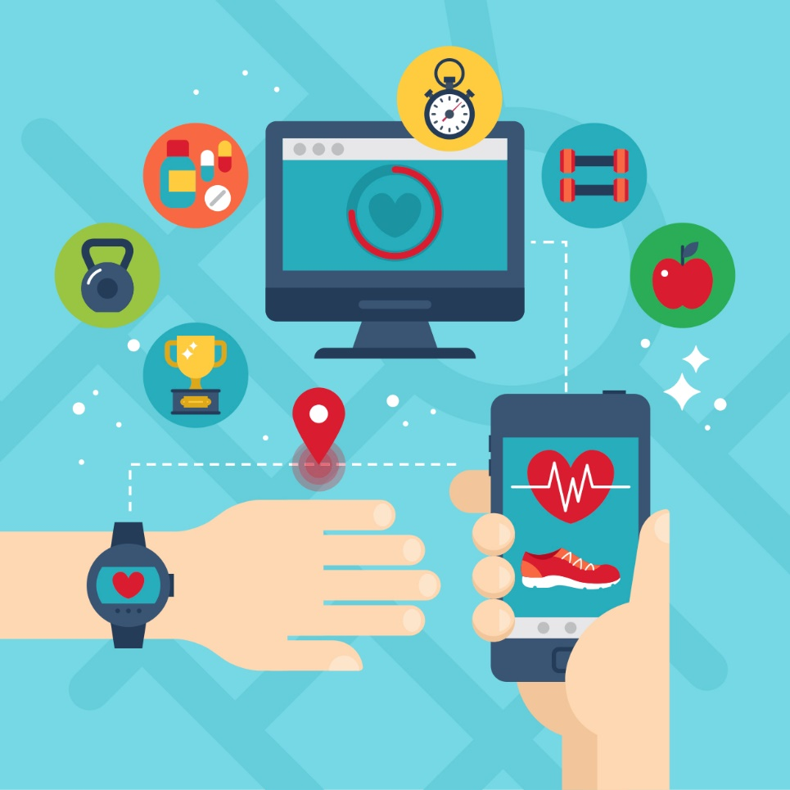
Overview of Uses
Measure health biometrics, health-related behaviours and outcomes
Engage customers in new ways
Potentially improve health as part of wider program of change
Offer disease specific products while tracking disease management
Manage chronic conditions

Slide 15
Current Uses
Life + Health insurance
Customer Engagement
Marketing
Behaviour data
Biometric data
Reward determination
Initial underwriting
Continuous underwriting
Disease specific products

Slide 16
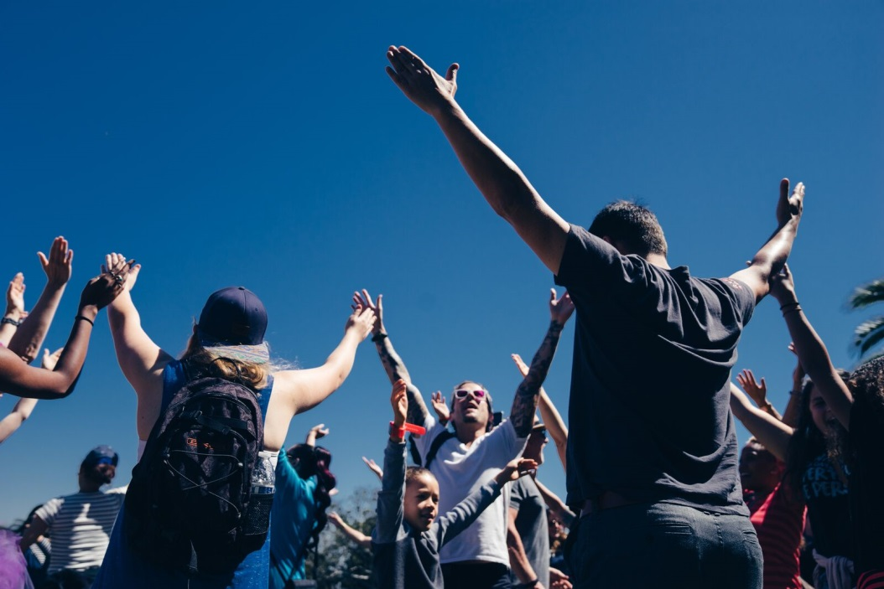
Current Uses
Wellbeing
Monitoring health behaviours
Monitoring health biometrics
Coaching to the wrist
Performance feedback

Slide 17
Current Uses
General insurance
Vehicle tracking
Claims risk management
Cover as you need it
Claims processing
Social media

Slide 18
Other Uses
Home diagnosis
Medical monitoring
Sports coaching
Mental health

Slide 19
Data Considerations

Slide 20
Data considerations
Value of data
Limitations
GDPR
Permissions and availability
Actuarial constraints
IT constraints
Cost of collection vs benefit
Future Use?
What data?

Slide 21
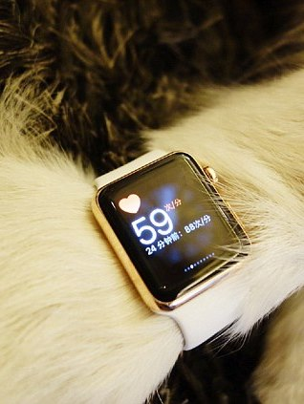
Data considerations
Fraud
Selective tracking vs frictionless tracking
Fit for purpose?
Data reliability
Potential systematic errors
The device itself, and changes in the device during the data collection period
How the device is used when collecting data of interest
How the device is worn, and impact on results
Data use
Changes over time vs a point in time
Data aggregation and analysis of cohorts
Application at individual level

Slide 22
Data considerations
Aggregators
Choice of technology = better engagement
Upgrading technology
Using API integration data aggregators collect, format and clean data from multiple sources
Data Aggregator
(API integration)
Apps
Fitbit
Garmin
Social Media
Apple Watch
Smart Phone

Slide 23
Risks and challenges

Slide 24
Risks & Challenges
Data quality and processing
Pace of change
Willingness to adopt new technology
Effectiveness of behavioural change
Need for insurance solution
Technological Capabilities
Viable Insurance Products
Customer Needs & Engagement
Insurers’ Objectives
Regulators’ Objectives
Cost vs benefit
Changing role of insurer
Data privacy
Risk pooling
Pace of change

Slide 25
Technical Developments – what the future might bring

Slide 26
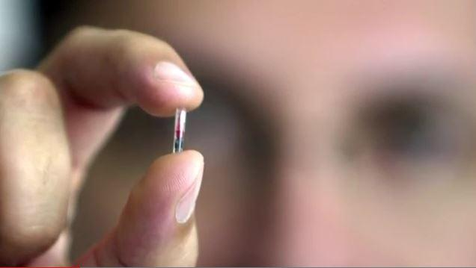
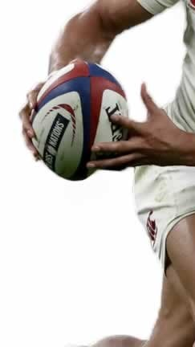
Tech Developments – What the future might bring…
Tracking emotional states
Embedded Technology
Microchipping humans!
Tracking, payment, make calls, send texts and emails, monitor health, access buildings, attend events…
Less than 10 years away…
Affective computing attempts to recognise and interpret human emotional states via:
Camera-based systems
Voice patterns
Brainwave activity
Electrodermal activity
Breath analysis
Wearables in sport
Often at forefront of technology uptake
Can give us an indication of current and future uses of technology
Some uses deemed as unfair advantage

Slide 27
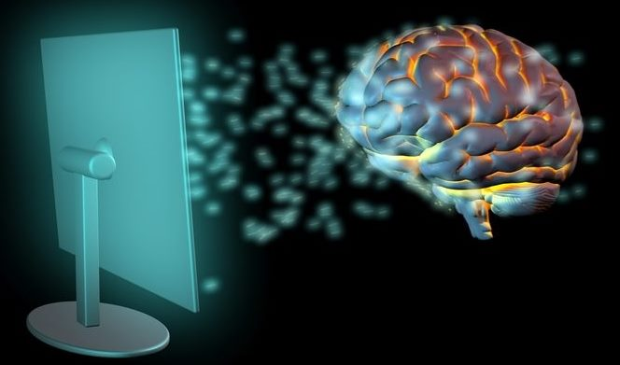
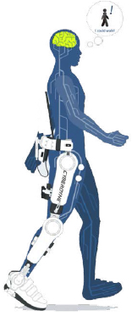
Tech Developments – What the future might bring…
Brain – computer interface
Exoskeletons
Bionic suits controlled using thought
Rehabilitation help for spinal cord injuries
Smart underwear as a solution for back pain
A “chairless chair” for use in industries such as manufacturing
Directly reads users’ thoughts
Control augmented and virtual realities

Slide 28
Considerations for the future of insurance
The future of insurance
Revolution or evolution?
Technology take up
Asymmentries/ anti selection
New opportunities
Evolution vs revolution
Living up to the hype
Who will take advantage?
Beyond reported conditions & claims
How will you collate data & analyse it
Short term vs long term
Game changing innovations
When will you get involved & how?

Slide 29
Conclusion
Rapidly developing area
Market opportunity vs catalyst for change
Technology is only part of the solution
Data considerations – data capture, legislation and interpretation
Ethical and moral behaviour in terms of sensitive personal data
Risk of market fragmentation through reduced cross subsidization
Specialist products
Those engaging will be on an evolving business case and product development journey
When will you get involved and how?

Slide 30
Questions
Comments
Expressions of individual views by members of the Institute and Faculty of Actuaries and its staff are encouraged.
The views expressed in this presentation are those of the presenters.

