Slide 1
Breakfast briefing: Task Force on Climate-related Financial Disclosure
Louise Pryor, Chair Resource and Environment Board
with
Russell Picot, Special Advisor to the Financial Stability Board’s Task Force on Climate-related Financial Disclosure

Slide 2
Task Force on Climate-related Financial Disclosures
Overview of Recommendations and Guidance
January 2018

Slide 3
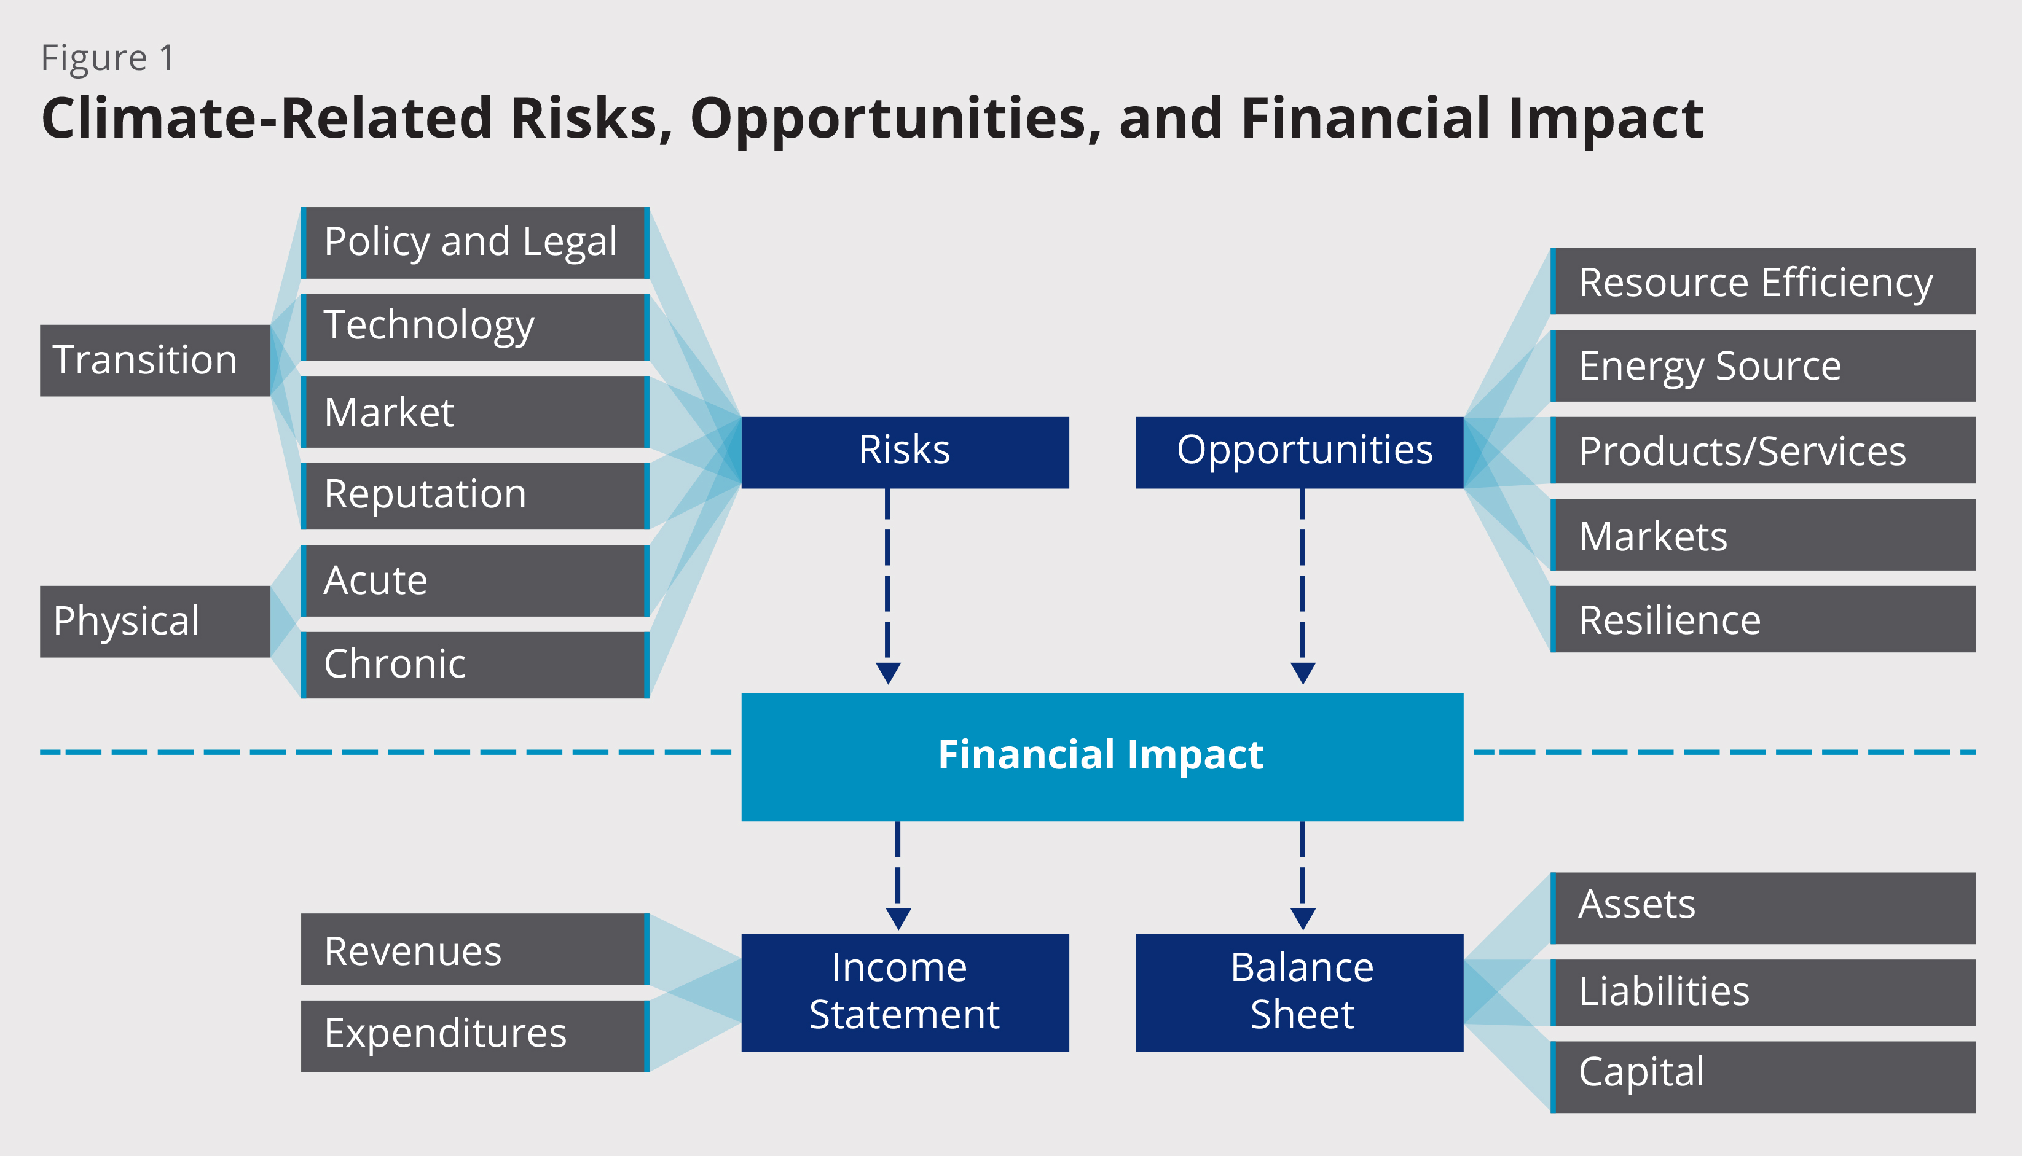
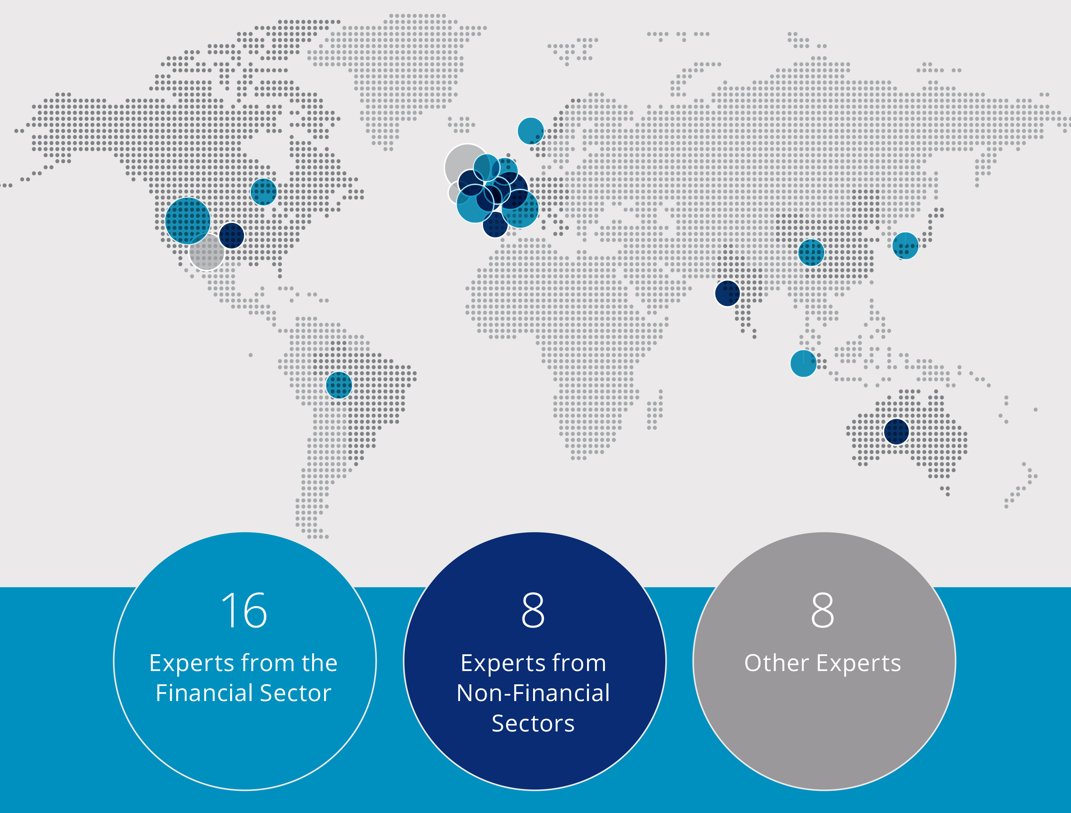
Background
G20 Finance Ministers and Central Bank Governors asked the Financial Stability Board (FSB) to review how the financial sector can take account of climate-related issues.
The FSB established the Task Force on Climate-related Financial Disclosures (TCFD) to develop recommendations for more effective climate-related disclosures that:
could “promote more informed investment, credit, and insurance underwriting decisions” and,
in turn, “would enable stakeholders to understand better the concentrations of carbon-related assets in the financial sector and the financial system’s exposures to climate-related risks.”
Industry Led and Geographically Diverse Task Force
  The Task Force’s 31 international members, led by Michael Bloomberg, include providers of capital, insurers, large non-financial companies, accounting and consulting firms, and credit rating agencies.
15
Notes:
A key objective of the Task Force’s work, as outlined by the FSB, is to develop more effective climate-related disclosures that
could “promote more informed investment, credit, and insurance underwriting decisions” and,
in turn, “would enable stakeholders to understand better the concentrations of carbon-related assets in the financial sector and the financial system’s exposures to climate-related risks.”
Our report sets out specific recommendations for voluntary disclosure to improve consistency, accessibility, clarity, and usefulness of climate-related financial reporting.
The Task Force brings a unique perspective to this work through its consensus-based and industry-led focus. The FSB chose extremely well in appointing Task Force members.
Michael Bloomberg, the founder of Bloomberg LP and former mayor of New York City, serves as chairman.
It is composed of 32 members, including four international vice-chairs, who are users and preparers of financial disclosures across a range of financial and non-financial sectors and industries. They are highly engaged and expert.

Slide 4
Background (continued)
The Task Force published its final report in June 2017.
The report outlines recommendations to help address climate-related disclosure challenges faced by:
  Issuers who generally have an obligation under existing law to disclose material information, but lack a coherent framework to do so for climate-related information, and
  Investors, lenders, and insurers who need decision-useful, climate-related information to make informed capital allocation and financial decisions

Slide 5
Focus on Financial Impact
RISKS
Transition | Policy and Legal Carbon pricing and reporting obligations Mandates on and regulation of existing products and services Exposure to litigation Technology Substitution of existing products and services with lower emissions options Unsuccessful investment in new technologies Market Changing customer behavior Uncertainty in market signals Increased cost of raw materials Reputation Shift in consumer preferences Increased stakeholder concern/negative feedback Stigmatization of sector
Physical | Acute: Extreme weather events Chronic: Changing weather patterns and rising mean temperature and sea levels
OPPORTUNITIES
Resource Efficiency | Use of more efficient modes of transport and production and distribution processes Use of recycling Move to more efficient buildings Reduced water usage and consumption
Energy Source | Use of lower-emission sources of energy Use of supportive policy incentives Use of new technologies Participation in carbon market
Products & Services | Development and/or expansion of low emission goods and services Development of climate adaptation and insurance risk solutions Development of new products or services through R&D and innovation
Markets | Access to new markets Use of public-sector incentives Access to new assets and locations needing insurance coverage
Resilience | Participation in renewable energy programs and adoption of energy-efficiency measures Resource substitutes/diversification
Strategic Planning
Risk Management
Financial Impact
Revenues
Income
Cash Flow
Balance
Assets
&
Liabilities
Expenditures
Statement
Statement
Sheet
Capital
& Financing

Slide 6
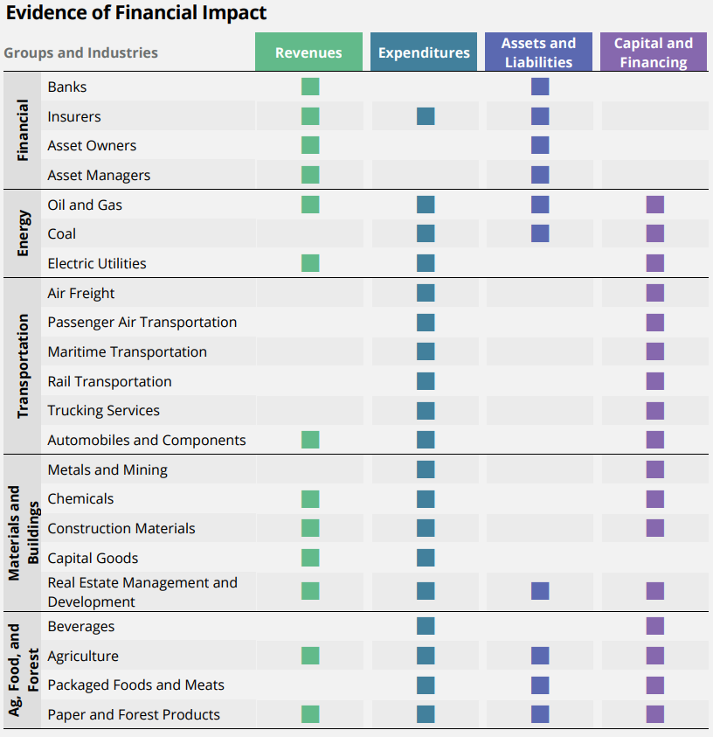
Financial Impact by Industry
To assist organizations in understanding how climate-related risks may impact them financially, the Task Force prepared a high-level overview of the types of financial impact of climate-related risks that have been identified for specific industries and groups.
The financial impacts from climate-related risks are grouped into the following general categories:
Revenues
Expenditures
Assets and Liabilities
Capital and Financing
*
*Largely, but not solely, based on select content from the Sustainability Accounting Standards Board (SASB) “Financial Impacts of Climate Risk” table in its Climate Risk Technical Bulletin
Notes:
The supplemental guidance provides industry-specific context and detail organizations should consider in developing their disclosures under the TCFD recommendations.
While every industry could experience potential financial impacts from climate-related risks and opportunities, the Task Force identified for 12 non-financial industries (and their related supply and distribution chains) more likely to be financially impacted than others due to their exposure to certain transition and physical risks around GHG emissions, energy, and/or water dependencies associated with their operations and/or products.
These 12 industries were categorized into four “groups” which are addressed in the supplemental guidance for non-financial organizations.

Slide 7
Disclosure Recommendations
The Task Force developed four widely-adoptable recommendations on climate-related financial disclosures that are applicable to organizations across sectors and jurisdictions.
The recommendations are structured around four thematic areas that represent core elements of how organizations operate:
Governance
The organization’s governance around climate-related risks and opportunities
Governance
Strategy
Strategy
The actual and potential impacts of climate-related risks and opportunities on the organization’s businesses, strategy, and financial planning
Risk
Management
Risk Management
The processes used by the organization to identify, assess, and manage climate-related risks
Metrics
and
Targets
Metrics and Targets
The metrics and targets used to assess and manage relevant climate-related risks and opportunities
Notes:
Using the common language of governance, strategy, risk management, and metrics and targets, the Task Force developed four widely-adoptable recommendations on climate-related financial disclosures that are applicable to organizations across sectors, around the world.
These are foundational recommendations that will permit the users of disclosure—investors, lenders, underwriters, and others—to understand how a company identifies its climate risk, manages it, incorporates it into its strategy and risk oversight process, and mitigates it.

Slide 8
Disclosure Recommendations (continued)
The four recommendations are supported by specific disclosures organizations should include in financial filings or other reports to provide decision-useful information to investors and others.
Governance |  |  | Strategy |  |  | Risk Management |  |  | Metrics and Targets
Disclose the organization’s governance around climate-related risks and opportunities. |  |  | Disclose the actual and potential impacts of climate-related risks and opportunities on the organization’s businesses, strategy, and financial planning where such information is material. |  |  | Disclose how the organization identifies, assesses, and manages climate-related risks. |  |  | Disclose the metrics and targets used to assess and manage relevant climate-related risks and opportunities where such information is material.
Recommended Disclosures |  |  | Recommended Disclosures |  |  | Recommended Disclosures |  |  | Recommended Disclosures
a) | Describe the board’s oversight of climate-related risks and opportunities. |  | a) | Describe the climate-related risks and opportunities the organization has identified over the short, medium, and long term. |  | a) | Describe the organization’s processes for identifying and assessing climate-related risks. |  | a) | Disclose the metrics used by the organization to assess climate-related risks and opportunities in line with its strategy and risk management process.
b) | Describe management’s role in assessing and managing climate-related risks and opportunities. |  | b) | Describe the impact of climate-related risks and opportunities on the organization’s businesses, strategy, and financial planning. |  | b) | Describe the organization’s processes for managing climate-related risks. |  | b) | Disclose Scope 1, Scope 2, and, if appropriate, Scope 3 greenhouse gas (GHG) emissions, and the related risks.
 |  |  | c) | Describe the resilience of the organization’s strategy, taking into consideration different climate-related scenarios, including a 2°C or lower scenario. |  | c) | Describe how processes for identifying, assessing, and managing climate-related risks are integrated into the organization’s overall risk management. |  | c) | Describe the targets used by the organization to manage climate-related risks and opportunities and performance against targets.
Notes:
Each of the four overarching recommendations is supported by two to three specific disclosures that organizations can include in financial filings to provide decision-useful information about their climate-related risks and opportunities.
The recommendations solicit information that is primarily forward-looking, which reflects the Task Force’s desire to raise the bar on climate-related financial disclosures where appropriate and further develop the currently limited disclosure of financial risks posed by climate-related impacts.
The Task Force is hopeful that widespread adoption will help organizations better demonstrate responsibility and foresight in their consideration of climate issues to their investors and others.

Slide 9
Key Elements of Disclosure Recommendations
Location of Disclosure
The Task Force recommends that organizations provide climate-related financial disclosures in their mainstream (i.e., public) annual financial filings.
The recommendations were developed to apply broadly across sectors and jurisdictions and do not supersede national disclosure requirements for financial filings.
If certain elements are incompatible with national disclosure requirements, the Task Force encourages organizations to disclose those elements in other official company reports.
Organizations in the four non-financial groups that have more than one billion U.S. dollar equivalent (USDE) in annual revenue should consider disclosing strategy and metrics and targets information in other reports when the information is not deemed material and not included in financial filings.
  Financial Filings
  Required annual reporting packages in which organizations deliver their audited financial results under the laws of the jurisdictions in which they operate.
  Other Official Company Reports
  Should be issued at least annually, widely distributed and available to investors and others, and subject to internal governance processes that are the same or substantially similar to those used for financial reporting.

Slide 10
Key Elements of Disclosure Recommendations (continued)
Principle of Materiality
The disclosures related to the Strategy and Metrics and Targets recommendations are subject to an assessment of materiality.
The disclosures related to the Governance and Risk Management recommendations are not subject to an assessment of materiality and should be provided because many investors want insight into the governance and risk management context in which organizations’ financial and operating results are achieved.
Scenario Analysis
The Task Force encourages forward-looking information through scenario analysis—a useful tool for considering and enhancing resiliency and flexibility of strategic plans.
Many investors want to understand how resilient organizations’ strategies are to climate-related risks.
Recommended disclosure (c) under Strategy and the related guidance asks organizations to describe the resilience of their strategies, taking into consideration different climate-related scenarios, including a 2°C or lower scenario.
2°C Scenario
Provides a common reference point that is generally aligned with the objectives of the Paris Agreement.
Scenario Analysis Threshold
The Task Force established a threshold for organizations that should consider conducting more robust scenario analysis to assess the resilience of their strategies (those in the four non-financial groups with more than 1B USDE in annual revenue).

Slide 11
Benefits of Implementing the Recommendations
Some of the potential benefits associated with implementing the Task Force’s recommendations include:
easier or better access to capital by increasing investors’ and lenders’ confidence that the company’s climate-related risks are appropriately assessed and managed
more effectively meeting existing disclosure requirements to report material information in financial filings
increased awareness and understanding of climate-related risks and opportunities within the company resulting in better risk management and more informed strategic planning
proactively addressing investors’ demand for climate-related information in a framework that investors are increasingly asking for, which could ultimately reduce the number of climate-related information requests received

Slide 12
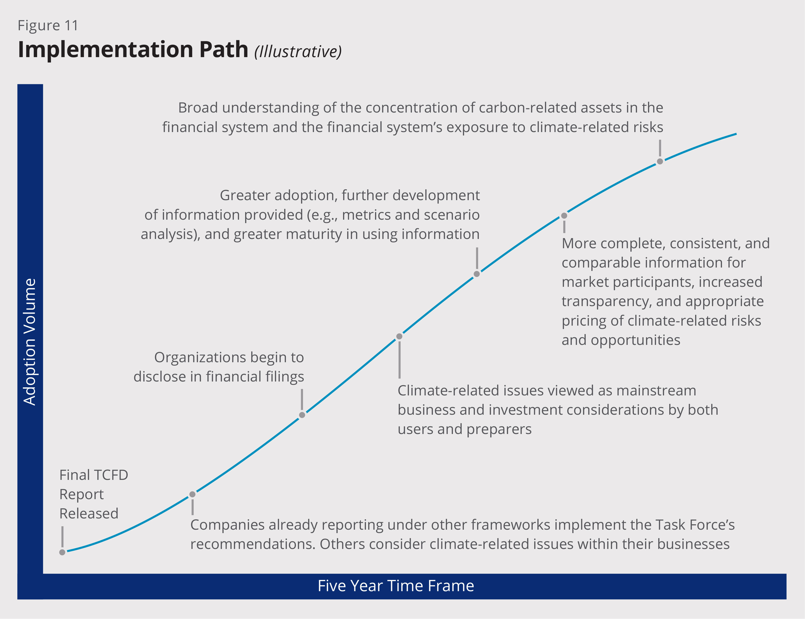
Illustrative Implementation Path
The TCFD expects that reporting of climate-related risks and opportunities will evolve over time as organizations, investors, and others contribute to the quality and consistency of the information disclosed.
Notes:
As previously mentioned, the Task Force expects that reporting of climate-related risks and opportunities will evolve over time.
While the precise timing and volume of adoption will depend on actions taken by the Task Force and others, we believe the evolution shown here could occur within the next 5 years.
Organizations already reporting climate-related financial information under other frameworks may be well positioned to disclose under this framework immediately and are encouraged to do so.
Those with less experience can begin by considering and disclosing how climate-related issues may be relevant in their current governance, strategy, and risk management practices.
This initial level of disclosure will allow investors to review, recognize, and understand how organizations consider climate-related issues and their potential impact.
Ultimately, the Task Force anticipates broad adoption of the recommendations in financial filings, consideration of climate-related issues as mainstream, and further development decision-useful information (including metrics and quantitative scenario analysis).
We plan to provide education and encourage adoption to achieve the goals of the Task Force through its completion.

Slide 13
Beginning the Journey – Illustrative Roadmap
For organizations in early stages of assessing climate-related risks and opportunities, it may be helpful to develop a roadmap for implementing the recommendations.
Year 1
Year 2
Year 3
  Compare current disclosures to the recommendations, especially Governance and Risk Management, and identify alignment and gaps
  Determine information and data needs and process changes
  Begin evaluating metrics for assessing climate-related risks and opportunities
  Incorporate climate-related risks into risk identification and assessment process as needed
  Assign oversight to board committees and management as needed
  Disclose information related to Governance and Risk Management recommendations or disclose intention to implement the TCFD recommendations
  Implement new processes for information and data collection and reporting
  Identify metrics useful for assessing climate-related risks and opportunities
  Adjust data collection to support metrics
  Identify climate-related risks and opportunities and assess whether they are material
  Identify relevant climate-related scenarios and consider how those scenarios might affect the organization
  Disclose information related to Governance and Risk Management recommendations and item (a) of the Strategy recommendation, where the information is material
  Calculate and use metrics for assessing climate-related risks and opportunities
  Integrate scenario analysis into strategic planning and/or risk management frameworks
  Disclose information related to Governance and Risk Management recommendations
  Disclose information related to Strategy and Metrics and Targets recommendations, where the information is material
Notes:
Implementing the recommendations will require organizations to collect new types of information and data from their supply chains and put in place new processes and governance structures. Integrating these changes into the business will take time and it is expected that many businesses will start on a journey to full implementation. Organizations need to show investors that they are making progress and should start by adopting an implementation plan.

Slide 14
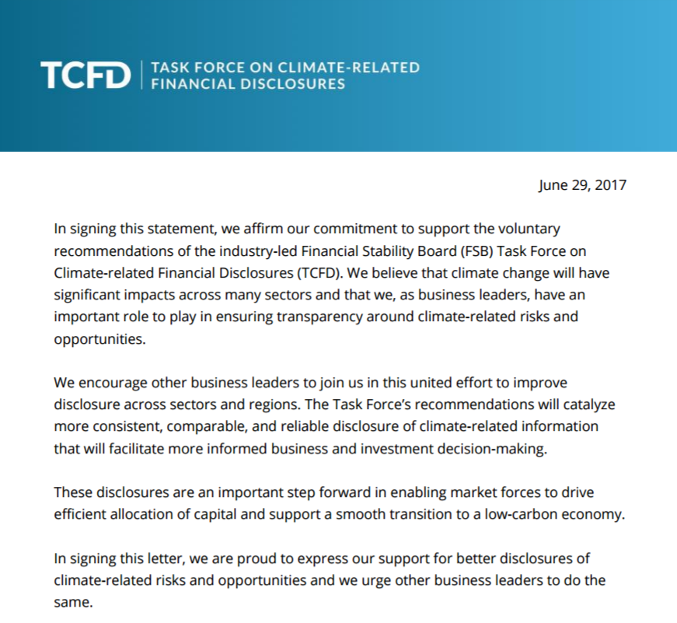
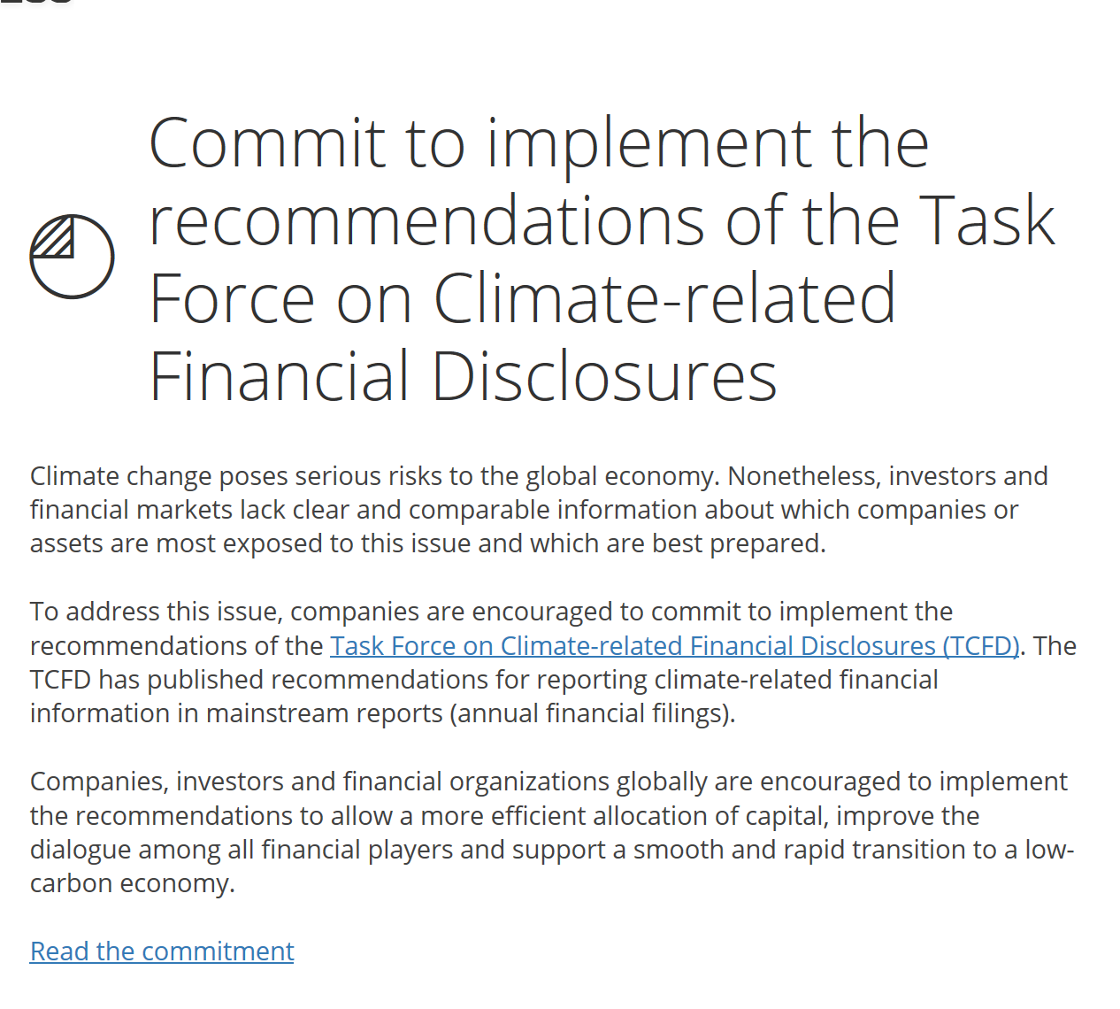
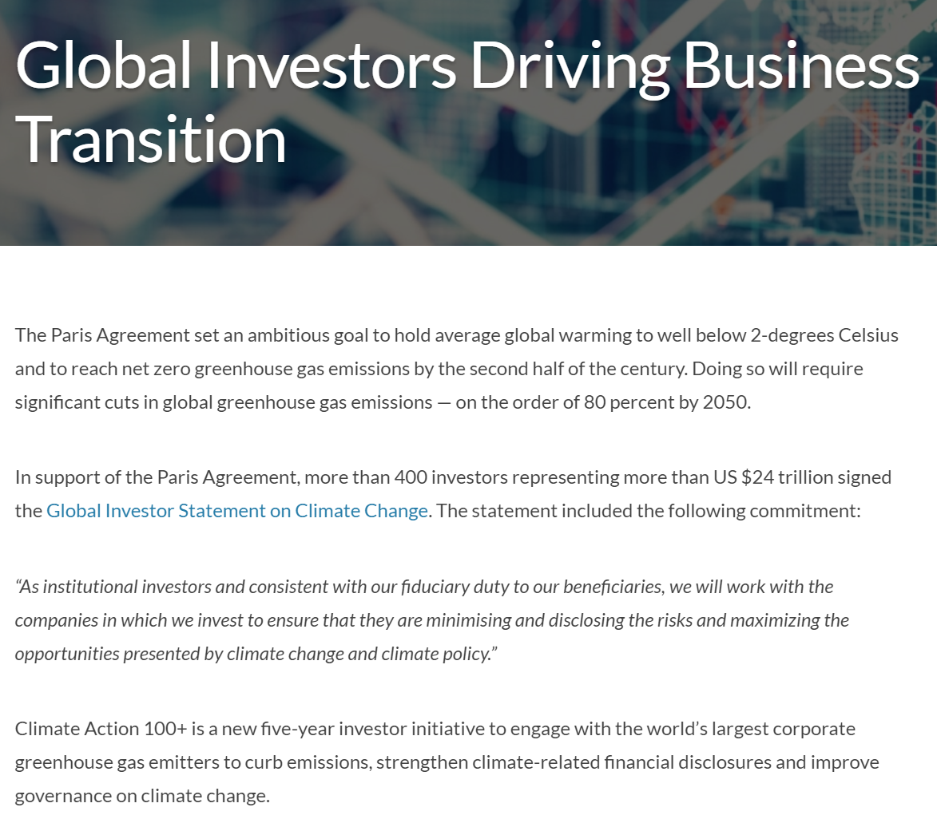
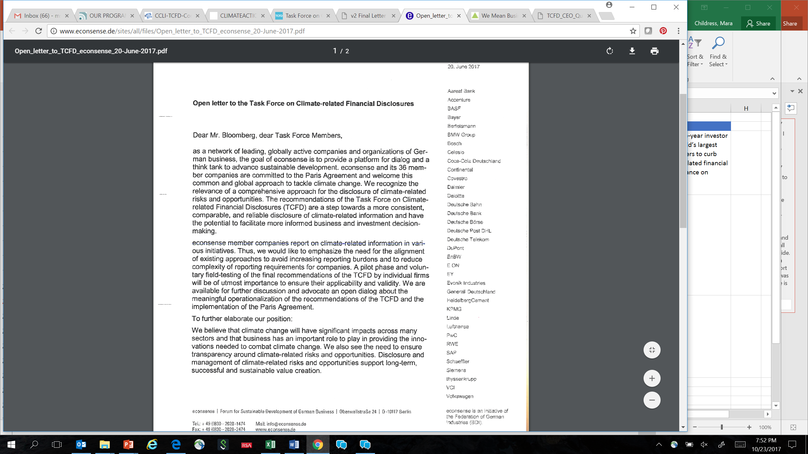
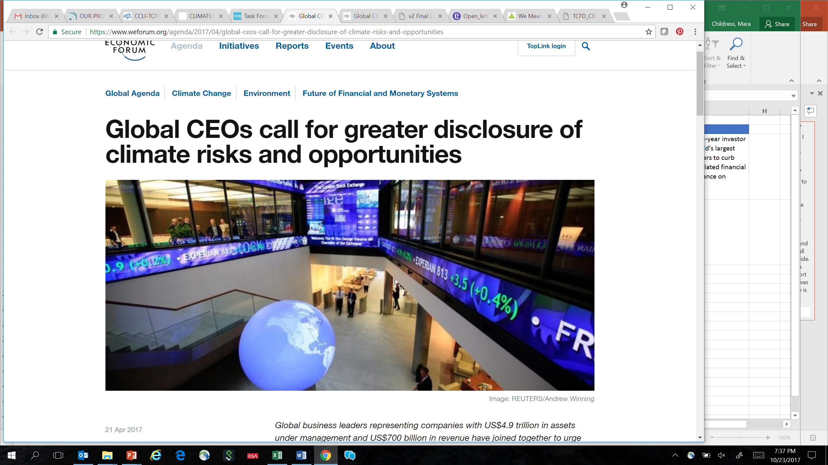
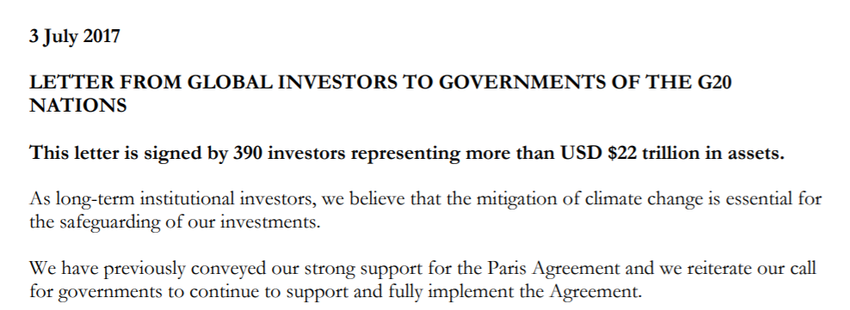
Widespread Support from Companies and Investors
In June 2017 more than 100 global CEOs signed a letter committing to support the Task Force’s recommendations. Hundreds of additional companies have since joined statements of support for or commitments to implement the recommendations.

Slide 15
Increasing Support Post Report Launch
On December 12, French President Emmanuel Macron hosted the One Planet Summit on the two year anniversary of the Paris Agreement. In advance of this summit more than 130 additional companies announced their support for the TCFD, demonstrating significant traction among both financial institutions and public corporations.
237 supporting companies with over $6.3 trillion in market cap, headquartered in 29 countries, including over 150 financial firms responsible for assest of more than $81.7 trillion. In addition to 3 national governments, over a dozen accounting organizations, and the largest proxy advisory firms

Slide 16
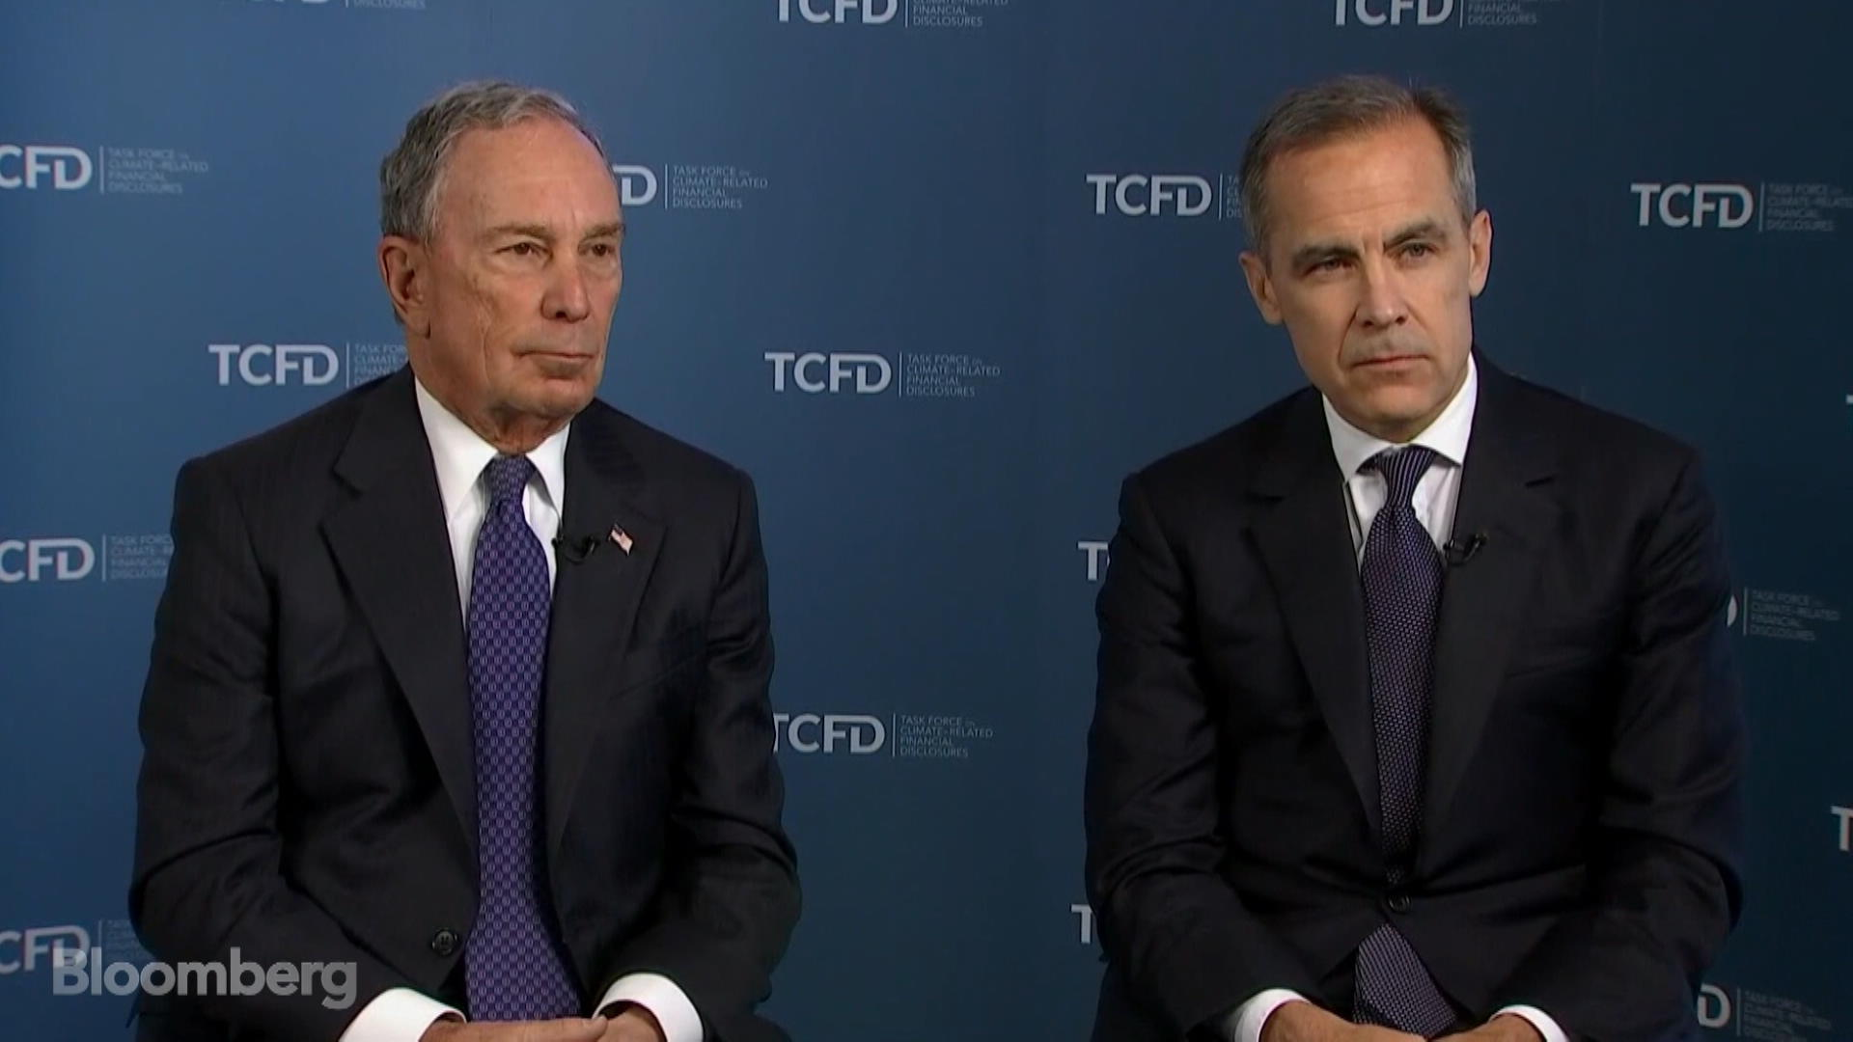
Extension of TCFD Remit
In February 2017, the FSB welcomed a proposal by the Task Force to continue its work until at least September 2018 with a focus on the following:
promoting and monitoring adoption of the TCFD’s recommendations by companies
evaluating the extent to which the recommended disclosures are meeting the needs of users

Slide 17
Current and Planned Activities
Since its report was issued, the Task Force has been focused on promoting adoption of the recommendations through the activities described below.
Current and Planned Activities
Held a two-day conference in collaboration with the Bank of England on scenario analysis.
Formed a “preparer forum” for European oil and gas companies to discuss implementation issues.
Speaking at conferences to build awareness and understanding of the TCFD recommendations.
Engaging with companies working on implementation of the recommendations to clarify expectations.
Conducting preparer workshops to support implementation.
Engaging with industry associations and NGOs to identify areas of common interest and possible collaboration.
Engaging with financial and non-financial companies, investors, industry associations, NGOs, and others to gain additional support for the recommendations.
Supporting integration of the TCFD recommendations into existing climate-related reporting frameworks.

Slide 18
Next Steps….
Read our Risk Alert: http://bit.ly/2qj9LOJ
Read the practical guide for pensions actuaries: http://bit.ly/2riAkSe
Join our Member Interest Group: send your details to rebecca.deegan@actuaries.org.uk
Join our call to action on the Sustainable Development Goals: https://www.actuaries.org.uk/news-and-insights/public-affairs-and-policy/sustainable-development-goals-and-actuarial-profession

Slide 19
Questions
Comments

