Slide 2
Cyber Risk Capital
Cyber Risk Working Party
Simon Cartagena – Deputy CRO, SCOR UK
Jasvir Grewal - Head of Data & Analytics, Global Fac, WTW

Slide 3
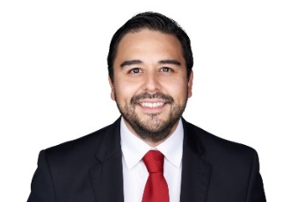
Cyber Risk Working Party
The purpose of the working party’s research is to provide insight for actuaries working on capital requirements for insurers setting out the potential impact of cyber risk events and the measures available to mitigate this risk.
The aim is to create a greater awareness of the risks for insurers, and highlight emerging issues in an area that is changing rapidly as the dependency on computer systems to support insurer’s business increases.
The working party has tried to produce frequent and relevant content in order to contribute to the discussion across the industry on cyber risk
The working party actively and encourages new members with new perspective on the risk. Please get in touch if you’d like to join and actively contribute to the group.
Simon Cartagena
Deputy CRO – SCOR Specialty
Jasvir Grewal
Head of Data & Analytics – Global Fac, WTW
https://www.actuaries.org.uk/practice-areas/risk-management/risk-management-research-working-parties/cyber-risk-investigation

Slide 4
Sessional Paper
The (re)insurance industry is maturing in its ability to measure and quantity cyber risk. The risk and threat landscapes around cyber continue to evolve and in some cases rapidly. Both the threat actor environment can change as well as the exposure base depending on a variety of external factors such as political, economic and technological factors.
The rapidly changing environment poses interesting challenges for the Risk & Capital actuaries across the market. The ability to accurately reflect all sources of material losses from cyber events is challenging for capital models and the validation exercise. Furthermore, having a robust ERM framework supporting the business to evaluate cyber risk is an important consideration to give the board comfort that cyber risk is being effectively understood and managed by the business.
This paper discusses cyber risk in relation to important risk and capital model topics that actuaries should be considering. The capital models are faced with a challenge to model this rapidly changing risk in a proportionate way that can be communicated to stakeholders. As model vendors continue to mature and update models the validation of these models and the ultimate cyber capital allocation is even more complex as one’s view of risk could change rapidly from year to year depending on the threat or exposure landscape as demonstrated by the ransomware trends in recent years).
This paper has been prepared primarily with General Insurers in mind however the broader aspects of capital modelling, dependencies and ERM framework are relevant to all disciplines of the profession.

Slide 5
Scope
Cyber Risk definition - the scope includes all three of the main categories of cyber risk that an insurance company is exposed to:
affirmative (underwriting) cyber risk,
non-affirmative (underwriting) cyber risk, and
operational cyber risk.
Capital definition: we do not consider the differences between different solvency capital setting regulations.
Considerations discussed are as those that would be used within a Solvency II “internal capital model” (as opposed to standard formula or any other regulatory guidance).
However, many considerations can generally be applied more broadly to situations where cyber risk needs to be modelled.

Slide 6
Agenda
Cyber Risk Landscape
Capital Modelling
Validation
ERM

Slide 7
Cyber Risk Landscape
Simon Cartagena

Slide 8
Why is Cyber Capital Uncertain?
Threat Actors
Treat Vectors
War
Wordings
Terrorism
Technology
Capacity

Slide 9
Threat Landscape Evolution
90% Ransomware attacks impacted ability to operate
86% attacks caused loss or revenue/business
~$800k average ransom payment
Manufacturing & Utilities highest average ransom payments
66% of companies hit by a ransomware in 2021 (4% got all their data back)
89% of affected companies had insurance, but 94% found it hard to get cover
Sophos Cyber Security Report: The State of Ransomware 2022 Findings
From an independent, vendor-agnostic survey of 5,600 IT professionals in mid-sized organizations across 31 countries.
https://assets.sophos.com/X24WTUEQ/at/4zpw59pnkpxxnhfhgj9bxgj9/sophos-state-of-ransomware-2022-wp.pdf

Slide 10
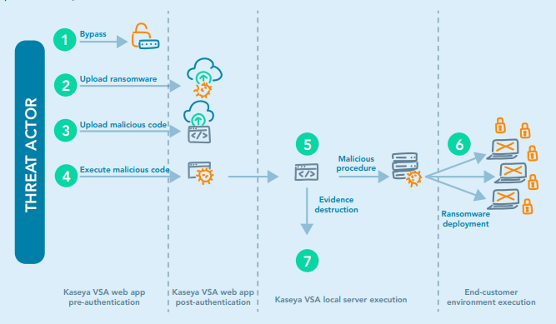
Supply Chain Attacks
SCOR Expert Views - Cybersecurity of the supply chain: https://www.scor.com/en/news/cybersecurity-supply-chain

Slide 11
2022 Developments
War in Ukraine
Weapons Developments
Accelerated the Cyber Arms Race, the cyber war began long before the “land war”.
46 zero day weapons developed
Focus of attacks has been mainly to disrupt, confuse and disorientate communications
Blackwired anticipates a tidal wave of attacks on global targets when the conflict in Ukraine allows the resources of the bad actors to be focused elsewhere.
Will this lead to increased frequency and/or severity of insurance claims in the coming months and years?
Three significant weapons developed in 2022 that change the risk landscape forever:
Click-less phishing: evolution of attack whereby the mere delivery of the email is sufficient to deliver malware.
Search poisoning: attack method in which cybercriminals create malicious websites and use search engine optimization tactics to make them show up prominently in search results
Supply Chain poisoning: Most software contains proprietary and open-source components. If any of those components have vulnerable code, hackers can exploit the vulnerabilities to access networks
Information provided by BLACKWIRED who are the largest cyber observatory in the world with a unique lens on adversaries and their preparations to attack.

Slide 12
What does it all mean?
How do we quantify the uncertainty (especially in the tail)?
Do our current approaches adequately capture and/or allow us to respond to the evolving risk?
How effective are the latest wordings/clauses?
Does it even matter?

Slide 13
Capital Modelling
Jasvir Grewal

Slide 14
Some questions for the audience to get us started…

Slide 15
Underwriting Risk
Key Considerations:
Data: The industry is still working towards standardising cyber data and other issues such as changing categorisations (e.g., movement away from non-affirmative towards affirmative cyber), and unclear loss causation codes.
Stability of parameterisation over time
Adequate allowance for systemic risk
Changing nature of the class: Changing drivers, threat actors, loss trends, increasing interconnectivities between companies, varying targeted industries.
Experience Based
Exposure Based
Scenario Modelling
Third Party Model Vendors
Are we adequately allowing for the true extent of the changing cyber landscape within capital models?

Slide 16
Other Risks: Key Considerations
Reserve Risk
Changing:
development patterns, frequency and severity of losses, cyber categorisations.
range of threat actors continually developing (e.g., from sole hackers to state backed attacks).
duration of the tail (in situations where there might be delegated authority/claim disputes)
Operational Risk
Meaningful cyber operational risks that are relevant and appropriate for the insurance company rather than generic scenarios.
See earlier paper provided by the working party.
Market Risk
RI Credit Risk
Recent high profile legal disputes over cyber policy coverages illustrate that disputes can occur.
Rating agencies already consider cyber risk as part of their credit rating work, given that a cyber operational risk event could have significant adverse implications for a company.
Adequate allowance for systemic risk where losses across occur across market risk and cyber risk distributions simultaneously?

Slide 17
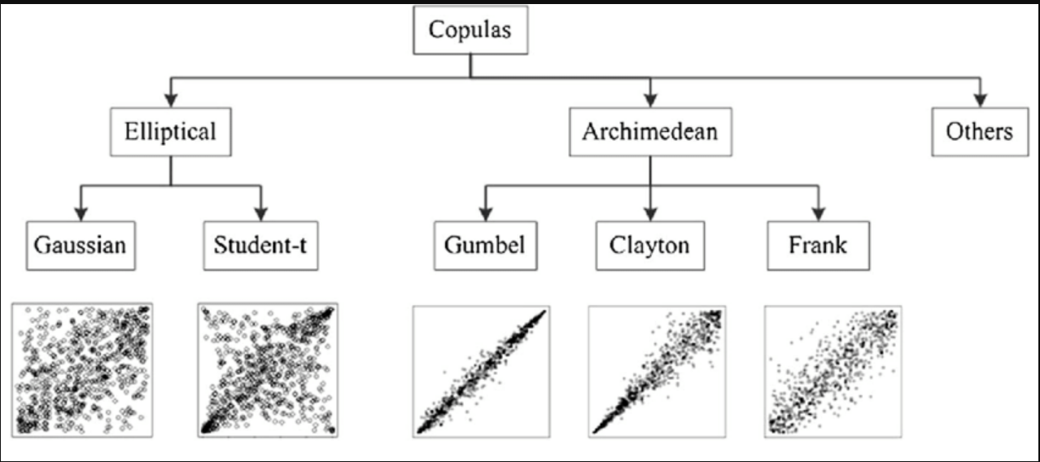
Dependencies: let’s parameterise together [1]

Slide 18
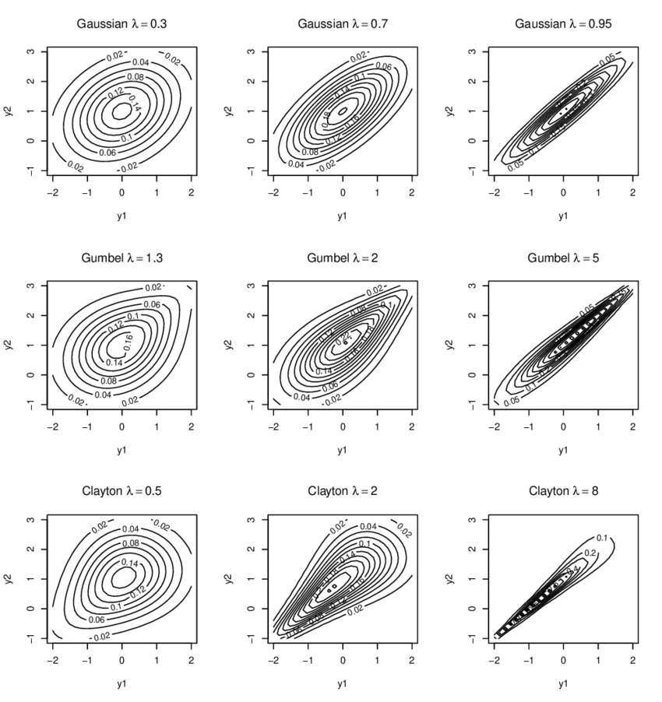
Dependencies: let’s parameterise together [2]
Lack of data to accurately parameterise the tail.
Some (re)insurers use dependency libraries to assist.
How effective is this approach in practice?
Affected by availability heuristic?
There are alternative approaches!

Slide 19
Capital Allocation
Impacts of Capital Allocation
Conversations about tail exposures – not just the mean!
Trade-off for RI premium spend vs risk retention.
Practical Considerations
Mitigators
Cyber RI Coverage
Mitigating Processes
Allocate to all types of Cyber Risk
Affirmative
Non-Affirmative
Operational
Staff Compensation
Wide range of capital allocation methodologies – often this is a real discussion point within (re)insurance companies.
Uncertainty in cyber capital modelling compounds the issues.
Considering cyber capital loads carefully is important especially in the current market dynamic where there is uncertainty in pricing adequacy, rapid increases in rates, and a shortage of underwriting talent.

Slide 20
Validation & ERM
Simon Cartagena

Slide 21
Validation Focus
Benchmarking
Materiality assessment/Risk Ranking
Peer Review
Methodology & Assumptions Review
Stress and Scenario Testing
Sensitivity Testing
Reverse Stress Testing
Goodness of fit
Backtesting
Stability & Convergence Testing
Cyber risk is a complex issue that constantly evolves, and it has been a challenging task to communicate all the risks in cyber security into something measurable and quantifiable. Hence, it’s important that the challenge contains some expertise in the cyber security space so that any material issues are not overlooked.
Given the maturity of the risk modelling, some of the more relied upon validation tools will be less useful than for other risks.

Slide 22
Attritional & Large Loss Deep Dives
How has the claims frequency and or severity changed over time?
Suitable volatility assumptions? Distribution selection process? Review and governance?
Have the cyber coverages offered changed?
How does this affect your parametrisation? Is it performed on a regular enough basis to remain relevant?
Has the companies risk appetite/strategy changed?
If so how has the parametrisation process addressed this?
Does the parametrisation process include an implicit/explicit cat load?
How does the current threat actor and/or threat vector landscape inform the view of risk going forward? For example, has the business considered the zero-day black market or commercial ransomware groups activity in estimating its loss ratios?

Slide 23
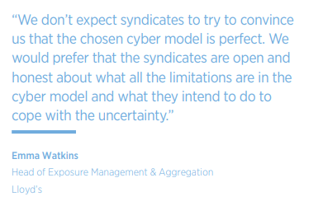
Catastrophe Risk Validation
*
Cat Models
Expert Judgement
Deterministic/Footprint Scenarios
Loss curves e.g. OEP/AEP/Stochastic output
Hybrid
There were no true cyber catastrophic events to leverage from
The estimation of cat losses is currently a theoretical exercise
What is your companies modelling philosophy for cyber?
What are the key exposures and how might they aggregate?
Can you communicate what type of scenarios are driving the tail? Do you agree with them?
* Cyber IQ Evaluation of Cyber Models | © 2022 Arthur J. Gallagher & Co.

Slide 24
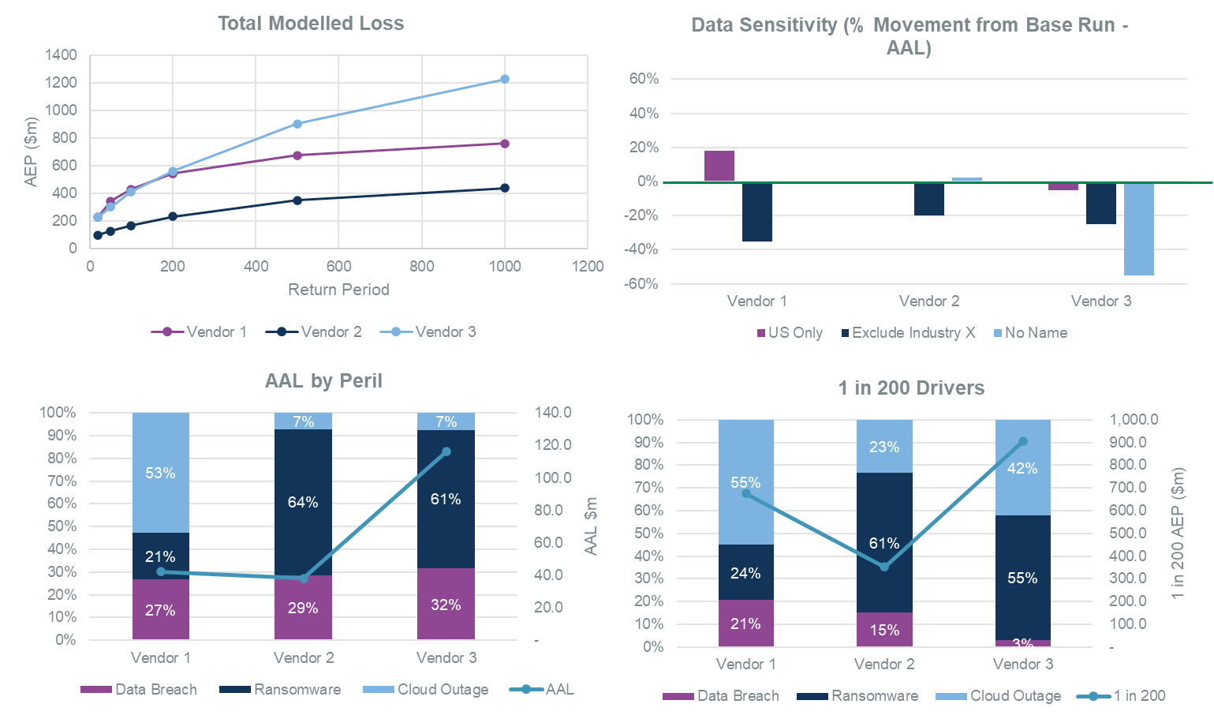
External Cyber Catastrophe Models
Demonstrate understanding of the model
Strengths and weaknesses
Model parameters
Model output adjustments
Vendors Validation
Demonstrate model suitability to the portfolio
Scenarios suite a good match for the exposure
Multi-model approach required
Independent Validation
Backtesting
Comparison to industry estimates
Sensitivity & Stress Testing
Stability testing
Theoretical results on an artificial portfolio performed for the ASTIN 2022 conference.
Data Sensitivity analysis performed by Gallagher Re

Slide 25
Other Risks
Has sufficient consideration/testing been performed on other risk areas such as:
Operational Risk: Dependency testing in the tail should be performed to asses if there is sufficient correlation between cyber operational risk events and cyber cat events. Type 3 or RSTs can be useful in assessing this.
Market Risk: Do you consider that a Cyber event will cause market disruption? If so is it captured in your modelled output somehow?
Credit Risk: Do cyber events make credit risk any more likely?
Cyber as a Peril: Cyber can impact other lines of business, has the capital model allowed for this somewhere, either through explicit pricing/premium risk pamaterisation or via scenarios?

Slide 26
Cyber Dynamic Feedback Loop
4. Business impact
Exposure monitoring
1. Identify Cyber Risks across the business
Insurance Risk
2. Evaluation & Qunatification of Cyber Risks
ORSA
3. Managing Cyber Risk
Risk Appetite
Operational Risk
Strategic Risk
Stress & Scenario testing
Pricing/modelling
Risk tolerances
Reinsurance
Business planning
Profit and Loss attribution
Capital intensity
Risk Limits

Slide 27
Quick Note on Wordings
“Clarity in the London market? Perhaps but either the wordings developments should not impact the tail risk/capital
Clause coverage | Clause coverage | LMA5564 | LMA5565 | LMA5566 | LMA5567 | Munich Re/Marsh/Aon | Beazley
War and Cyber Operations in the course of war
Cyber Operations that have a “major detrimental impact" on the functioning of a state security defence or essential services
Cyber Operations that are retaliatory between specified states (G7) | leading to 2 or more specified states becoming impacted states
 | without leading to 2 or more specified states becoming impacted states
Effects on by standing cyber assets
Other losses due to cyber operations not set out in all of the above | without specified coverage limits
 | with specified coverage limits

Slide 29
Questions
Comments
Expressions of individual views by members of the Institute and Faculty of Actuaries and its staff are encouraged.
The views expressed in this presentation are those of the presenter.

