Slide 1
Data, Cognitive & IoT
Graham Jackson & Steve Mills

Slide 2
Agenda
Big Data Analytics
Cognitive Computing
The Internet of Things

Slide 3


Today’s Speakers
Graham Jackson
Graham Jackson is an Associate Partner in IBM's Global Business Services Insurance Practice. Graham has a deep background in P&C insurance developed from his working within the industry in Australia, New Zealand and the UK, prior to joining IBM. Graham's specialisms are in core insurance business transformation, with particular focus on underwriting, actuarial pricing, reinsurance and claims. More recently, Graham has led the UK deployment of Watson Cognitive solutions leveraging unstructured data in claims, underwriting and robotics, and then in IoT insurance propositions.
Email : graham.jackson@uk.ibm.com; Mobile : 07710 981405
Stephen Mills
Stephen Mills is an Associate Partner in IBM's Cognitive Solutions Insurance Practice. Stephen has spent the majority of his career working with Financial Services customers on data and analytics related projects including regulatory reporting (Solvency II), Customer Insight and Data warehouse related projects. More recently Stephen has led the IBM Data & Analytics strategy capability working with a number of financial services clients on topics such as Data Target Operating Model, Data Governance and Analytics Competence Centres.
Email : stephen.mills@uk.ibm.com; Mobile : 07966 265804

Slide 4












The Insurance Industry Is Undergoing a Significant Transformation
Historically conservative, now the majority insurance executives believe new business models will impact their industries more profoundly than ever before
Changed Customer Expectations
The Explosion of Data
ANALYTICS
SENSORS
INFORMATION
DATA
Changing Risks
Transition in the Workforce
  Source: Centerline Digital

Slide 5
Who will win the Race?
The customer interface has become important for disruptive business models
The world’s largest taxi company…
… owns no cars
The world’s most popular media owner…
… creates no content
The world’s most valuable retailer…
… owns no stores
The world’s largest accommodation provider…
… owns no estate
The world’s largest insurance company…
… ?
?
  Source: The Battle Is For The Customer Interface, Tom Goodwin, Havas Media, March 2015 - http://techcrunch.com/2015/03/03/in-the-age-of-disintermediation-the-battle-is-all-for-the-customer-interface/

Slide 6
All insurance processes are candidates for disruption
Telematics, Smart Home, WorkRight, Predictive Maintenance, Weather, Health, Cyber Security
Redesign of underwritings processes, (semi-)automations of knowledge work
Finance performance management (predictive, cognitive), risk management, auditing, compliance
Marketing
Distribution
& Service
Underwriting
Claims
Finance & Risk
Personality insight, Customer DNA, City Analytics, Behavior Based Customer Insight
On-demand, personalized access to advisor experience for clients and agents, Robots, new services (e.g. legal), Company Analytics
Anti-fraud, (semi-)automations of knowledge work in claims, complaint management

Slide 7
Big Data Analytics
An IBM Perspective

Slide 8
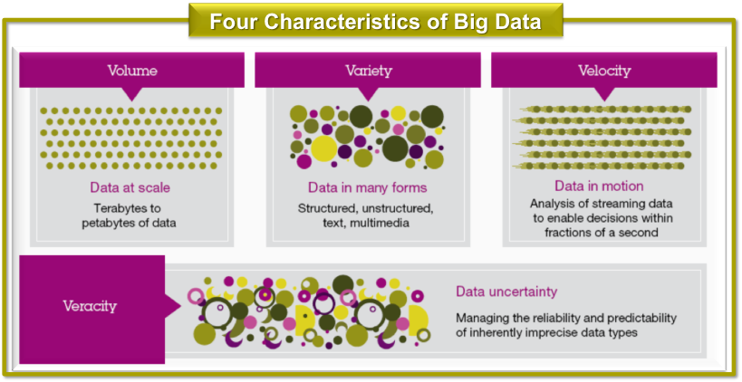
Three years ago we’d have been discussing the merits of the 4 V’s… not anymore.

Slide 9
Organisations are looking to move from Descriptive to Cognitive Analytics

Slide 10




Analytics leads to actionable business insights that can drive new types of innovation
Analytics facilitates new types of innovation
Examples of data-infused innovation
Big data and analytics insights motivate new products, services, processes and business models
Big data itself is intrinsic to the formation of new ideas
Improve Customer engagement for Retirement planning
How do you use big data and analytics?¹
Developing new, innovative products and services
71%
Refining and improving internal processes
66%
Predict and identify health issues early through data
Conceiving new innovative ideas
66%
Creating or supporting innovative business models
63%
n=340
Provides new app for storing and managing insurance policies centrally
Notes:
10
10

Slide 11








Examples of Big Data Analytics at Work
Cancer Research
Connected Vehicle
Price Optimisation
Network Optimization
Customer Interaction
Race Optimisation
Performance
Predication
Traffic Analysis

Slide 12
How to get organised in the new world of Big Data Analytics
1. Enterprise . . . . . . . .approach to managing analytics
2. Leadership . . . . . . . . . . . . Passion, commitment and control
3. Specialists . . . . . . . . . . . . . . . . . . . . to derive insights
4. Architecture . . . . . . . . . . . . Flexible and fit for purpose
5. Data . . . . . . . ……... Breadth and quality
6. Protect. . . . . . . . . . the asset to maintain quality and avoid fines

Slide 13



1. How companies are getting organised: Starting with people and building a culture that infuses analytics everywhere
1
1. Start with your people
Develop a curiosity driven workforce
Move from elite few to empowered many
Imagine what’s possible!
CDO
Business Users
Data Scientists
Lead a data-driven transformation
Fuel their curiosity
and creativity
Innovate faster
and scale securely

Slide 14
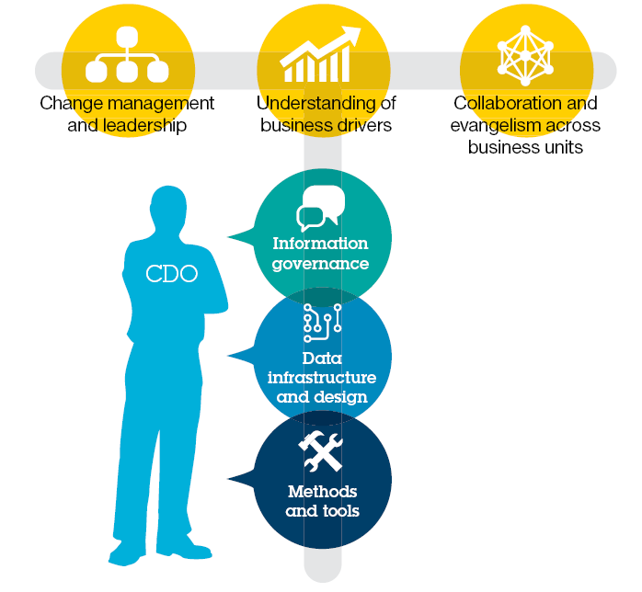
2. The CDO is there to not only protect the data assets of the organisation but also to support the business to exploit the value hidden in the data
Source: The new hero of big data and analytics: The Chief Data Officer, IBM Institute for Business Value. ©2014 IBM

Slide 15
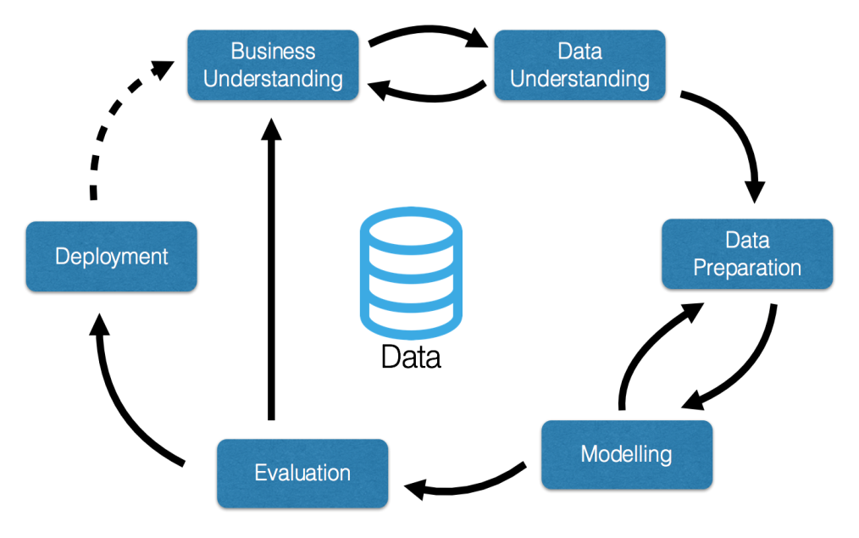
3. Data Science functions are emerging as experts to exploit the value in the data to provide insight not seen before
Understand
what’s happening
Mine Content
Accelerate Decisions
Optimise Processes
Find Patterns & Derive Insights
Fast, interactive reporting from any source
Customize visualizations
Combined views of what happened vs what will happen
Understand not only what happened, but why
Identify trends and patters across time in unstructured content
Real-time analytics
Wide range of analytics on multiple data types - machine learning, natural language, text and more
Infuse predictive analytics into business processes
Broad set of analytical techniques: big data, sentiment analysis, next best action
Reveal hidden patterns in data
Tell stories using powerful visualizations
Allow users to ask questions, explore data and get insights

Slide 16
4. A new (flexible) architecture is required to gain the full value from information
All Data
Data & Analytics Strategy, Integration & Managed Services
New / Enhanced
Applications
Big Data & Analytics Platform
Machine/Sensor
Information Integration & Governance
What is happening?
Discovery and exploration
Better and Individual Pricing
Real-time Data Processing & Analytics
Policy
Operational data zone
Landing, Exploration and Archive data zone
Deep Analytics data zone
Enhanced 360 Degree View
What action should I take?
Decision management
What did
I learn,
what’s best?
Cognitive
Why did it happen?
Reporting and analysis
Broker
Claims
EDW and data mart zone
Claims Analytics & Real-time Fraud Detection
What could happen?
Predictive analytics and modeling
Social Media
Batch or Real Time Next Best Action
Location
Litigation & Other 3rd party
Data & Analytics Infrastructure
Information Sharing & Transparency
Notes:
IBM Big Data & Analytics
© 2013 IBM Corporation
16

Slide 17
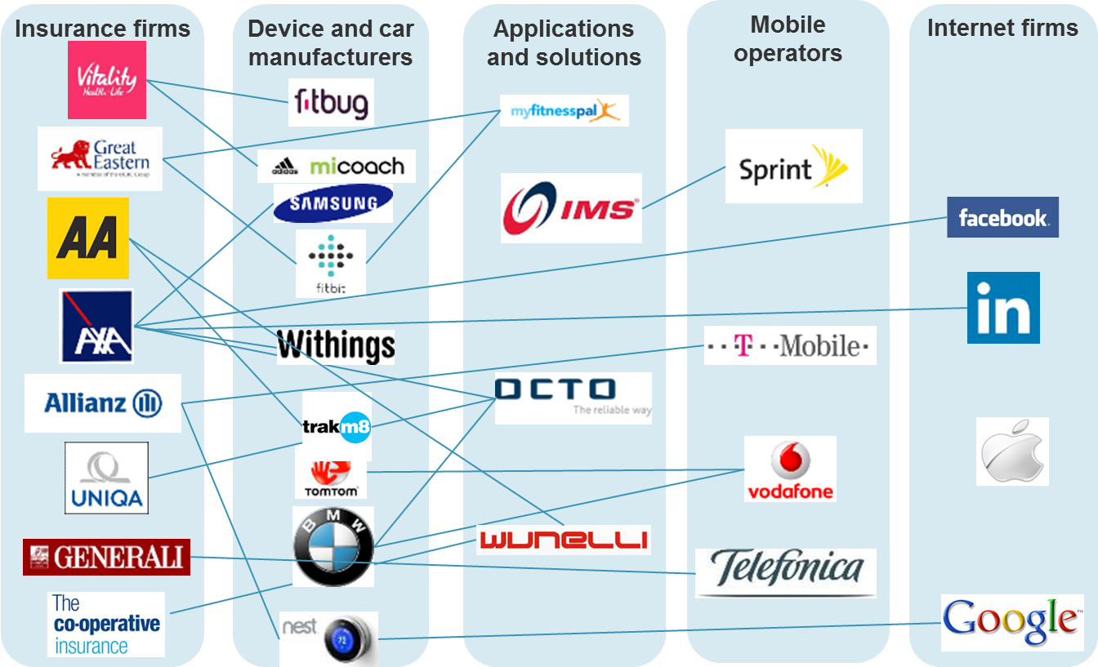
5. Breadth of Data : Insurers are now looking outside their organisations for sources of value
Source: Forrester Research.

Slide 18
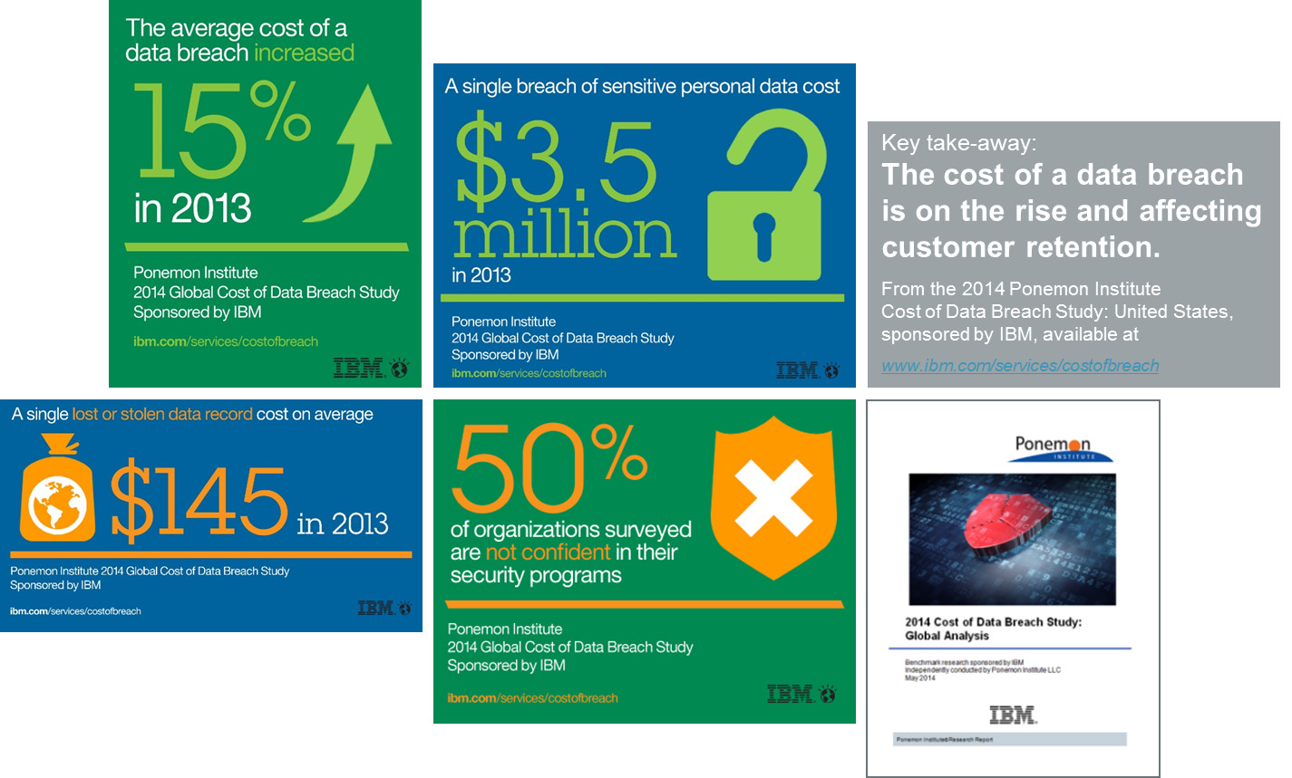
6. How to keep out of jail: Understand and manage your data environment to avoid Data Privacy risks & costs

Slide 19

The new General Data Protection Regulation (GDPR) has arrived
GDPR has just been adopted and is applicable as of 2018
It also has international reach – applying to any organisation that processes data of EU data subjects.
Fines for non-compliance will increase substantially up to a maximum fine of €20 million or 4% of global annual sales, whichever is higher
GDPR will fundamentally change the way companies must manage their data
  Any handling of Personal Data throughout its entire life cycle, from collection to deletion, is considered “processing”. Even remote access is considered “processing”.
The majority of US and EU companies are not ready for the new Privacy requirements of the GDPR

Slide 20
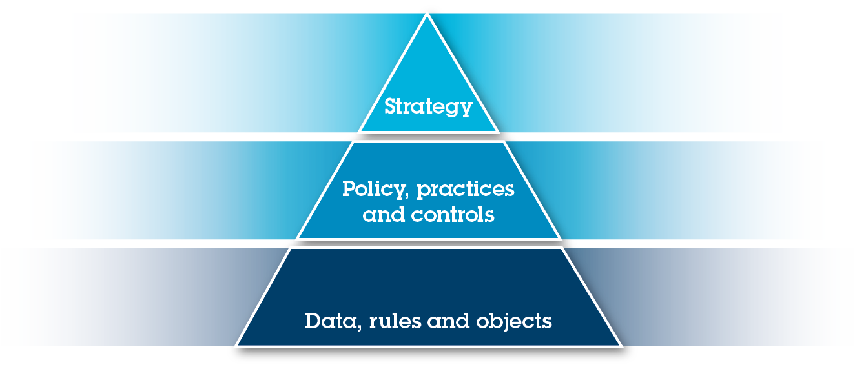
A TPM Framework is needed for a robust Privacy operating model addressing a range of dimensions
Designed to build a bridge between business, Legal, IT, and management structures, the TPM provides a reference for how to understand, analyze, govern and control privacy from the strategy level down to the data level.
Governance Objectives
Risk Threat Analysis
Compliance
& Audit Levels
Incident Response
Privacy By Design
Policy Alignment & Structure
Minimization & Collection Process
Privacy Impact Assessment
Privacy Audit
Internet Of Things
Third Parties
Training
Data Usage Compliance & Testing
Data Taxonomy & Classification
Data Mapping
Business Continuity Process

Slide 21
Cognitive Computing

Slide 22
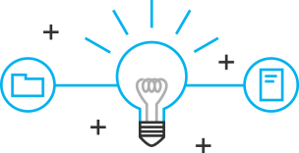

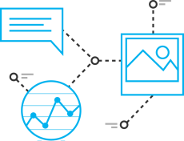
Cognitive vs Traditional Applications – the differentiators
Learning
They never stop learning. As a technology, this means the system actually gets more valuable with time. They develop “expertise”. Think about what it means to be an expert- - it’s not about executing a mathematical model. We don’t consider our doctors to be experts in their fields because they answer every question correctly. We expect them to be able to reason and be transparent about their reasoning, and expose the rationale for why they came to a conclusion.
Reasoning
They reason. They can understand information but also the underlying ideas and concepts. This reasoning ability can become more advanced over time. It’s the difference between the reasoning strategies we used as children to solve mathematical problems, and then the strategies we developed when we got into advanced maths like geometry, algebra and calculus.
Understanding
Cognitive systems understand like humans do, whether that’s through natural language or the written word; vocal or visual.

Slide 23
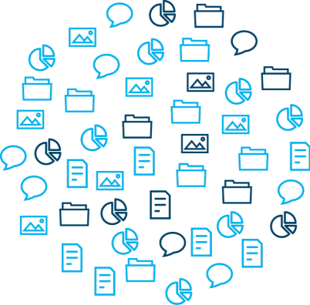
Cognitive Systems Rely on Collections of Data and Information…
Data, information, and expertise create the foundation of cognitive systems. Examples include:
Analyst reports
Tweets
Wire tap transcripts
Battlefield docs
E-mails
Texts
Forensic reports
Newspapers
Blogs
Wiki
Court rulings
International crime database
Stolen vehicle data
Missing persons data
11 May 2016
23

Slide 24
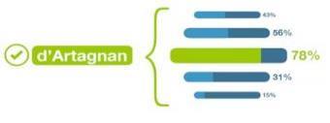




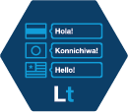











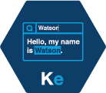










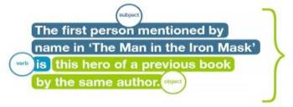

… and then leverage Watson APIs to Apply Cognitive Capabilities
Watson APIs are the cognitive building blocks that harness our data.
Retrieve and Rank
Message Resonance
Concept Expansion
Face Detection
Natural Language Classifier
Speech to Text
Text to Speech
Language Translation
Language Detection
Sentiment Analysis
Dialog
Retrieve and Rank
Image Link Extraction
Tradeoff Analytics
Entity Extraction
Tone Analyzer
Personality Insights
Taxonomy
Author Extraction
Concept Tagging
Relationship Extraction
Concept Insights
Relationship Extraction
Question & Answer
Feed Detection
Keyword Extraction
Visual Recognition
Image Tagging
Text Extraction
Natural Language
Classifier
Tone Analyzer
  Check out Watson Developer Cloud: http://ibm.biz/WatsonDev
11 May 2016
24

Slide 25


Cognitive systems combine data, information, and expertise
Improve your processes and operations
Create better products
Enable new kinds of
engagement
Leverage expertise
Organized Data
Watson APIs
Enable new business models
11 May 2016

Slide 26
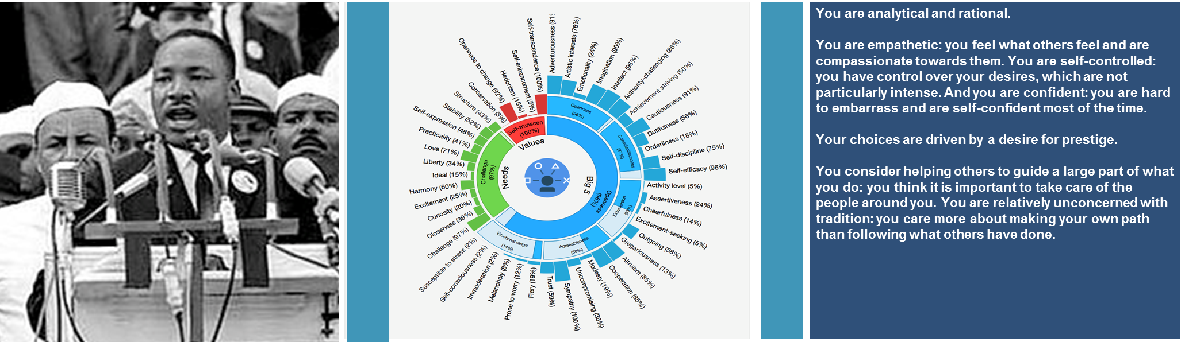
Cognitive Functionalities for Your Applications
The Watson APIs provide access to cognitive features
Image left: http://www.americanrhetoric.com/speeches/mlkihaveadream.htm
Image middle: https://watson-pi- demo.mybluemix.net/?cm_mc_uid=53312115606814496114958&cm_mc_sid_50200000=1449664956
11 May 2016

Slide 27
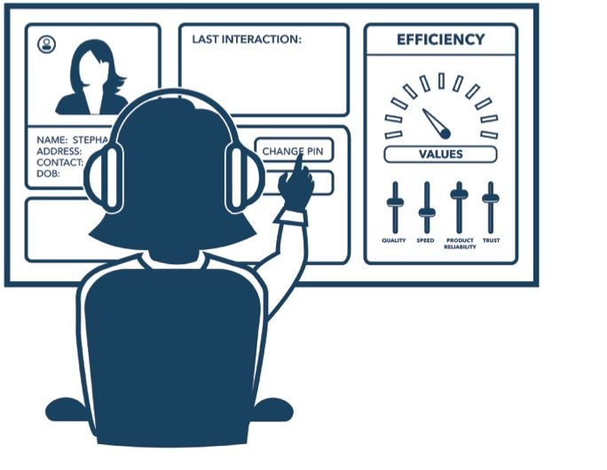
Cognitive Contact Centre
Empower agents to better respond to requests and improve call conversion rates
Self-Service Q&A: Help resolve procedural and simple customer questions. Identify common customer issues
Real-time aggregation of relevant customer information and locate relevant documents to answer every question with consistently accurate answers
  Create a personalized customer experience with deeper insights into customer preferences by obtaining a personality profile
Improve the agent productivity by analyzing extracted and mined call logs to identify patterns, quality issues, similar phrases, topics and trends

Slide 28
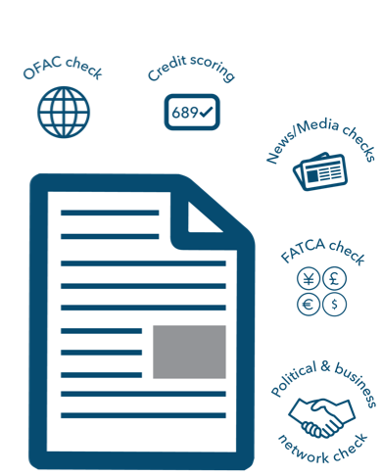
Cognitive Underwriting
Make existing decisions smarter by incorporating insights from unstructured data
Extract information from disparate submission documents to prioritize and reduce time spent collecting information.
Enhance examination of submission with deep analysis of internal and external sources, including underwriting criteria, to create a more complete view of risk.
Create a comprehensive evaluation process to collect, integrate, visualize and evaluate the risk

Slide 29
The Internet of Things

Slide 30
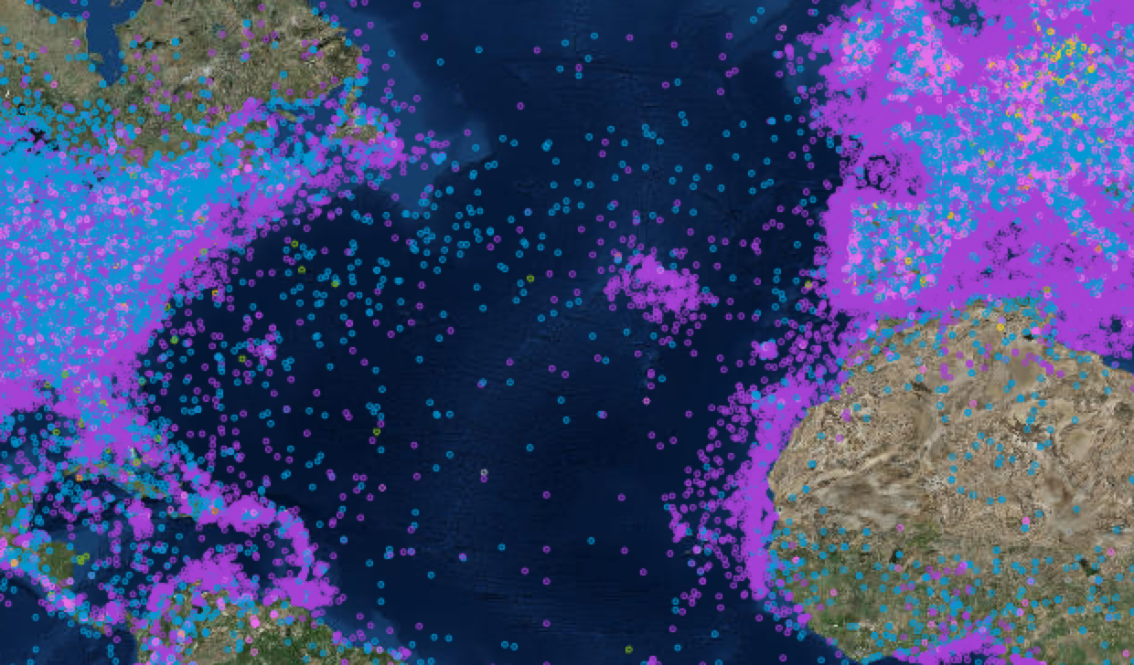
Insurance data will grow 94%,
84% of which is unstructured
“By 2020, Internet of Things spending will rise to $3 trillion and nearly 30 billion devices”
Source: “IDC MaturityScape Benchmark: Enterprise Mobility in the United States”, IDC, May 2015, Picture: www.thingful.net
© 2016 IBM Corporation
Notes:
Explain also the picture optional do a live demo

Slide 31
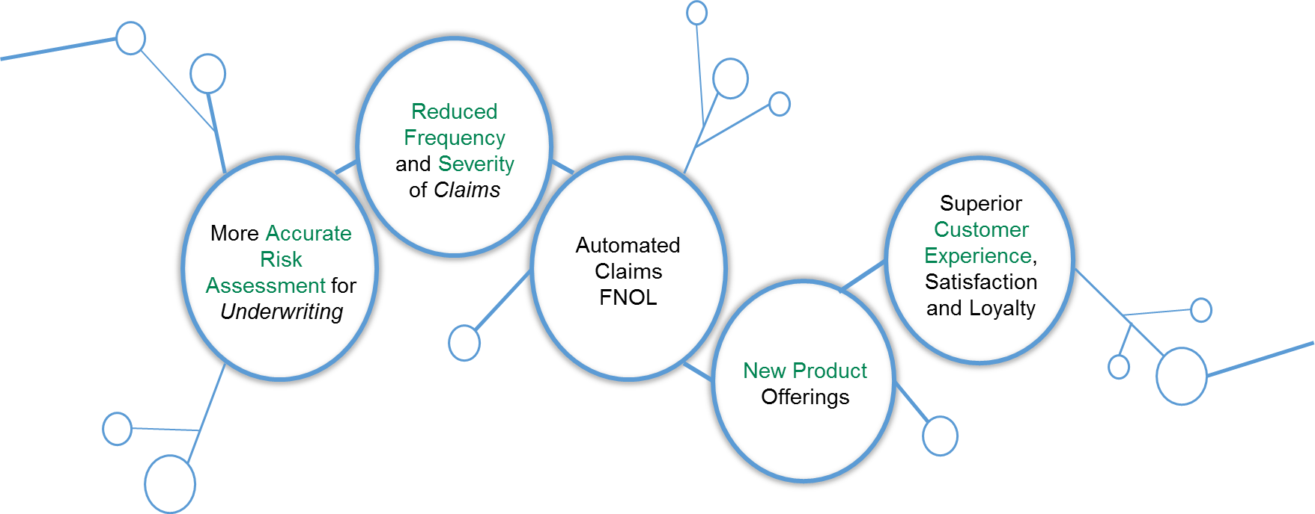
Top 5 Benefits of IoT to the Insurance Industry
What we learn from the physical world will transform several industries, including the Insurance Sector in which IoT will have one of the greatest impacts.

Slide 32


Example IoT Use Cases for Insurance
The Internet created liquid markets of the digital world. The Internet of Things will do the same for the physical world.
Smart Home | Telematics | Health Care | Weather | WorkRight | Predictive Maintenance

Slide 33

Cognitive Solutions for Internet of Things Applications
Keeping up with the ever-growing amount of sensor data by utilizing cognitive solutions.
Sensors
Data
Analytics
Information
Cognitive
Knowledge
11 May 2016
33

Slide 34
The security concerns of IoT participants – hacking, service disruption and data exploitation

Slide 35
The Internet of Things – the ‘so what’ test?
Behavioural Change
  Inertia
  Early response to peril alerts (Escape of water, storm)
  Rewards
Risk Mitigation and Pricing
  Frequency and severity
  Improved business retention
  Self-selection
The Economic Argument
  Win-win for insurer and customer
  Expanded propositions; care, energy usage, behaviour rewards
  Eco-system sharing of value creation

Slide 36
In conclusion ….

Slide 37
Success for insurers in a digital environment will need more data, intelligence, cognitive systems, IoT and security
Integrating Cognitive Solutions: A data driven digital environment and a secure and scalable infrastructure to drive value from business “ecosystems”
Cognitive
Solutions
Digital
Environment
NLP, Machine Learning
Mobile & Social
Internet of Things
Omni-channel
Predictive Analytics
Design Thinking
Cognitive
Insurance
Data (e.g. Weather, Health)
Digital Operations
Cloud enabled platform
Enabling
Infrastructure
Business Ecosystems
Customer
Economic Choices
Big Data
Integration
Customer
Value Chains
Security
Ecosystem data, services
and partners
Resilience

