Slide 1
Recent advances in the biology of ageing
Richard Faragher
Professor of Biogerontology

Slide 2
Professor Richard Faragher
B.Sc. ARCS D.Phil. FSB
Professor of Biogerontology
  Scientific interests are Werner’s syndrome, the phenotype of senescent cells and the Insulin-IGF1 axis
  Chairman, British Society for Research on Ageing
  Chairman, International Association of Biomedical Gerontology
  Executive Director American Aging Association
15 years involvement in direction of UK national strategy for ageing research
  BBSRC ERA – Special Initiative Panel & Ageing Strategy Group Member
  BBSRC-EPSRC – SPARC Programme Co-Director (involved design and execution of new funding schemes & managing a portfolio of 35 projects)
  Research Into Ageing-member of the Research Advisory Council
  BBSRC Bioscience for health Strategy Panel Member- one of eight scientists responsible for strategic direction in this area.
Royal Pharmaceutical Society Conference Science Medal for outstanding scientific achievement
Help the Aged ‘Living Legend’ award for championship of older people
Paul F Glenn Award for biological gerontology

Slide 3
What is ageing?
An increasing probability of death and morbidity with increasing time (the Gompertz relationship)
Why does ageing exist? Is it possible to be non-ageing?
What are the causal mechanisms? What does this tell us about the relationship between ageing and age-related diseases?
Can we intervene effectively in the causes of ageing? If so how, and what are the likely effects?

Slide 4
Why does the Gompertz relationship (i.e. Ageing) exist?

Slide 5
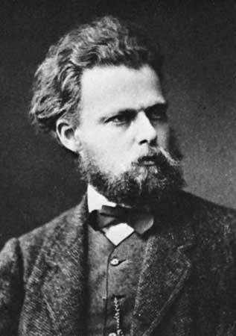
First thoughts on ageing
In regulating the duration of life, the advantage to the species (and not to the individual) is alone of any importance. This must be obvious to anyone who has once thoroughly thought out the process of natural selection.
Relies on group selection arguments which are historically weak
August Weismann 1834-1914

Slide 6
Ageing
Breeding
Breeding

Slide 7
Evolutionary explanations for ageing
Antagonistic pleiotropy: In the wild chronologically old organisms are rare compared to young ones, thus selection for any gene with beneficial effects on fecundity even if these are associated with deleterious effects later in the life course.
Disposable soma: Under pressure of natural selection, organisms can afford only limited investments in somatic maintenance and repair. Ageing is caused by the progressive accumulation of unrepaired faults and damage.
These theories predict that non-ageing organisms usually get out-competed by ageing ones , however they also allow for the possibility of that organisms could be non-ageing

Slide 8
Across species, population ageing effectively IS the Gompertz relationship

Slide 9
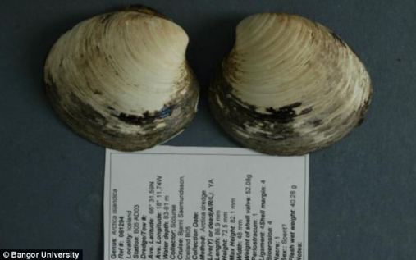
Are there non-ageing animals?
Ageing seems to be exceptionally common but not universal and ageing rates vary widely
“Ming the mollusc” 507 year old specimen of a commercially fished species killed by “heartless scientists”

Slide 10
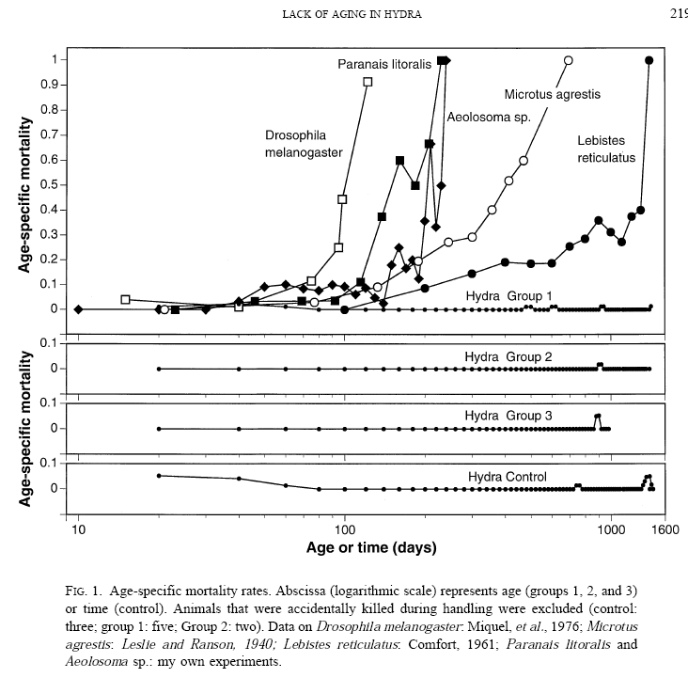
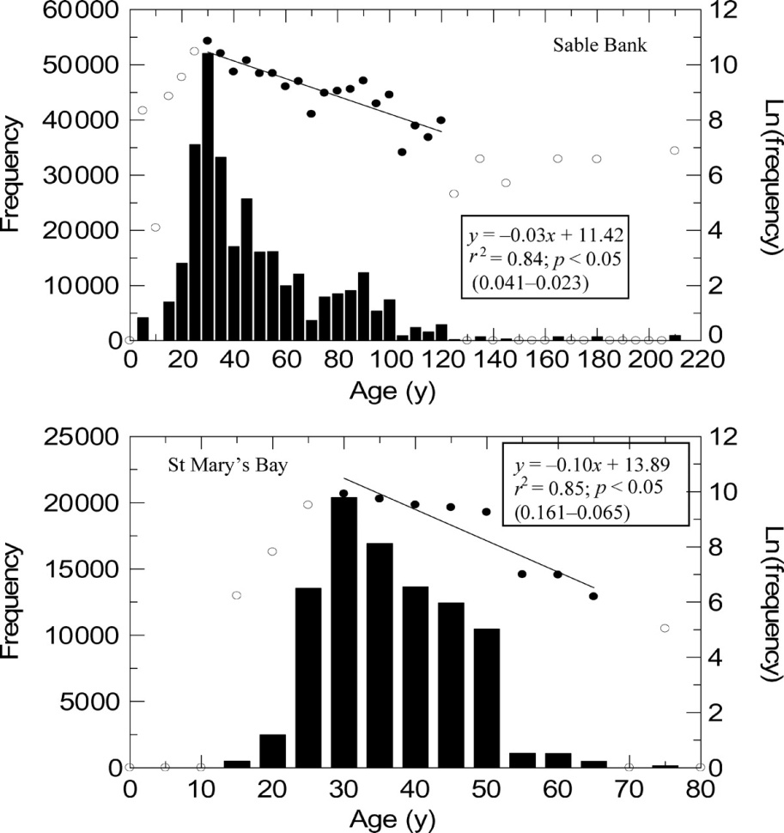

Non ageing in Hydra and Arctica?
* Kilada et al (2007) 56(1):55-65. Martínez (1998) Exp Gerontol. 33(3):217-25
© 2006 International Council for the Exploration of the Sea. Published by Oxford Journals. All rights reserved. For Permissions, please email: journals.permissions@oxfordjournals.org

Slide 11
Conclusions
Ageing is a highly malleable trait
Difficult to distinguish between being non-ageing and a very gradual increase in mortality in very long lived species
Exponential increases in all cause mortality do not seem to be an absolute requirement of the physiology of complex organisms

Slide 12
BUT
Being “non-ageing” is not equivalent to immortality.
Extending lifespan is not equivalent to immortality either.
I’ll show you what I mean.

Slide 13


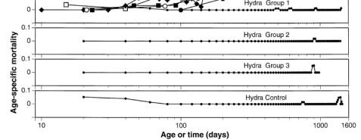
The non-ageing human: A thought experiment
“Hydra Elixir”
Fixed chance of death
Chance of death ~100% at age 8330
Chance of death in the next 10 years ~0.12%
Someone this old today would have been born in 6317 BC

Slide 14
Non ageing organisms are NOT immortal
Oliver’s new improved lifespan = 8000 years [1]
Emergence of first civilisations = 11,000 years ago [1.4]
Earliest H.sapiens = ~190-200,000 years ago [24]
K-T boundary event = ~65 million years ago [8125]
Great Dying = 252 million years ago [31,500]
Age of the Earth = 4.54 billion years [56,750,000]
Age of the Universe = ~13.8 billion years [172,500,000]
Date when Earth becomes unable to support life* = 2000002013 [250,000]
Forever is a very very very long time...
Ageing research is not about immortality. It’s about health.
*According to the Daily Telegraph back in November 2013

Slide 15
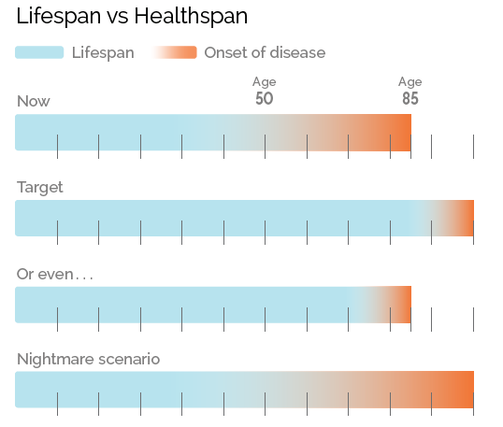
Possible futures

Slide 16
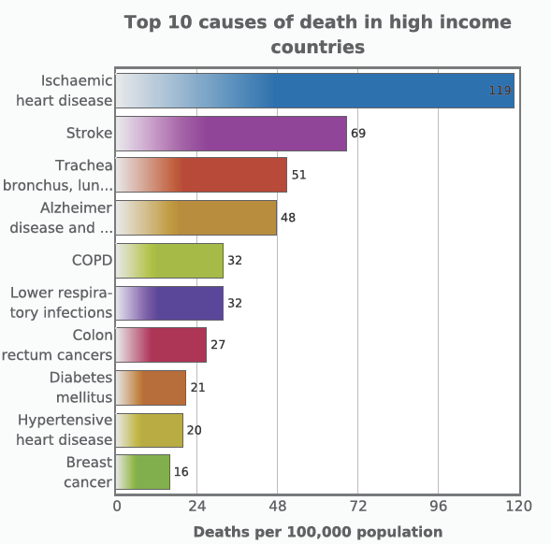
The major causes of death are age-associated
Public health discussions tend to focus on ‘modifiable’ risk factors (e.g. smoking and diet). But these are not necessarily the largest risks

Slide 17
Life expectancy has increased markedly has maximum lifespan changed?
90
80
70
60
50
Life expectancy (years)
40
30
20
10
0
1200
1300
1400
1500
1600
1700
1800
1900
2000
Year (AD)

Slide 18
“People live longer nowadays”
Name DOB COD Age
Alexander 356 BC fever 33
Titus 41 AD fever 42
Henry V 1422 dysentery 35
Raphael 1477 plague 37
Keats 1795 tuberculosis 25

Slide 19
Really?
Maximum age of individuals within 33 separate collections of skeletons from the European Neolithic (Faragher & Stewart, unpublished)

Slide 20
Do they?...
Name DOB COD Age
Isocrates 435 BC “old age” 98
Antigonius 382 BC ambition 81
T.Flavius Virilis* 3rd CAD “old age” 70
Dodge Foscari 1373 “old age” 84
Suleiman 1495 stroke 71
Voltaire 1778 “old age” 84
*Centurion of II Augusta, XX Valeria Victrix, III Augusta and hastastus posterior of III Parthica Severiana as his tombstone is careful to explain

Slide 21
What to make of papers like this?
“the human life span shows no sign of approaching a fixed limit imposed by biology or other factors.”

Slide 22
Is maximum human lifespan increasing?
Quality of data prior to 1750AD is very poor.
Some evidence of increased age at death from Swedish records over the period 1860-1990*
Lifespan can be lengthened significantly by selective breeding but (i) humans aren’t doing this and (ii) even if they were the number of generations is probably too low for an effect.
Thus, the genetic background of the population is pretty constant.
*Wilmoth (2000) Increase of maximum life-span in Sweden, 1861-1999 Science 289:2366-8.

Slide 23
“No sign of a fixed limit imposed by biology”?
What might determine the absolute limit to human survival? (If you did nothing to intervene)
  Total thymic atrophy estimated at age ~105
  Glomerular filtration rate falls to zero at ~150 years*
  Corneal endothelial cell density becomes pathological at 100-175 years
  ~1 population doubling decline in fibroblast replicative capacity per five years of donor life (theoretical zero at 150-250 years)
  0.3% decline in corneal keratocyte density per year with age (theoretical zero at ~333 years)
All this suggests to me an absolute maximum of 150-300 years. Probably VERY significantly less
However, ALL of this is based on scattered data and highly questionable assumptions
* Teixeira et al (2013) Evaluation of renal function and immune system cells in elderly individuals from São Paulo City. Clinics (Sao Paulo) 68(1):39-44.

Slide 24
What does the Gompertz relationship actually measure?
Just death

Slide 25
If so, does ‘ageing’ even exist?
Is there such a thing as “an ageing process” or is there just “disease” or is there something in between?
This matters because:
  If there are only age-related diseases then working on “ageing” is a worthless distraction.
  If there is an ageing process then perhaps working on “age-related disease” is the distraction!
  Is the distinction itself a false dichotomy?

Slide 26
There is a long tradition of confused thinking on this relationship...
In the Hippocratic corpus (5th Century BC) old age was essentially classified as an illness.
Aristotle (4th Century BC) viewed old age as a ‘natural disease’
Galen (2nd Century AD) saw disease as ‘contrary to nature’ but old age as a ‘natural condition’.
Korenchevsky (1961) “the father of gerontology” directly echoed Galen and distinguished between ‘physiological and pathological ageing’.

Slide 27
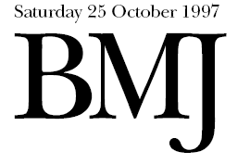
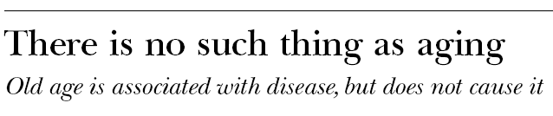
“The fact that [lots of adult diseases] tend to arise in the same part of the life span is not good evidence that they have similar underlying mechanisms, nor is it good evidence that any single unifying change awaits discovery that could properly be called ‘aging’(sic)”
Sir Richard Doll, author of the above, not undergoing “aging” at the “age” of 85...

Slide 28
Was this Doll’s thinking?
Healthy (and young)
Sick (and old)
No Cardiovascular disease
No Cancer
No Alzheimer disease
No Parkinson disease
No Type II diabetes
No Osteoporosis
A process
Get CVD
Get Cancer
Get Alzheimer’s
Get Parkinson’s
Get Diabetes
Get Osteoporosis
A different process
Another process
A distinct process
Another distinct process
Yet another process

Slide 29
“No fool like an old fool”?
This argument is a reasonable example of deduction a priori from epidemiological data
Reasonable in 1967, but in 1997 it was untenable and had been so for at least a decade
It follows from this argument that, if every disease has a distinct ‘underlying mechanism’, then a single change should not be able to cure or cause more than one disease

Slide 30

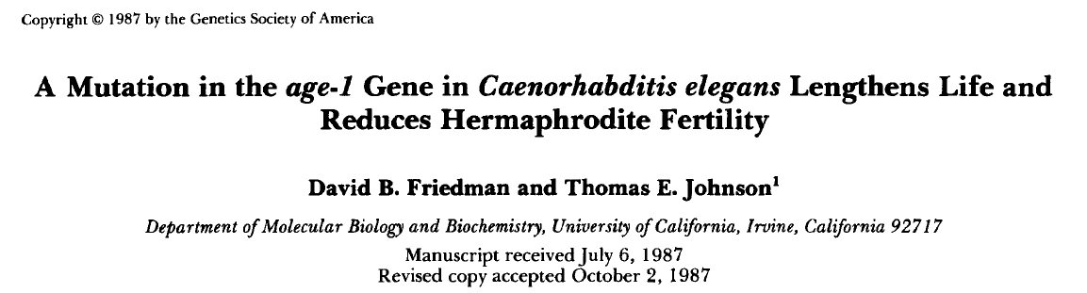
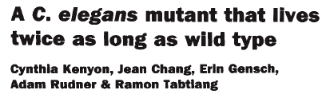
Which is difficult to square with observations like this
For 30 years it have proved possible to isolate single-gene mutants which showed greatly extended healthy lives.
Mech Ageing Dev (1983) 22:279-286.
Genetics (1987) 118:75-86.
Nature (1993) 366:461-464.

Slide 31
Or this..
Werner’s syndrome*
“segmental progeroid syndrome”
Rare autosomal recessive genetic disease
Premature ageing of many (but not all) tissues
Premature development of
Osteoporosis
Bilateral cataracts
Diabetes
Thymic atrophy
Overall aged appearance
Death (primarily from cardiovascular disease and cancer) at mean age of 47
*Cox L & Faragher R.G.A. (2007) Cell & Molecular Life Science 64:2620-41

Slide 32
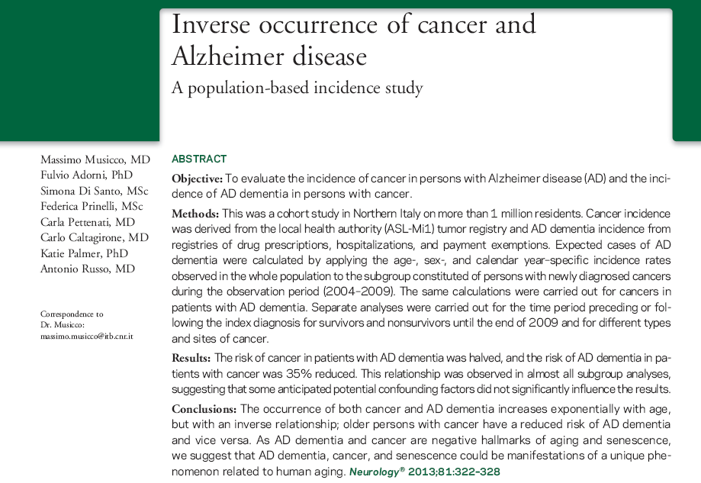
Or this

Slide 33
To summarise
The fundamental biology of ageing probably does NOT look like this:
Healthy (and young)
Sick (and old)
A process
No Cardiovascular disease
No Cancer
No Alzheimer disease
No Parkinson disease
No Type II diabetes
No Osteoporosis
Get CVD
Get Cancer
Get Alzheimer’s
Get Parkinson’s
Get Diabetes
Get Osteoporosis
A different process
Another process
A distinct process
Another distinct process
Yet another process

Slide 34
Summary 2
Instead it probably looks like this:
The “diseases of ageing”
Cancer
Cardiovascular disease
Alzheimer’s disease
Parkinson’s disease
Macular degeneration
Type II diabetes
Osteoporosis
Etc, etc, etc
A few
“AGEING”
Mechanisms
Cause
Sickness & Death
Therefore targeting a few conserved pathways should target multiple late-life pathologies and impairments.

Slide 35
Drawing false distinctions between ageing and disease?
Features of ageing
Age related disease | Causal Mechanism | ‘Natural change’ | Causal Mechanism | ‘Oddities’ | Causal Mechanism
Cognitive impairment, CVD, diabetes, osteoporosis etc | Replicative senescence | Grey hair, wrinkles | Replicative senescence | Menopause Hearing loss Visual problems Immune problems Joint stiffness | Replicative senescence
 | Autophagy & Nutrient sensing |  | Autophagy & Nutrient sensing |  | Autophagy & Nutrient sensing
 | Stem cell dysfunction & cell loss |  | Stem cell dysfunction & cell loss |  | Stem cell dysfunction & cell loss
 | Metabolic & mitochondrial dysfunction |  | Metabolic & mitochondrial dysfunction |  | Metabolic & mitochondrial dysfunction
For a slightly different perspective López-Otín et al (2013) The hallmarks of aging. Cell. 53(6):1194-217.

Slide 36
What are the general classes of causal mechanism?
Nutrient sensing mechanisms
Tumour suppression mechanisms
Limited evidence for simple oxidative damage as a major limit to lifespan

Slide 37
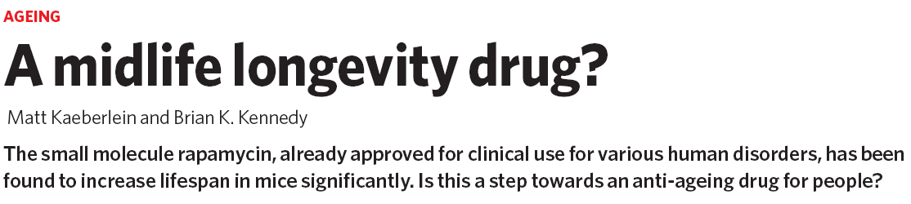
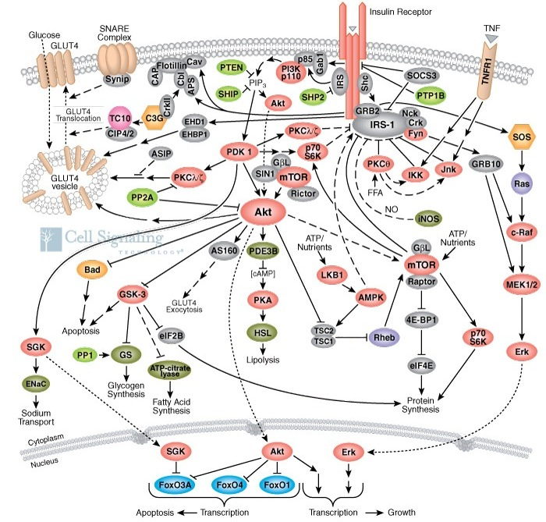
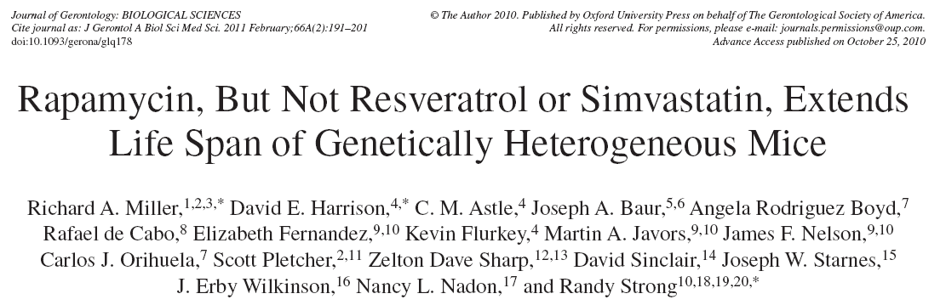
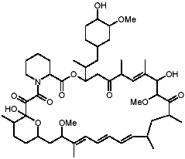
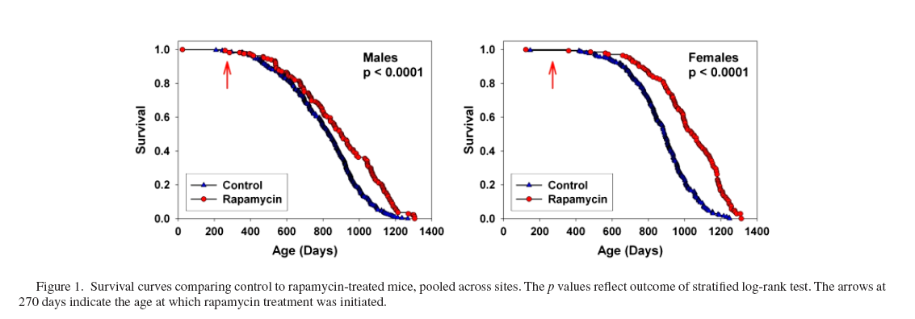
Nutrient sensing pathways
×

Slide 38
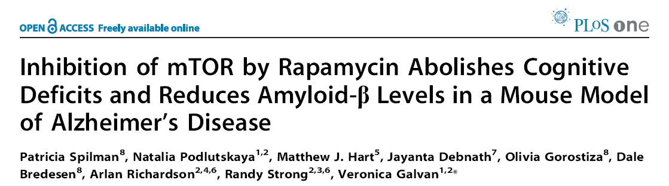
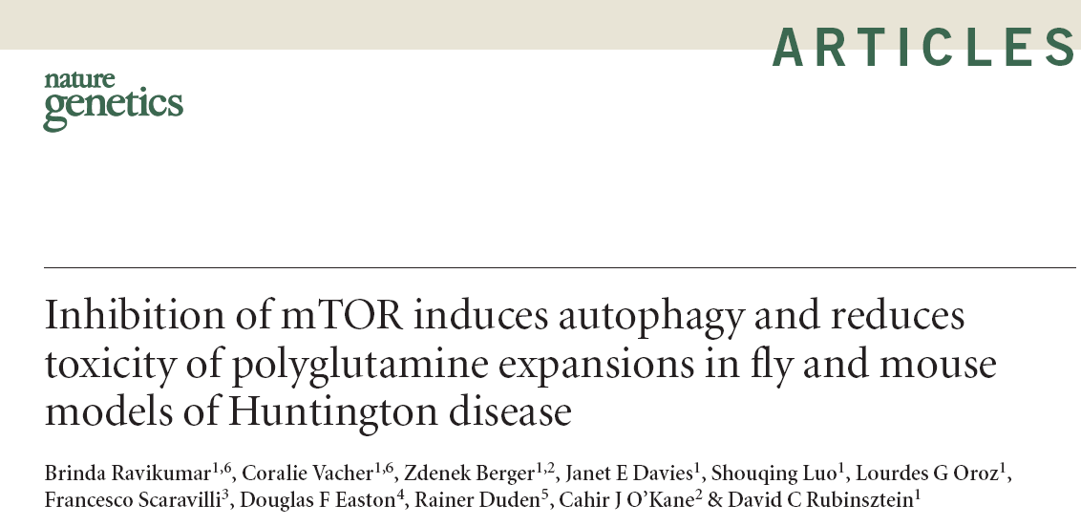
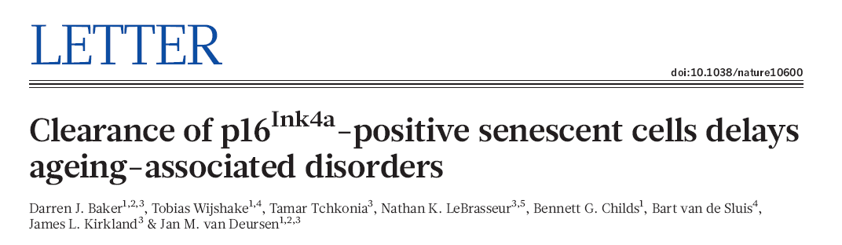
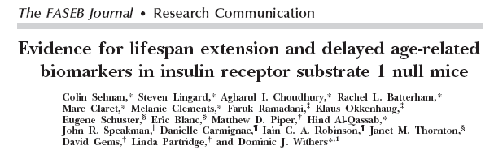
Extended life through improved health

Slide 39
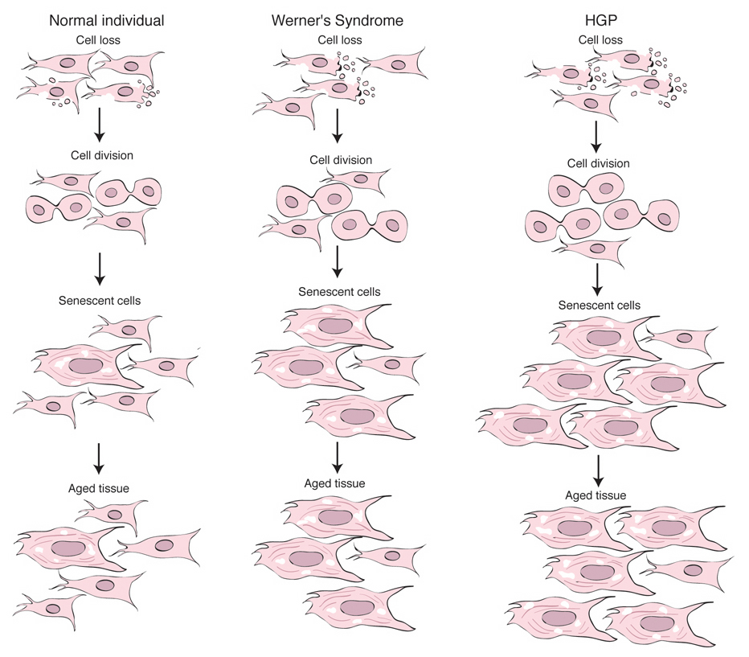
Tumour suppression pathways
Cell turnover
Senescent cells made
Bad stuff happens when they build up
Kipling et al. (2004) Science 305: 1426-31

Slide 40
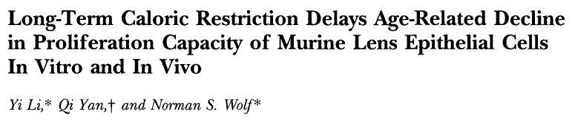
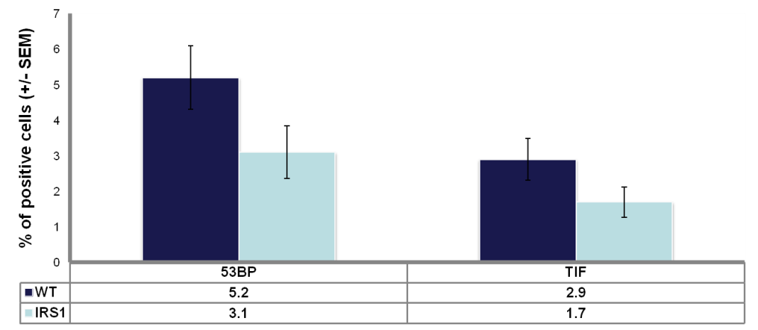
The evidence they build up?
Telomere dysfunction in lung tissue between 700 day old WT and Irs1 ^{-/-} C57/B6 mice.

Slide 41
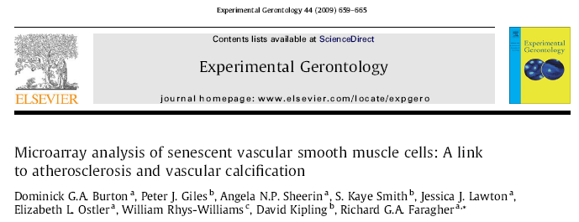
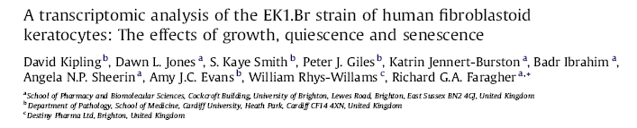
The evidence they do bad stuff
Senescent VSMC secrete inflammatory cytokines and promote vascular calcification
Senescent keratocytes fail to produce IL-6 compromising corneal defenses
Removal of senescent cells improves multiple markers of health (e.g. wheel running)

Slide 42
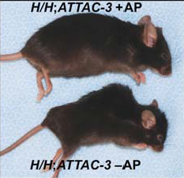

Slide 43
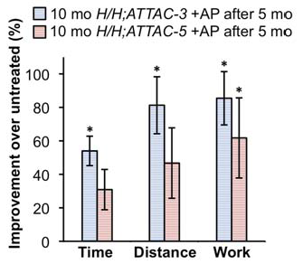
Treadmill Exercise Capacity of Two INK-ATTAC Strains After Senescent Cell Clearance with AP20187 vs. Vehicle
Nature 479:232, 2011

Slide 44
But watch this space
NIA Intervention testing program: designed to detect lifespan extension.
Testing at three sites gives a 80% power to detect 10% change (two-sided), for each sex, pooling across sites.
Genetically heterogeneous mice (UM-HET3)
  Grandparents: BALB, B6, C3H, DBA/2
Anyone can suggest an intervention
-- Evaluation by Access Committee

Slide 45
Results so far
No lifespan extension
Lifespan extenstion
Curcumin,
oxaloacetic acid
medium chain length triglycerides
green tea extract
Enalapril
Simvastatin
caffeic acid phenethyl-ester
Nitrofluorbiprofen
Resveratrol
4-hydroxyl-para-butylnitrone
  Rapamycin (males & females, 10-25%)
  Aspirin (males, 10%)
  Nordihydroguaiaretic Acid (males, 10%)
  α-Estradiol – non-feminizing (males, 10%)
  Acarbose – glucosidase inhibitor (males, 22%)
Better functional screens are required to detect healthspan extension

Slide 46
Infections after Hip-Fracture¹
15%
63%
12%
10%
¹Previously healthy, independent older people

Slide 47
DHEAs levels decline with Age
Cortisol
Work by Professor Janet Lord, University of Birmingham

Slide 48
Trauma suppresses neutrophil bactericidal function in older people
P<0.005
P<0.0001
P<0.05
Young Old Old Trauma Young
control control trauma +5 wks trauma

Slide 49
Summary
Older trauma patients have enhanced cortisol:DHEAs ratios and a high incidence of bacterial infection
Neutrophil phagocytic function declines with age and trauma additionally reduces superoxide generation
DHEAs can enhance neutrophil superoxide generation in vitro
DHEA supplementation in older hip fracture patients (and the bereaved) may reduce post-traumatic infections

Slide 50
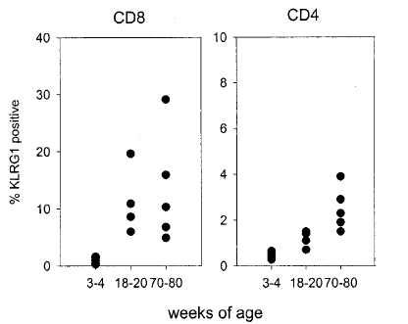
Senescent T cells (KLRG-1) increase with age.
Human PBL
Mouse PBL
CD8
CD4
CD8
CD4
% KLRG1
% KLRG1
Age (years)
Age (weeks)
Voehringer et al J.Imm 2001 167 4838-43

Slide 51
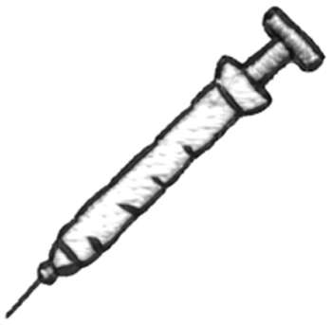
IL-7 therapy
Absolute numbers
3 weeks
y
O +S
O +IL-7
Thymic output
Saline
treated
group
proliferation to anti-CD3
dEC
IL-7
treated
group
counts per minute
O +S
O +IL-7

Slide 52
My personal view on ‘interventions’
Three broad classes
  Reuse of licensed drugs in new ways to treat health problems as a result of fundamental research in gerontology (timescale potentially short)
  Development of new compounds which target effector mechanisms of ageing (e.g. p38 MAP kinase inhibitors, resveralogues, IL-7 etc. Medium timescale, some in Phase II already)
  Development of compounds intended to target senescent cells, better macrolides etc (timescale 30-40 years by analogy with anticancer drugs like tamoxifen)

Slide 53
We fear failure: should we fear success?
No: A better world for older people is a better world for everyone

Slide 54
Dana Goldman conducted research to identify the potential health and economic returns of ‘delayed aging’

Slide 55
We modeled four successful R&D scenarios
Baseline – medical care reflects the standard of care in the United States over the last two decades
Delayed cancer – Cancer incidence is reduced 25% over the next 20 years, similar to tobacco campaign
Delayed heart disease – Heart disease incidence is reduced 25% over 20 years
‘Delayed aging’ – Reproduce latest evidence emerging
from biological studies
    Reduce mortality by 20% by 2050
    Modify diseases and frailty (as measured by functional status) in a similar manner

Slide 56
Delayed aging had the largest impact on the number of healthy, older adults…
Scenario | 2010 | 2060
Baseline | 31.0 | 75.5
CVD | 31.0 | 76.1
Cancer | 31.0 | 76.5
Aging | 31.0 | 87.2

Slide 57
…and it did so without increasing the number of disabled.
Scenario | 2010 | 2060
Baseline | 12.3 | 30.9
CVD | 12.3 | 31.1
Cancer | 12.3 | 32.0
Aging | 12.3 | 26.6

Slide 58
There will be a large social benefit if we are successful in any of these research areas
Note: Benefits and costs computed through 2060; assumes each life-year is worth $100,000. Costs and benefits are discounted at 3% annually. Government costs are net of taxes for the major entitlement programs: OASDI, Medicare, Medicaid, and SSI.
Notes:
VSLY 150k

Slide 59
Policy Implications
More than $7 trillion in social value awaits the US alone if we can translate laboratory studies into the clinic
  A 10% chance of scientific success would justify an investment of $700 billion
Fiscal challenges are manageable
Enormous social value in prevention generally, but some healthcare systems do not reward it sufficiently
  Paying for health, rather than health care, would move us in the right direction

Slide 60
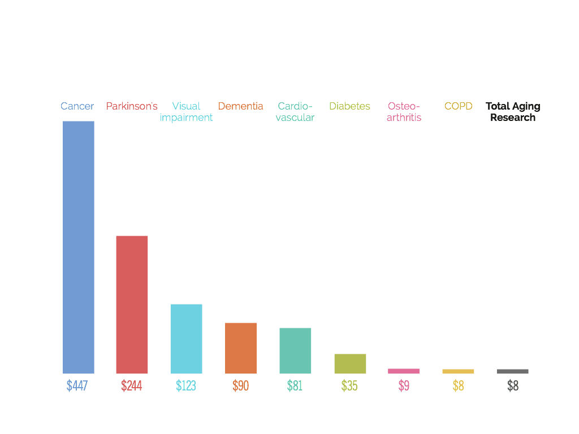
Amount Spent per Person on Research
Yearly
2012, US data
Notes:
A minimal amount spend on research into the mechanisms of aging.

Slide 61
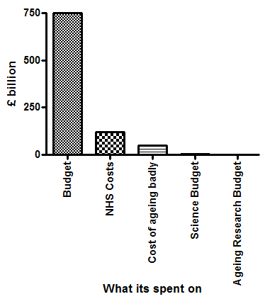
You get what you pay for
“There is a strong case for identifying broad problems. For example, the challenges thrown up by an ageing population”
Vince Cable (2010)

Slide 62
Can human lifespan be extended?
Now? NO!
In the future? Probably, but with two caveats
  Saying ‘never’ would mean there was something very different about humans and other species in which we have been able to extend lifespan
  By analogy with other species extensions of ~15%-40% in maximum life might be possible
  But, the future is a vast expanse of time...

Slide 63
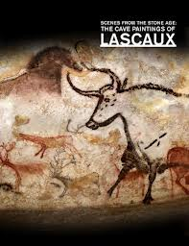
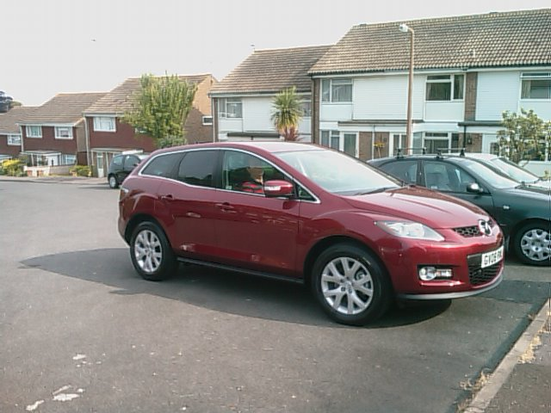
I’m agnostic not enthusiastic
Everything depends on your definition of ‘future’. These cave paintings are 20,000 years old. If their author ever said ‘men will never travel faster than a galloping horse’ he was wrong. However, he was correct that men couldn’t travel faster than a horse for ~19,900 years

Slide 64
The long and short of it:
Fundamental ageing mechanisms exist, are evolutionarily conserved and cause the things we think of as ‘ageing changes’, the things we think of as ‘age-related diseases’ and the things that compromise health in later life which we have trouble classifying (e.g. Menopause).
Targeting them is a plausible and ergometric route to preventing later life morbidity.
So why don’t we do more work on ageing?
Perhaps because ageing is seen as a ‘natural process’ distinct from ‘unnatural’ disease. This leaves us prey to..

Slide 65
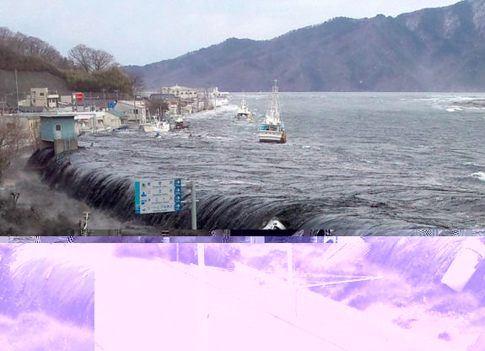
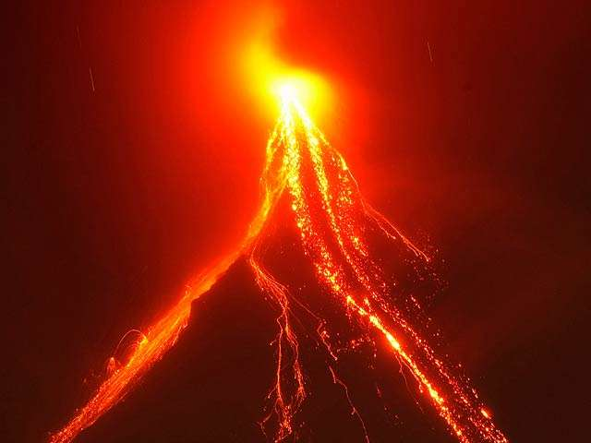
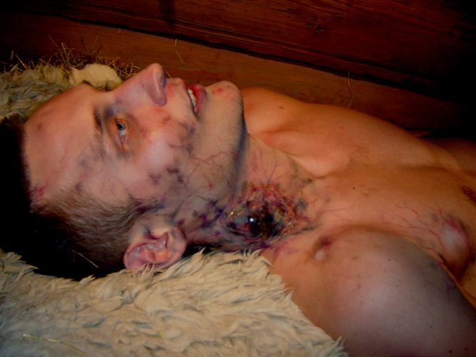

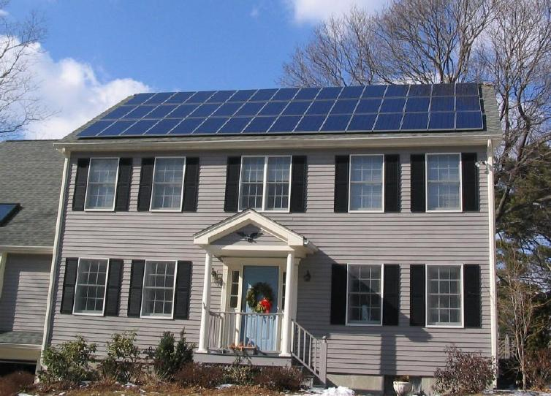

The naturalistic fallacy
The claim that what is natural is inherently good or right and shouldn’t be altered, and that what is unnatural is bad or wrong and should be changed
Natural & Good - ???
Unnatural & Bad - ???

Slide 66
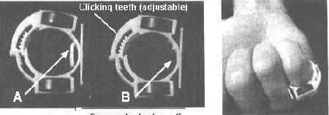
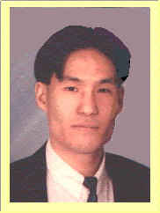
The solution to all our problems?
Alex Chui
Inventor of the Immortality Device,
on sale at www.alexchiu.com
“If you are not satisfied with the results brought by the Immortality Devices we can refund your money back within 90 days.”

