Slide 1
Communicating Uncertainty
Good vs Bad
James McPherson 21st June 2012

Slide 2
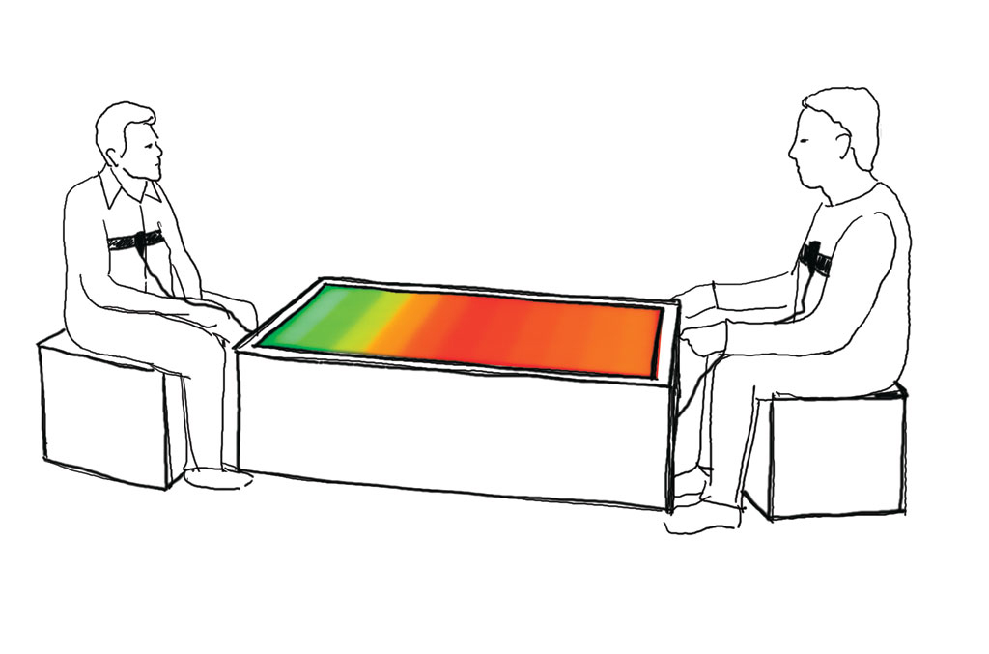
What Actuaries say
There is process risk, parameter risk, model risk and output variability

Slide 3
What people hear
There is parameter risk, model risk and output variability
There is blah, blah, blah

Slide 4
ROC example
“The best estimate reserve is my estimate of the expected value of future claims. However, there is considerable uncertainty in the eventual outcome of claim payments, and future claim payments could be more or less, possibly significantly so, than the best estimate. Estimating this uncertainty is a judgemental process, but in my view there is a reasonable chance that claim payments will exceed £Am, but unlikely that the outcome will exceed £Bm. [A and B are estimated 75% and 90% percentiles respectively]
Some of the key features which contribute to this uncertainty are:
(1) the XYZ legal dispute, which could cost up to £C1 million or produce savings of £C2 million;
(2) normal volatility in payments experienced in the past. If this repeats in the future, it is possible (but unlikely) that claims will be greater by £Dm or more; [90 percentile for this component of volatility];
and
(3) uncertainty on the impact on reserves of the change in underwriting strategy in 2004 and 2005. This could increase reserves by £E million or reduce them by £F million.
Overall I believe it likely that the outturn for total claim payments will lie in the range £Gm to £Hm. [90% confidence interval]”
Quantification and Reporting of Uncertainty for GI Reserving – ROC Giro 2007

Slide 5
ROC again – Now rarely used?
Indicative Percentile | 75% | 90% | 95% | 99%
Wording ‘below’ percentile | Fairly likely that the outcome will lie below this estimate | Likely that the outcome will lie below this estimate | Very likely that the outcome will lie below this estimate | Extremely likely that the outcome will lie below this estimate
Wording ‘above’ percentile | Reasonable chance that the outcome could lie above this estimate | Possible but unlikely that the outcome will lie above this estimate | Possible but very unlikely that the outcome will lie above this estimate | There is a possibility, albeit remote, that the outcome will lie above this estimate
Quantification and Reporting of Uncertainty for GI Reserving – ROC Giro 2007

Slide 6
ABI Research Paper No 25 HELPING CONSUMERS UNDERSTAND INVESTMENT RISK
Introducing a pictorial presentation of investment risk is more effective than a purely text based description. Pictorial presentations can improve people’s ability to pick the right fund by over 20% relative to a purely text based version.
• Standardising the disclosure of investment risk helps. People who see the same presentation of risk for all the investment funds are on average 16% more likely to pick the right fund than those who see a different presentation of risk for each of the funds.
• The form of standardisation also matters. The top three pictorial designs are roughly twice as effective as the three worst designs.
• The most effective pictorial design is a horizon thermometer. There are two thermometers that do particularly well, one of which is the thermometer design proposed by CESR in its consultation of risk disclosure for the Key Information Document for UCITS.
• Although consumers often comment that they would prefer to see more charts, introducing charts can reduce their ability to understand the information. Using bar charts, instead of a table, to present relative investment performance and the probability of losing money, reduces people’s ability to answer questions by between 50-75%.
• Although the fan chart design is associated with a higher number of participants in the top group for the suitability task, overall it does not lead to an improvement in performance.

Slide 7
Other
Martin Lunnon (Oct 2008) chief actuary, Social security and overseas pensions, Government Actuary’s Department Central Estimate – then alternatives
Derek Newton (Nov 2011) – Process Risk, Parameter Risk, Model Risk, Future Systemic Risk

Slide 8
An inconvenient uncertainty “What would I want?” – From David Ibeson CEO, Giro 2007
Tell me what I need to hear not what you think I want to hear.
Take a step back and try and look at the analysis top down rather than bottom up.
Act as if you are part of the team! Be prepared to tell me what you would do.
Make sure that you know the relevance/context.
Be prepared to push back if you think I haven’t fully understood.

Slide 9
An inconvenient uncertainty “Summary” – From David Ibeson CEO, Giro 2007
The limit of an actuary’s ability to contribute is directly proportional to his ability to communicate.
This should not be a limiting factor!

Slide 10
Communicating badly – Slide 1 of 3
“Reserving is fundamentally uncertain.”
“I set out below the limitations and uncertainties of our work” – 45 paragraphs follow, mostly standard.

Slide 11
Communicating badly – Slide 2 of 3
A – The expected value (“best estimate”) of the company’s liabilities.
B – The probability density function for the company’s liabilities.
D – The range of possible outcomes.
Increasing
probability
B
B
B
A
A
A
£0m
£100m
£200m
D
Reserve Estimates

Slide 12
Communicating badly – Slide 3 of 3
C – The range of reasonable best estimates
D – The range of possible outcomes
Increasing
probability
£0m
£100m
£200m
C
D
Reserve Estimate

Slide 13
2 Categories of Uncertainty
Variability Range of Possible Outcomes
Casual explanation based on expert judgement
Quantitative methods
Verification
£100m deficit really? Guess / Professional Judgement / Rigorous Analysis with Robust Evidence
Range of Reasonable Best Estimate

Slide 14
TAS R
“An aggregate report shall indicate the nature and extent of any material uncertainty in the information it contains.”
Uncertainty may concern the results of the calculations, assumptions on which information is based or other aspects. It may arise from random variations, lack of information or other sources. The extent of any material uncertainty may itself be subject to uncertainty.
There are many ways of indicating the extent of uncertainty, such as:
Giving a range, measure of the value at risk or other statistical calculation;
Showing the numerical consequences of change in assumptions;
Presenting the outcomes of scenarios, possibly including extreme scenarios; and
Describing the uncertainty and explaining why it has not been quantified

Slide 15
TAS R
“An aggregate report shall indicate the nature and extent of any material uncertainty in the information it contains.”
Uncertainty may concern the results of the calculations, assumptions on which information is based or other aspects. It may arise from random variations, lack of information or other sources. The extent of any material uncertainty may itself be subject to uncertainty.
There are many ways of indicating the extent of uncertainty, such as:
Giving a range, measure of the value at risk or other statistical calculation;
Showing the numerical consequences of change in assumptions;
Presenting the outcomes of scenarios, possibly including extreme scenarios; and
Describing the uncertainty and explaining why it has not been quantified
Variability

Slide 16
TAS R
“An aggregate report shall indicate the nature and extent of any material uncertainty in the information it contains.”
Uncertainty may concern the results of the calculations, assumptions on which information is based or other aspects. It may arise from random variations, lack of information or other sources. The extent of any material uncertainty may itself be subject to uncertainty.
There are many ways of indicating the extent of uncertainty, such as:
Giving a range, measure of the value at risk or other statistical calculation;
Showing the numerical consequences of change in assumptions;
Presenting the outcomes of scenarios, possibly including extreme scenarios; and
Describing the uncertainty and explaining why it has not been quantified
Verification

Slide 17
Derek Newton - Questions
What do you want to say?
•To whom do you want to say it?
•What do the stakeholders want / expect to hear?
•What do the stakeholders already know?
•How will the stakeholders use your advice?
•By what means is communication with them most effective?
Then....
•Explain that there is uncertainty
•Explain its nature and causes
•Explain its magnitude

Slide 18
Our scope and process
-1 Our scope and process
Our scope |  |  |  | We have reviewed the UK reserves only, and have not considered the other legal entities in the group.
Limited |  | Extensive
Access to management |  |  |  | In general we have had reasonable access to management through meetings in person and conference calls (see Appendix 2).
None |  | Good
Access to information |  |  |  | Overall, the information provided has given us a reasonable basis to assess the appropriateness of the processes and actuarial methodologies adopted in calculating the claims reserves of the Companies.
Limited |  | Extensive
Clarity of information |  |  |  | The information provided, together with our access to management, has allowed us to gain preliminary insight and understanding into some of the more significant risks, trends and issues of the Company.
Poor |  | Good
Important scope comments |  |  |  | We have not considered the reinsurance arrangements, nor audited the data or information provided. Further important details regarding the scope and process of our work are included in Appendix 2.

Slide 19
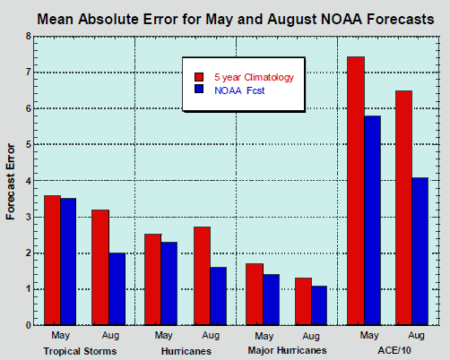
Are these Hurricane Forecasts Accurate?
Figure 2. Mean absolute error for the May and August NOAA seasonal hurricane forecasts (1999 - 2009 for May, 1998 - 2009 for August), and for forecasts made using climatology from the past five years. A forecast made using climatology was in error, on average, by 3.6 named storms, 2.5 hurricanes, and 1.7 intense hurricanes. NOAA's May forecast was not significantly better than climatology for these quantities, with average errors of 3.5 named storms, 2.3 hurricanes, and 1.4 intense hurricanes. Only NOAA's May ACE forecast was significantly better than climatology, averaging 58 ACE units off, compared to the 74 for climatology. Image credit: Verification of 12 years of NOAA seasonal hurricane forecasts, National Hurricane Center.

