Slide 1
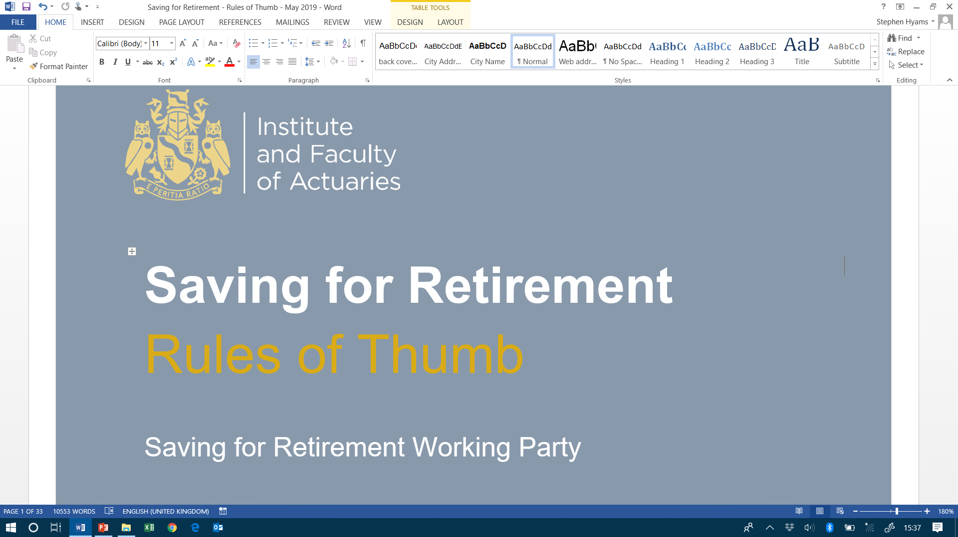

Staple Inn
Monday 20th May 2019
Stephen Hyams
Alan Smith
Chris Squirrell

Slide 2
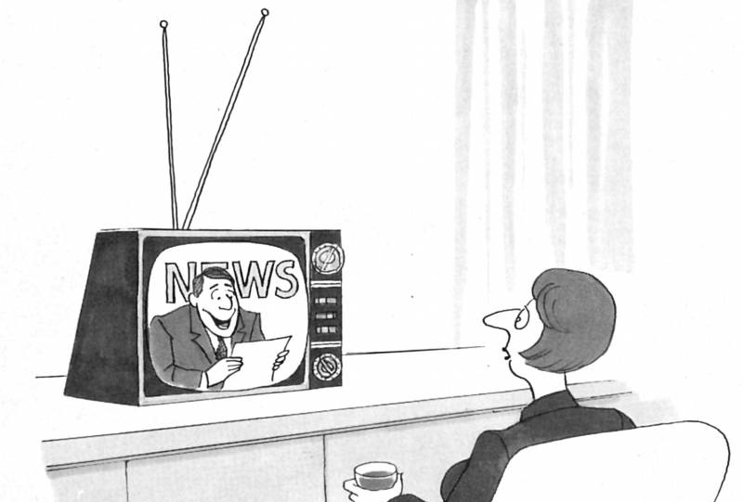
Evening News

Slide 3
Saving for retirement
Voluntary contributions
How much is needed?
How to raise awareness?
Automatic enrolment
Provides basic level of retirement income
State pension

Slide 4
Bottom up approach
Savings for retirement are inadequate
Outcomes-based approach to engage/ promote action
Retirement income targets

Slide 5
Retirement income targets
Salary related
Monetary based
Personalised
Replacement ratio
2/3rd for average earner
2/3 x £27,500 or about £18,000
Australian approach (being developed by the PLSA)
Three levels: “Basic”, “Intermediate” and “Comfortable”
Individual needs must be considered, but not part of rules of thumb

Slide 6
What are we targeting?
Retirement age?
Allowance for inflation?
Individual or household?
Allowance for State pension?
Allowance for tax?

Slide 7
Role of rules of thumb
Raise awareness of how much to save for retirement
Guide for most people most of the time
For those reliant on DC in retirement
Work alongside more bespoke tools and guidance
Factual & objective
Universal
Actionable
Simple & memorable
Empowering
Intuitive

Slide 8
Our rules of thumb
Contribution paid over working life to provide reasonable pension for average person
LPC
Pension provided by any contribution paid over working life
How the above varies by retirement age
How to check if you are on track to get your target pension

Slide 9
LPC - methodology
Retirement income and age
Contributions needed to achieve the fund
Fund at retirement needed to deliver the income

Slide 10
LPC – target income & age
Retirement income £18,000
Retirement age 68
State Pension Age for those in their 20’s & 30’s
Income detail
Indexed to earnings/inflation pre/post retirement
Single life

Slide 11
LPC – target fund
Security & inflation protection
Annuity
£310,000 cost
Flexibility & legacy intentions
Drawdown
£310,000
Roughly “Safe” withdrawal rate : 85% chance lasts 30 years
24% chance survival for 30 years (to age 98)

Slide 12
LPC derivation - financial assumptions
10 year lifestyle period
Net of 0.75% expenses

Slide 13
Derived LPC
Contributions from age 22 to 68
Increase annually by growth in Average Weekly Earnings
Rule of Thumb:
LPC is £525 per month
(about 23% of Average Weekly Earnings)

Slide 14
Why is the LPC so high?
Low interest rates
Annuity real yield -2.0%
Individual annuities expensive
Bulk rates 15 - 20% cheaper
Individual drawdown expensive
Collective solutions cheaper?

Slide 15
Target pension: rule of thumb, retire at 68
£9,500 / £6,300 = 1.5 times
Target pension for LPC
Annualised LPC

Slide 16
Rules of thumb at other retirement ages
Retirement age | 60 | 65 | 68 | 69 | 70 | 71 | 72
Ratio target pension: annual contribution | 0.8 | 1.2 | 1.5 | 1.6 | 1.7 | 1.9 | 2.0
LPC |  |  | 525 | 465 | 405 | 355 | 310
Rule of thumb:
LPC is reduced by £55 per month for each year retirement is delayed beyond 68

Slide 17
Keeping on track
Age | Benchmark fund as a multiple of annual contribution
Up to 40 | Age – 22
41 to 50 | Age – 20
51 or more | Age - 18
E.g. age 45 paying LPC
Benchmark fund = £525 x 12 x (45 – 20)
= £157,500

Slide 18


Slide 19


Slide 20

Getting back on track or change plans
Pay More
Retire Later
Lower Pension

Slide 21
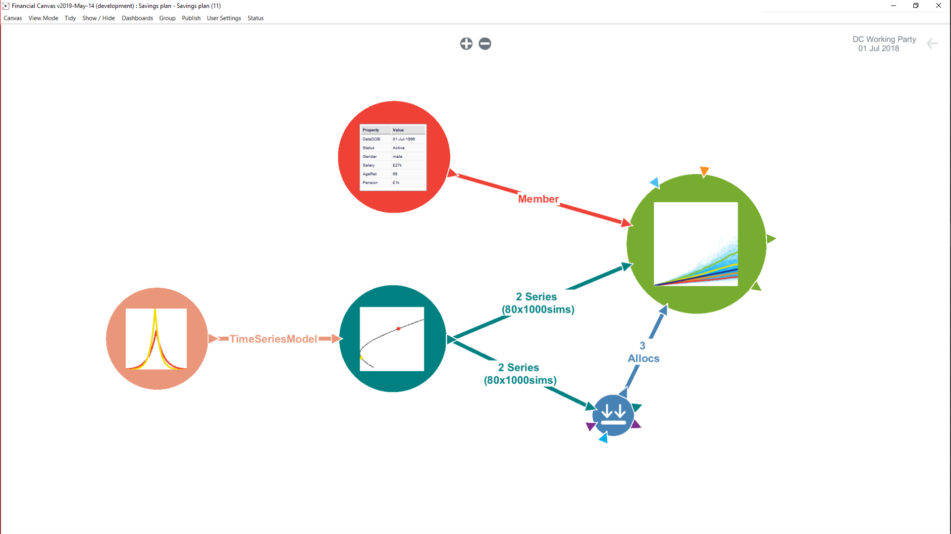

Stochastic Model and Assumptions

Slide 22
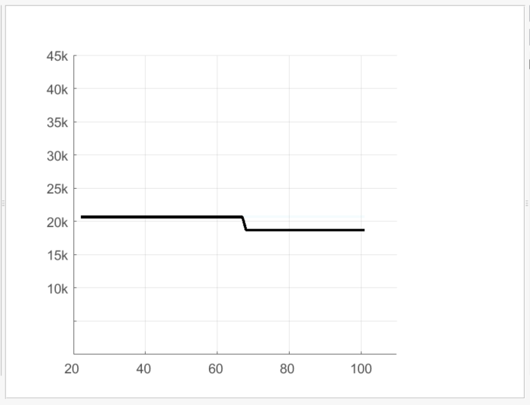
Blown off course – Lower Pension
Age

Slide 23
Blown off course – Lower Pension
Broad range of outcomes
5% chance that DC only delivers half its target

Slide 24
Blown off course – Vary Contributions
Spending varies over lifetime
Range of retirement outcomes narrowed
Downside is stubborn

Slide 25
Blown off course – Retire Later
20+ year spread of retirement ages!
Probability
1/8 chance retirement delayed by
5 years
Retirement Age

Slide 26

Blown off course – Further Work
Likely to be a mix of solutions
Looking at working and contribution patterns during lifetime
Utility measures to assess trade-offs?
… Further guidance rules of thumb

Slide 27
Using the Rules of Thumb
Monthly contribution £525
Current age 45
Retirement age 68
Current fund £130,000
Target pension = £6,300 x 1.5 = £9,450
Annual contribution
Target pension multiple
Benchmark fund = £6,300 x 25 = £157,500
Annual contribution
Age - 20
Shortfall £27,500

Slide 28
Smartphone app - identify my status

Slide 29

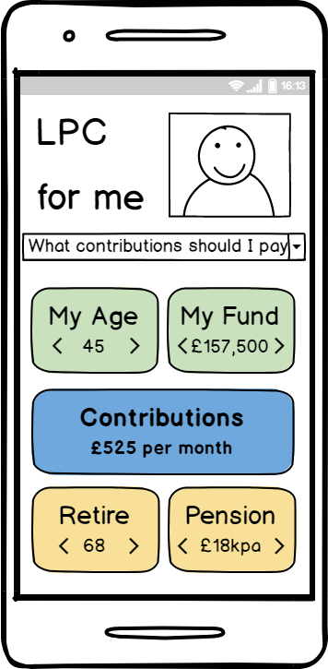

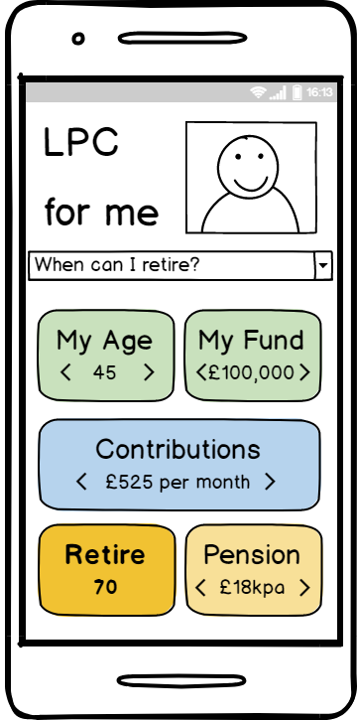

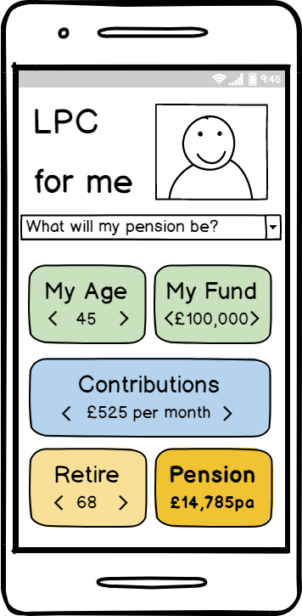

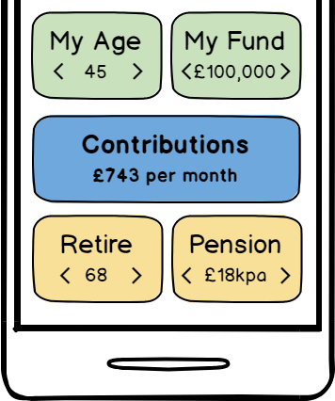
Smartphone app – what can I do?

Slide 30

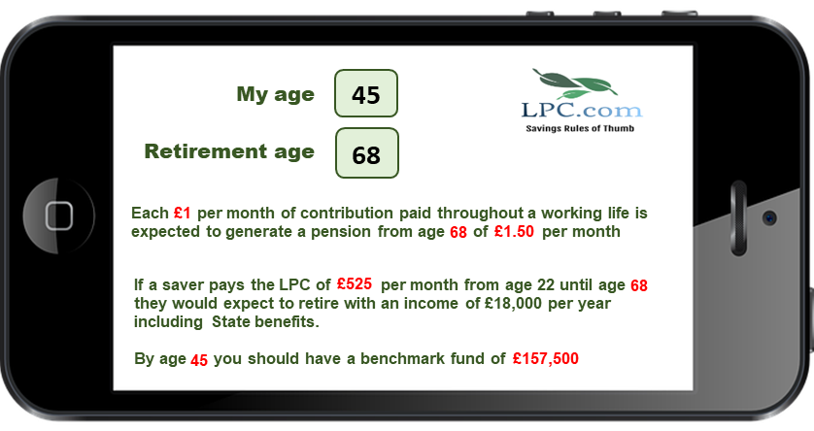
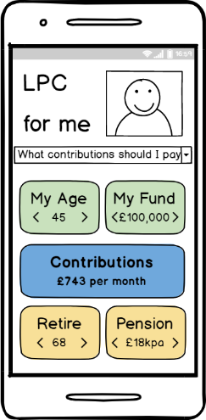


Increasing awareness and triggering action
IFA Advice
Bespoke Tools
£525pm
A mix of existing providers and pentech solutions coming to the market
1.5 x

Slide 31
Rules of thumb for young consumers
LPC based on “intermediate” target pension and State retirement age
Target pension as multiple of contribution
Contributions
Target pension
Retirement age
Variation in the other rules of thumb by retirement age

Slide 32
Keeping on track
Expected accumulation of DC fund
(Rule of thumb)
Am I on track?
x
Actual fund
Contributions
How can I get back on track?
Retirement age
Target pension

Slide 33

Affordability
Employer’s share & auto-enrolment
Target pension £18k?
Retirement age 68?
LPC £525 per month
Cost effective DC solutions
Low interest rates

Slide 34
Risk
Contributions
Investment returns
Will fund deliver expected lifetime income?
Fund at retirement
More secure
Will investments deliver expected fund at retirement?

Slide 35
Rules of thumb principles
Factual & objective
Universal
Actionable
How have we done?
Empowering
Intuitive
Simple & memorable

