Slide 1
Value of with-profits for consumers Working party update
Tim Bateman (Chair),
Ross Thompson, and
Catherine Thorn
Notes:
This presentation was delivered at the IFoA Life Conference 2017 on 23rd November.
The presentation delivered at CILA on 4th May 2017 is included within the appendices (slides 53 to 96).

Slide 2
How often do consumers review their financial product?

Slide 3
How often would consumers like to review their financial product?

Slide 4
Agenda
The value of with-profits for consumers working party.
Scope: Do consumers understand the value of their with-profits policies?
Background
Customer Engagement
Customer Sentiment
Ross Thompson – Standard Life
Catherine Thorn – Prudential
Tim Bateman – Mazars LLP
Notes:
The working party was set up to review the question of whether with-profits consumers understand their policies.
We don’t expect customers to be experts, but do they understand the basics? Do they understand enough to avoid making bad decisions?
Work was split into 2 phases:
Phase 1 = review the current with-profits environment and existing research
Phase 2 = carry out consumer research of our own

Slide 5
Background

Slide 6
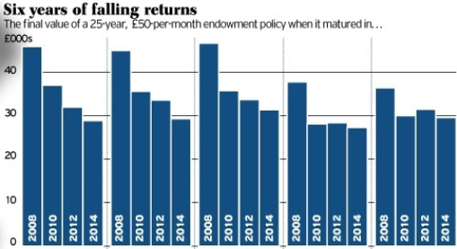
With-profits funds continue to make negative headlines...
Savers should plot their escape from zombie funds
The Times – 9 July 2016
Endowment Scandal! The endowment scandal gets even worse: 70,000 face selling homes as plans expected to pay £110,000 are now worth just £24,000 Daily Mail – 16 November 2017
Help! Why has my 'with profits' pension fund shrunk 11% in two years as stocks hit record highs?
www.thisismoney.co.uk – 20 May 2015
Savers see with-profits pensions slashed by 87%: Thousands promised annual payments of £30,000 now set to receive just £3,700
www.thisismoney.co.uk – 12 July 2016
The Telegraph – March 2014
Notes:
With-profits continues to suffer from negative headlines.
Is there more we can do as an industry to get better information into the public domain?

Slide 7
With-profits funds have performed comparably to similar unit-linked funds...
Single Premium Pensions – 20 Year Return Comparison
Source: Money Management surveys – values typically as at 1st Jan 2016. 1 March 2015 where PRA returns have been used.
Notes:
If you look beyond the headlines, with-profits funds have performed comparably well.
Note – source is Money Management, this gives an example of a 20 year single premium pension. We looked across a range of terms and products and – although with-profits doesn’t outperform in all cases – the overall message is positive (see phase 1 report or CILA slides in appendix – slide 61).

Slide 8
With-profits funds have performed comparably to similar unit-linked funds...
Single Premium Pensions – 20 Year Return Comparison
... But performance varies by fund
And “performance” depends on customer expectation
Source: Money Management surveys – values typically as at 1st Jan 2016. 1 March 2015 where PRA returns have been used.
Notes:
But with-profits fund performance does vary widely, and customers were given high expectations when the policies were taken out (typically in the 80’s).
Yellow bars show range of returns.

Slide 9
Phase 1 Summary
With-profits performance has been comparable to similar UL funds …
On average
But it is highly variable, dependent upon the fund
Information provided on benefit statements varies:
Content
Terminology
Unclear how communications regarding changing investment mix have been handled
There is little existing consumer-specific with-profits research

Slide 10
Survey
Purpose
Better engagement with consumers and improved communications.
Objectives
Do consumers understand the value of their with-profits policies?
What information about their products do consumers value?
Do with profits consumers understand the changing nature of their policy?
Notes:
After we completed Phase 1 we identified there had been limited research into with-profits from a consumer’s point of view
So arranged for a survey to be completed with the purpose of formulating guidelines to improve engagement and communication with customers.
We set out 3 key objectives we hoped to address as part of this survey:
Do customers understand the value of their with-profits policies?
Including some of the key features like guarantees, bonuses and smoothing
What information do consumers value and what is the best way to present this to them from their perspective
Do consumers understand the changing nature of their with-profits policies as more funds close and move towards an end game
We have selected a few of the results from our survey which address some of these objectives

Slide 11
Survey methodology
Method – online survey carried out by YouGov
Numbers of respondents:
At least one financial product: 2,851
With-profits product: 473 (17%)
Fieldwork was undertaken between 2nd – 6th November 2017
Analysis split by categories
Notes:
The key points to note from the survey methodology were that:
We used YouGov, a well respected survey company
One of the main reasons they were selected was because of their ability find a representative sample of with-profits customers
It was an online survey, which helped with the turnaround so we had the results in time to present at this conference. Although I’ll discuss this more later.
Although it could be argued this leads to some selection bias in terms of only showing computer literate policyholders
Of the interviewees with at least one financial product, (473) 17% of them had a with-profits policy, which was pleasing because YouGov had initially expected this to be lower.
And as you can see this survey is hot off the press having been completed earlier in the month and has thrown up some interesting statistics
The full findings of the results will form part of the written report which will be produced in due course

Slide 12
Survey population With-profits financial product (sample size 473)
Notes:
I will flick through the next two slides quickly, but the key takeaways are:
We feel this that the with-profits sample is a good representation
As would be expected the majority of with-profits policyholders are over 55
As a lot of with-profits products are now closed to new business
Slightly older than the control sample

Slide 13
Customer Engagement
All figures, unless otherwise stated, are from YouGov Plc. Total sample size was 4,585 adults, of which 473 held a with-profits financial product. Fieldwork was undertaken between 2nd - 6th November 2017. The survey was carried out online. The figures have been weighted and are representative of all GB adults (aged 18+).

Slide 14
Why with-profits?
Customers were asked the reasons for choosing a with-profits product
Notes:
Suggests a lot of people knew what they wanted at outset
Values come from grouping responses to Q based on high level groups

Slide 15
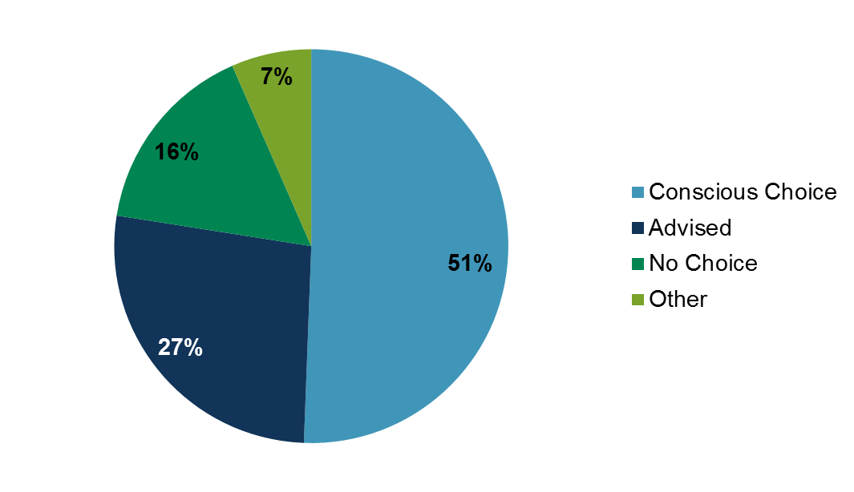
Why with-profits?
Customers were asked the reasons for choosing a with-profits product
Conscious Choice responses in more detail:
Customers appear to have been engaged with the product originally!
Notes:
Looking at the “Conscious Choice” category more granularly suggests people did research and chose WP for one reason or another

Slide 16
Customer loyalty / apathy?
Customers were asked how long they were likely to hold on to their with-profits product … Any guesses how many would stay until/after maturity?

Slide 17
Customer loyalty / apathy?
Customers were asked how long they were likely to hold on to their with-profits product … Any guesses how many would stay until/after maturity?
Is this customer loyalty, apathy or a fear of exit penalties?
Notes:
What does this tell us, in it for the long term?

Slide 18
No exit penalties?
Customers were asked how likely they would be to surrender early if there were no exit penalties
Customers do seem to be loyal to their investments or reluctant to part with them! Are they still so engaged with their products?
Notes:
People still intend to keep their product despite no barrier to exiting!

Slide 19
Are customers engaged?
Customers were asked what info they would like to receive in annual statements
Notes:
What info wanted in annual statements
Point out the more obvious things scored highly
Worryingly low scores lower down – risks, improving projected position, gtees
Some specific comparisons overleaf

Slide 20
Are customers engaged?
Customers were asked what info they would like to receive in annual statements
Customers don’t seem to want to know what they can do about it, or what risks and protections they should be aware of!
Notes:
People want to know what the projected position is, but not what they can do to improve it
People want their current value but not the downside protection

Slide 21
Are customers engaged?
Customers were asked what info they would like to receive in annual statements – classified differently:
Customers don’t seem to want to know what options they have NOW to improve things in future!
Notes:
Reclassified the answers to previous slide
Resist saying the Status Quo category covers “whatever you want” or that the result was “down down deeper and down”

Slide 22
Are customers engaged?
Customers were then asked what info they would like to receive when approaching maturity:
57% want this information (cf 32% in annual statements)
Suddenly customers become interested in what they can do about it (fund switches etc) – will this make a difference?!
Notes:
Now move on to info received/wanted approaching maturity – people turn back on again!

Slide 23
Customer understanding - Benefits
Customers were asked what the benefits of having a with-profits product were:
Less than 20% of WP customers see guarantees or smoothing as a benefit!
Guarantees and smoothing are what we think of as two of the main benefits of WP over other investment types. Are we so out of line with customers’ thinking?
Notes:
Customer view of the benefits of WP – respondents could choose as many as they wanted
Some sensible results but so few choosing some of the key benefits!

Slide 24
Customer understanding – Value and Options
Customers were asked if they understood how the cash-in value of their WP product could change and if they understood all of their options and guarantees
53% did not understand how their cash-in value could change
59% did not understand all of their options and guarantees
What does this mean for customer communications? What more can we do to try and land the message and the important features of products?
Notes:
Understanding of volatility in current value and options and guarantees
Little understanding of how/why value could change from one statement to the next
Ditto for what options and guarantees are available – possible use of jargon causing misunderstanding?
Segue into customer communications IF THAT FOLLOWS, otherwise just a tease

Slide 25
What do customers value about with-profits?
The survey produced some other surprising results:
High reported understanding of with-profits terminology
Understanding of the options available doesn’t increase with age
40% of people don’t understand the implications of cashing in early
18% review their product ‘never’
Customers chose with-profits for a reason and seem to be keen to stick with it to the end.
What more can we do to help increase customer engagement and understanding or help us improve communications?
Notes:
Surprising or dissapointing
Holding to maturity – apathy or do they value it?
Do customers understand terminology (even MVRs) – and how can we test this?
Behavioural economics shows us customers not always economically rational
More info = better understanding of our customers = meet their needs

Slide 26
Customer Sentiment
An alternative analysis
Notes:
Now we’ll look at policyholder communication, linking back to our review of annual statements we reviewed during phase 1.

Slide 27
Tools to look at customer sentiment
Survey included options about free text answers to questions ‘What do you like or dislike about your annual statement?’
Positive and negative feelings expressed – how do we measure?
Analysed with deep neural network (trained to predict the next character in the text of Amazon reviews)
Learns to identify sentiment of text
Can be used even on small amounts of data
Notes:
Data from ‘free text’ responses to questions
System trained already on amazon reviews – can detect sentiment in text, character by character
A general property of certain large neural networks that are trained to predict the next step or dimension in their inputs
Also gives a numerical fingerprint of response – which allows responses with similar meanings to be identified and grouped or clustered automatically (even if they don’t use the same words)
Many possible applications – detect customer sentiment in customer by team, monitor trends etc
This tech will be available real time in the near future
Actuaries working with people from other disciplines can be a very powerful combination

Slide 28
Sentiment value character by character
Radford A, Sutskever I, et al, 2017 “Unsupervised sentiment Neuron System”
available at https://blog.openai.com/unsupervised-sentiment-neuron/
Notes:
Apologies for red/green colour blind – but darker = stronger sentiment. Colour represents sentiment being measured having read that far through the text. As it reads more the sentiment changes.
Focus on sentence ‘The book is really, really good’ – as character by character, colour doesn’t change to become more positive until sentence ends

Slide 29
Customer sentiment in survey responses ‘What do you like about your annual statement?’
(+1.11) [My provider] has done an excellent job for me with my SIP and I get full annual info from [my adviser] who provides my monthly income.
(+1.10) Clear and concise; everything I need on one page.
(-0.77) Nothing. Don't know enough
(-0.76) No, waste of paper
??? They are obliged to send them. Like is not a useful word in this context
Notes:
Examples showing sentiment measures of different responses
Overall sentiment value (average all responses):

Slide 30
Customer sentiment in survey responses ‘What do you like about your annual statement?’
(+1.11) [My provider] has done an excellent job for me with my SIP and I get full annual info from [my adviser] who provides my monthly income.
(+1.10) Clear and concise; everything I need on one page.
(-0.77) Nothing. Don't know enough
(-0.76) No, waste of paper
(-0.67) They are obliged to send them. Like is not a useful word in this context
Overall sentiment +0.095
Notes:
Examples showing sentiment measures of different responses
Overall sentiment value (average all responses):

Slide 31
Customer sentiment in survey responses ‘What do you dislike or would change about your annual statement?’
(+0.45) Being jargon free; easier to understand
(-1.62) Too long and complicated and does not explain anything relevant in plain English
(-1.52) Waste of paper, for which I am paying.
??? Too lengthy; too wordy; too much legal waffle ; lay out very boring ; small font; incomprehensible explanations; poor definitions; too repetitive
Overall sentiment -0.096
Notes:
Examples showing sentiment measures of different responses
Overall sentiment value (average all responses):

Slide 32
Customer sentiment in survey responses ‘What do you dislike or would change about your annual statement?’
(+0.45) Being jargon free; easier to understand
(-1.62) Too long and complicated and does not explain anything relevant in plain English
(-1.52) Waste of paper, for which I am paying.
(-1.91) Too lengthy; too wordy; too much legal waffle ; lay out very boring ; small font; incomprehensible explanations; poor definitions; too repetitive
Overall sentiment -0.096
Notes:
Examples showing sentiment measures of different responses
Overall sentiment value (average all responses):

Slide 33
Digital fingerprint allows grouping of responses
Grouping (clustering) does not rely on customers using identical language, or even spelling correctly!
Example responses grouped together:
Easy to understand
'Easy to understand; informative'
'Clear;concise;up to date'
Value
'Clear about its overall value.‘
'Comparisons of value now against 1 year previously'
Notes:
Examples showing sentiment measures of different responses
Overall sentiment value (average all responses):

Slide 34
Automated grouping of responses reveals themes
Key themes important to customers in communications
I want it to be easy to understand (17%)
I want to know the value (6%)
Many customers don’t have a view (77%)
Notes:
Digital fingerprint also allows the grouping of similar responses
To look at themes in the free text responses for what customers really like and don’t like
Easy to understand
responses: 115
avg sentiment: 0.44
relevant words: 'easy', 'clear', 'understand'
sample responses:
'Easy to understand; informative;'
'Clear;concise;up to date'
'They are informative and generally clear to understand‘
Value
responses: 39
avg sentiment: 0.19
relevant words: 'value', 'current', 'final'
sample responses:
'Clear about its overall value.'
'Comparisons of value now against 1 year previously'
'Just the surrender and transfer value of my units.'
'Don't Know'
responses: 253
avg sentiment: 0.00
relevant words: 'n/a', 'dk', 'none'
sample responses:
'Don't know'
'N/a'
'None.‘
'Value'
'Mixed bag'
responses: 538
avg sentiment: 0.15
relevant words: 'information', 'like', 'how'
sample responses:
'I am very happy about the way the performance of my products is presented'
'Regular updates and online access to review the performance of my chosen investments'
'No, waste of paper'
Notes: responses cover the full range of sentiment from good to bad. Needs further analysis to identify clear themes.
'No'
responses: 251
avg sentiment: -0.10
relevant words: 'no', 'nothing', 'really'
sample responses:

Slide 35
Conclusion and next steps

Slide 36
Summary and Conclusions – 1 of 2
Returns are competitive, but we could do more to “advertise”.
With profits can change over the lifecycle - ongoing engagement is important.
Consumers want regular and detailed information – maybe more as they nearer to maturity
Consumers state they have a reasonable understanding of the information being provided...
... And better relative to holders of financial products generally.

Slide 37
Summary and Conclusions – 2 of 2
However, certain key issues are not well understood...
...And there is a substantial proportion who will not actively manage their policy.
Clearer communication is key, but only one part of the solution.
There is some evidence of a transition towards a preference for digital communications
Will evolve as younger generations engage with with-profits?

Slide 38
Next steps
Second survey planned to get deeper understanding of with-profits customers
Use sentiment measures – including open questions with free text responses, like a product review on an e-commerce website
Grouping allows meaningful analysis of unprompted replies
Inviting companies to participate
Potential for benchmarking
Engagement with FCA
Please contact us if you have any further feedback or comments.

Slide 39
Questions
Comments
Expressions of individual views by members of the Institute and Faculty of Actuaries and its staff are encouraged.
The views expressed in this presentation are those of the presenter.

Slide 40
Should you require any further information, please do not hesitate to contact:
Chair: Tim Bateman (Mazars LLP) tim.bateman@mazars.co.uk
Deputy Chair: Jonathan Welsh (Wesleyan) Jonathan.Welsh@wesleyan.co.uk
Secretary: Ben Stroud (ReAssure) Ben.Stroud@reassure.co.uk
Further working party details, including our Life Conference 2017 and CILA 2017 presentations can be found here:
https://www.actuaries.org.uk/practice-areas/life/research-working-parties/value-profits-consumers

Slide 41
Working party members:
Chair: Tim Bateman (Mazars)
Deputy Chair: Jonathan Welsh (Wesleyan)
Secretary: Ben Stroud (ReAssure)
Andrew Fraser (Standard Life)
Rebecca MacDonald¹ (PwC)
Kris Overlund (PwC)
Rosalind Rossouw (Sun Life Financial of Canada)
Ross Thompson (Standard Life)
Catherine Thorn (Prudential)
Catherine Zhang (Abbey Life)
1. Currently on maternity leave – thanks for the support Rebecca!

Slide 42
Contributors
Our special thanks go out to the following contributors to Phase 1:
Mazars
Wesleyan
ReAssure
Standard Life
NFU Mutual
Sun Life Financial of Canada
Aviva
LV=
Equitable Life
PwC
KPMG
Healthy Investment
Kingston Unity
Royal London
AEGON
Phoenix Life
Legal & General
Scottish Widows
ABI
MAS

Slide 43
Appendix

Slide 44
Survey – Representative sample
The survey has been done by YouGov and a key reason they were chosen is their experience of finding a representative sample
They have a UK panel of 800,000 and using a 2,000 nationally representative sample gives a margin of error of +/-2%
The final data is statistically weighted to the national profile, using key sources such as the census and ONS population data
We were told anything above 50 people with with-profits would be sufficient - we got 473 (16%) out of 2,851.

Slide 45
Survey questions At least one financial product (sample size: 2,851)
Which, if any, of the following financial products do you personally currently own?
Which, if any, of the following are reasons why you purchased any financial product?
Which ONE of the following BEST describes the reason why you initially took out this product?
In general, how often, if at all, do you review any of your financial products?
And how often, if at all, would you like to receive information from your provide about your financial products?
Which, if any, of the following statements describes the information you currently receive about your financial products?

Slide 46
Survey questions At least one financial product (sample size: 2,851)
How easy or difficult to understand do you find the information you currently receive?
In which ONE of the following ways would you most like to receive/ view your annual financial product statements?
Which ONE of the following statements best applies to your financial products in general?
Which, if any, of the following do you currently receive as part of your annual statements?
Is there anything you like about your financial product statements?
Is there anything you dislike/ would change about your financial product statements?
Which, if any, of the following types of information would you like to receive in order to understand the options available to you?

Slide 47
Survey questions At least one financial product (sample size: 2,851)
How likely, if at all, do you think you would be to cancel your life insurance policy early?
Which, if any, of the following phrases would you say you understand the meaning of?
Would you say you fully understand the charges that might incur if you cash in early on this financial product?
How likely, if at all, are you to hold this product through to its maturity date (i.e. the end date of the policy )?

Slide 48
Survey questions With-profits financial product (sample size 473)
How easy or difficult do you currently find the information you receive about your with-profits policy to understand?
Which, if any, of the following describe any of the financial products that you own?
Which, if any, of the following types of information would you like to receive?
Which, if any, of the following are reasons why you purchased a with-profits financial product?
Which, if any, of the following do you think are benefits of holding a with-profits product?
Does the with-profits financial product pay both regular and final bonuses on the policy?
Do you understand the difference between regular and final bonuses?

Slide 49
Survey questions With-profits financial product (sample size 473)
If you had to choose, which ONE of the following best describes what you would prefer?
Which ONE, if any, of the following statements best applies to you?
Which, if any, of the following actions would you take?
Through which, if any, of the following ways would you be likely to seek further information?
Which, if any, of the following types of information would be important for you?
In which, if any, of the following ways would you like to receive/ be able to view your annual financial product statements?
Which ONE, of the following statements best applies to you?

Slide 50
Survey questions With-profits financial product (sample size 473)
Would you say you would know all of your options and guarantees and understand how the cash in value of your policy can change?
Is your with-profits product you are invested in open or closed?
Has your with-profits financial product changed any of its investments over the last 5 years (e.g. reducing the proportion of the fund which is invested in equities)?

Slide 51
Survey population With-profits financial product (sample size 473)
Notes:
There is a good regional split of the policyholders sampled
All other splits indicate this is a good representative sample

Slide 52
Key Survey Results Hold to Maturity?
What percentage of the with-profit policyholders we surveyed said they would hold their policy to maturity?
50%
65%
80%
Notes:
Now for a bit of audience engagement

Slide 53
Key Survey Results Hold to Maturity?
“Don't take too much notice to be honest, I just pay into it waiting for it to mature”
Notes:
Well in the family fortune format …our survey said 80%
So what does this tell us?
Going back to objectives, does this tell us that policyholders value with-profits policy and are satisfied with it?
Or is this an example of financial apathy which is widely present in the market. As this comment we received would indicate:
“Don't take too much notice to be honest, I just pay into it waiting for it to mature”
Alternatively it could be that they aren’t aware of alternative options open to them

Slide 54
Key Survey Results Cash in value
Would you say you would know all of your options and guarantees and understand how the cash in value of your policy can change?
Notes:
Which leads me on nicely to the next results we have pulled out, where we asked the with-profits policyholders if they understood their options and guarantees and how their cash in value can vary over time:
It is slightly disappointingly on a fifth of people understand both their guarantees and options, and fluctuations in their cash in value:
Interestingly, we also found, that the results did not vary by age group either. As I would have expected the older generations approaching retirement would have had a better handle on this
This maybe indicates that the communications are not getting this across clearly enough or policyholders don’t read past the headline policy value
Which is slightly counter to the result that Jon presented at the start and maybe highlights a lack of depth of knowledge
In a separate question 40% of people said they don’t understand the charges if they were to cash in their policy early

Slide 55
Key Survey Results Open or Closed
Notes:
The next slide looks back at one of the key objectives of understanding of policyholders about the changing nature of their policies as funds close
The stand out fact is the number of don’t knows:
Which leads to the question of does this actually matter?
Do they need to know this information as part of any decisions they make regarding their policy?
And the majority have indicated they will hold this until maturity anyway
Questions we can maybe debate at the end.

Slide 56
Key Survey Results Engagement
Notes:
Next few slides look at policyholder engagement, starting with financial statements
It is pleasing for us, and I’m sure the regulator, that such a large percentage of policyholders indicated they thought the information received was about right
In a separate questions we asked “Is there anything you like about your financial statements”. We received mixed responses to this as you’d expect:
Positive “Receiving statement reminds me to check my investments/pension”
Negative “I don’t understand them and so I usually just put them directly into a drawer”
At least he or she doesn’t throw them away
“They should not assume the reader is an idiot”, but counter this with
“They are always overcomplex”
“Sometime you get fed up with the repeated warnings”
which highlights how hard it is to get the balance right

Slide 57
Key Survey Results Engagement
Which were the reasons why you purchased your with-profits product(s)?
Notes:
My next slide looks at reasons for taking up the policy in the first place
Note people could tick multiple options in this question
A large percentage of policyholders have indicated that it was the default option, compulsory or that it was advised to them:
So one view is that they feel they have not chosen themselves, which may make it hard to increase their level of engagement

Slide 58
How often do consumers want information?
Providers should communicate “early and often”
MAS review of retirement language
“The problem with all the information is when to read it all”
Notes:
A previous Money Advice Service survey highlighted that policyholder preferred to contacted often and well in advance of retirement
From our survey of all holders of a financial product 70% of people said they would like to receive information on an annual basis:
This was up to 86% for with-profits policyholders
This shows positive engagement
Annual statements are enough, and we don’t want to send out too much information as indicated by the quote

Slide 59
Key Survey Results Correspondence
Notes:
My final slide shows how policyholders preferred method of communication
For me it was interesting to see how many people still prefer letters in this online world, especially given this was an online survey
With more than 50% of all policyholders over 35 preferring letters.
Although I have to admit I prefer letters, because you are bombarded with emails every day, so it can sometimes be hard to see the wood from the trees and refreshing to receive a letter.
It might also be driven by people being in the habit of receiving and filing letters and feeling more comfortable to continue this method
And finally, there may be a lack of trust with having personal financial information online given the number of high profile data breaches in the last few years
It does however indicate a trend, that younger generations prefer to receive the information digitally,
So maybe offering different options to policyholders rather than a one size fits all may be beneficial and providing new products purely online
Key takeaways:
Policyholders still want regular information
This is still a preference for letters over digital correspondence, but the tides may be turning on this
There is a good level of understanding, but subtle issues like funds been closed are less well understood.

Slide 60
Identifying the problem
Communications
With-profits annual benefit statements…
Provide lots of ‘useful’ information
Bespoke and can be very detailed
Lack consistency
Notes:
Our desk-based research earlier in the year identified concerns with the suitability of annual benefit statements. They contained a lot of information, we wanted to know if they were too long, and also, whether all that information was deemed useful and adding value to the consumer.
There was also concern about the use of technical terminology or Jargon, which runs the risk of disengaging or bewildering consumers.
Finally, every firm had different approaches; whilst some differences were driven by the fund or product, with-profits doesn’t have a recommended best practice to the same extent as unit linked products.

Slide 61
Identifying the problem
Communications
Provide lots of ‘useful’ information
Q: How much information do you receive for your policy?
I feel I receive too much information
The amount I receive is about right
I feel I received too little information
Notes:
To address the first of these, we asked policyholders how they felt about the volume of information they received.
<Audience participation>

Slide 62
Identifying the problem
Communications
Provide lots of ‘useful’ information
Policyholders think it is ‘about right’
Notes:
The results from our survey indicated that policyholders feel the amount of information they receive is about right, 64% of all policyholders thought it was about right.
Amongst with-profits policyholders, this rose to 72%. In fact, it was the number who didn’t know that decreased between the entire population of policyholders and the with-profits policyholders. This, at least, suggests that the with-profits policyholders are more aware of the information they receive.
So it seems providers are getting the amount of information about right.

Slide 63
Identifying the problem
Communications
Provide lots of ‘useful’ information
With-profits policyholders want the ‘difficult to provide’ information
Notes:
We also asked policyholders which information they most wanted to see on their annual statements.
Results weren’t all that surprising with the most popular responses being value of the policy now, investment performance and changes over the year, projected values, and premiums or charges.
What was interesting is that, the with-profits policyholders were even more interested to see this information. The FCA’s recent Legacy Review noted that some of this information may prove difficult for providers to provide for their conventional with-profits policies, for example with implicit charges. But our survey suggests that these are exactly the policyholders most interested in seeing this information. Perhaps this is because they’ve not seen it before.
With-profits policyholders, again, displayed higher engagement and want to receive information, even that which we might find ‘difficult to provide’.

Slide 64
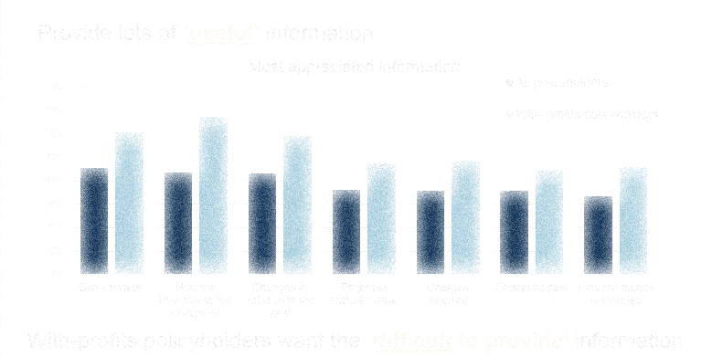
Identifying the problem
Communications
Provide lots of ‘useful’ information
“smoke and mirrors”
“should not assume the reader is an idiot”
I feel my money is “safe”
“Keep it short, snappy and true”
too repetitive
“layout very boring”
“table after table of figures that don't seem to mean much”
With-profits policyholders want the ‘difficult to provide’ information
Notes:
We also asked policyholders what they liked or disliked about their annual statement.
There was a mix of feelings. Ranging from those who felt their money was in safe hands, through to those who spoke of smoke and mirrors.
One theme that emerged in a number of comments was of boring layouts or poor explanations suggesting there’s still some room for improvement within the industry. Consumers want to receive regular communication of the key messages but they don’t need to know the full detail.

Slide 65
Consumers understanding of terminology
Communications
Providers have identified a lack of understanding of terminology, but …
Notes:
With-profits is full of its own jargon, regular and final bonuses, smoothing and MVRs. Providers were concerned about how well consumers really understand all the with-profits terminology they receive.
The entire surveyed population were not very confident with these with-profits terms, with fewer than 40% feeling they understood the terms: with-profits, sum assured, regular bonus or final bonus.

Slide 66
Consumers understanding of terminology
Communications
Providers have identified a lack of understanding of terminology, but … many believe they understand
Notes:
There is a reassuring improvement looking at with-profits policyholders, with almost two-thirds of policyholders understanding the key terms. Or at least thinking they do. Those who don’t understand will include many of those who don’t engage with or read their statements.
This still means that most policyholders aren’t switching off when they read these terms.
But …

Slide 67
Consumers understanding of terminology
Communications
Providers have identified a lack of understanding of terminology, but … many believe they understand
Not all terminology is easily understood
“jargon is not aimed at the lay person”
Notes:
… there are terms that are still not well understood. Despite annual statements referencing MVRs, this hasn’t generated anywhere near the same level of understanding of what an MVR is.
What can we do about this? As an industry we need to be clear with the language we use and strive to make statements engaging and easy to understand.

