Slide 1
The Impact of Wearable Technology and Internet of Things
Networking and CPD Event
Anna Spender – Chair
Colin Bullen – Deputy Chair

Slide 2
Agenda
Working Party Introduction and Scope
Progress Report
  Workstream 1 Update
  Workstream 2 Update
Next Steps & Output

Slide 3
Working Party Introduction & Scope

Slide 4
Introduction - Opportunities
Rapidly developing area
Wide and ever expanding range of wearables, devices, apps, data aggregators & platforms
Ability to
  Measure health and gain insight in to health related behaviours and outcomes
  Engage customers in new ways & throughout the lifetime of an insurance policy rather than at distinct events
  Improve health and manage chronic conditions
Increasing numbers of insurers have started incorporating technology in to their product offerings
More than 30% of insurers worldwide are already using wearable technology for customer engagement*
“ Data sharing with insurance companies is the “holy grail” of the wearable tech business”
Fitbit CEO James Park
* Accenture 2015

Slide 5
Introduction - Challenges
Rapidly developing area
Wide and ever expanding range of wearables, devices, apps, data aggregators & platforms
Currently limited evidence of the effectiveness of technology in providing sustained health improvements and outcomes
Engaging individuals in consistent and long term use of technology
Sustained behaviour change
Launching products prior to building up data and evidence to support pricing or changes in underwriting & claims management
Data use & integration with current systems & processes
Data protection

Slide 6
Working Party Brief
This Working Party aims to look at the emergence of wearable technology and the internet of things and their current and potential use within the health and care area
Wearable technology related to healthier wellbeing is developing quickly and the working party looks to develop an understanding of the currently available technology, and the capabilities of the next generation. This includes considering the impact of wearables on individually underwritten protection products and/or employee benefit schemes

Slide 7
Working Party Progress Report
Workstream 1

Slide 8
Workstream 1 Brief
Research the interests of the various stakeholders regarding wearables and the internet of things.
Investigate the areas of conflict and commonality between the stakeholders with an aim to understand the potential challenges and opportunities in linking this technology with health insurance. Covering;
Stakeholder needs and aims
Stakeholder current usage (insurance market / other markets / personal)
Distribution / barriers to use
Data protection
Incentives

Slide 9
Stakeholders
Stakeholders
Beliefs / Drivers
Employers
Opportunities
Barriers
Incentives / Penalties
Distributors
Manufacturers
(Re)insurers
Areas of focus
Activity
Partners / collaborators
Investments
Articles, blogs, white papers, published evidence
Consumers / End Users

Slide 10
Next Step – Case Studies
Data
Aggregators
Data Protection
Value of data
Collection devices
Continuous Underwriting
Key area of emerging propositions
Chronic diseases
Medical advice?
Establishing incentive / Penalty bands
Other
General Insurance
Technology & Insurance Tech Companies
Employers

Slide 11
Working Party Progress Report
Workstream 2

Slide 12
Workstream 2 Brief
Research the various technologies available now or in the future with the potential to impact health and wellbeing
What can be measured?
What data is captured, and by what process?
How accurate and reliable is that data?
How do users engage with the technology, and implications for stakeholders?
What is cost of using this technology?
Expected impact on behaviour, if any

Slide 13
Devices Identified
Wrist – activity/HR | Clothing | Body | IoT | Medical
Apple Watch | Tune shoes | Ouraring | Sentiance | Quell
Fitbit | Under Armour SpeedForm | Prevent - mouthguards | AliveCor - Kardia Mobile | SEEQ Mobile Cardiac Telemetry
Mio Global | ATO-Gear Arion | Kokoon | mybitat | Stedi
Sence | Iofit shoes | Neuroon | OnKol | DIA-VIT
HELO | OMBra | Sleep Shepherd | 3rings | Shade
Garmin | Samsung WELT | Muse | Canary care | GlucoTrack
Striiv | Lumo Run shorts | Modius Health | Howz | SwellFit
Misfit | VSP Global | Moodmetric | Preventice Solutions | BeVITAL
Jawbone | InSenth IN1 | Bloomlife | Mimo | ADAMM
Moov | Osterhoutgroup | Qardio Arm | Philips lifeline | Valedo
Xiaomi |  | Freestyle Libre | Future path | iTBra
TomTom |  | Omron RS4/6/8 | my-signals
 |  | iHeart | Smartplate
 |  | Qardio | Smart cities
 |  | Lifepatch | NHS "test beds"
 |  |  | TZOA
 |  |  | Alcove

Slide 14
Devices Identified
Wrist – activity/HR | Clothing | Body | IoT | Medical
Apple Watch | Tune shoes | Ouraring | Sentiance | Quell
Fitbit | Under Armour SpeedForm | Prevent - mouthguards | AliveCor - Kardia Mobile | SEEQ Mobile Cardiac Telemetry
Mio Global | ATO-Gear Arion | Kokoon | mybitat | Stedi
Sence | Iofit shoes | Neuroon | OnKol | DIA-VIT
HELO | OMBra | Sleep Shepherd | 3rings | Shade
Garmin | Samsung WELT | Muse | Canary care | GlucoTrack
Striiv | Lumo Run shorts | Modius Health | Howz | SwellFit
Misfit | VSP Global | Moodmetric | Preventice Solutions | BeVITAL
Jawbone | InSenth IN1 | Bloomlife | Mimo | ADAMM
Moov | Osterhoutgroup | Qardio Arm | Philips lifeline | Valedo
Xiaomi |  | Freestyle Libre | Future path | iTBra
TomTom |  | Omron RS4/6/8 | my-signals
 |  | iHeart | Smartplate
 |  | Qardio | Smart cities
 |  | Lifepatch | NHS "test beds"
 |  |  | TZOA
 |  |  | Alcove

Slide 15
Measures Identified
Measurements current available
Activity time | Coughing | Goal progress | Respiration rate and patterns
Ankle curvature | Distance | Heart rate/pulse | Sleep duration
Ascent/Decent (Floors) | ECG/EKG | Heart rate variability (HRV) | Sleep quality (N3/light/REM)
Blood pressure | EEG | Impacts to head (forces) | Steps
Blood sugar | Falls (in the elderly) | Light exposure (pre-sleep) | Swimming lengths
Body composition | Fitness (Cardiovascular) | Location | Swimming strokes
Body temperature | Focus/attention | Pace/speed/cadence | UV exposure
Calories | Galvanic skin responses (emotional health) | Pollution | V02 Max (derived from HRV)
Contractions | Girth | Posture and balance, pressure distribution and weight shift information | Weight

Slide 16
Working Party Next Steps

Slide 17
Working Party – Next Steps & Output
Contact with manufacturers to understand more about device measurement accuracy and consistency
Reflect on stakeholder needs versus what is available in the market
Explore potential ways to make better use of the technology available –signposting not solutioning
Expand the current research to include some case studies beyond health insurance which could give insight into overcoming implementation challenges and further technology opportunities
Present at Protection, Health & Care Conference 2018
Write a paper on our findings – mid 2018

Slide 18
Questions
Comments
The views expressed in this presentation are those of invited contributors and not necessarily those of the IFoA. The IFoA do not endorse any of the views stated, nor any claims or representations made in this presentation and accept no responsibility or liability to any person for loss or damage suffered as a consequence of their placing reliance upon any view, claim or representation made in this presentation.
The information and expressions of opinion contained in this publication are not intended to be a comprehensive study, nor to provide actuarial advice or advice of any nature and should not be treated as a substitute for specific advice concerning individual situations. On no account may any part of this presentation be reproduced without the written permission of the IFoA [or authors, in the case of non-IFoA research].

Slide 19
The future of behaviour tracking
Patrick Lynch
VP Sentiance.

Slide 20
From the Internet of things to the internet of YOU.

Slide 21
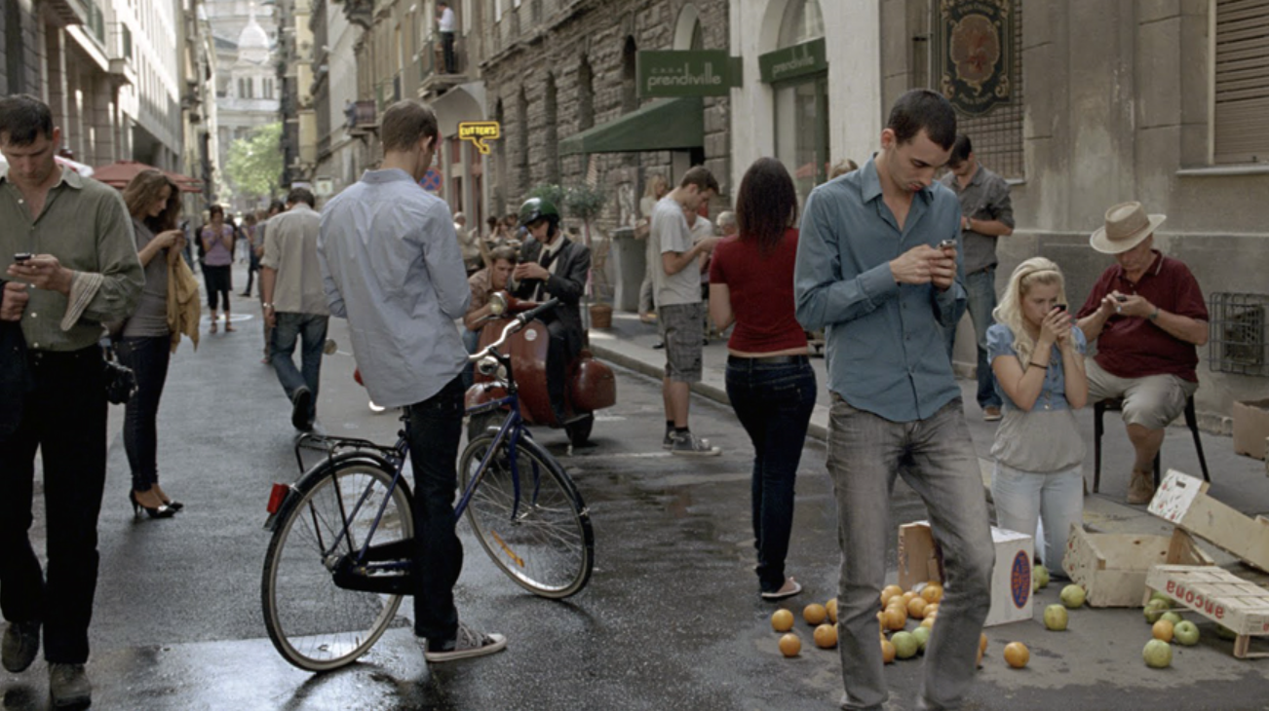
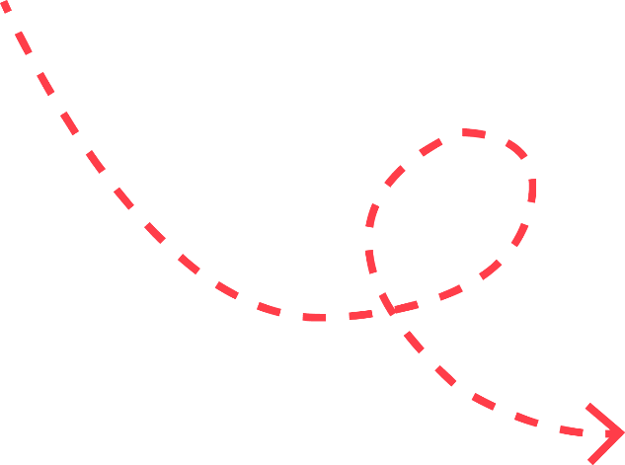


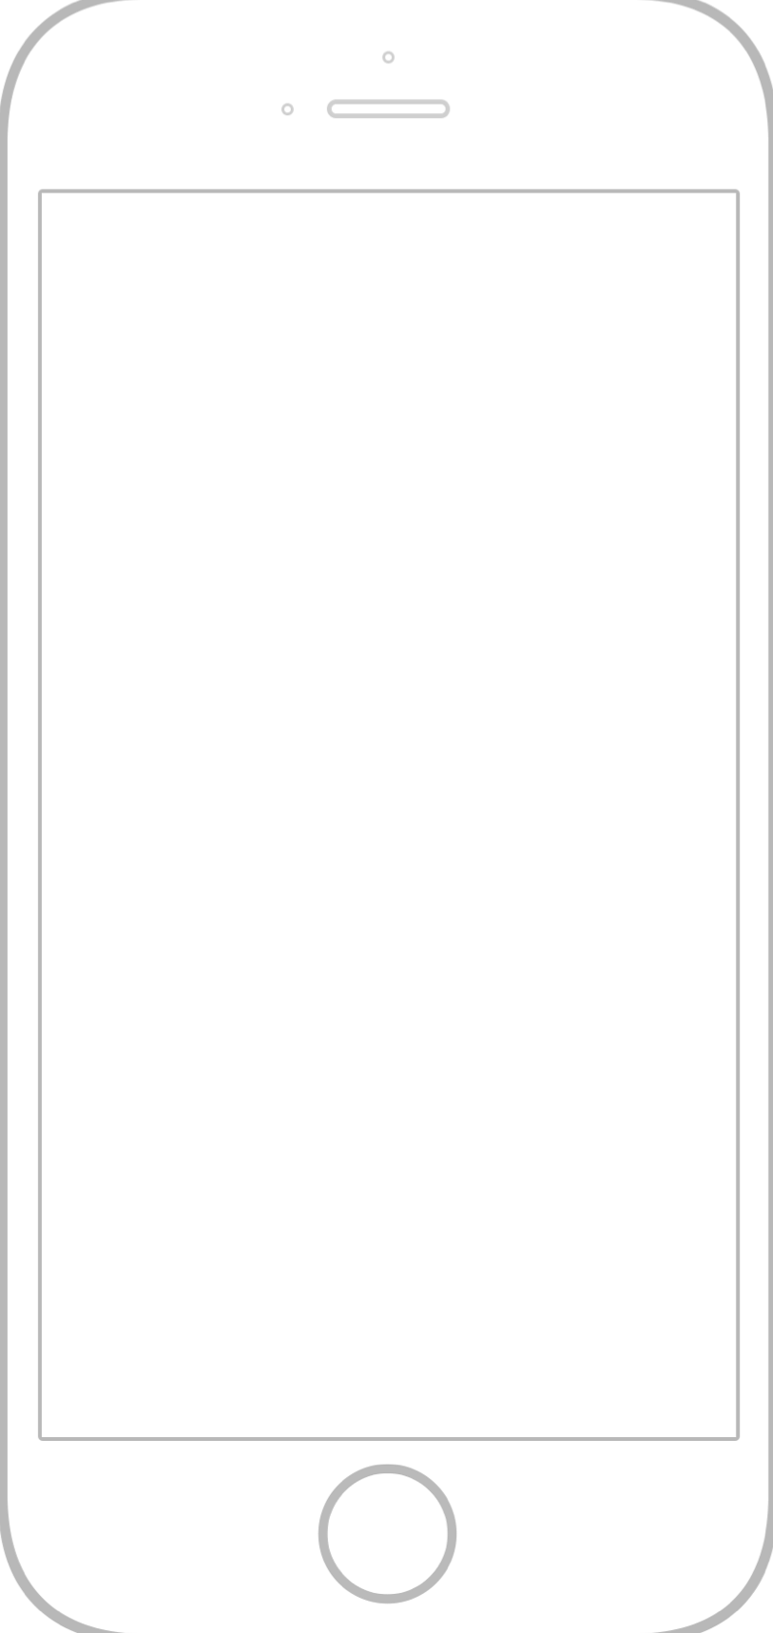



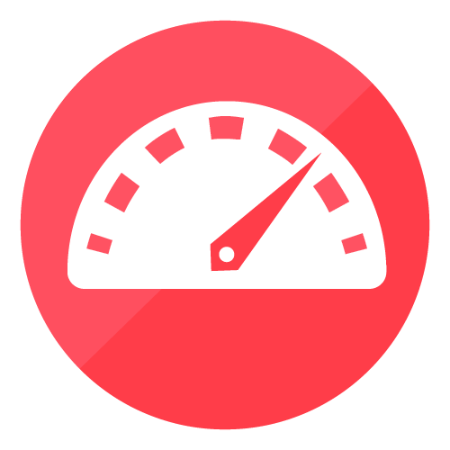
Behavior
on the go
Notes:
Well, consider the fact that we’re all running around with our smartphones these days, almost as an extension of our body itself.
All of these smartphones are packed with sensors such as gyroscopes and accelerometers, measuring every small vibration and motion change.
At Sentiance, we developed a machine learning platform that takes in this raw sensor data, detects, extracts and predicts patterns from it, and turns these patterns into behavioral insights and gives them back to our partners – insurance companies in order to help them understand their customers and amongst other things - manage risk and start moving from protection to prevention

Slide 22
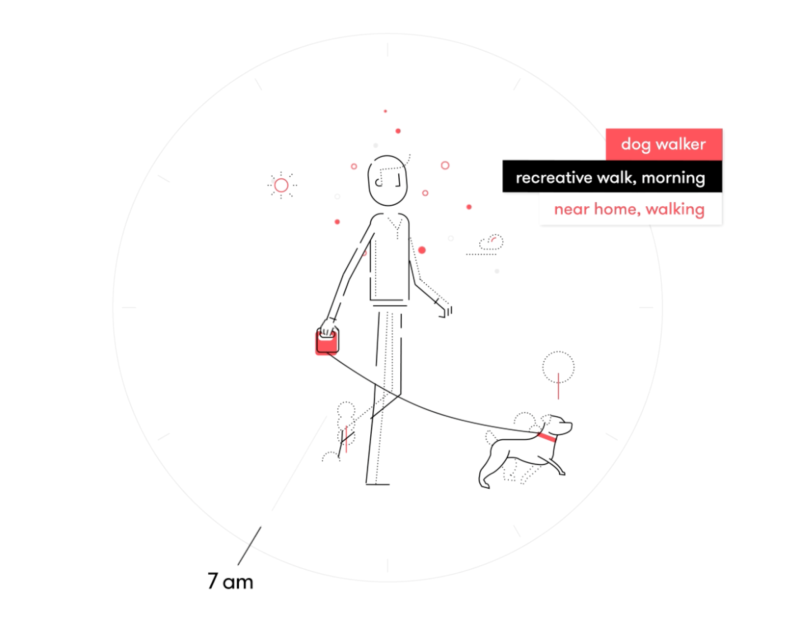









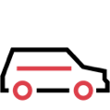
LAYER 3
SEGMENTS
WHO
LAYER 2
MOMENTS
WHY
\
LAYER 1
WHAT
WHERE
WHEN
EVENTS
Notes:
We do this on three levels.
On the lowest level, we do event detection. In this example for instance, we detect that the user is walking, based on the vibrations of the phone, and that he is nearby his home, learned from his past behavior.
The sequence of recent events is then pushed through our deep learning pipeline to come up with moments. Moments explain why an event is actually happening.
In this example, the user is on a recreative walk, as opposed to for instance a commute to work, and is in his personal morning routine.
Finally, we aggregate all this data over a longer period of time, to detect segments, explaining who the user is. For example, this user is a dog walker, and maybe also a workaholic or shopaholi.
Like I said this only works if the app the person is susing has our code in it. Our demo app

Slide 23
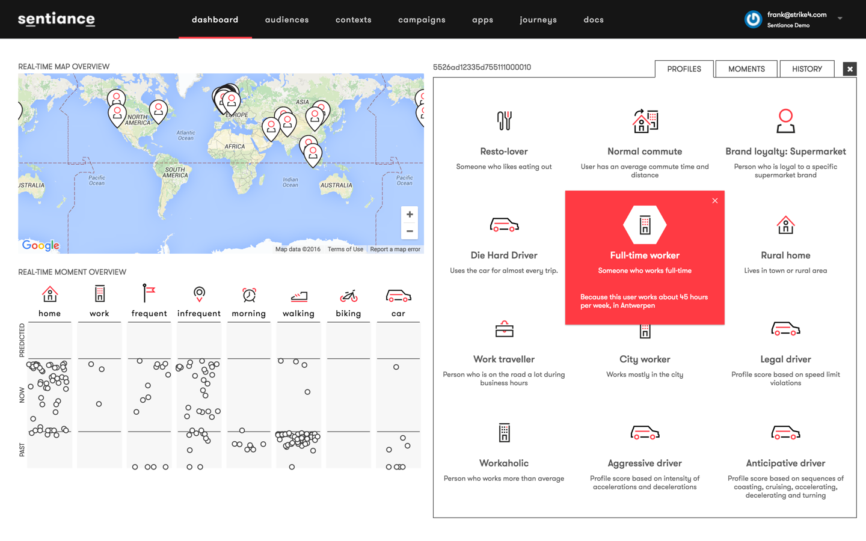

Slide 24
Engagement over pricing
Oliver Werneyer
Customer Technology Manager, Swiss Re Life Capital Management

Slide 25
Questions
Comments
The views expressed in this presentation are those of invited contributors and not necessarily those of the IFoA. The IFoA do not endorse any of the views stated, nor any claims or representations made in this presentation and accept no responsibility or liability to any person for loss or damage suffered as a consequence of their placing reliance upon any view, claim or representation made in this presentation.
The information and expressions of opinion contained in this publication are not intended to be a comprehensive study, nor to provide actuarial advice or advice of any nature and should not be treated as a substitute for specific advice concerning individual situations. On no account may any part of this presentation be reproduced without the written permission of the IFoA [or authors, in the case of non-IFoA research].

