Slide 1
Survival Analysis of Big Health Data in Actuarial Research
Elena Kulinskaya (UEA)
Co-investigators: Nigel Wright (Aviva), Nicholas Steel (NMS)
Team: Ilyas Bakbergenuly, Padma Chutoo, Nurunnahar Akter,
Njabulo Ncube
The ‘Use of Big Health and Actuarial Data for understanding Longevity and Morbidity Risks’ research programme is being funded by the Actuarial Research Centre.
www.actuaries.org.uk/arc

Slide 2
Contents
Introduction
Hazards, hazards ratios and the Cox Regression
Landmark analysis
Case study 1: landmark analysis of statins
Double-Cox model
Case study 2: Modelling survival after ischemic stroke
Summary and discussion

Slide 3
Aims and data
Aims: Development of novel statistical and actuarial methods for modelling mortality and morbidity and evaluating longevity improvement based on Big Health and Actuarial Data.
Data: Our research uses The Health Improvement Network (THIN) primary care data to develop statistical models of longevity
Our subset of THIN includes all patients born before 1960 and followed to 01.01.2017, this is 3.5 million patients
The advantage of using individual-level medical data is that it is possible to model both the uptake of medical treatment and the effect of that treatment on longevity conditional on the individual lifestyle and health factors instead of the aggregated profile

Slide 4
Target Conditions and interventions

Slide 5
Contents
Introduction
Hazards, hazards ratios and the Cox Regression
Landmark analysis
Case study 1: landmark analysis of statins

Slide 6
Survival analysis vs GLMMs
The GLMMs are ubiquitous in actuarial practice. The standard approach to modelling mortality is the Poisson model.
This ignores interdependencies in the data. Instead we can use time to event or survival analysis.
ID | Year | sex | age | health1 | health2 | Death
1 | 2019 | M | 71 | … | … | 0
2 | 2019 | F | 66 | … | … | 0
3 | 2019 | F | 74 | … | … | 1
… | … | … | … | … | … | …
1 | 2020 | M | 72 | … | … | 1
2 | 2020 | F | 67 | … | … | 0

Slide 7
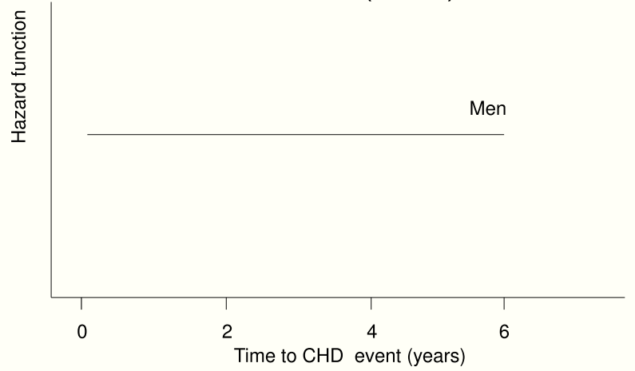
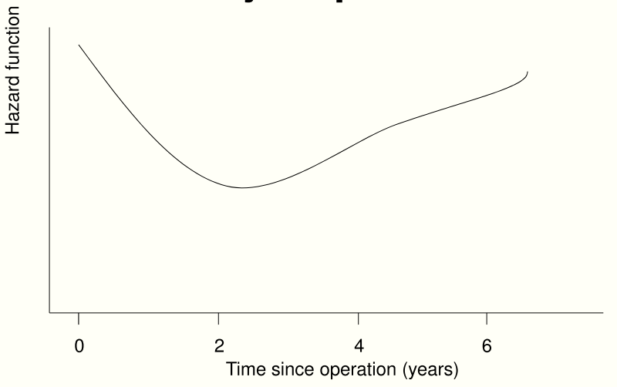
Hazard aka “force of mortality” and “mortality intensity”
Survival analysis often aims to model the hazards of death.
Hazard is an instantaneous failure rate at time (age) t
Probability that an individual will experience the event at time t given that the event has not yet occurred.

Slide 8
Cox proportional hazards regression
The type of regression model typically used in survival analysis in medicine is the Cox proportional hazards regression model.
The Cox model estimates the hazard or force of mortality μ_{i}(t) for subject i for time t by multiplying the baseline hazard function μ₀(t) by the subject’s risk score r_{i} as
${ μ}_{i}\left(t, β, Z_{i}\right)= μ_{0}\left(t\right){ r}_{i}\left(β, Z_{i}\right)=μ_{0}\left(t\right)e^{β Z_{i}}$
The risk factors Z have a log-linear contribution to the force of mortality which does not depend on time t.
The hazard ratio for subjects i and j does not include the baseline hazard, and is constant over time (age).

Slide 9
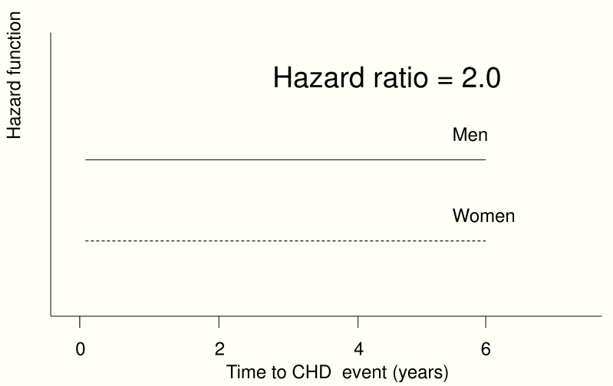
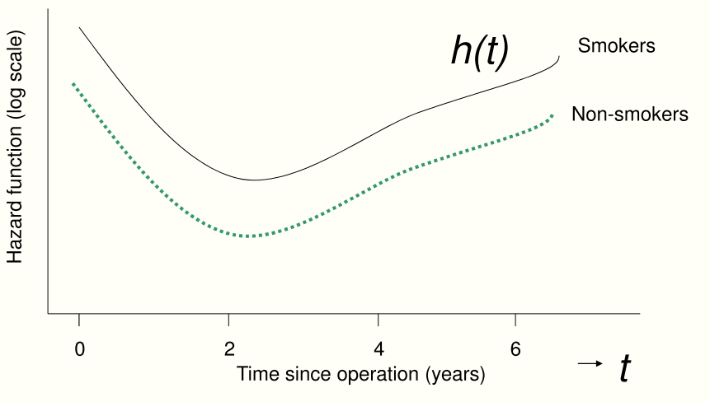
Hazard ratio (HR)
Comparison of two hazard functions
Cox model assumes constant hazard ratio over time

Slide 10
Gompertz baseline hazards
It is well accepted that the Gompertz distribution provides a good description of human mortality between ages 50 and 95 (Brenner et al. 1993, Spiegelhalter 2016).
Using Gompertz law,
${\ln{μ_{0}\left(t\right)=}λ}_{0}$(t)=a+bt,
For England and Wales in 2010-2012, the increase in the hazard between those ages was approximately 1.1 per year.
Log force of mortality for UK population based on 2010 period life table (Office for National Statistics 2017).
We use Gompertz baseline hazards with the HRs from Cox regression. [3]

Slide 11
What if the proportional hazards assumption is not met?
For a Cox model $μ\left(t | β, Z\right)=μ_{0}\left(t\right){exp⁡(ZΤβ) }^{}$ we use two ways to cope with non-proportionality:
Use landmark analysis which amalgamates a smoothed series of piecewise constant hazards
This is a comparatively new statistical method [Van Houwelingen, H. and Putter, H., 2011]
We published papers on linking landmark analysis to longevity [4] and on landmark analysis of statins [5] .
Include additionally a model for shape of baseline hazards- “Double-Cox” model
This is a new statistical model developed by us to deal with these kinds of data [2]

Slide 12
Contents
Introduction
Hazards, hazards ratios and the Cox Regression
Landmark analysis
Case study 1: landmark analysis of statins

Slide 13
Landmark analysis
Landmark Analysis accounts for time-dependent effects by fitting a series of Cox regression models within a sliding window [$t_{LM}$, $t_{LM}$+w] for a series of points ${s=t}_{LM}$.
$$μ \left(t | x,t_{LM}, w\right)=μ_{0}\left(t | t_{LM},w\right)\exp\left(Z^{T}β_{LM}\right), s≤t≤s+w$$
Each consecutive data set s is obtained by truncation at ${s=t}_{LM}$ and administrative censoring at $t_{LM}$+w.
Dynamic prediction for the conditional survival after t=$t_{LM}$ is based on current information for all patients still alive just prior to $t_{LM}$. [Van Houwelingen, H. and Putter, H., 2011]

Slide 14
Application: Landmark Analysis of Statins
Data: 110,243 patients who turned 60 between 1990 and 2000 and did not have a previous statin prescription or a cardiovascular disease diagnosis.
Medical history was updated every half a year (landmark) until end of follow-up (death, deregistered or end of study).
Imputation: Due to missing data at early ages, multiple imputation was performed using joint modelling at age 60.
Analysis: Landmark analysis was carried out by fitting Cox proportional hazards regression of all cause mortality associated with current statin prescription at each landmark from age 60 to 85 (51 landmark points) and adjusted for medical history [5]

Slide 15
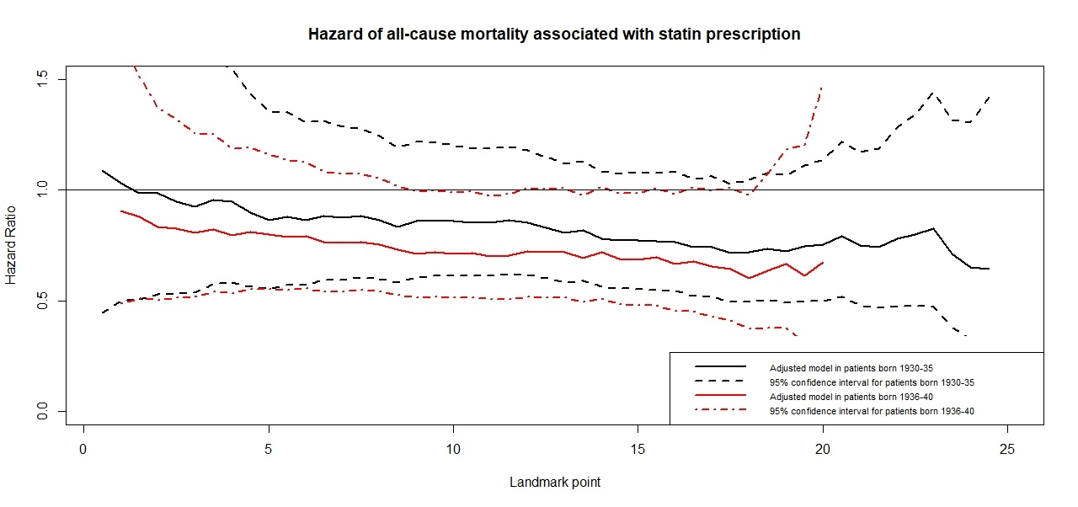
Sliding Cox model results (crude model)
The solid lines are the HRs of statin prescription from the Cox regressions at the ages 60+s with the window of 30 years (s is the landmark point).

Slide 16
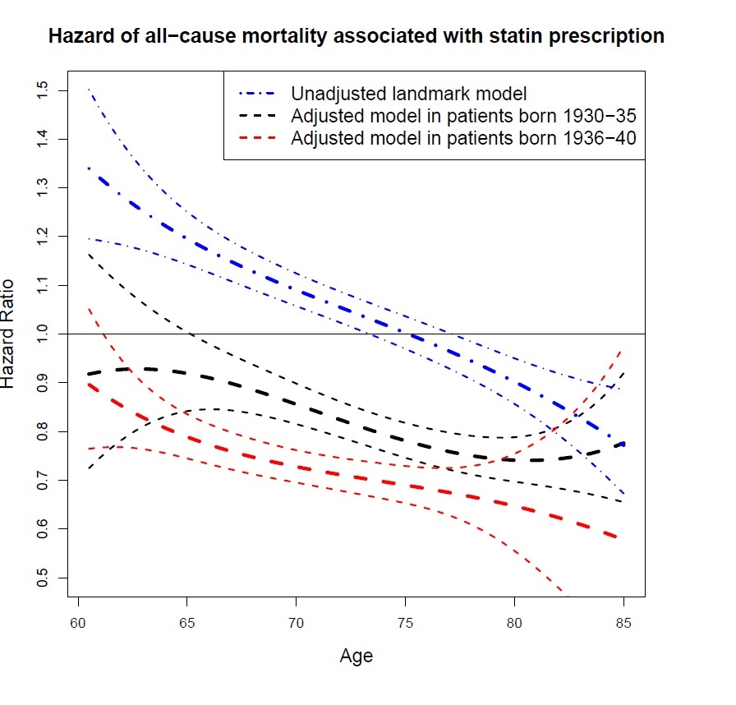
Hazard of all-cause mortality associated with statin prescription
The raw regression coefficients $β_{LM}$and the baseline hazards are smoothed over time as the mth degree polynomials in $s$. Their, coefficients are estimated using pseudo-partial log-likelihood.
We add Gompertz baseline hazards to obtain survival functions and the life expectancy (LE). [4]

Slide 17
Table 1. Characteristics of study population at baseline age 60 by cardiac risk and sex. ªMean across ten imputed datasets
 |  |  | QRISK2<20%ª |  | QRISK2≥20%ª
 |  |  | Women (%) | Men (%) | Women (%) | Men (%)
Number of patients |  |  | 59,082 | 48,836 | 314 | 2011
Person-years of follow-up (mean) |  |  | 1,002,627 (17.0) | 789,677 (16.2) | 4291 (13.7) | 28,900 (14.4)
Deaths during follow-up |  |  | 10,152 (17%) | 10,743 (22%) | 152 (48%) | 814 (40%)
Transferred during follow-up |  |  | 15,410 (26%) | 13,401 (27%) | 70 (22%) | 422 (21%)
Year of birth |  | 1930-35 | 23,139 (39%) | 18224 (37%) | 92 (29%) | 594 (30%)
 |  | 1936-40 | 35,943 (61%) | 30,612 (63%) | 222 (71%) | 1417 (70%)
Deprivation |  | 1st quintile | 15,481 (26%) | 13,681 (28%) | 12 (4%) | 315 (16%)
 |  | 2nd quintile | 13,652 (23%) | 11,376 (23%) | 22 (7%) | 342 (17%)
 |  | 3rd quintile | 12,149 (21%) | 9775 (20%) | 37 (12%) | 388 (19%)
 |  | 4th quintile | 10,310 (17%) | 8007 (16%) | 80 (25%) | 442 (22%)
 |  | 5th quintile (most deprived) | 7492 (13%) | 5996 (12%) | 162 (52%) | 525 (26%)
CKD |  | Stage 3-5 | 9 (0%) | 1 (0%) | 2 (1%) | 7 (0%)
Diabetes |  | Type 2 | 1130 (2%) | 863 (2%) | 247 (79%) | 926 (46%)
Hypertension |  | Diagnosed & treated | 6443 (11%) | 3200 (7%) | 204 (65%) | 1128 (56%)
 |  | Diagnosed & not treated | 8229 (14%) | 6807 (14%) | 55 (18%) | 477 (24%)
SBPª |  | Mean (sd) in mmHg | 135 (17.3) | 134 (16.6) | 159 (20.1) | 153 (17.7)
Aspirin |  | Prescribed | 592 (1%) | 467 (1%) | 21 (7%) | 93 (5%)
HCL |  | Diagnosed | 3117 (5%) | 2709 (6%) | 71 (22%) | 373 (19%)
BMIª |  | Overweight | 22,739 (38%) | 21,520 (44%) | 98 (31%) | 834 (41%)
 |  | Obese | 13,063 (22%) | 9111 (19%) | 167 (53%) | 651 (32%)
Alcoholª |  | Current | 28,160 (48%) | 31,530 (65%) | 178 (57%) | 1582 (79%)
Smokingª |  | Ex | 3984 (7%) | 5644 (12%) | 45 (14%) | 231 (11%)
 |  | Current | 8098 (14%) | 8476 (17%) | 206 (66%) | 1369 (68%)

Slide 18
Prevalence of statin prescription
The median age of the statin prescription was at 70 (IQR 66-74). The prevalence of current statin prescription differed by cardiac risk, sex, age and study population.

Slide 19
Calculating component life expectancies
Since the mortality rates and the prevalences of the factors diﬀer by gender and by socio-economic status (SES), we analysed the life tables separately for each SES quintile-by-gender combination.
For each life table, we considered, all combinations of statin use (2 levels), smoking (3), hypertension (3), diabetes (2), hypercholesterolaemia (2), BMI category (3) and cardiac risk (3), 648 combinations in total, and estimated their prevalences at 51 landmark points.
We estimated survival functions and LE for each risk group at each landmark point. The overall survival function is the weighted mean of the survival functions in the individual risk groups. This was used for calibration of LEs. [3, 4]

Slide 20
Life expectancy for healthy people at age 65 by Townsend score quintiles (Q1 least to Q5 most deprived) and sex
Tounsend score quintile /sex | Healthy Statin(N/Y) |  | Diabetes Statin(N/Y) |  | Smoker Statin(N/Y)
Q1/F | 90.6 | 94.0 | 87,1 | 90.2 | 84.4 | 87.3
Q1/M | 89.4 | 92.6 | 85.2 | 88.3 | 82.5 | 85.4
Q5/F | 90.3 | 93.6 | 86.3 | 89.0 | 83.1 | 86.5
Q5/M | 87.1 | 89.1 | 83.3 | 85.2 | 80.4 | 82.1
These life expectancies do not take into account future health and lifestyle choices (nor future mortality improvement). If we assume the same health and lifestyle continuing to age 85, life expectancies for healthy and prosperous people on statins increase by another 4 years.

Slide 21
mylongevity.org app
Our results are implemented in the LE calculator app
(web developer George Oastler).

Slide 22
Contents
Introduction
Hazards, hazards ratios and the Cox Regression
Landmark analysis
Double-Cox model
Case study 2: Modelling survival after ischemic stroke
Summary and discussion

Slide 23
Parametric “Double-Cox” regression
Components:
A baseline hazard function (which changes over time).
The risk factors Z have a log-linear contribution to the force of mortality which does not depend on time t.
The Cox parametric regression model
$$μ(t|Z)=μ_{0}(t|Z) {U exp{(ZΤβ)}}^{}$$
$β$ is a vector of unknown parameters for scale and Z is a vector of covariates
Baseline hazard function
U ~ Gamma with mean 1 and variance σ² is a shared (across a cluster, e.g. GP practice) frailty. σ² is population heterogeneity
Weibull or Gompertz baseline hazard function with scale 𝜈 and shape k. Shape k is modelled as k=k(Z).
Additional regression model to allow varying shape depending on covariates
$$μ_{0}(t|Z)= \frac{k(Z)}{ν}{\left(\frac{t}{ν}\right)}^{k(Z)−1}$$
$$μ_{0}\left(t|Z\right)=ν exp⁡(k(Z)t)$$
$$\text{k}\text{(}\text{Z}\text{)} \text{=}k0e^{ZΤβk}$$

Slide 24
Shape effects of birth cohorts in T2DM
Log cumulative hazards of all-cause mortality by birth cohort and T2DM diagnosis
for patients with treated hypertension (Gompertz baseline hazards)

Slide 25
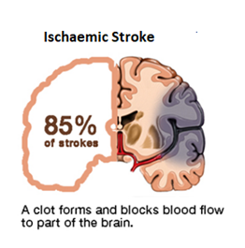
Case study 2: Modelling survival after ischemic stroke (with Padma Chutoo)
Ischaemic stroke is caused by a blood clot that blocks or plugs a blood vessel in the brain.
Stroke is the biggest single cause of major disability in the UK. Almost two–thirds of stroke survivors leave hospital with disability.
Stroke prevalence is projected to increase by 120% between 2015 and 2035 and the associated societal costs will almost treble [King et al.,2020].

Slide 26
Stroke study: brief description
Objective: impact of 1st ischaemic stroke on longevity and morbidity risks.
The study period is from 1986 up to 2017.
Design: case/control 1:3
Exclusion criteria: prior major cancers, dementia, chronic kidney disease stages 3+ and haemorrhagic stroke.
The primary outcome is all-cause mortality.
A total of 20,250 eligible patients with first-ever IS event and their 55,519 controls

Slide 27
Stroke study: Variables of interest
Drugs: Antihypertensive drugs, Antiplatelet drugs, Anticoagulant drugs, Lipid regulating drugs and antidiabetic drugs.
Medical conditions: Asthma, Atrial Fibrillation, CKD, CHD, PAD, Hypothyroidism, COPD, Diabetes, Hypercholesterolemia, Hypertension, Depression.
Demographics and lifestyle: Blood Pressure, Cholesterol, BMI, gender, date of birth, age at entry, smoking status, alcohol status and IMD Decile.
.

Slide 28
IS case fatality and medications 1995-2016
Stroke survival outcomes in England improved over time.
Pre-morbid use of preventive anticoagulants, anti-hypertensive drugs and statins increased over time, but antiplatelet treatment use declined after year 2010 in England

Slide 29
Findings on survival after IS
Hazards of all-cause mortality steadily declined over time in both cases and controls.
Cases still have considerably higher hazards.
Antiplatelets provide survival benefits to cases, but not to controls, especially in younger birth cohorts.
Continuing BP control is most important to prevent further strokes.

Slide 30
Longevity after IS : Some examples
Medical condition | Gender | Age at diagnosis | Years after diagnosis | Number of years lost
IS | Male | 50 | 2 | 14.1
IS | Female | 50 | 2 | 16.0
IS | Male | 60 | 2 | 9.9
IS | Female | 60 | 2 | 11.2
IS | Male | 70 | 2 | 6.9
IS | Female | 70 | 2 | 7.8

Slide 31
Summary and discussion, 1: Benefits of careful survival modelling of big health data
Better assessment of individual and population life expectancy;
Understanding of past mortality improvements feeding into projections of future mortality improvements;
Direct implementation in pricing and reserving of longevity products;
Facilitating the use of “what if” scenarios for better understanding of longevity risk.
Medical advances:
Given our landmark analysis results, we now believe that large changes in LE at older ages are possible if the elderly embrace statins.
From our stroke results, optimal management of patients after IS should include BP control and antiplatelet prescription.

Slide 32
Summary and discussion, 2: Possible pitfalls of observational studies
Well-known biases in observation studies are the "immortality bias“ and the “bias by indication“.
Immortal time in observational studies can bias the results in favour of the treatment group. It refers to a period of follow-up during which, by design, death or the study outcome cannot occur (i.e. waiting time for a treatment).
The “bias by indication“ arises when GPs prescribe drugs to sicker people.
Other (self)selection biases, when say better-off people get more treatments.
Unavoidable unmeasured confounding – by e.g. family history, social factors, etc that are just not there in primary care data.
Missing data are unavoidable in big health databases, potentially leading to bias and loss of precision.

Slide 33
Design of an observational study should be i chosen to minimize possible biases
We take a lot of care at the design stage.
Diabetes/ Stroke/ HRT studies: case-control studies from the date of diagnosis or treatment. Controls matched by age/sex/GP practice.
Selection biases are partly eliminated by matching, and mostly by careful statistical modelling which includes all available confounders and sophisticated imputation to fill missing values.

Slide 34
References
Gitsels L.A., Kulinskaya E., Steel N. (2016). PLoS ONE 11(11): e0166847.
Begun A., Kulinskaya E. and MacGregor A. (2019) BMC Med Res Methodol 19, 217 (2019).
Kulinskaya E. , Gitsels, LA. Bakbergenuly, I. and Wright N.R. (2020) Insurance Mathematics and Economics, 93, 27-35
Kulinskaya, E. , Gitsels, L.A., Bakbergenuly, I. and Wright, N.R. (2020) Insurance Mathematics and Economics https://doi.org/10.1016/j.insmatheco.2020.11.001
Gitsels, LA. , Bakbergenuly, I., Steel N. and Kulinskaya E. (2021) Family Medicine and Community Health Journal, 2021; 9: e000780. https://doi.org/10.1136/fmch-2020-000780

Slide 35
The Actuarial Research Centre (ARC)
A gateway to global actuarial research
The Actuarial Research Centre (ARC) is the Institute and Faculty of Actuaries’ (IFoA)
network of actuarial researchers around the world.
The ARC seeks to deliver cutting-edge research programmes that address some of the
significant, global challenges in actuarial science, through a partnership of the actuarial
profession, the academic community and practitioners.
www.actuaries.org.uk/arc

Slide 36
Questions
Comments
The views expressed in this presentation are those of the presenter.

