Slide 1
More ideas on how to use EI to get the best from your teams
Peter Heffernan and Michelle Lister

Slide 2
Hello!
Mid 40’s.
Life insurance actuary
Grumpy, becoming more communist with age
Cyclist (mainly mountain biking)
Plays videogames (mainly Nintendo)
Mid 20’s
Life insurance actuary
Not grumpy
Runner
Obsessed with poor quality indie music
Notes:
Slides available.
Questions?

Slide 3
Background
This is the final part of an exciting trilogy. You’ll be familiar with the first two instalments:
Emotional Intelligence – an introduction
Using Emotional Intelligence (EI) to better manage actuarial teams
By EI, we mean (broadly):
“the capacity to be aware of, control, and express one's emotions, and to handle interpersonal relationships judiciously and empathetically.”

Slide 4
What are we covering today?
Groupthink
Reality Tunnels
Dealing with uncertainty
Destination addiction

Slide 5
Groupthink

Slide 6
Groupthink
Groupthink is a psychological phenomenon that occurs within a group of people in which the desire for harmony or conformity in the group results in an irrational or dysfunctional decision-making outcome.
Group members try to minimize conflict and reach a consensus decision without critical evaluation of alternative viewpoints by actively suppressing dissenting viewpoints, and by isolating themselves from outside influences.
Question: can we name any actuarial examples of groupthink?

Slide 7
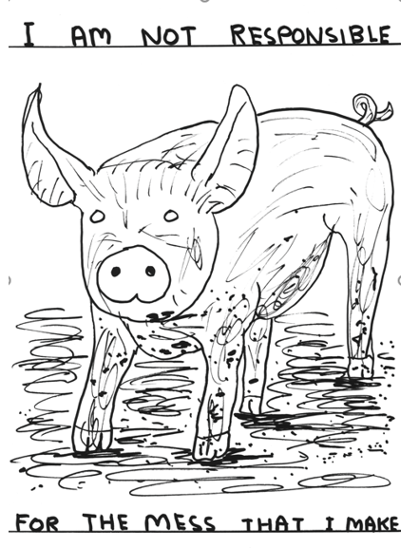
Actuarial groupthink?
Solvency II
Mortgage endowment projections, and ‘own charges’
Mortality improvements
‘AAA’ rated credit risky assets c. 2007-2008
Guaranteed annuity rates
Differential terminal bonus strategies, in the late 1990s
Mandatory small print: you may not agree all of these are groupthink, that’s sort of the point (!)

Slide 8
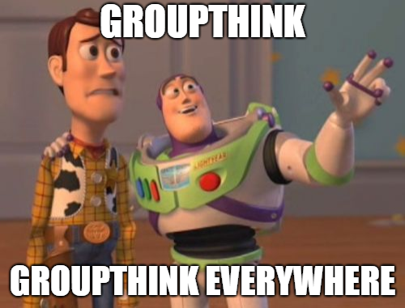
The moral of the story?

Slide 9
Consider the Johari Window…
Our contention is that groupthink is often a blind spot in actuarial teams
Known to me
Not known to me
Open area
Blind area
Known to others
Hidden area
To be known
Not known to others

Slide 10
How to avoid Groupthink?
As it’s a blind spot – first step is seeing it, and then challenging it!
Challenge yourselves and your teams to receive contrarian ideas neutrally in the first instance.
Avoid common traps (e.g. the most senior person in a committee setting the path, often inadvertently).
Use your Risk team
Embrace your audit team (!)
Remember your Actuaries Code

Slide 11
Reality Tunnels

Slide 12
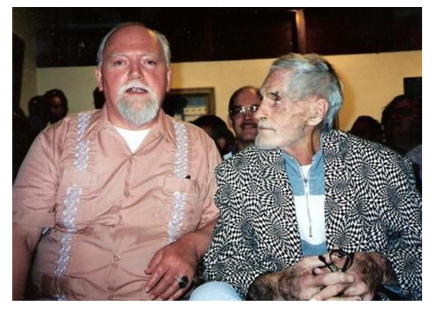
Reality tunnels
Reality tunnel is a term coined by Timothy Leary (1960s LSD guru) and popularised by Robert Anton Wilson (so-called “Pope of Discordianism”) (Google them).
It refers to the concept that with a subconscious set of filters formed from their beliefs and experiences, everyone interprets this same world differently, hence "Truth is in the eye of the beholder".
This is not necessarily meant to imply that there is no objective truth; just that our access to it is mediated through our senses, experience, conditioning, prior beliefs, and other non-objective factors.
The individual world each person occupies is said to be their reality tunnel.

Slide 13
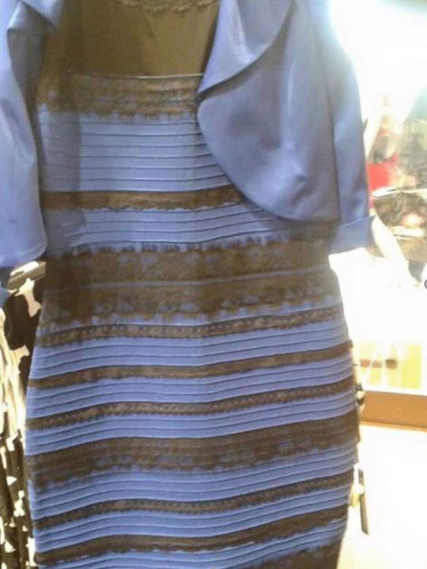
What colours do you see?
Black and blue
or
White and gold
or
Pale blue and gold (maybe only Michelle?)

Slide 14
Reality tunnels
The term can also apply to groups of people united by beliefs: we can speak of the veganism reality tunnel, the scientific materialist reality tunnel, etc.
Links to confirmation bias – most people’s reality tunnel is transparent – it’s normally in the ‘blind spot’ zone.
As it links to confirmation bias – watch for this. People surround themselves in the real world and on social media with like minded individuals to hear their beliefs confirmed regularly. The common phrase on social media is “echo-chamber”.
Through various techniques one can break down old reality tunnels and impose new reality tunnels by removing old filters and replacing them with new ones, new perspectives on reality - at will. This is achieved through various processes of deprogramming using coaching, meditation, controlled use of hallucinogens, neuro-linguistic programming, hypnosis etc.
(NOTE WE DON’T ENDORSE ALL OF THESE!!!)

Slide 15
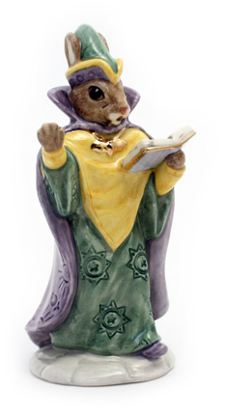
So what?
This is a useful tool to challenge teams as to whether their interpretation of a situation is reality, or their personal interpretation.
Very useful when dealing with team members who struggle with empathy, and challenging them to think if their interpretation of a situation is the same reality for other people.
Challenge a team member to work with someone who has a completely different reality tunnel to them to broaden their perspective.
Works well when discussing a conflict situation 1:1 with a member of your team – for example you can ask them to suggest what do they think is happening with the person they are in conflict with.
Always bear in mind that your reality may not be the reality of people you are dealing with.

Slide 16
Dealing with uncertainty

Slide 17
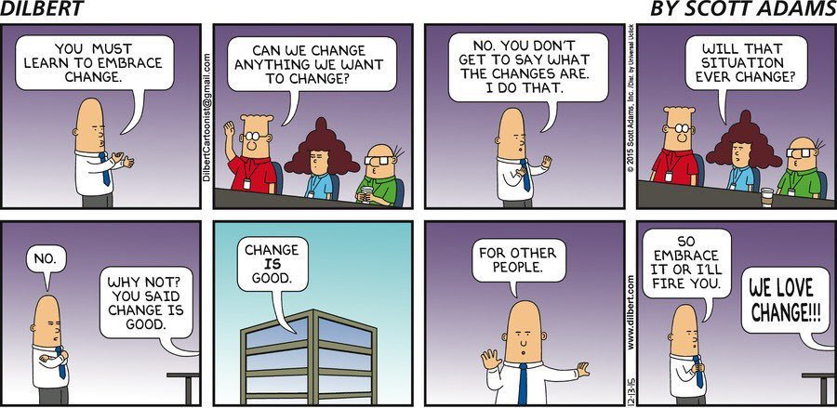
Enabling your teams to deal with uncertainty

Slide 18
Enabling your teams to deal with uncertainty
Uncertainty is sadly an inevitable and unsettling part of modern working life.
The perils of neoliberalism and late-stage capitalism (!)
So how can you help your teams to navigate through uncertainty with more resilience?
Spoons, and the theory of energy conservation
Whether spending spoons on moaning is a good thing…

Slide 19
Spoons, and energy conservation
Metaphor for how much energy you have to spend each day – commonly used where people have reduced energy (e.g. with chronic illness).
You use spoons by doing stuff, and replenish them by resting
Starting point for the metaphor is the concept of limited energy
In a work context – where should you and your teams deploy their energy
… and is that energy being deployed positively or negatively.
Consider whether, in a change situation, you and your teams are using your spoons in a considered and positive way….
Or are you guilty of moaning unproductively…?

Slide 20
Things I care about
Things I can’t control
Things I can control
Things I don’t care about

Slide 21
Idiot or not idiot
Introducing a game for your teams, that we call “IDIOT OR NOT IDIOT”, where you can prove using the power of mathematics!!! that we are all idiots.
The rules:
You put up a statement and your team has to say if you’re an idiot or not an idiot.
As an example:
“I’ve never really wanted to go to Japan. Simply because I don’t like eating fish. And I know that’s very popular out there in Africa.”

Slide 22
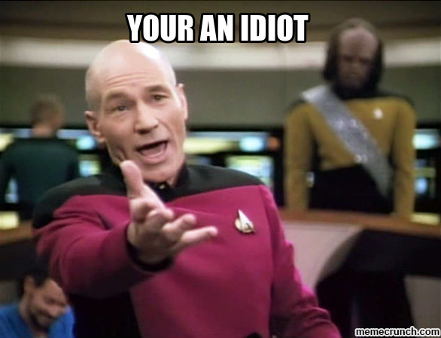
Idiot or not idiot
1) I moan about things that I can’t control and I don’t care about.
2) I moan about things I can’t control but I care about.
3) I moan about things that I can control but I don’t care about.
4) I moan about things I can control and I care about.
What have we proved?
If I moan about things, I’m an idiot.
If you moan about things, you’re an idiot.
We all moan, so we’re all idiots at one time or another.
QED

Slide 23
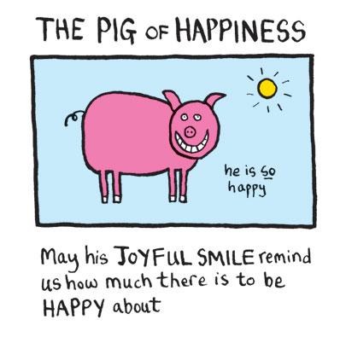
What’s the point?
Required reading
My argument is that moaning about any of the four examples of the previous page is a negative waste of energy.
We all do it…
We’re never going to eradicate it but we should maybe do less of it.

Slide 24
Destination Addiction

Slide 25
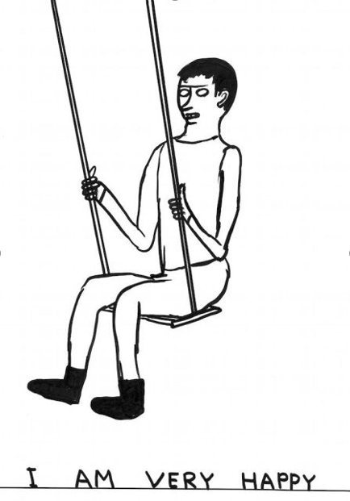
Destination Addiction
Beware of Destination Addiction - a preoccupation with the idea that happiness is in the next place, the next job and with the next partner.
Until you give up the idea that happiness is somewhere else, it will never be where you are.
Destination

Slide 26
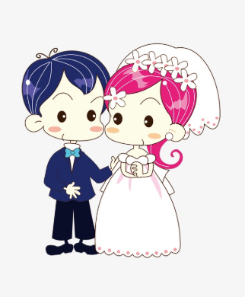
Is this familiar?

Slide 27
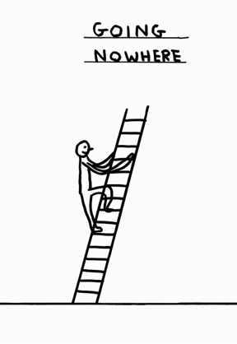
What is destination addiction?
A phrase coined by Robert Holden (American psychologist).
He uses it to describe a mind-set where we:
View every passing moment as merely a ticket to get to the future.
Always need to get somewhere else before we can relax and savour the moment. But we never get there!
Celebrate the end of the day in the meantime and recover at the weekends (TGIF).
This can lead us to be absent from the present moment and to disregard or not appreciate the things we have.

Slide 28
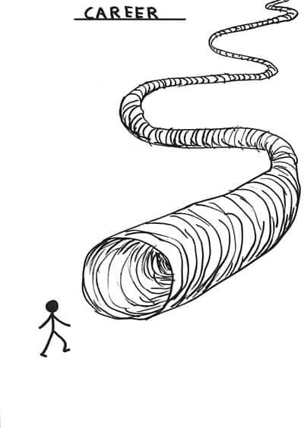
Do you recognise these symptoms (in you or your team?)
Whatever you are doing, you are always thinking about what comes next.
You are always in a hurry even when you don’t need to be.
You always promise that next year you will be less busy.
Your dream home is always the next home you plan to buy.
You don’t like your job but it has good prospects for the future.
You never commit fully to anything in case something better comes along.
You think you should be further ahead of where you are now.
You have so many forecasts, projections, and targets that you never enjoy your life.
You can sit down now, thanks.

Slide 29
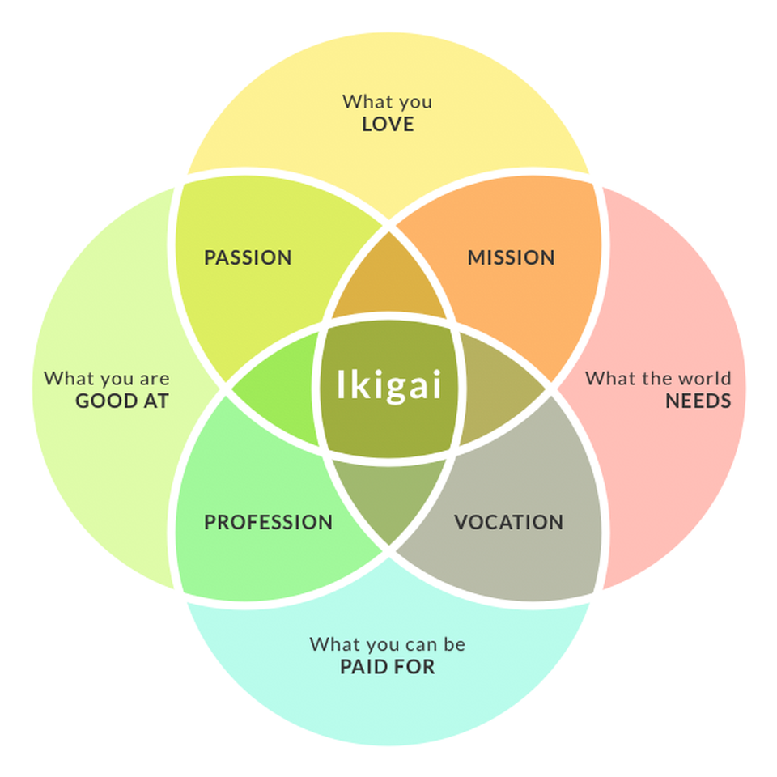
An alternative perspective
Reframe our view of “the end” or “our destination” – instead of thinking of the end as the finish, think of it as the purpose.
“Drink wine(*). This is life eternal. This is all that youth will give you. It is the season for wine, roses and drunken friends.
Be happy for this moment. This moment is your life.”
(Omar Khayam)
(*)Please enjoy inspirational quotes responsibly

Slide 30
Existential questions for your teams
Does this seem familiar?
If so, what do you think is causing it, here and elsewhere?
How specifically does destination addiction manifest itself at work?
Do we need to change anything as a team? If so, what, and how?

Slide 31
Some things you could think about
Finding and speaking to a mentor, to help you challenge your current way of thinking.
List the things that brought you joy today, or list things that you are really good at.
Psychotherapy / cognitive behavioural therapy (seriously!)
A quote from a wise friend – “life is good when we let ourselves enjoy it, but that doesn't explain why we let things get all tangled up in the first place.”

Slide 32
Summary
We’ve covered the following areas:
Groupthink
Reality Tunnels
Dealing with uncertainty
Destination addiction
Our ask –
Be mindful of what you do and how you do it; and
Take these ideas back to your teams, and start exploring them.

Slide 33
Contact details
Michelle Lister
Phone: 07714 567303
Email: michelle.l.lister@pwc.com
Peter Heffernan
Phone: 07730 146553
Email: peter.heffernan@pwc.com
If you would like to talk about this further, drop us a line. We’ll also be about all conference.

Slide 34
Comments
The views expressed in this presentation are those of invited contributors and not those of the IFoA. The IFoA does not endorse any of the views stated, nor any claims or representations made in this presentation and accepts no responsibility or liability to any person for loss or damage suffered as a consequence of their placing reliance upon any view, claim or representation made in this presentation.
The information and expressions of opinion contained in this publication are not intended to be a comprehensive study, nor to provide actuarial advice or advice of any nature and should not be treated as a substitute for specific advice concerning individual situations. On no account may any part of this presentation be reproduced without the written permission of the authors.

