Slide 1
Medical advances and the changing role of real-world evidence
Dr Jacoline Bouvy
Senior Scientific Adviser
Science, Policy and Research Programme

Slide 2

The background: why NICE was set up
Established in 1999
Aim: to reduce variation in the availability and quality of treatments and care (the so called ‘postcode lottery’)
To resolve uncertainty about which medicines and treatments work best and which represent best value for money for the NHS

Slide 3
Improving outcomes for people
Evidence-based guidance and advice for health, public health and social care
Quality standards and performance metrics for those providing and commissioning health, public health and social care
Information services for commissioners, practitioners and managers

Slide 4
The NICE portfolio in 2018
NICE
Clinical practice
Social care
New drugs
Indicators
Public health
Quality standards
Medtech and diagnostics

Slide 5
Core principles of NICE’s work
Based on the best evidence available
Expert input
Patient and carer involvement
Independent advisory committees
Consultation
Regular review
Open and transparent process
Social values and equity considerations

Slide 6
Procedural principles for guidance development
Scientific Rigour
Inclusiveness
Transparency
Independence
Challenge
Review
Support for implementation
Timeliness
NICE Guidance

Slide 7
Our role: how does NICE develop recommendations?

Slide 8

What works? And how much does it cost?
NICE guidance takes into account both clinical effectiveness and cost effectiveness
Notes:
NICE does not just assess how much a new treatment, medicine or medical device costs: we balance this carefully with how well it works compared to the treatment currently used in the NHS. We do not compare with a placebo, like in RCTs – we compare with how patients are being treated already. Does the new drug offer a sufficient advantage compared to current treatment, to justify its price?

Slide 9
Committee decision making
Clinical
effectiveness
Cost-
effectiveness
Other health
benefits
Recommendations
Extent of
uncertainty
Innovation
Equality
legislation
Social value judgements

Slide 10

Economic evaluation of new drugs/treatments
How well does the drug/treatment work in relation to how much it costs compared to standard practice in the NHS ?
Recognises the reality of fixed NHS resources
Exposes the opportunity cost of new interventions, that is if you spend money on a new healthcare intervention, you have to take away the health care from someone else
Enables consistency and fairness across all decisions

Slide 11
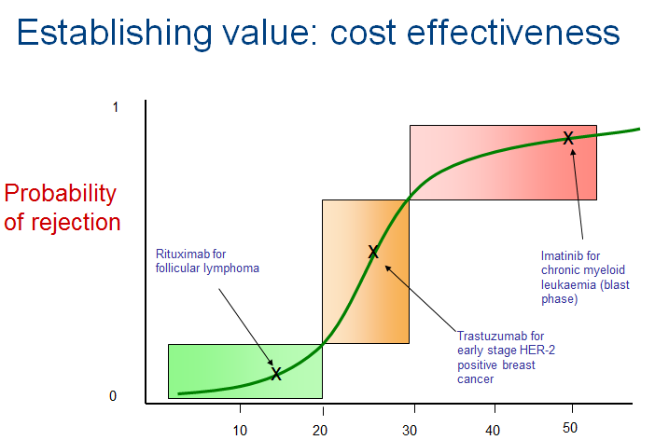
Establishing value: cost effectiveness
Cost per QALY (£’000)
Notes:
Quality Adjusted Life Years – QALYs – are a tool that NICE uses to understand how well a new drug or treatment works, and to compare that with the current standard practice in the NHS.

Slide 12
Research Priorities
Improving NICE methods and processes
Anticipating and influencing external change
Better evidence to inform guidance
Precision medicine
Data visualisation
Data science
Implementation of guidance
NICE research priorities
Real-world data
Expert elicitation
Adaptive pathways
Cross-sector comparisons
Patient preferences

Slide 13
Anticipating and influencing external change
Data science
Precision medicine
Real-world data
Adaptive pathways

Slide 14
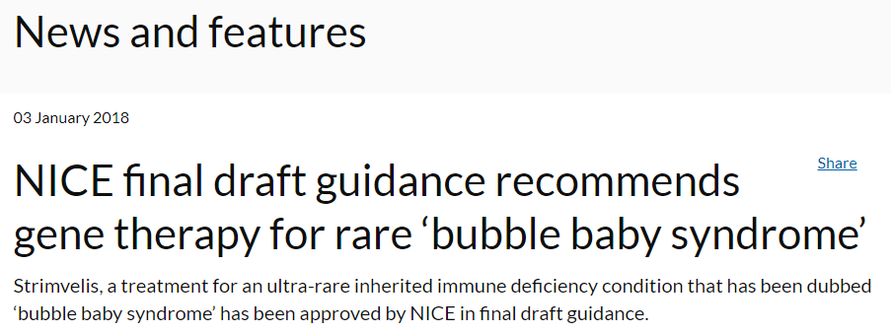


Andrew Obenshain, Bluebird’s head of Europe, said:
“Europe will be the first market. We’re having very pro-active early discussions. We don’t plan to come and surprise governments.”
(Telegraph, 6 August 2017)

Slide 15
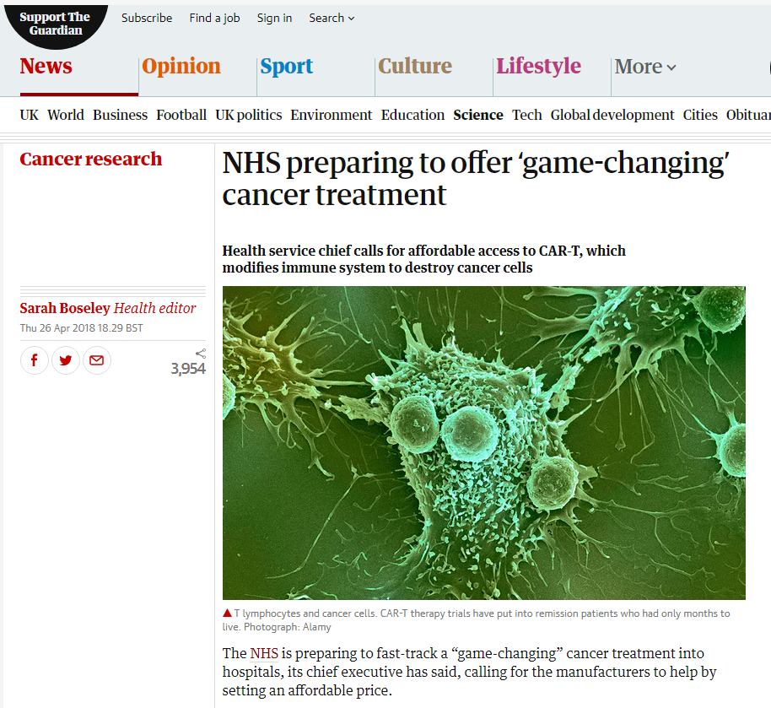

Slide 16

Implications
Regulatory approvals based on:
  Non-comparative studies
    Single-arm trials
    Basket trials
  Small patient numbers
Promise of highly innovative treatments…
…but with considerable uncertainty (esp long-term outcomes)
…and usually, (very) expensive

Slide 17

Real-world evidence
Increasing availability of data offers opportunities
Advanced analytics & machine learning
Need for quality standards
Grandjean, Martin (2014). "La connaissance est un réseau". Les Cahiers du Numérique 10 (3): 37-54.

Slide 18
Conclusions
The changing nature of medical innovations change the evidence available to inform NICE guidance…
…accelerating the need for better utilisation of real-world data and advanced analytics
Quality standards are needed to ensure evidence generated using real-world data and advanced analytics to inform decisions is robust and valid

Slide 19
Thank you
www.nice.org.uk/research
Jacoline.Bouvy@nice.org.uk

