Slide 1
The Impact of HRT on Mortality: A Retrospective Cohort Study of UK Women
Nurunnahar Akter
Ilyas Bakbergenuly, Nicholas Steel, Elena Kulinskaya
University of East Anglia
The ‘Use of Big Health and Actuarial Data for understanding Longevity and Morbidity Risks’ research programme is being funded by the Actuarial Research Centre.
www.actuaries.org.uk/arc

Slide 2
Outline
A Brief Description of HRT
Study Design and Selection Criteria
Distribution of the Study Population
Survival Model of All-Cause Mortality
Results

Slide 3
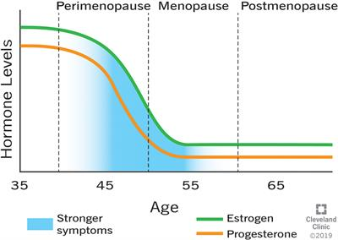
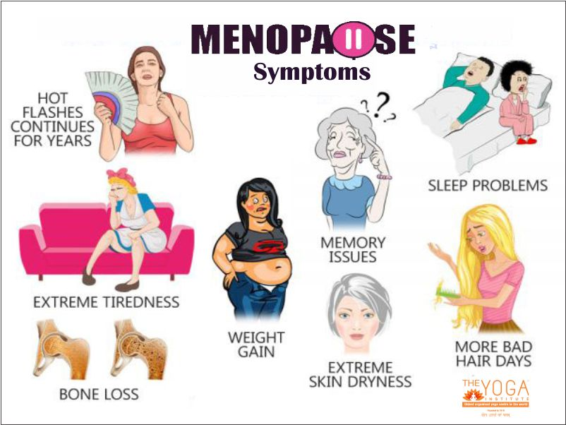
Menopause and its Symptoms:

Slide 4
Brief Description of Hormone Replacement Therapy (HRT)
What is HRT?
HRT is mainly used to relieve women from menopausal symptoms
It contains female sex hormones estrogen and/or progesterone
It has been used for more than sixty years
First available in the United Kingdom in 1965
Routes of Administration
Oral tablets, transdermal patches, injections, topical gels, and ointments.

Slide 5
Study design and patients selection criteria
A subset of The Health Improvement Network (THIN) database has been used to extract patients information for this study.
Cases are patients of age 46 years and above who received their first HRT between 1984 and 2017.
Controls are matched with cases by year of birth and general practice (GP).
Patients with all kinds of cancer, acute myocardial infarction (AMI), serious heart failure, stroke (except TIA), chronic kidney disease (CKD) stage 3-5, dementia, oophorectomy before 45, premature ovarian insufficiency, premature menopause and surgical menopause are excluded.
Primary outcome of interest is all-cause mortality. Secondary outcomes are osteoporosis, dementia, cardiovascular disease, type II diabetes, and hormonal cancers.
Length of follow-up was upto 31 years.
Working data consists of 112,354 cases and 245,320 matched controls.

Slide 6
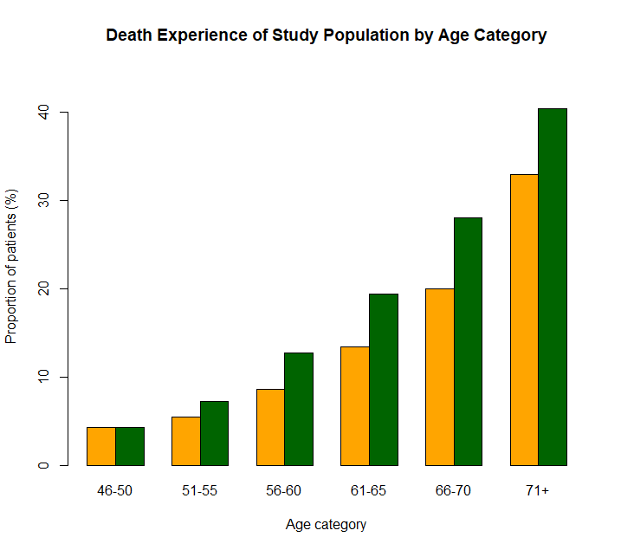
Age distribution at first HRT prescription and death experience at follow-up
Age-group | 46-50 | 51-55 | 56-60 | 61-65 | 66-70 | 71+
Cases | 42269 | 36680 | 17362 | 8930 | 4185 | 2928
Controls | 87125 | 72497 | 40688 | 24382 | 12160 | 8468
Age-group | 46-50 | 51-55 | 56-60 | 61-65 | 66-70 | 71+
Cases | 1809 | 1985 | 1498 | 1199 | 837 | 965
Controls | 3747 | 5260 | 5166 | 4718 | 3414 | 3423
Majority of women started HRT between 46-55 years of age
There are more death in controls than cases in all age category

Slide 7
Survival model of all-cause mortality
The following predictors were used in the survival modelling:
Socio-economic status: Townsend score
Lifestyle: Smoking status, body mass index (BMI)
Health: Type II diabetes, hypertension, hypercholesterolaemia, peripheral vascular disease (PVD)/peripheral arterial disease (PAD), coronary heart disease (CHD), oophorectomy/hysterectomy status, systolic and diastolic blood pressure
Demography: Age category at first HRT and birth cohort
Medication: Eestrogen-only HRT, combined HRT (estrogen and progesterone), antihypertensive drugs
Patients with full records of all of the above covariates have been selected for complete case analysis
A second order interaction is considered with smoking, BMI and Townsend score to all other variables.

Slide 8
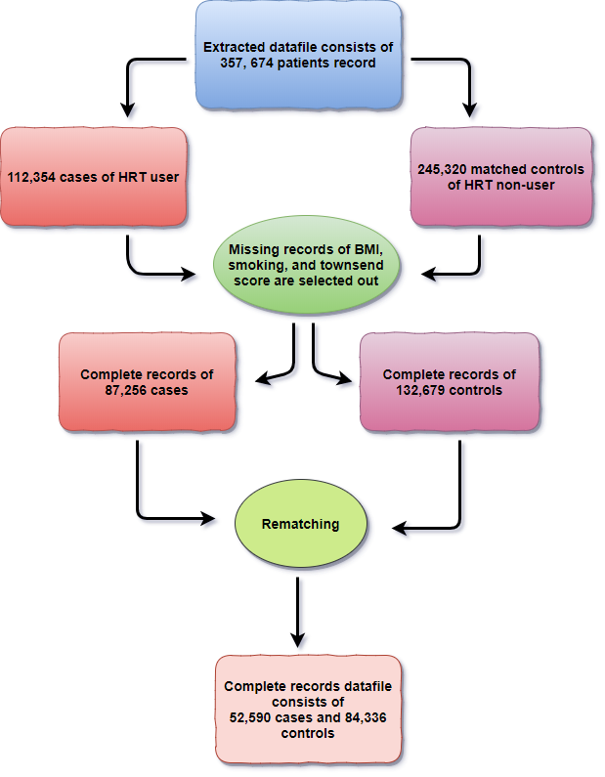
Selection of patients with complete records:

Slide 9
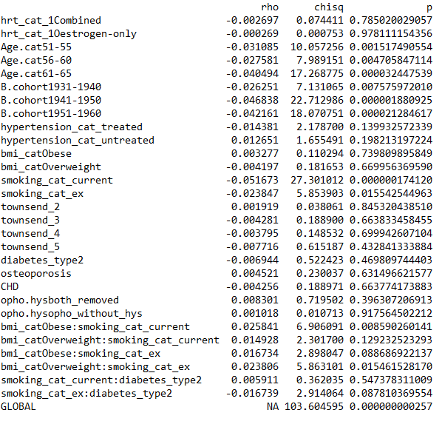
Grambsch and Therneau test
A significant
p-value (< 0.05)
is an indication of violation of the proportional hazard assumption in the Cox PH model

Slide 10
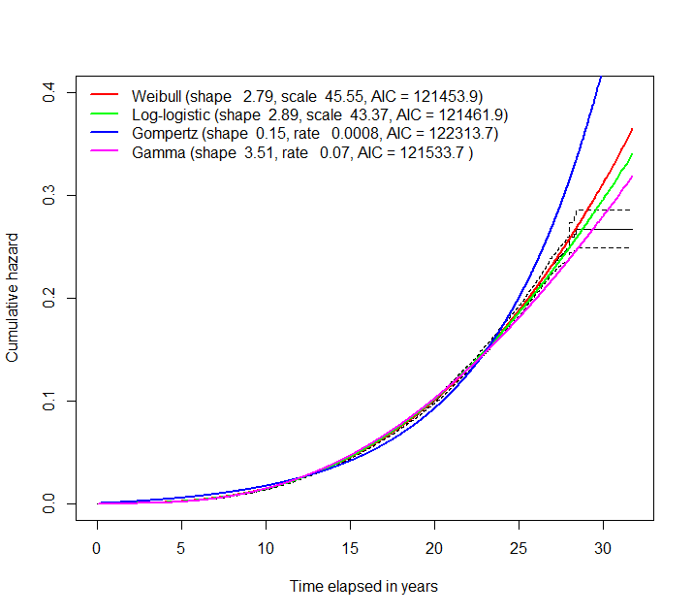
Baseline hazard function fitted with different parametric distributions:
Weibull distribution fits the best to the baseline hazard of the study population. The value of Akaike’s Information Criterion (AIC) is another indication of fitting. The lower the AIC the better the fit.

Slide 11
Weibull-Cox Regression Model
Covariate matrix
vector of regression parameters
Weibull distribution
Weibull baseline hazard function consists of scale parameter “a” and shape parameter “b”
The cumulative hazard of the Weibull-Cox model that changes over time is estimated by:

Slide 12
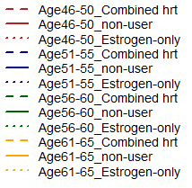
Cumulative hazard by age at first HRT and its type
Women adhering to combined HRT have decreased hazard and estrogen-only have
increased hazard of mortality than the non-user at all age group.
Women born in 1951-1960 cohort faced reduce hazard of mortality compared to
those took HRT at the same age and type but born in 1941-1950 cohort

Slide 13
HRT model: Forest Plot I

Slide 14
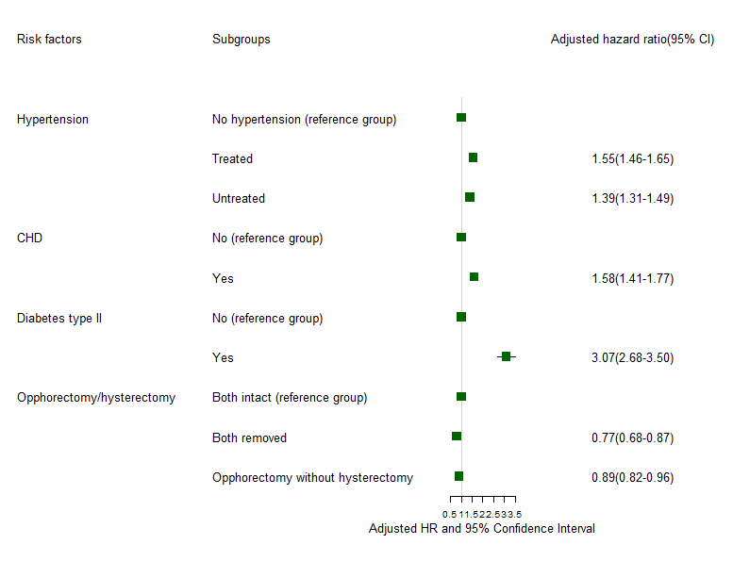
HRT model: Forest Plot II

Slide 15
Future Work:
Models for imputed datasets.
Translation of models into actuarial analysis
Landmark analysis

Slide 16
The Actuarial Research Centre (ARC)
A gateway to global actuarial research
The Actuarial Research Centre (ARC) is the Institute and Faculty of Actuaries’ (IFoA)
network of actuarial researchers around the world.
The ARC seeks to deliver cutting-edge research programmes that address some of the
significant, global challenges in actuarial science, through a partnership of the actuarial
profession, the academic community and practitioners.
www.actuaries.org.uk/arc

