Slide 1




Critical illness insurance rates: are they changing over time and how?
Dr George Streftaris & Dr Erengul Dodd
Work with
Chunxiao Xie
.
www.actuaries.org.uk/arc

Slide 2

Modelling, Measurement and Management of Longevity and Morbidity Risk
Major research programme funded by the Actuarial Research Centre of the Institute and Faculty of Actuaries running from 2016 to 2020
Significant supporting funding from the Society of Actuaries and the Canadian Institute of Actuaries
Themes
  Development of new single and multi-population models for mortality and new sub-population mortality datasets
  Drivers of mortality and cause of death analysis
  Longevity risk management
  Stochastic models for critical illness insurance

Slide 3
Outline
Critical illness insurance
Data
Stochastic modelling
  Delay time distribution (diagnosis to settlement)
  Claim rates
Claim rates comparison
  Smoothed rates: 1999-2005 v 2007-2010
Pricing rates

Slide 4
Critical illness insurance

Slide 5
Critical illness: Policy description
Fixed term policy, usually ceasing at age 65
A fixed sum insured payable on the diagnosis of one of a specified list of critical illnesses
Covers: Cancer; Death; Heart attack; Stroke; Multiple Sclerosis; Total & permanent disability; Coronary artery bypass graft; Kidney failure; Major organ transplant etc.
Policies are often sold together with term or endowment insurance
Benefit type: Full Accelerated (FA) or Stand Alone (SA)

Slide 6
Data
Provided by the CMI Assurances Committee

Slide 7
Data
CII data supplied by CMI:
1999-2005
  Details of policies inforce at the start and end of each year
  19,000 claims settled
2007- 2010
  Grouped by various risk factors
  25,187 claims settled

Slide 8
Risk factor (covariate) | 1999 – 2005 | 2007 – 2010
Age (last birthday) | √ | √
Gender | √ | √
Smoker | √ | √
Policy duration | √ | √
Office | √
Distribution channel | √ | √
Benefit type (accelerated, standalone) | √ | √
Benefit amount | √ | √
Policy type (single, joint) | √
Settlement year | √ | √
Cause | √
Product category |  | √
Date of diagnosis | √
Data:
Claims
Exposures
Risk factors:

Slide 9
Data: 2007 - 2010

Slide 10
Data: 2007 – 2010 v 1999 – 2005
Distributions more “even” in 2007 – 2010
Higher proportion of smokers in 2007 – 2010

Slide 11
Data: 2007 – 2010 v 1999 – 2005
Higher proportion of age 16-30 in 2007 – 2010
Higher proportion of stand-alone in 2007 – 2010

Slide 12
Modelling
Mostly Bayesian stochastic

Slide 13
Stochastic modelling
Estimation & smoothing of CI diagnosis rates
  – how do these depend on risk factors?
Diagnosis is the insured event and there is a delay between diagnosis and settlement
The exposure corresponds to claims settled, not to claims diagnosed
This can lead to biased rate estimates; need to adjust it
Also take into account uncertainty
Diagnosis
Notification
Admission
Settlement

Slide 14
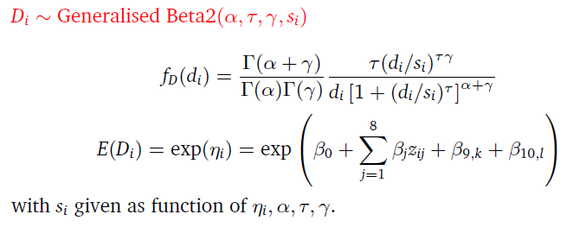
Stochastic modelling
Delay time distribution (1999-2005)
Diagnosis date not always recorded or available
  18% diagnosis dates missing
Observed data: mean delay 185 days; sd 263 days
Fit a delay distribution (GB2 in Bayesian GLM-type setting):
  F(d; x, z) = Pr(claim diagnosed age x, risk factors z, will be settled in d days)

Slide 15
Stochastic modelling
Delay time distribution (1999-2005)
Most factors significant:
    Policy duration, amount, death: shorter delay
    Single life, stroke, multiple sclerosis: longer delay
Non-recorded diagnosis dates estimated through delay distribution F()
Data (exposures) adjusted to allow for non-settled claims
  E*(u; x) = E(u; x) × F(t-u; x)

Slide 16
Stochastic modelling
Delay time distribution (2007 – 2010)
Diagnosis date not available
Assume similar delay distribution
Match claims with common characteristics (age, policy duration etc)
Adjust exposures as in earlier data

Slide 17
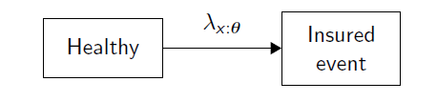
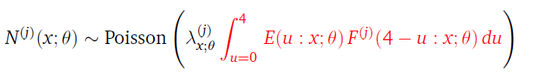
Stochastic modelling: Claim rates
Model:
Fit Bayesian model:
λ^{(j)}_{x,θ} : diagnosis (claim) rate for cause j at age x with risk factors θ
Adjusted exposure

Slide 18
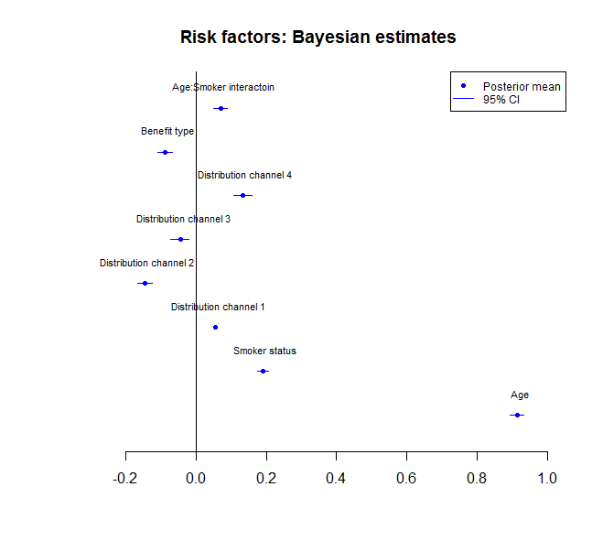
Stochastic modelling:
Risk factor estimates for claim rates (2007 – 2010)
Perform variable (factor) selection
Selected model includes:
age (older ↑)
smoker status (S ↑)
distribution channel
benefit type (stand-alone ↓)
age x smoker

Slide 19
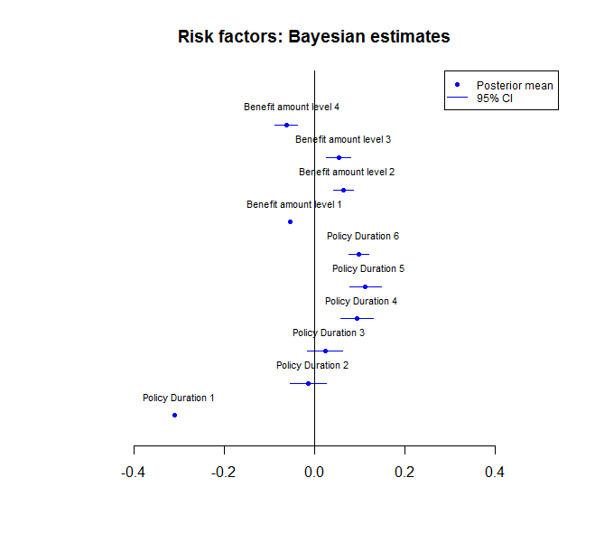
Stochastic modelling:
Risk factor estimates for claim rates (2007 – 2010) cont.
Selected model includes:
policy duration (longer ↑)
benefit amount (mid ↑)

Slide 20
Claim rates
Smoothed estimates, intervals

Slide 21
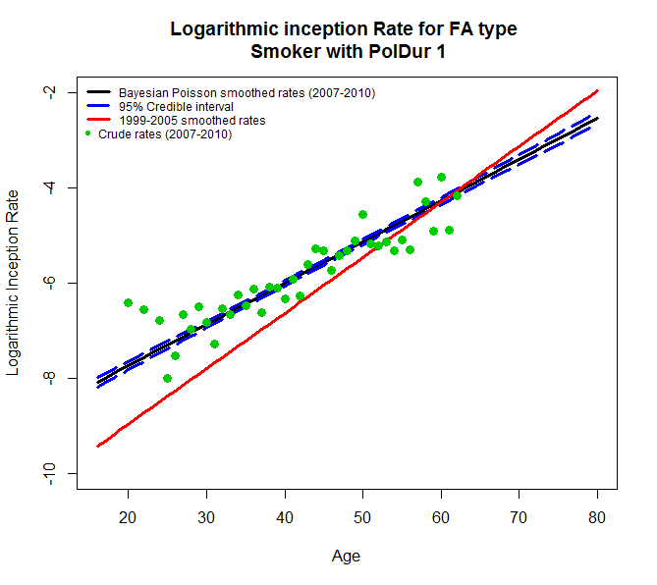
Claim rates
2007-2010 v 1999 – 2005, Accelerated, Smoker, Pol Duration 1
Model fits crude rates (2007 – 2010) well
2007 – 2010 rates significantly higher
Gap widens at younger ages

Slide 22
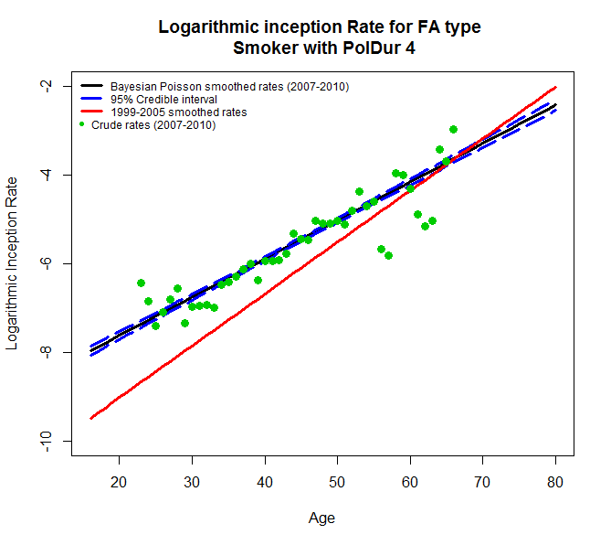
Claim rates
2007-2010 v 1999 – 2005, Accelerated, Smoker, Pol Duration 4
Again, 2007 – 2010 rates significantly higher
Rates higher than for Pol Duration 1

Slide 23
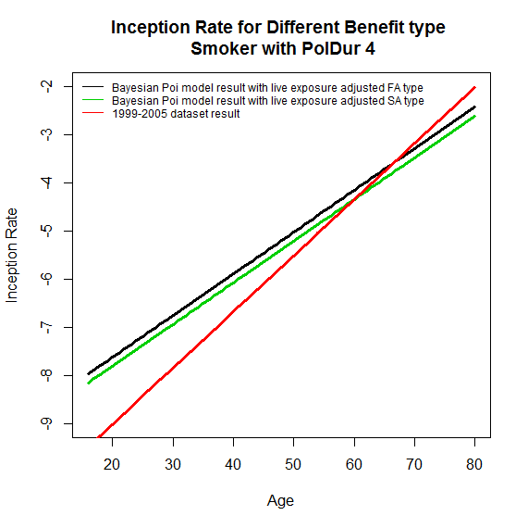
Claim rates
Accelerated v Stand alone (2007 – 2010) & 1999 – 2005
Accelerated 2007 -2010 (black) higher than stand-alone (green)
Both significantly higher than 1999 – 2005

Slide 24
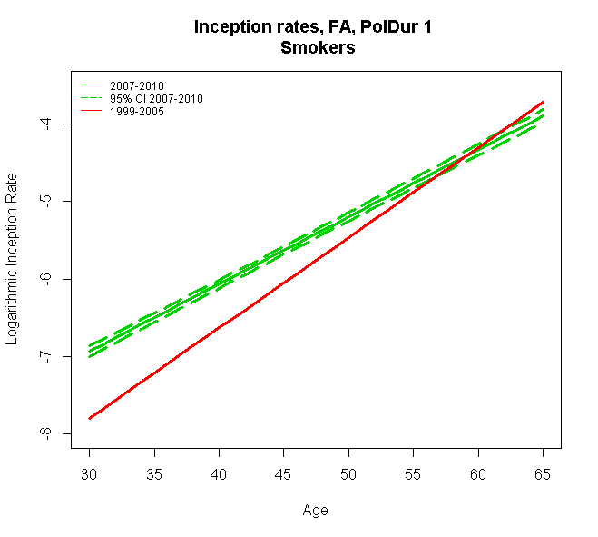
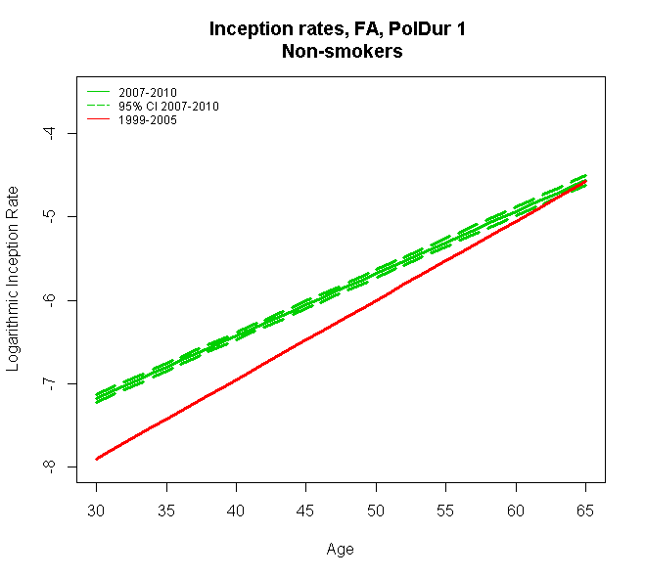
Claim rates
Smokers & non-smokers (Accelerated, Pol Duration 1)
2007 – 2010 rates significantly higher, both S & NS

Slide 25
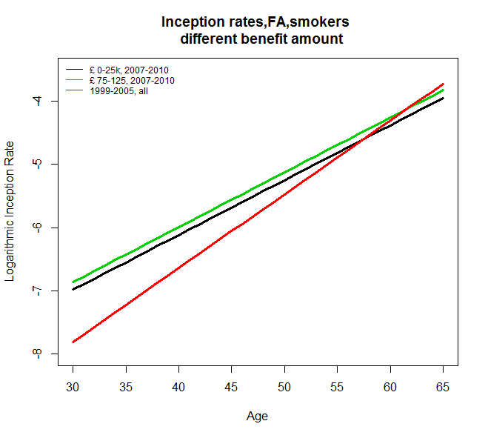
Claim rates
Different benefit amount (Accelerated, Smokers)
2007 – 2010 rates significantly higher, also for different amount

Slide 26
Pricing

Slide 27
Pricing

Slide 28
Pricing
^{All causes, Smoker,} Age 40, Policy duration 0, Benefit amount £100k, i=3%
Since 2007 – 2010 FA rates are higher than 1999-2005 combined rates, the net premium rates are also higher.

Slide 29
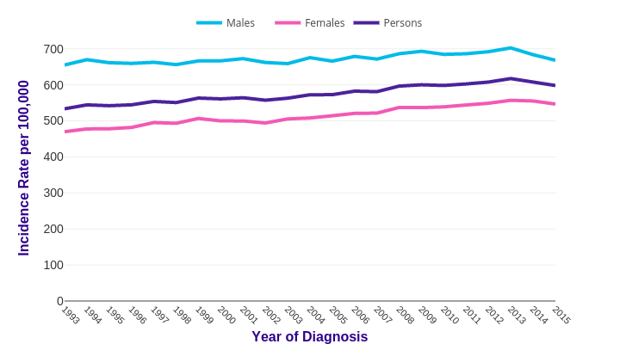
All Cancers Excluding Non-melanoma Skin Cancer (UK)
In 1999-2005 dataset
49% of the claims were caused by cancer
Death 17.6%
Heart attack 11.6%
CABG 2.1%
Source: cruk.org/cancerstats

Slide 30
Future trends of CII claims
Cancer forms almost half of the CII claims.
  Availability of screening (e.g colonoscopy, mammography)
  Social/behavioural changes (e.g. obesity, alcohol consumption)
  New treatments (e.g. targeted immunotherapy)
  Statistical advances (e.g. use of big data, AI methods)

Slide 31
Conclusions

Slide 32
Conclusions
Critical illness insured population distribution has some differences between 1999-2005 & 2007-2010
Time between diagnosis and settlement of a claim is important
Claim rates (2007-2010) depend on a number of risk factors including:
  age, smoker status, distribution channel, policy duration, benefit amount and benefit type
Analysis suggests increase of a CII claim and premium rates over time (1999-2005 v 2007-2010)
  especially at younger ages

Slide 33
Continuing work
Fit more sophisticated Bayesian model to allow for more variation in rates (e.g. hierarchical, negative binomial)
Use of population morbidity statistics
Liaise with CMI for knowledge exchange on data, modelling
Compare with CMI rates

Slide 34
Questions
Comments
The views expressed in this presentation are those of the presenter.

Slide 35
Stochastic modelling: Delay time distribution
1999 – 2005 (cont.)
Generalised Beta 2 distribution in Bayesian GLM-type setting
Most factors significant:
Policy duration, amount, death, CABG: shorter delay
Single life, stroke, mult sclerosis: longer delay

